Slide 1
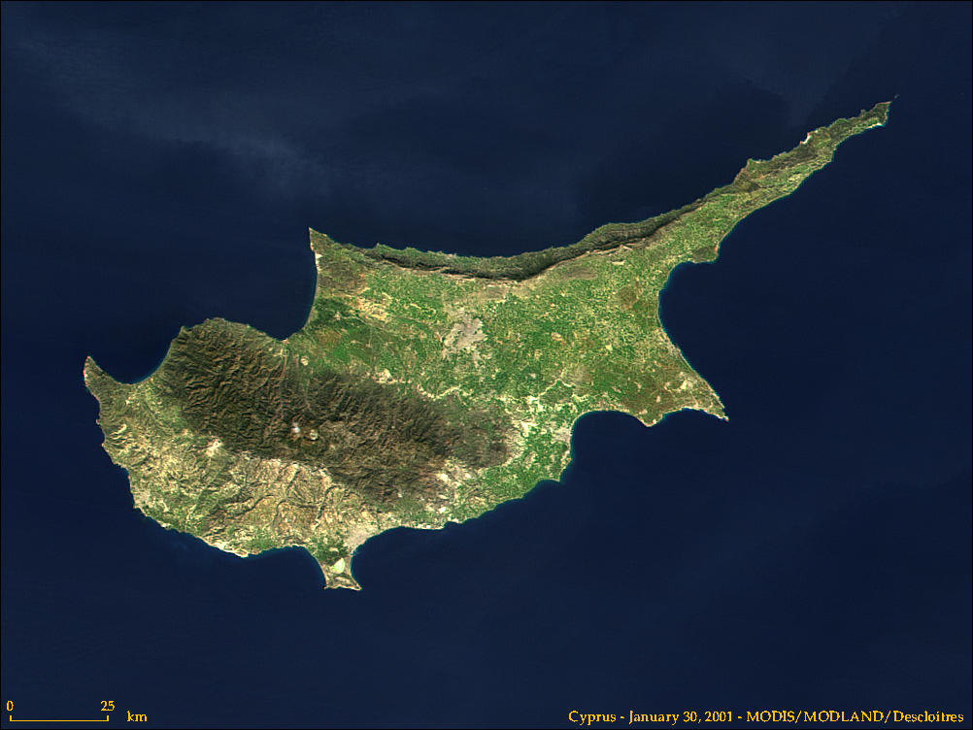
The Role of Kittim in Daniel 11
Kition-Larnaca

Slide 2
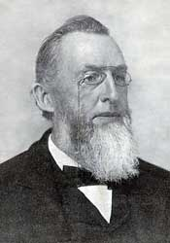
Uriah Smith’s Chronology
Uriah wanted to move the forward chronological flow of Daniel 11 up through v.22 (the breaking of the Prince of the Covenant, c. 31 AD) backwards in verse 23 (the “alliance” חָבַר (chabar) involving a “small people) to 161 BC
Uriah saw this as an alliance between the Jews and the Romans in 161—the Romans being the small people

Slide 3
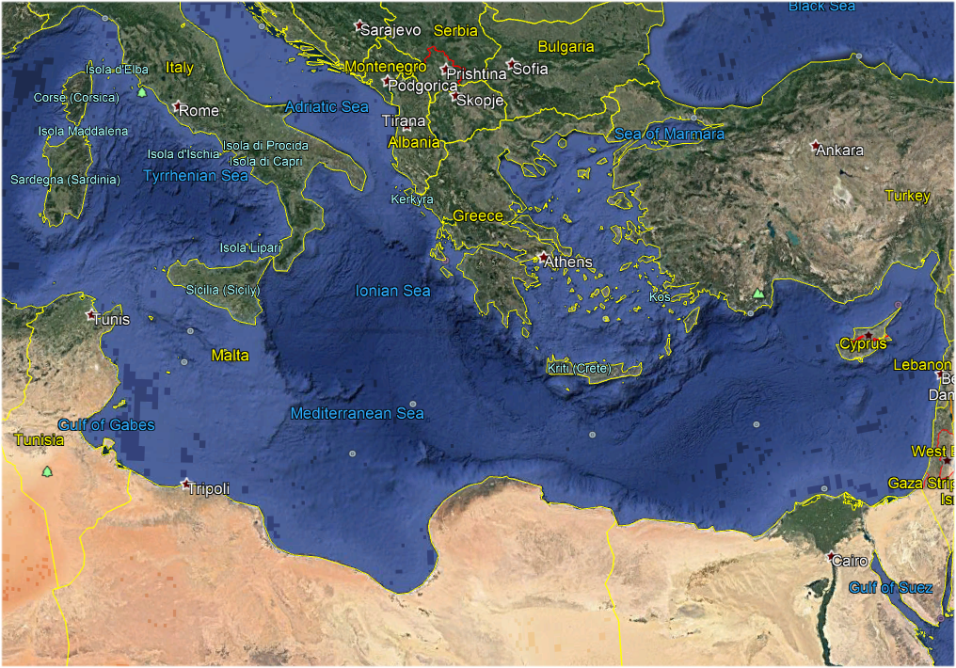

Slide 4
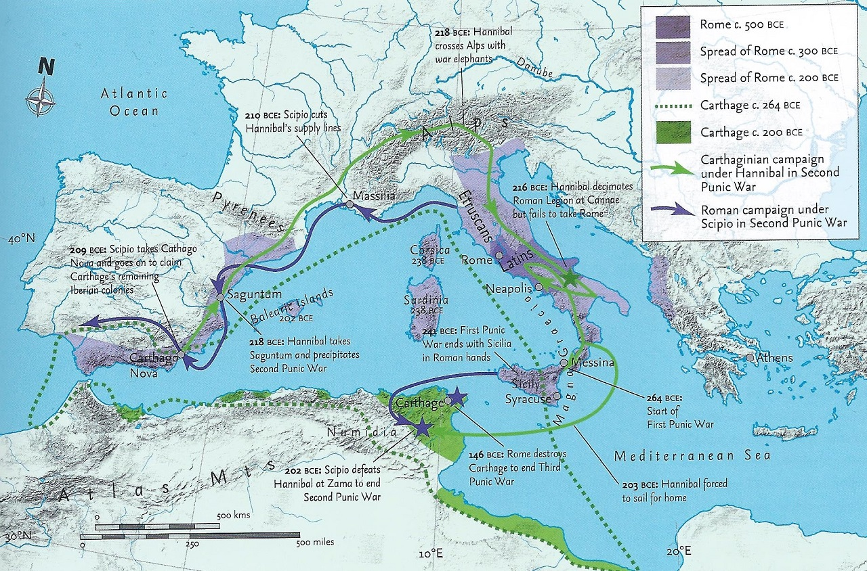

Slide 5
Rome was the strongest power in the Mediterranean in 161 BC
By 201 BC Rome had won the Second Punic War defeating the Carthaginians and taking all of Italy and Spain
In the Seleucid War (192–188 BC), also known as the War of Antiochos or the Syrian War, the Romans defeated Antiochus III (the Great)
In 168 the Romans demanded that Antiochus IV Ephiphanes leave Egypt and return to Syria—Antiochus complied

Slide 6
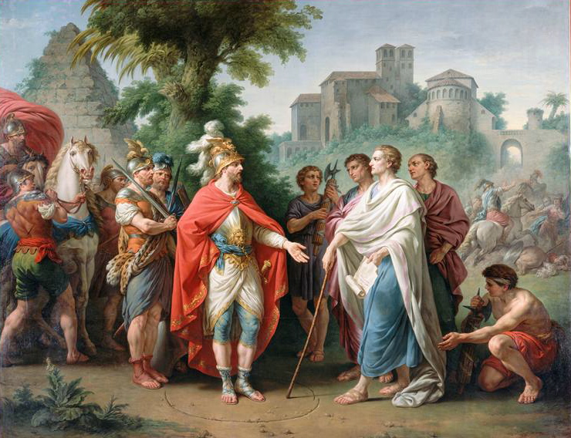
Antiochus IV and
Popillius Laenas

Slide 7
Kittim means only Cyprus in all OT
Numbers 24:24
Isaiah 23:1, 12
Ezekiel 27:6-7
Jeremiah 2:10
What about Daniel 11:30? Cyprus or vague western lands?

Slide 8
Date of Daniel 11:30
If Daniel 11:30 is written in 6th century BC then Kittim can only mean Cyprus
If Daniel is written in 2nd century BC then it could mean Western Lands—this is how the Jews between the 2nd century BC and the second century AD (131) understood Kittim (for them Kittim was either Greece or Rome); this is also how most modern critical scholars (following the 3rd century AD pagain Greek philosopher, Porphyry, understand Kittim in Dan 11

Slide 9
Kittim becomes western lands
Between 168 BC and 131 AD various Jewish communities produced apocryphal apocalyptic literature—often based on Daniel

Slide 10
Jewish apocryphal apocalyptic
They knew that Kittim meant Cyprus (Josephus) but they began to assign symbolic meanings to the term based on Num 24:24 and Dan 11:30

Slide 11
Jewish apocryphal apocalyptic
They initially thought Kittim referred to the Greeks—either the Macedonian Greeks or the Seleucid Greeks

Slide 12
Jewish apocryphal apocalyptic
After 63 BC they began to believe the Kittim referred to the Romans (who defeated the Greeks)
They even changed the word “kittim” in the OG LXX to Romans (ῥωμαῖοι )

Slide 13
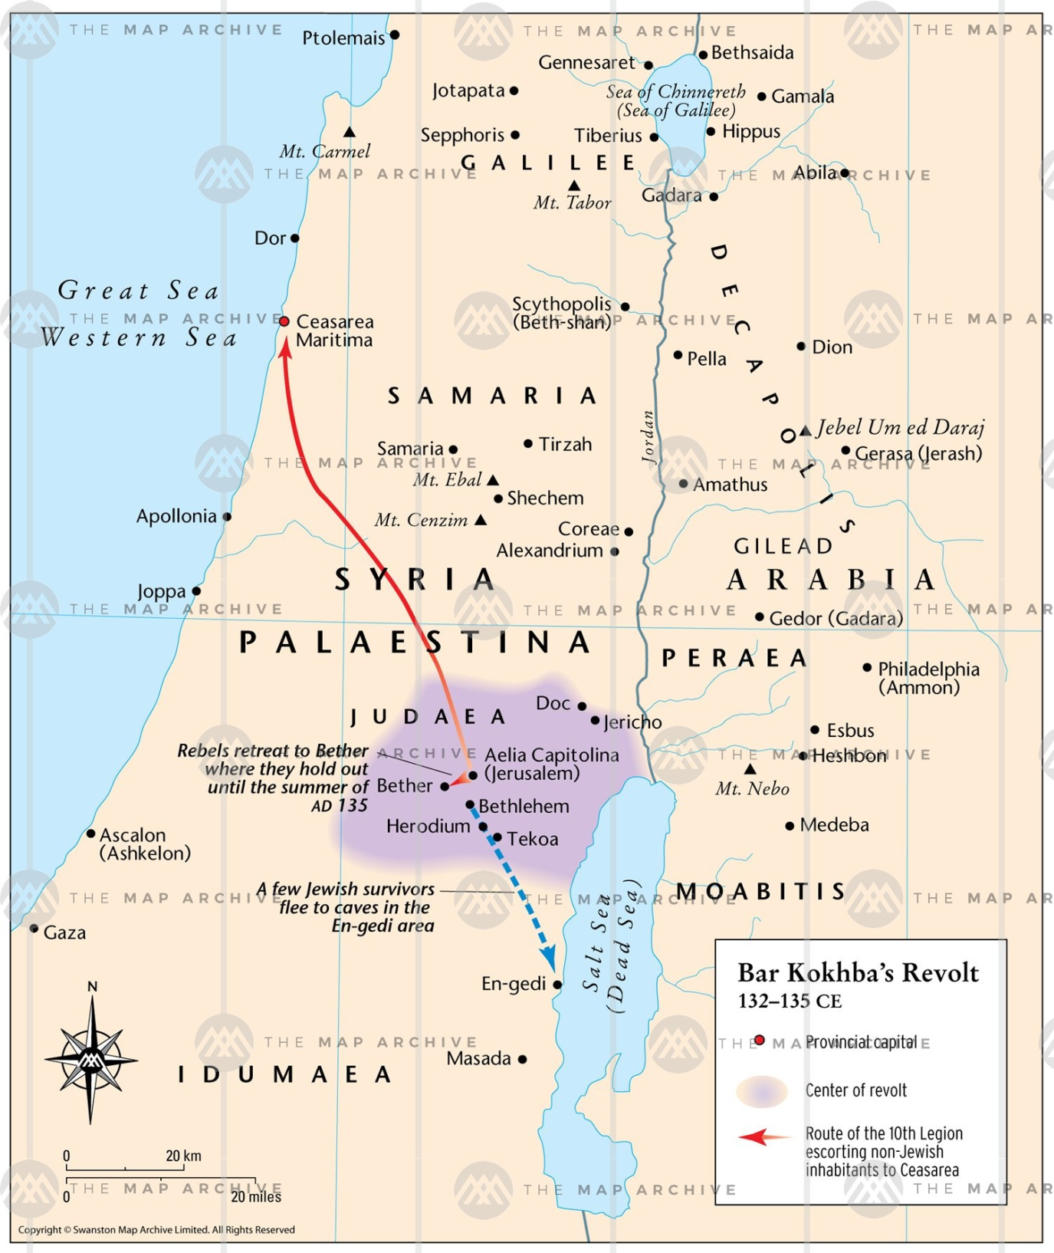
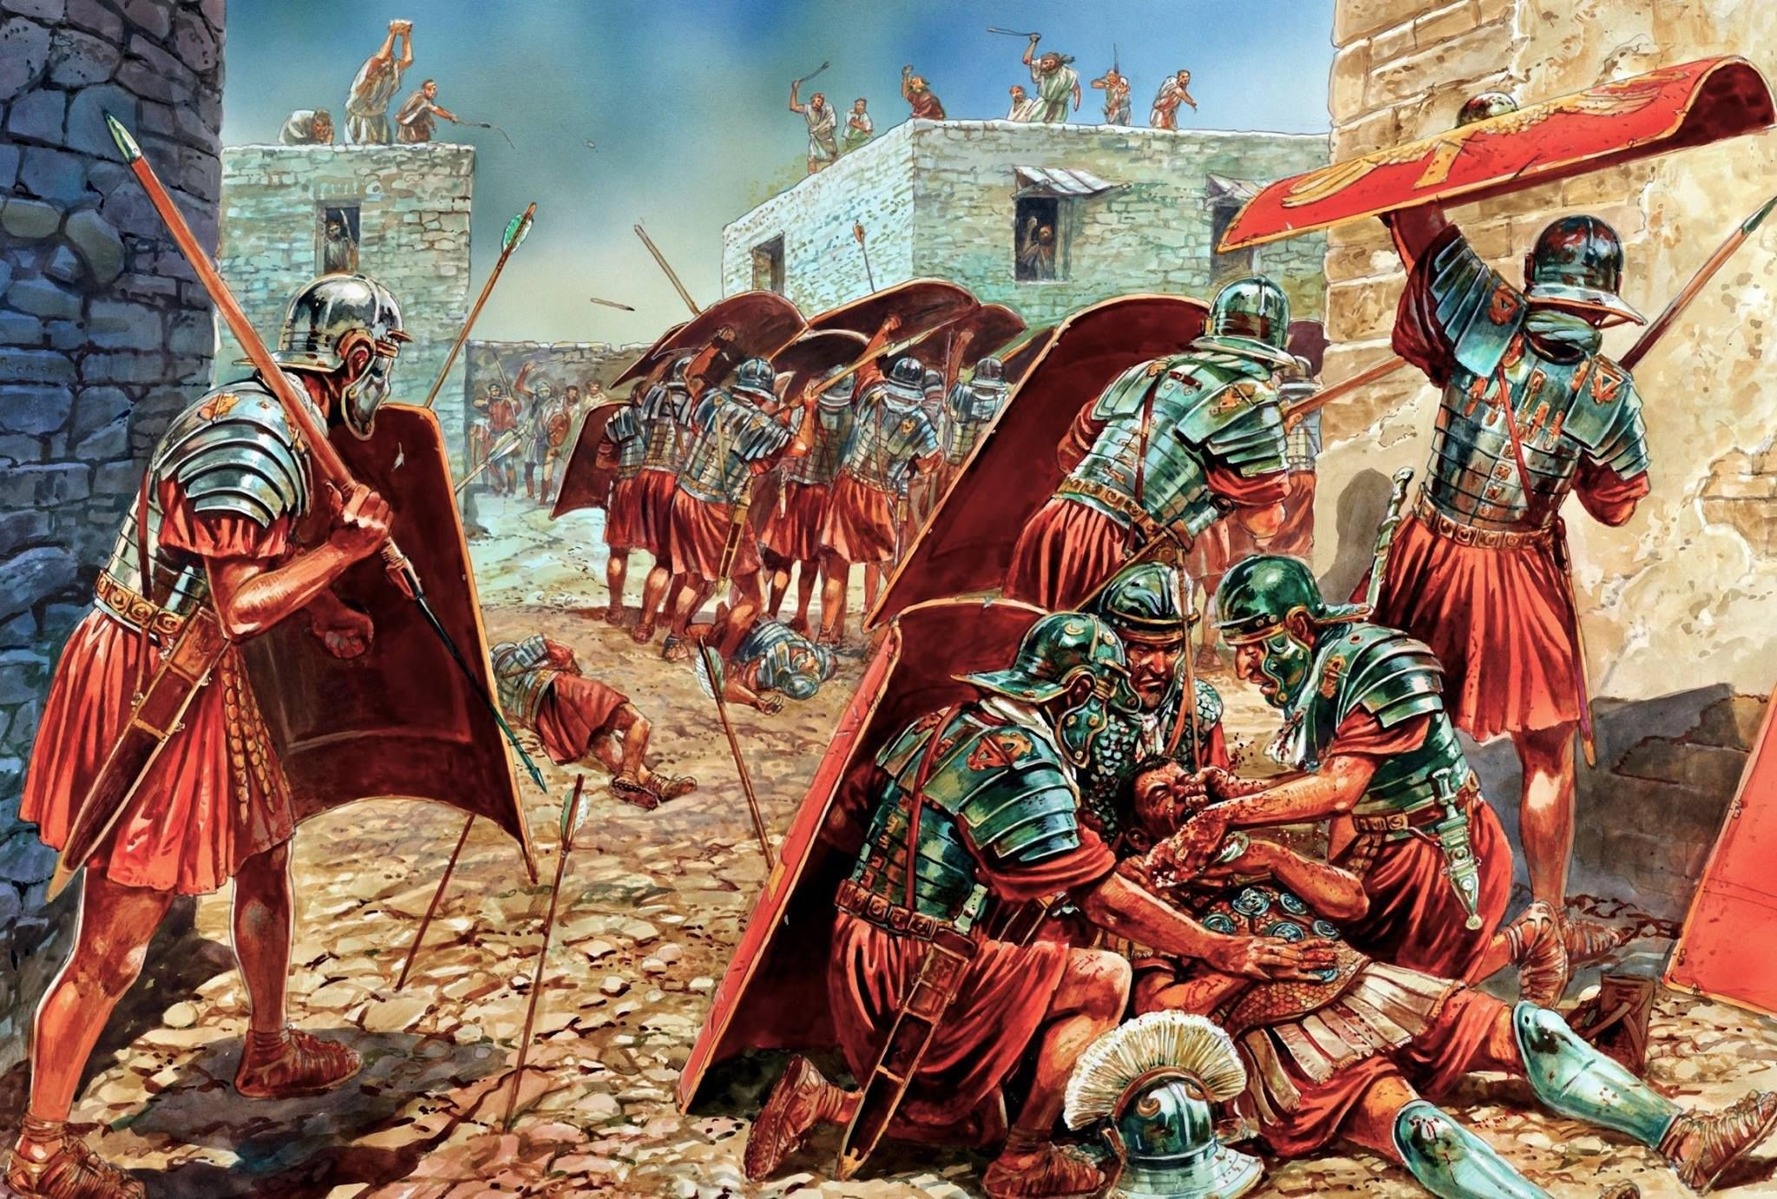

Slide 14
Josephus and Cyprus
“Cethimus [son of Javan] possessed the island Cethima [Kittim]: it is now called Cyprus; and from that it is that all islands, and the greatest part of the sea-coasts, are named Cethim by the Hebrews: and one city there is in Cyprus that has been able to preserve its denomination; it has been called Citius [or Citium/Κίτιον] by those who use the language of the Greeks, and has not, by the use of that dialect, escaped the name of Cethim.”

Slide 15
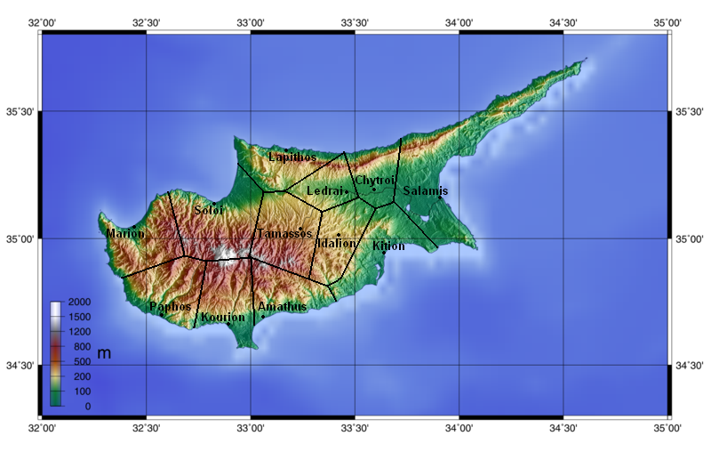
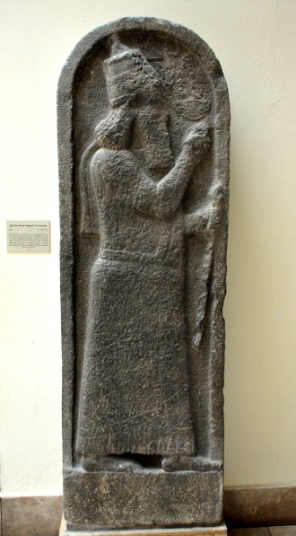
Ten Kingdoms of Cyprus from Sargon II Stele found at Kition, 707 BC

Slide 16
מִיַּ֣ד or from the coasts of Kittim

Slide 17
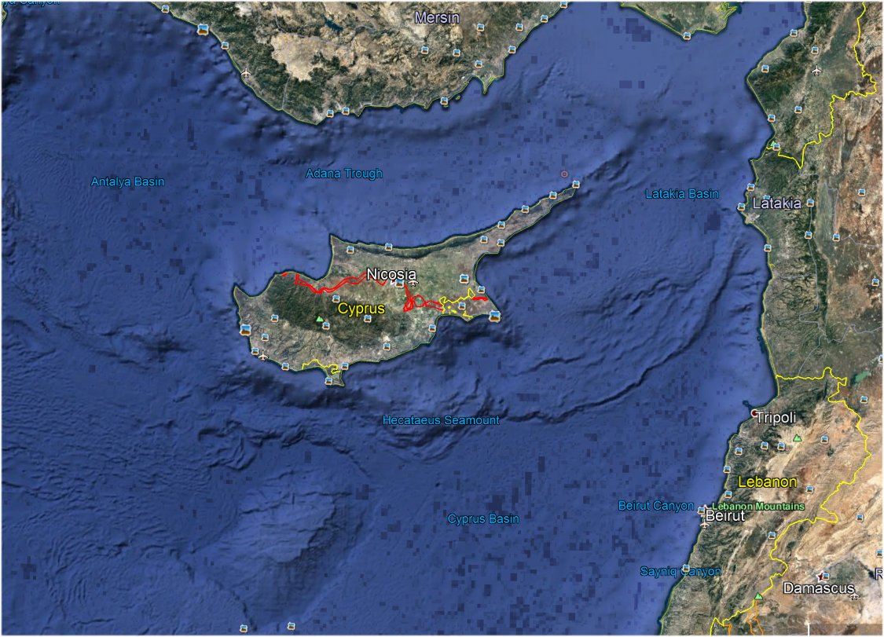
No islands around Cyprus

Slide 18
Christians returned to Kittim as Cyprus
Theodotian (c. 150 AD) after the failure of Jewish apocryphal prophecies, Theodotian changed the term “Romans” (for Kittim) in the OG Daniel 11:30 back to Kitians. Romans had become the bad guys—plus Theodotian and the Antioch school believed in being more faithful to the original Hebrew. Theodotian’s version of the Septuagint came to be more accepted

Slide 19
The War of Cyprus—1570-1573
Kition-Larnaca

Slide 20
Danielic Apocryphal Apocalyptic
The “Book of Daniel’s” explicit reference to Cyprus’s eschatological role has been inspirational to one of the most popular cycles of apocalyptic prognostications, the apocryphal Daniel literature . . . The Daniel apocrypha and pseudopigrapha of Late Antiquity and the Middle Ages revolved around the canonical “Book of Daniel” and recycled with varying degrees of flexibility it topoi and motifs. Although parts of this literature share nothing but their attribution of authorship to the prophet Daniel, they form a large warehouse of cross-cultural tropes and motifs of apocalyptic and other esoteric genres successfully permeating religious boundaries among Judaism, Christianity and Islam throughout the Middle Ages.
Tamas Kiss, p 162.

Slide 21
Daniel on the Island of Cyprus
One of these prophecies was entitled “Daniel on the Island of Cyprus” based on Daniel 11:30
In the decades before the War of Cyprus (1570-73) both Christians and Muslims produced apocryphal apocalyptic literature that saw a major battle would occur between the Christians and the Muslims—this battle would not be the last battle

Slide 22
Daniel on the Island of Cyprus
The battle of Cyprus was seen to precede the final battle that would involve the Antichrist—many tied this to Dan 11:40—the last battle at the end of the world
It was thought it would occur in the early 1600’s

Slide 23
Daniel on the Island of Cyprus
The war finally broke out in 1570 when the Turkish fleet invaded Cyprus; On 27 June, the invasion force, some 350–400 ships and 60,000–100,000 men, set sail for Cyprus. They landed their men and took Nicosia and Famagusta—and the rest of the island

Slide 24
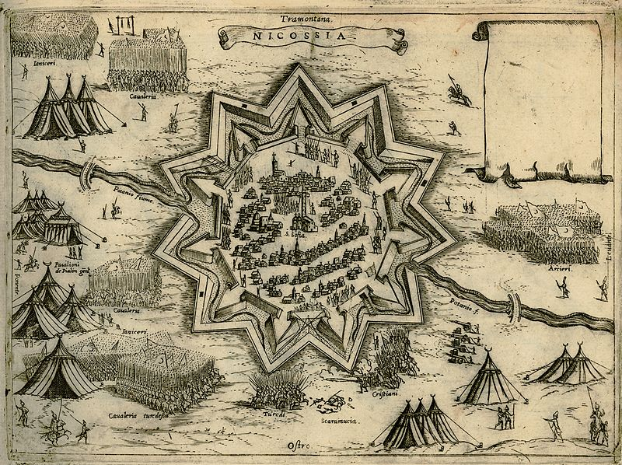

Slide 25
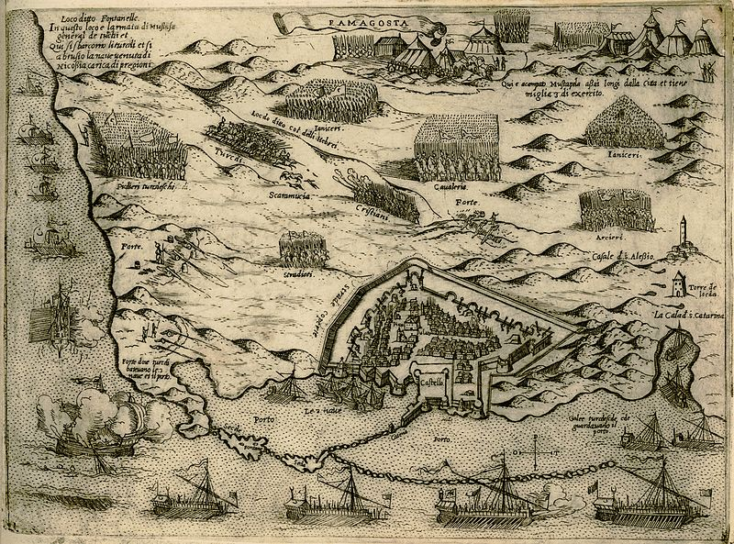

Slide 26
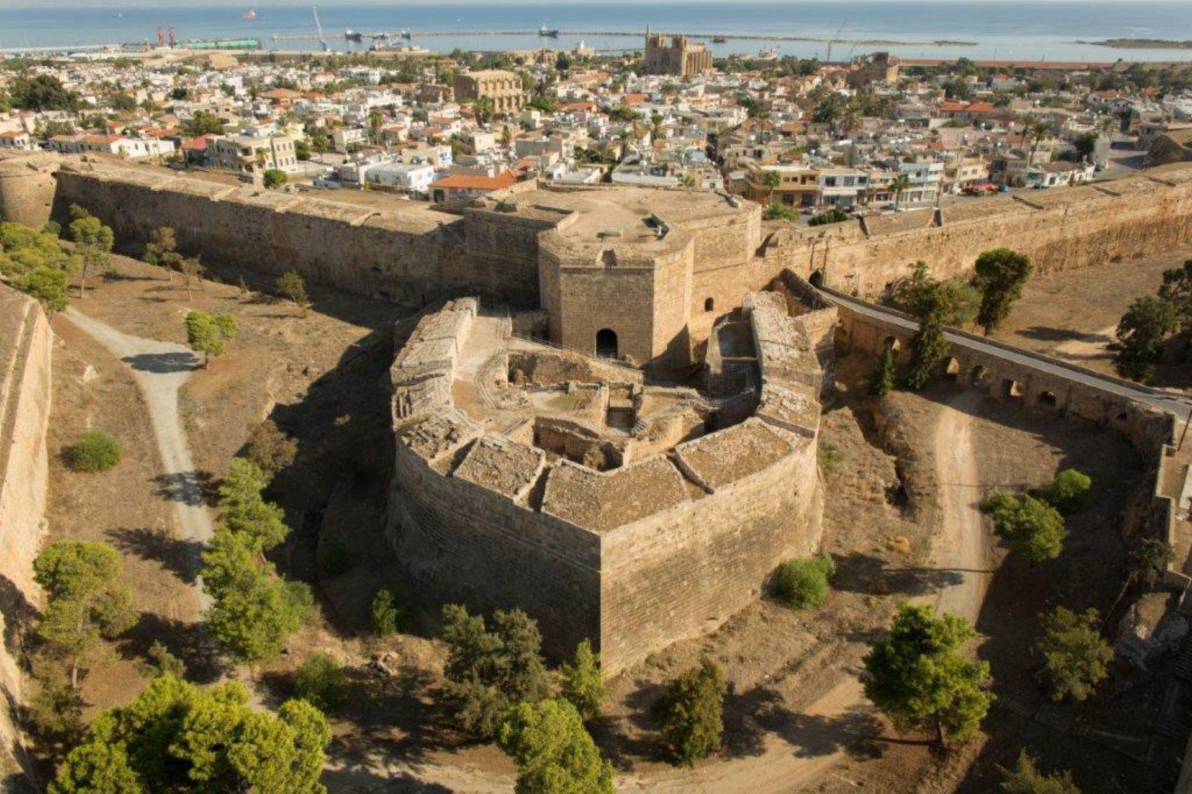
Famagusta today

Slide 27
Pius V and the Holy League
In response Pope Pius V patched together the Holy Roman League
the Papal States under Pius V, Habsburg Spain under Philip II (including Naples and Sicily), the Republic of Venice, the Republic of Genoa, the Knights of Malta, etc. Don Juan de Austria (related to the Spanish throne) was the admiral

Slide 28
Pius V and the Holy League
After taking Cyprus, the Turkish fleet rushed to stop the fleet of the Holy Roman League from getting to Cyprus to retake the island—the Christians planned to go all the way to the Holy Land—take Jerusalem and conquer Egypt

Slide 29
Turkish fleet rushes to stop Holy Roman League
The Turks heard the Christian fleet was coming and rushed 250 ships to stop the Christians—they met of of Lepanto (near a Turkish naval base not far from Greece)

Slide 30
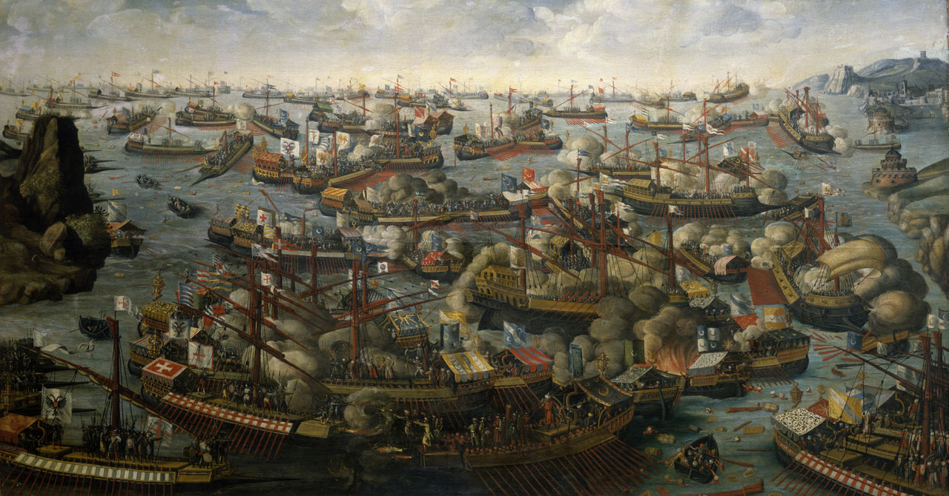
It was the largest naval battle in Western history since classical antiquity, involving nearly 500 warships and 100,000 sailors and marines

Slide 31
The Turks suffered a devastating defeat; The pope urged the Christians to follow up and retake Cyprus and the Holy Land

Slide 32
Battle of Lepanto Oct 7 1771
The Pope was so pleased with the news that he commissioned Giorgia Visari to paint a large mural in the Sala Regia in the Vatican

Slide 33
Turks win the War of Cyprus
But within a year, the Turks rebuilt their fleet, and the Christians ceded Cyprus and the entire eastern Mediterrean to the Ottomans and paid the muslims a huge fine—The Muslims then held it for the next 300 years, changing the political dynamics of the Mediteranean—their domination was depicted in western art

Slide 35
Pope turns attention to the Protestants
The Pope Gregory XIII was furious at the surrender---but his anger was assuaged by news of the St Bartholomew day massacre—he ordered Vasari to stop the painting of the Battle of Lepanto and to paint the St Bartholomew massacre instead!

Slide 36
End

Slide 37
Christian interpretation pre-19th century
By the fourth century AD Christian interpreters returned to the Old Testament understanding of Kittim as referring only to the island of Cyprus

Slide 38
HC influences later Christian interpretation
By the 19th century (and probably earlier), conservative Christian interpreters began following both Josephus and (probably unknowingly) the historical critics in interpreting Kittim as “western lands”

Slide 39
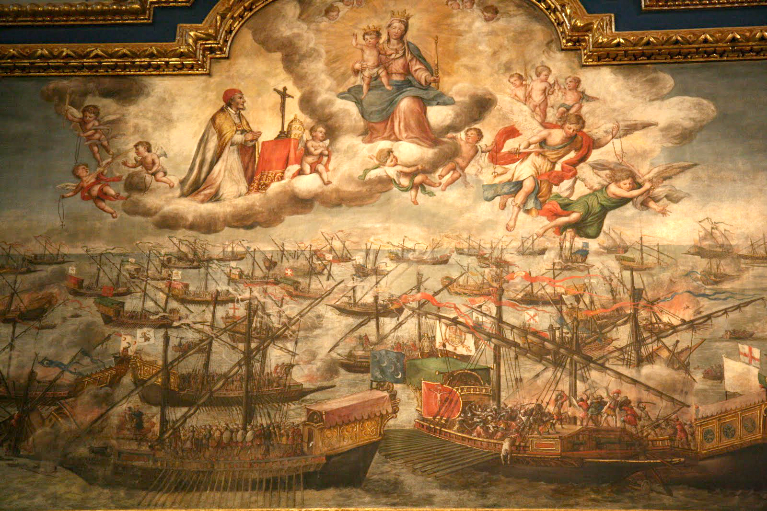

Slide 40
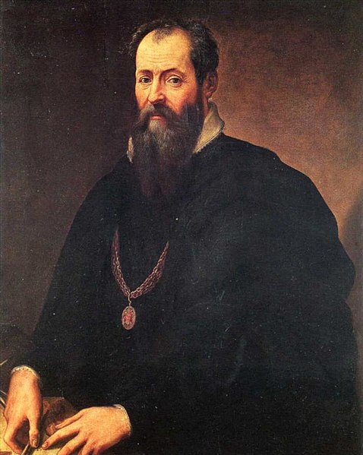
Giorgio Vasari
Pope asked Vasari to paint the Battle of Lepanto
But the Holy Roman League failed to follow up their victory and ultimately lost the War of Cyprus, having to not only let the Muslims keep Cyprus, but the entire east Mediterranean and also had to pay an fine to the Ottomans
But then word came of the St Bartholomews Massacre

Slide 41
Genesis 10:4-5
Genesis 10:4-5 ⁴ And the sons of Javan were Elishah and ªTarshish, Kittim and ¹Dodanim. ⁵ From these the coastlands of the nations ¹were separated into their lands, every one according to his language, according to their families, into their nations.
Kittim and Elishah are now known to both be located on the island of Cyprus—based on both inscriptions and archaeological evidence

Slide 42
Oracle against Tyre
Isaiah 23:1-2 The ¹oracle concerning ªTyre. Wail, O ^{b}ships of ^{c}Tarshish (Carthage), For Tyre is destroyed, without house or ^{2d}harbor; It is reported to them from the land of ^{3e}Cyprus (Kitti). ² ªBe silent, you inhabitants of the coastland, You merchants of Sidon; ¹Your messengers crossed the sea
Isaiah 23:12 ¹² And He has said, ª"You shall exult no more, O crushed virgin daughter of Sidon. Arise, pass over to ^{1b}Cyprus (Kitti); even there you will find no rest.“
Kittim is between Tyre, Sidon and Tarshish (Carthage)—has to be Cyprus (Davis)

Slide 43
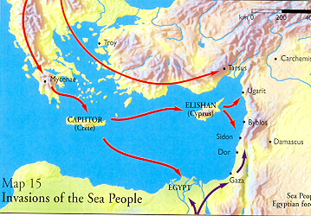
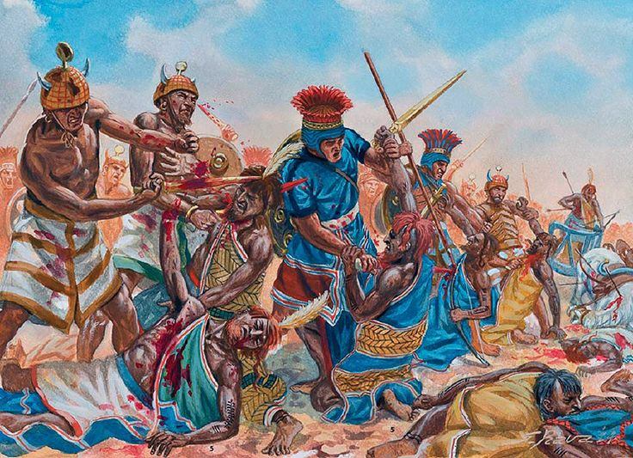
Numbers 24:23-25 ²³ And he took up his discourse and said, "Alas, who can live except God has ordained it? ²⁴ "But ships shall come from the coast of ªKittim, And they shall afflict Asshur and shall afflict ^{b}Eber; ^{c}So they also shall come to destruction.“
Many scholars (following W F Albirhgt) now see this as a reference to the invasion of the Sea Peoples from Cyprus—now supported by archaeology (E. Stern)

Slide 44
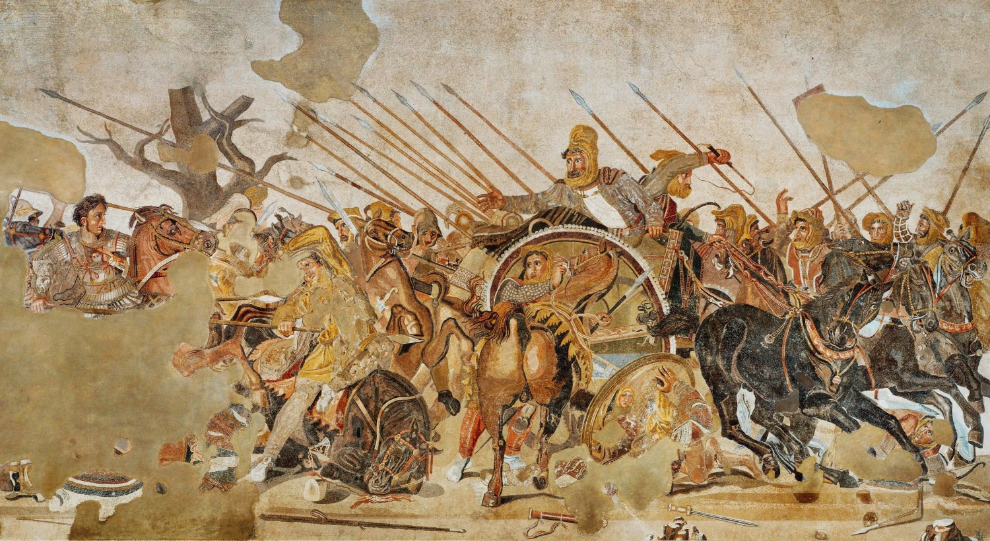
Numbers 24:24 in Maccabees 1:1

Slide 45
Antiochus IV Epiphanes

