Slide 2
Hermeneutical
Horses

Slide 3
Format of Daniel
Dream/Vision
followed by
Interpretation
Notes:
Lutheran-Roman Catholic Commission on Unity invites all Christians to study its report
open-mindedly and critically, and to walk along the path towards the full, visible unity of the Church.

Slide 4
Daniel 2
Notes:
Lutheran-Roman Catholic Commission on Unity invites all Christians to study its report
open-mindedly and critically, and to walk along the path towards the full, visible unity of the Church.

Slide 5
“This is the dream; and we will tell the interpretation thereof before the king.”
Placeholder
Daniel 2 Image
Daniel 2:36
Notes:
Lutheran-Roman Catholic Commission on Unity invites all Christians to study its report
open-mindedly and critically, and to walk along the path towards the full, visible unity of the Church.

Slide 6
Format of Daniel
Symbolic Dream/Vision
followed by
Literal Interpretation
Notes:
Lutheran-Roman Catholic Commission on Unity invites all Christians to study its report
open-mindedly and critically, and to walk along the path towards the full, visible unity of the Church.

Slide 7
Daniel 4
Notes:
Lutheran-Roman Catholic Commission on Unity invites all Christians to study its report
open-mindedly and critically, and to walk along the path towards the full, visible unity of the Church.

Slide 8
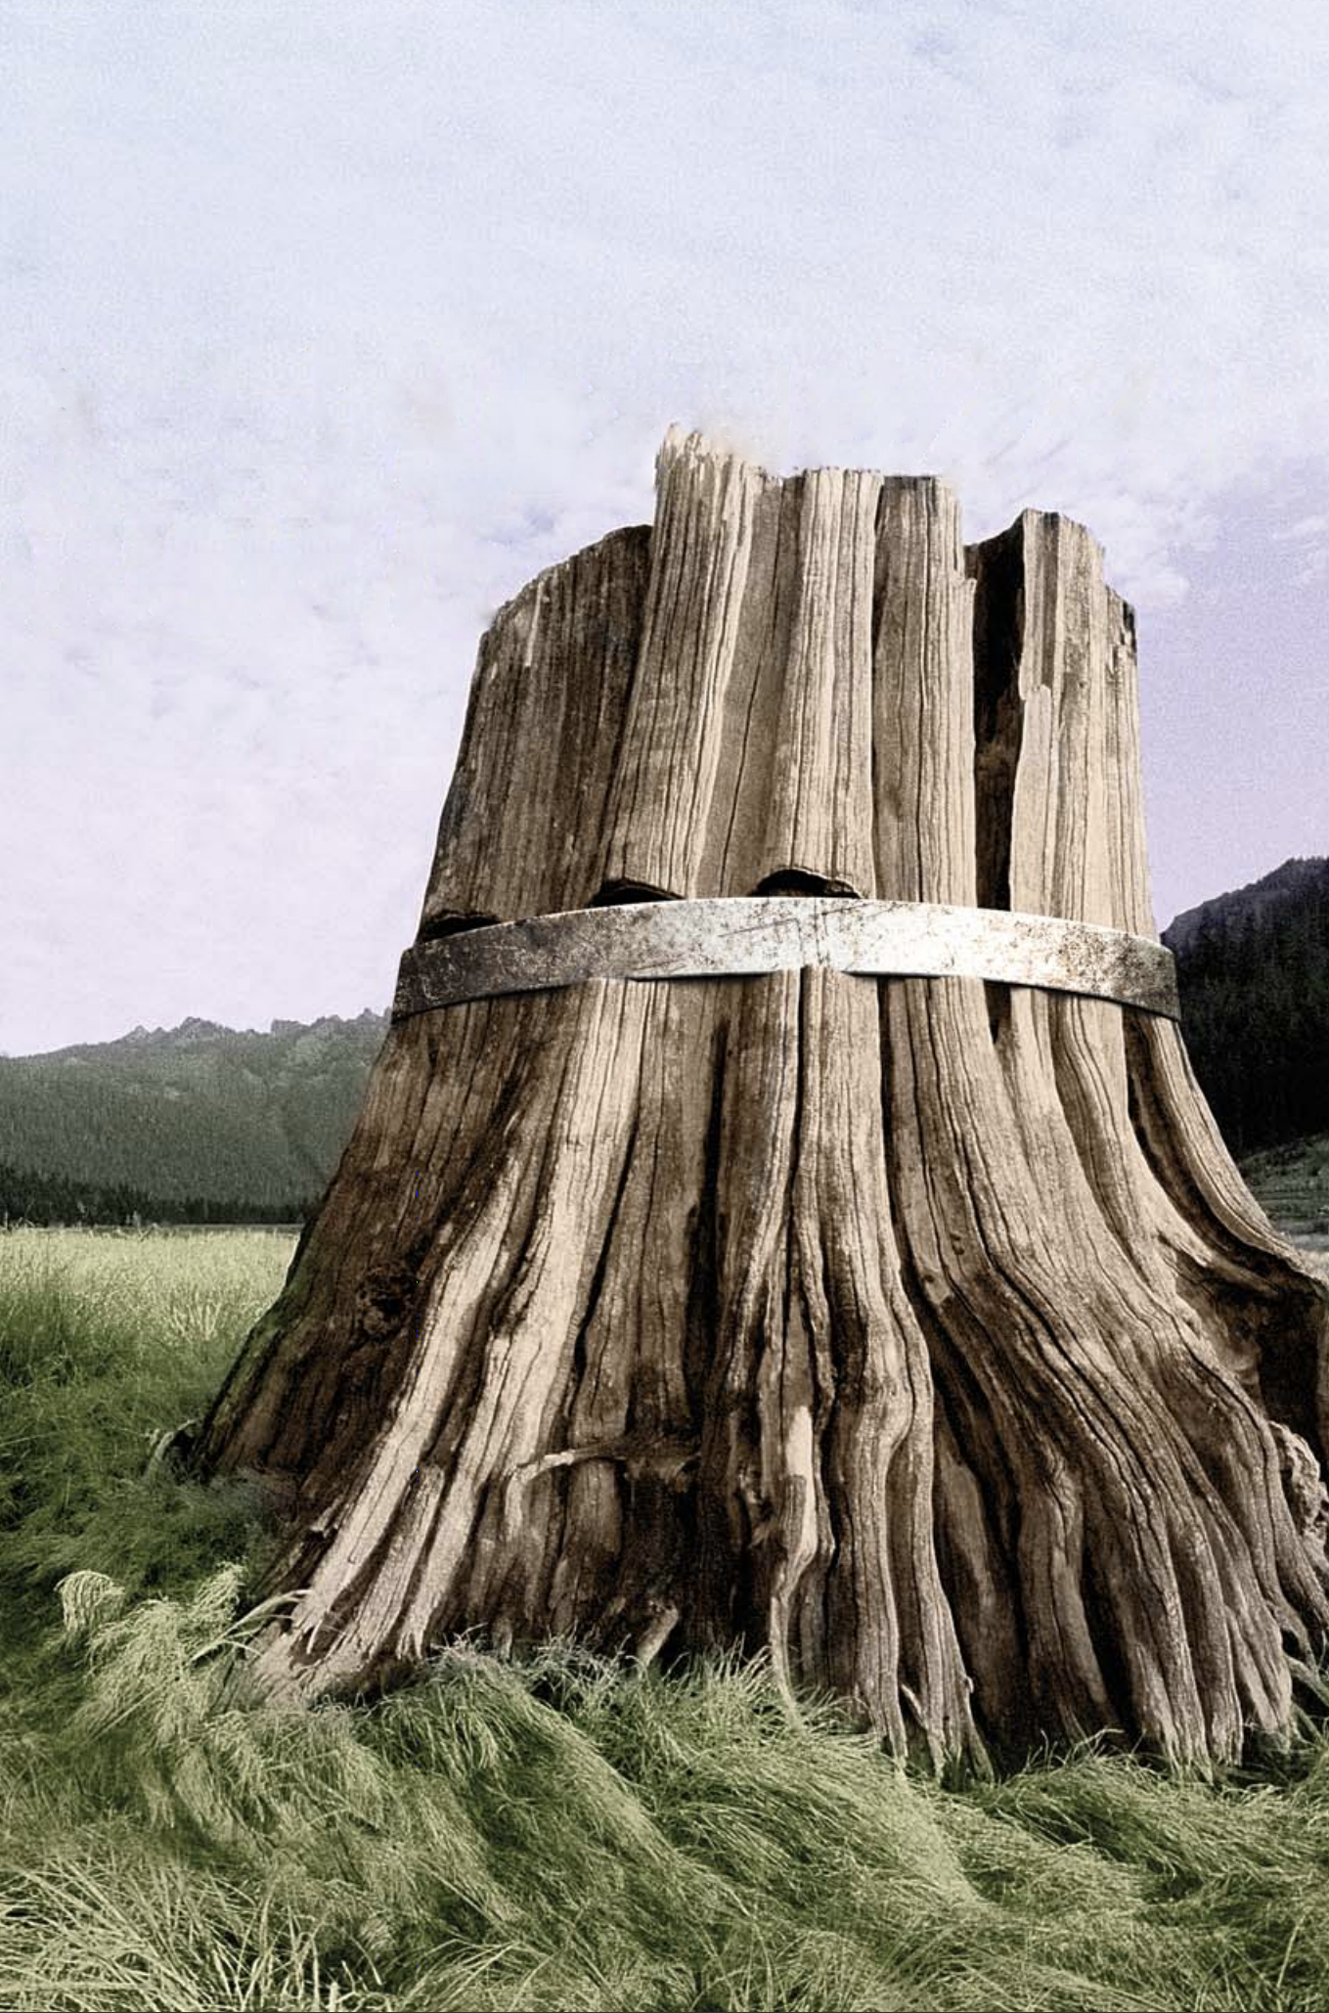
“…tell me the visions of my dream that I have seen, and the interpretation thereof.”
Daniel 4:9
Notes:
Lutheran-Roman Catholic Commission on Unity invites all Christians to study its report
open-mindedly and critically, and to walk along the path towards the full, visible unity of the Church.

Slide 9
Format of Daniel
Symbolic Dream/Vision
followed by
Literal Interpretation
Notes:
Lutheran-Roman Catholic Commission on Unity invites all Christians to study its report
open-mindedly and critically, and to walk along the path towards the full, visible unity of the Church.

Slide 10
Daniel 5
Notes:
Lutheran-Roman Catholic Commission on Unity invites all Christians to study its report
open-mindedly and critically, and to walk along the path towards the full, visible unity of the Church.

Slide 11
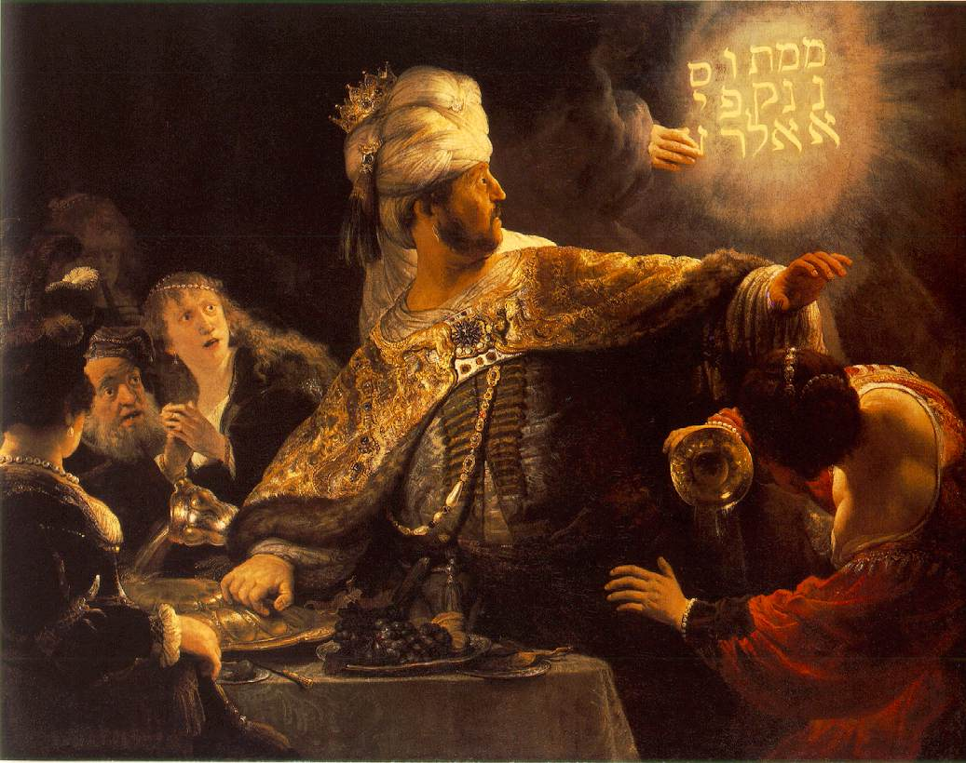
“This is the interpretation of the thing: MENE; God hath numbered thy kingdom, and finished it.”
Daniel 5:26
Notes:
Lutheran-Roman Catholic Commission on Unity invites all Christians to study its report
open-mindedly and critically, and to walk along the path towards the full, visible unity of the Church.

Slide 12
Format of Daniel
Symbolic Dream/Vision
followed by
Literal Interpretation
Notes:
Lutheran-Roman Catholic Commission on Unity invites all Christians to study its report
open-mindedly and critically, and to walk along the path towards the full, visible unity of the Church.

Slide 13
Daniel 7
Notes:
Lutheran-Roman Catholic Commission on Unity invites all Christians to study its report
open-mindedly and critically, and to walk along the path towards the full, visible unity of the Church.

Slide 14
“I came near unto one of them
that stood by, and asked him
the truth of all this. So he told
me, and made me know the
interpretation of the things.”
Placeholder
for
4 Beasts
Placeholder
for
Little Horn
Daniel 7:16
Notes:
Lutheran-Roman Catholic Commission on Unity invites all Christians to study its report
open-mindedly and critically, and to walk along the path towards the full, visible unity of the Church.

Slide 15
“Thus he said, The fourth beast
shall be the fourth kingdom
upon earth…And the ten
horns out of this kingdom
are ten kings that shall arise:
and another shall rise after
them…”
Placeholder
for
4 Beasts
Placeholder
for
Little Horn
Daniel 7:23,24
Notes:
Lutheran-Roman Catholic Commission on Unity invites all Christians to study its report
open-mindedly and critically, and to walk along the path towards the full, visible unity of the Church.

Slide 16
Format of Daniel
Symbolic Dream/Vision
followed by
Literal Interpretation
Notes:
Lutheran-Roman Catholic Commission on Unity invites all Christians to study its report
open-mindedly and critically, and to walk along the path towards the full, visible unity of the Church.

Slide 17
Daniel “…could not under-stand the relation sustained by the seventy years’ captivity, as foretold through Jeremiah, to the twenty-three hundred years that in vision he heard the heavenly visitant declare should elapse before the cleansing of God’s sanctuary.”
Prophets and Kings, p. 554
Notes:
Lutheran-Roman Catholic Commission on Unity invites all Christians to study its report
open-mindedly and critically, and to walk along the path towards the full, visible unity of the Church.

Slide 18
Geography
“Thus he said, The fourth beast shall be the fourth kingdom upon earth…And the ten horns out of this kingdom are ten kings that shall arise: and another shall rise after them…”
Placeholder
4th Beast of
Daniel 7
Daniel 7:23,24
Notes:
Lutheran-Roman Catholic Commission on Unity invites all Christians to study its report
open-mindedly and critically, and to walk along the path towards the full, visible unity of the Church.

Slide 19
Geography
“I considered the horns, and, behold, there came up among them another little horn…”
Placeholder
for
Little Horn
Daniel 7:8
Notes:
Lutheran-Roman Catholic Commission on Unity invites all Christians to study its report
open-mindedly and critically, and to walk along the path towards the full, visible unity of the Church.

Slide 20
Geography
“Now that being broken, whereas four stood up for it, four kingdoms shall stand up out of the nation, but not in his power.”
Daniel 8:22
Notes:
Lutheran-Roman Catholic Commission on Unity invites all Christians to study its report
open-mindedly and critically, and to walk along the path towards the full, visible unity of the Church.

Slide 21
Daniel 8
Notes:
Lutheran-Roman Catholic Commission on Unity invites all Christians to study its report
open-mindedly and critically, and to walk along the path towards the full, visible unity of the Church.

Slide 22
“And it came to pass, when I, even I Daniel, had seen the vision, and sought for the meaning, then, behold, there stood before me as the appearance of a man.
Daniel 8:15
Notes:
Lutheran-Roman Catholic Commission on Unity invites all Christians to study its report
open-mindedly and critically, and to walk along the path towards the full, visible unity of the Church.

Slide 23
And I heard a man’s voice between the banks of Ulai, which called, and said, Gabriel, make this man to understand the vision.”
Daniel 8:16
Notes:
Lutheran-Roman Catholic Commission on Unity invites all Christians to study its report
open-mindedly and critically, and to walk along the path towards the full, visible unity of the Church.

Slide 24
Daniel
Gabriel
Wants to know the meaning
Relates the meaning

Slide 25
Daniel 9
Notes:
Lutheran-Roman Catholic Commission on Unity invites all Christians to study its report
open-mindedly and critically, and to walk along the path towards the full, visible unity of the Church.

Slide 26
“And he informed me, and talked with me, and said, O Daniel, I am now come forth to give thee skill and understanding.”
Daniel 9:22
Notes:
Lutheran-Roman Catholic Commission on Unity invites all Christians to study its report
open-mindedly and critically, and to walk along the path towards the full, visible unity of the Church.

Slide 27
“At the beginning of thy supplications the commandment came forth, and I am come to shew thee; for thou art greatly beloved: therefore understand the matter, and consider the vision.”
Daniel 9:23
Notes:
Lutheran-Roman Catholic Commission on Unity invites all Christians to study its report
open-mindedly and critically, and to walk along the path towards the full, visible unity of the Church.

Slide 28
Literal Events in Daniel 9
1. The beginning point of the 2300 years.
2. The restoration of Jerusalem.
3. The coming of the Messiah.
4. The death of the Messiah.
5. The destruction of Jerusalem & the Sanctuary.
6. The pouring out of “that determined” on the desolator.
Notes:
Lutheran-Roman Catholic Commission on Unity invites all Christians to study its report
open-mindedly and critically, and to walk along the path towards the full, visible unity of the Church.

Slide 29
Format of Daniel
Symbolic Dream/Vision
followed by
Literal Interpretation
Notes:
Lutheran-Roman Catholic Commission on Unity invites all Christians to study its report
open-mindedly and critically, and to walk along the path towards the full, visible unity of the Church.

Slide 30
Placeholder
for
Daniel 2 Image
Placeholder
for 2
Daniel 7
Beasts
Placeholder
for
Little Horn
Placeholder
for 2
Daniel 7
Beasts
Notes:
Lutheran-Roman Catholic Commission on Unity invites all Christians to study its report
open-mindedly and critically, and to walk along the path towards the full, visible unity of the Church.

Slide 31
Daniel 11
Notes:
Lutheran-Roman Catholic Commission on Unity invites all Christians to study its report
open-mindedly and critically, and to walk along the path towards the full, visible unity of the Church.

Slide 32
Daniel 8 & 11
“And the vision of the evening and the morning which was told is true: wherefore shut thou up the vision; for it shall be for many days.”
Daniel 8:26
“Now I am come to make thee understand what shall befall thy people in the latter days: for yet the vision is for many days.”
Daniel 10:14
Notes:
Lutheran-Roman Catholic Commission on Unity invites all Christians to study its report
open-mindedly and critically, and to walk along the path towards the full, visible unity of the Church.

Slide 33
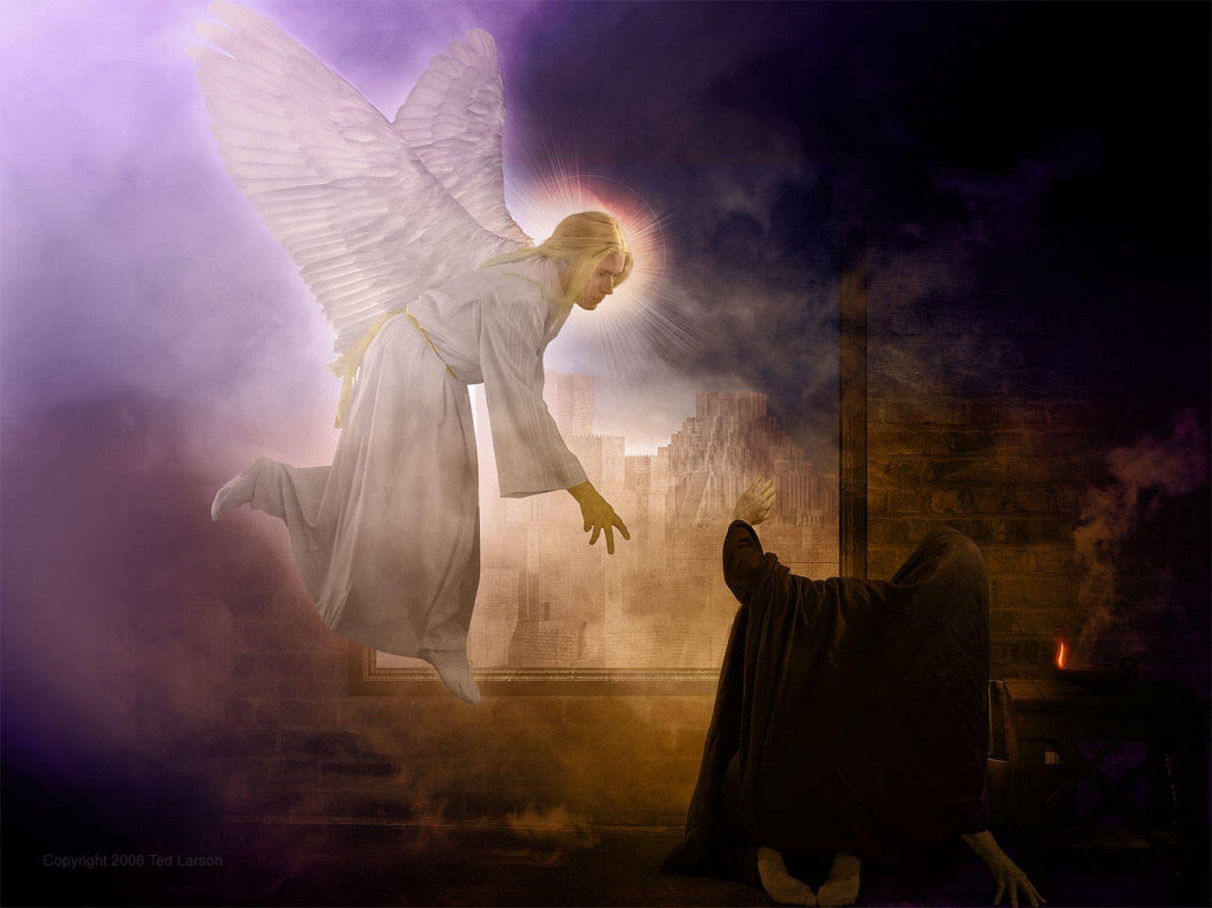
70 Weeks
457BC
27AD
34AD
1844AD
31AD
Notes:
Lutheran-Roman Catholic Commission on Unity invites all Christians to study its report
open-mindedly and critically, and to walk along the path towards the full, visible unity of the Church.

Slide 34
Daniel 8 & 11
“Knowest thou wherefore I come unto thee?…”
Daniel 10:20
“But I will shew thee that which is noted [recorded] in the scripture of truth: and there is none that holdeth with me in these things, but Michael your prince.”
Daniel 10:21
Notes:
Lutheran-Roman Catholic Commission on Unity invites all Christians to study its report
open-mindedly and critically, and to walk along the path towards the full, visible unity of the Church.

Slide 35
Daniel 8 & 11
“And the vision of the evening and the morning which was told is true: wherefore shut thou up the vision; for it shall be for many days…none understood it.”
Daniel 8:26,27
“But thou, O Daniel, shut up the words, and seal the book, even to the time of the end: many shall run to and fro, and knowledge shall be increased.”
Daniel 12:4
Notes:
Lutheran-Roman Catholic Commission on Unity invites all Christians to study its report
open-mindedly and critically, and to walk along the path towards the full, visible unity of the Church.

Slide 36
Daniel 8 & 11
“…make this man to understand the vision.”
Daniel 8:16
“…I am now come forth to give thee skill and understanding.”
Daniel 9:22
“Now I am come to make thee understand…”
Daniel 10:14
Notes:
Lutheran-Roman Catholic Commission on Unity invites all Christians to study its report
open-mindedly and critically, and to walk along the path towards the full, visible unity of the Church.

Slide 37
Daniel 9
1. There is no symbolic vision in chapter 9.
2. Gabriel says he is returning to give Daniel understanding in answer to his prayer. Daniel 9:23
3. Gabriel refers to chapter 8 when he says “consider the vision.” Daniel 9:23
4. The other linguistic ties to chapter 8.
Notes:
Lutheran-Roman Catholic Commission on Unity invites all Christians to study its report
open-mindedly and critically, and to walk along the path towards the full, visible unity of the Church.

Slide 38
Daniel 11
1. There is no symbolic vision in chapter 11.
2. Gabriel says he is returning to give Daniel understanding in answer to his prayer. Daniel 10:12
3. Gabriel refers to chapter 8 when he says “Now I am come to make thee understand…the vision.” Daniel 10:14
4. The other linguistic ties to chapter 8.
Notes:
Lutheran-Roman Catholic Commission on Unity invites all Christians to study its report
open-mindedly and critically, and to walk along the path towards the full, visible unity of the Church.

Slide 39
“Upon the occasion just described [Gabriel’s visit in Daniel 9 where Ellen White quotes Daniel 9:4-6,15-19], the angel Gabriel imparted to Daniel all the instruction which he was then able to receive.”
Sanctified Life, p. 49
Notes:
Lutheran-Roman Catholic Commission on Unity invites all Christians to study its report
open-mindedly and critically, and to walk along the path towards the full, visible unity of the Church.

Slide 40
“A few years afterward, however, the prophet desired to learn more of subjects not yet fully explained, and again set himself to seek light and wisdom from God. (Daniel 10:2-6 quoted).... Our Lord comes with another heavenly messenger to teach Daniel what would take place in the latter days.”
Sanctified Life, p. 49
Notes:
Lutheran-Roman Catholic Commission on Unity invites all Christians to study its report
open-mindedly and critically, and to walk along the path towards the full, visible unity of the Church.

Slide 41
Not Yet Fully Explained
1. The 1810 years before the cleansing of the sanctuary?
2. What would happen in “last end of the indignation?”
3. What would happen to the “desolator” of sanctuary?
Notes:
Lutheran-Roman Catholic Commission on Unity invites all Christians to study its report
open-mindedly and critically, and to walk along the path towards the full, visible unity of the Church.

Slide 42
Summary
1. Symbolic vision followed by literal interpretation
2. Interpretations are literal throughout
3. Daniel 11 is an interpretation of Daniel 8
4. Daniel 11 interpretation is literal throughout
Notes:
Lutheran-Roman Catholic Commission on Unity invites all Christians to study its report
open-mindedly and critically, and to walk along the path towards the full, visible unity of the Church.

Slide 43
Hermeneutic Switch
1. At vs. 40 - Time of the End
2. At vs. 30,31 - Introduction of the Papacy
3. At vs. 23 - After the death of the Messiah
4. Some have suggested at vs. 5, others at vs. 2
Notes:
Lutheran-Roman Catholic Commission on Unity invites all Christians to study its report
open-mindedly and critically, and to walk along the path towards the full, visible unity of the Church.

Slide 44
Symbols After The Cross
1. Why not “people of the prince?”
2. The city, sanctuary, and their destruction?
3. Who or what is the King of the South in Daniel 11:25?
4. Why should “king” be an ideology?
Notes:
Lutheran-Roman Catholic Commission on Unity invites all Christians to study its report
open-mindedly and critically, and to walk along the path towards the full, visible unity of the Church.

Slide 45
Symbols After The Cross
5. How is warfare in 11:25 global, spiritual warfare?
6. Where is king going when goes “toward the south?”
7. Are the ships of Chittim “economics?”
8. How is “Chittim” global and spiritual?
Notes:
Lutheran-Roman Catholic Commission on Unity invites all Christians to study its report
open-mindedly and critically, and to walk along the path towards the full, visible unity of the Church.

Slide 46
Symbols After Papacy
1. Why not great words spoken by little horn?
2. Why not the wearing out of the saints?
3. Why not the changing of times and laws?
4. Why not the judgment & kingdom given to saints?
Notes:
Lutheran-Roman Catholic Commission on Unity invites all Christians to study its report
open-mindedly and critically, and to walk along the path towards the full, visible unity of the Church.

Slide 47
Symbols After Papacy
5. Are “arms” spiritual?
6. Was it spiritual sword, flame, captivity and spoil?
Notes:
Lutheran-Roman Catholic Commission on Unity invites all Christians to study its report
open-mindedly and critically, and to walk along the path towards the full, visible unity of the Church.

Slide 48
Notes:
Lutheran-Roman Catholic Commission on Unity invites all Christians to study its report
open-mindedly and critically, and to walk along the path towards the full, visible unity of the Church.

Slide 49
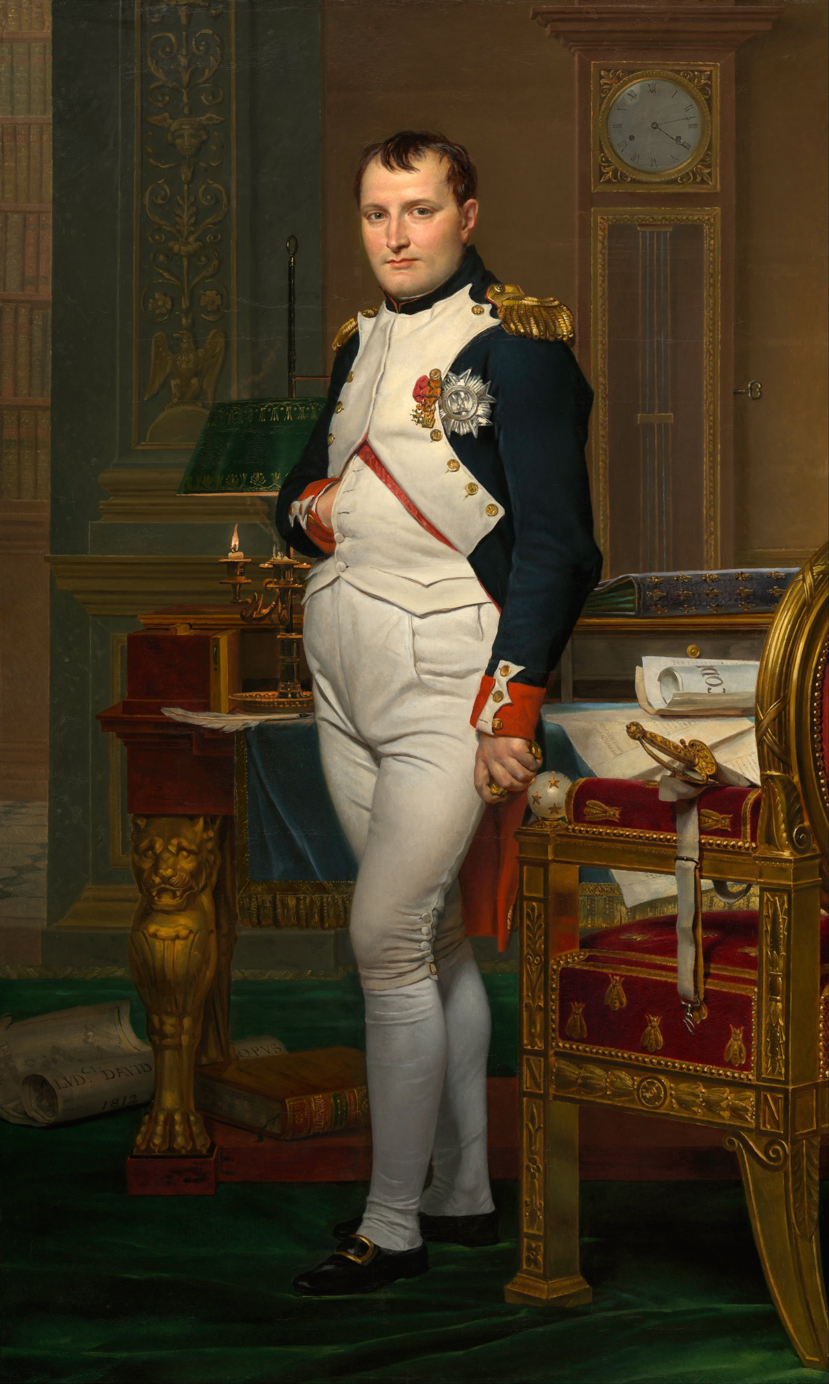
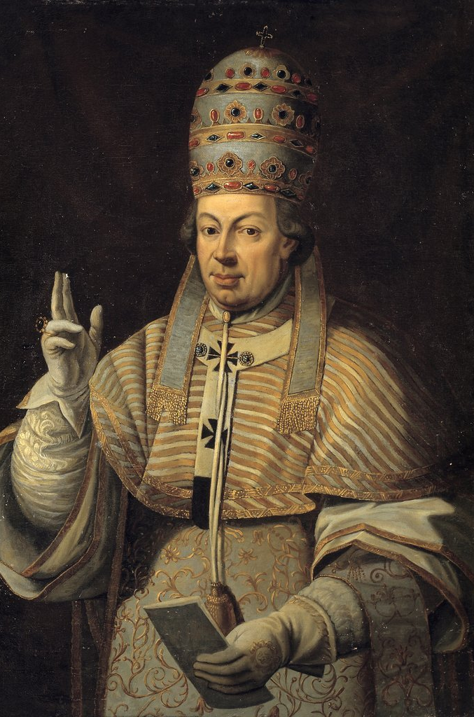
Specific Kings
Notes:
Lutheran-Roman Catholic Commission on Unity invites all Christians to study its report
open-mindedly and critically, and to walk along the path towards the full, visible unity of the Church.

Slide 50
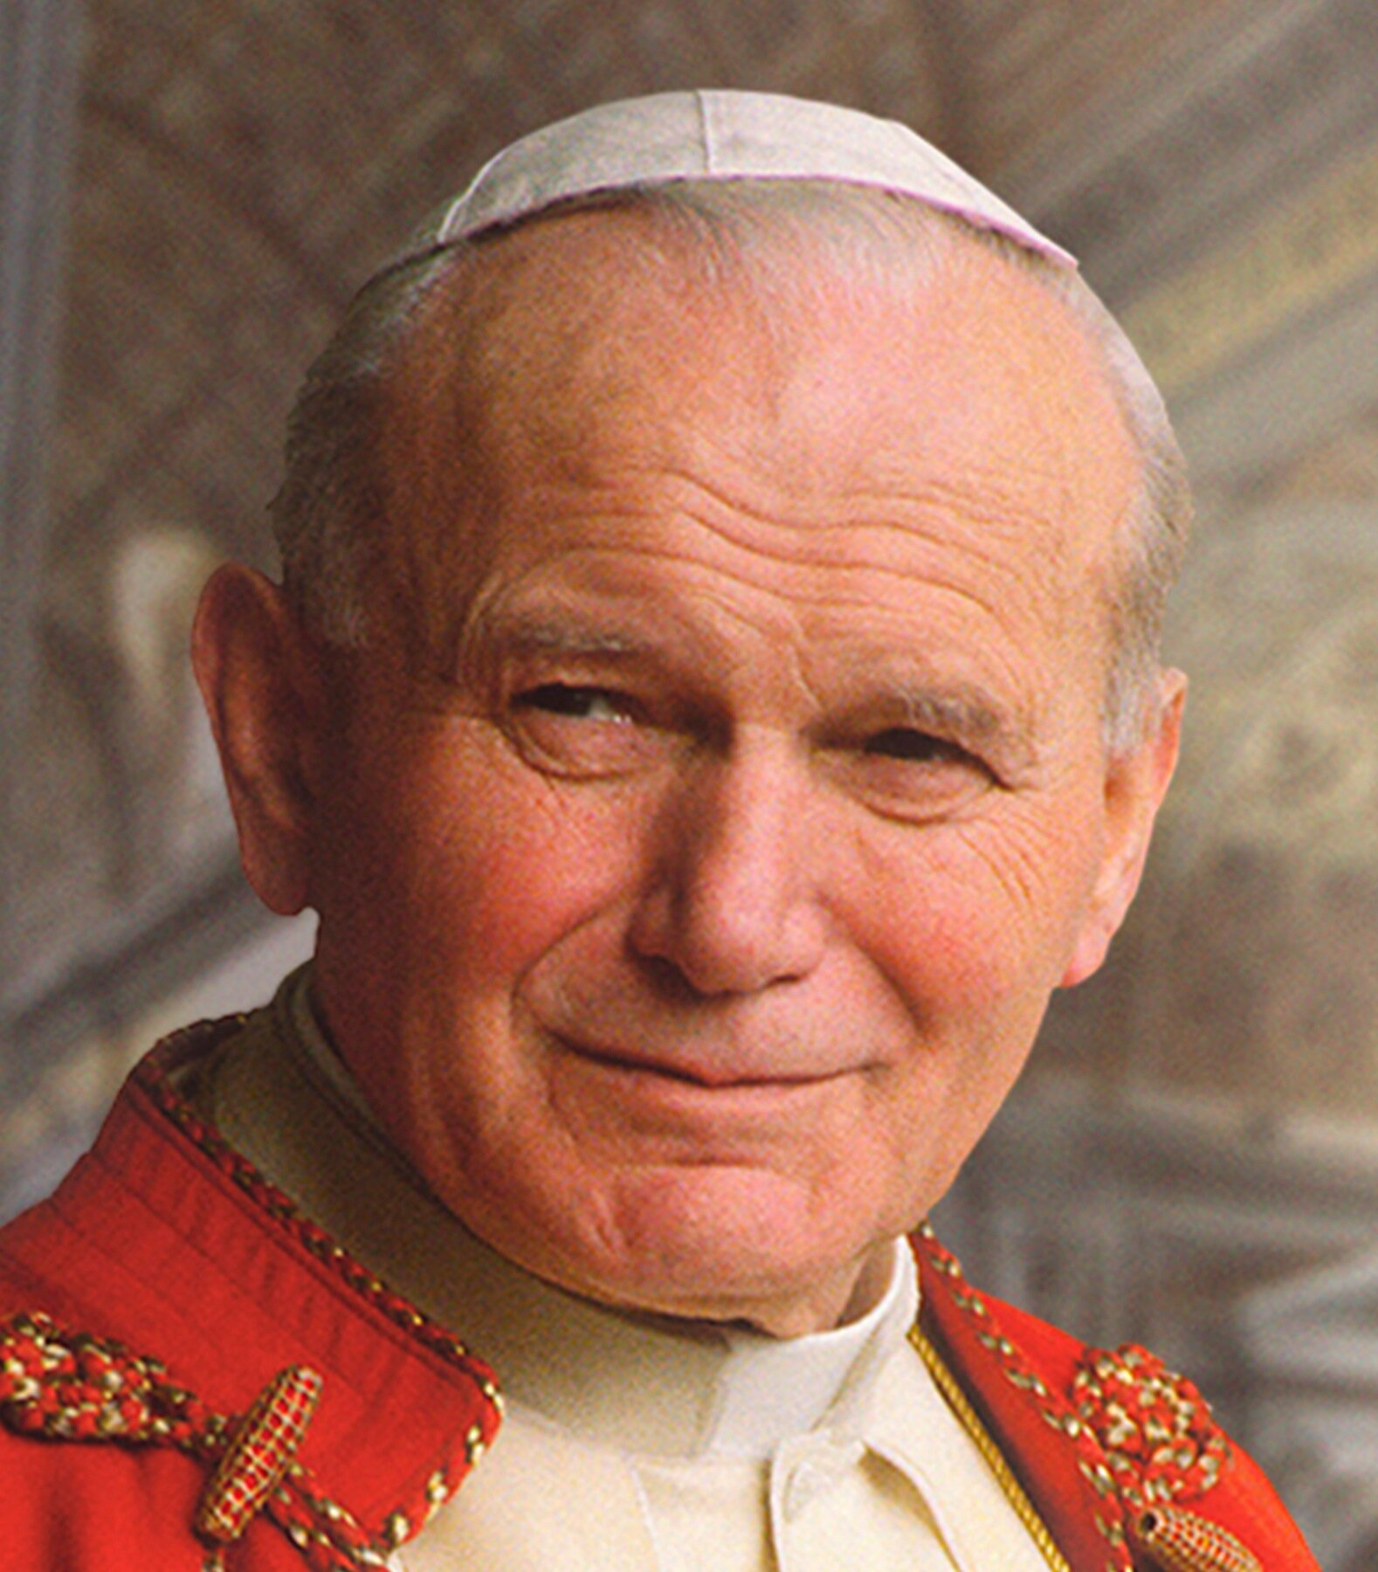
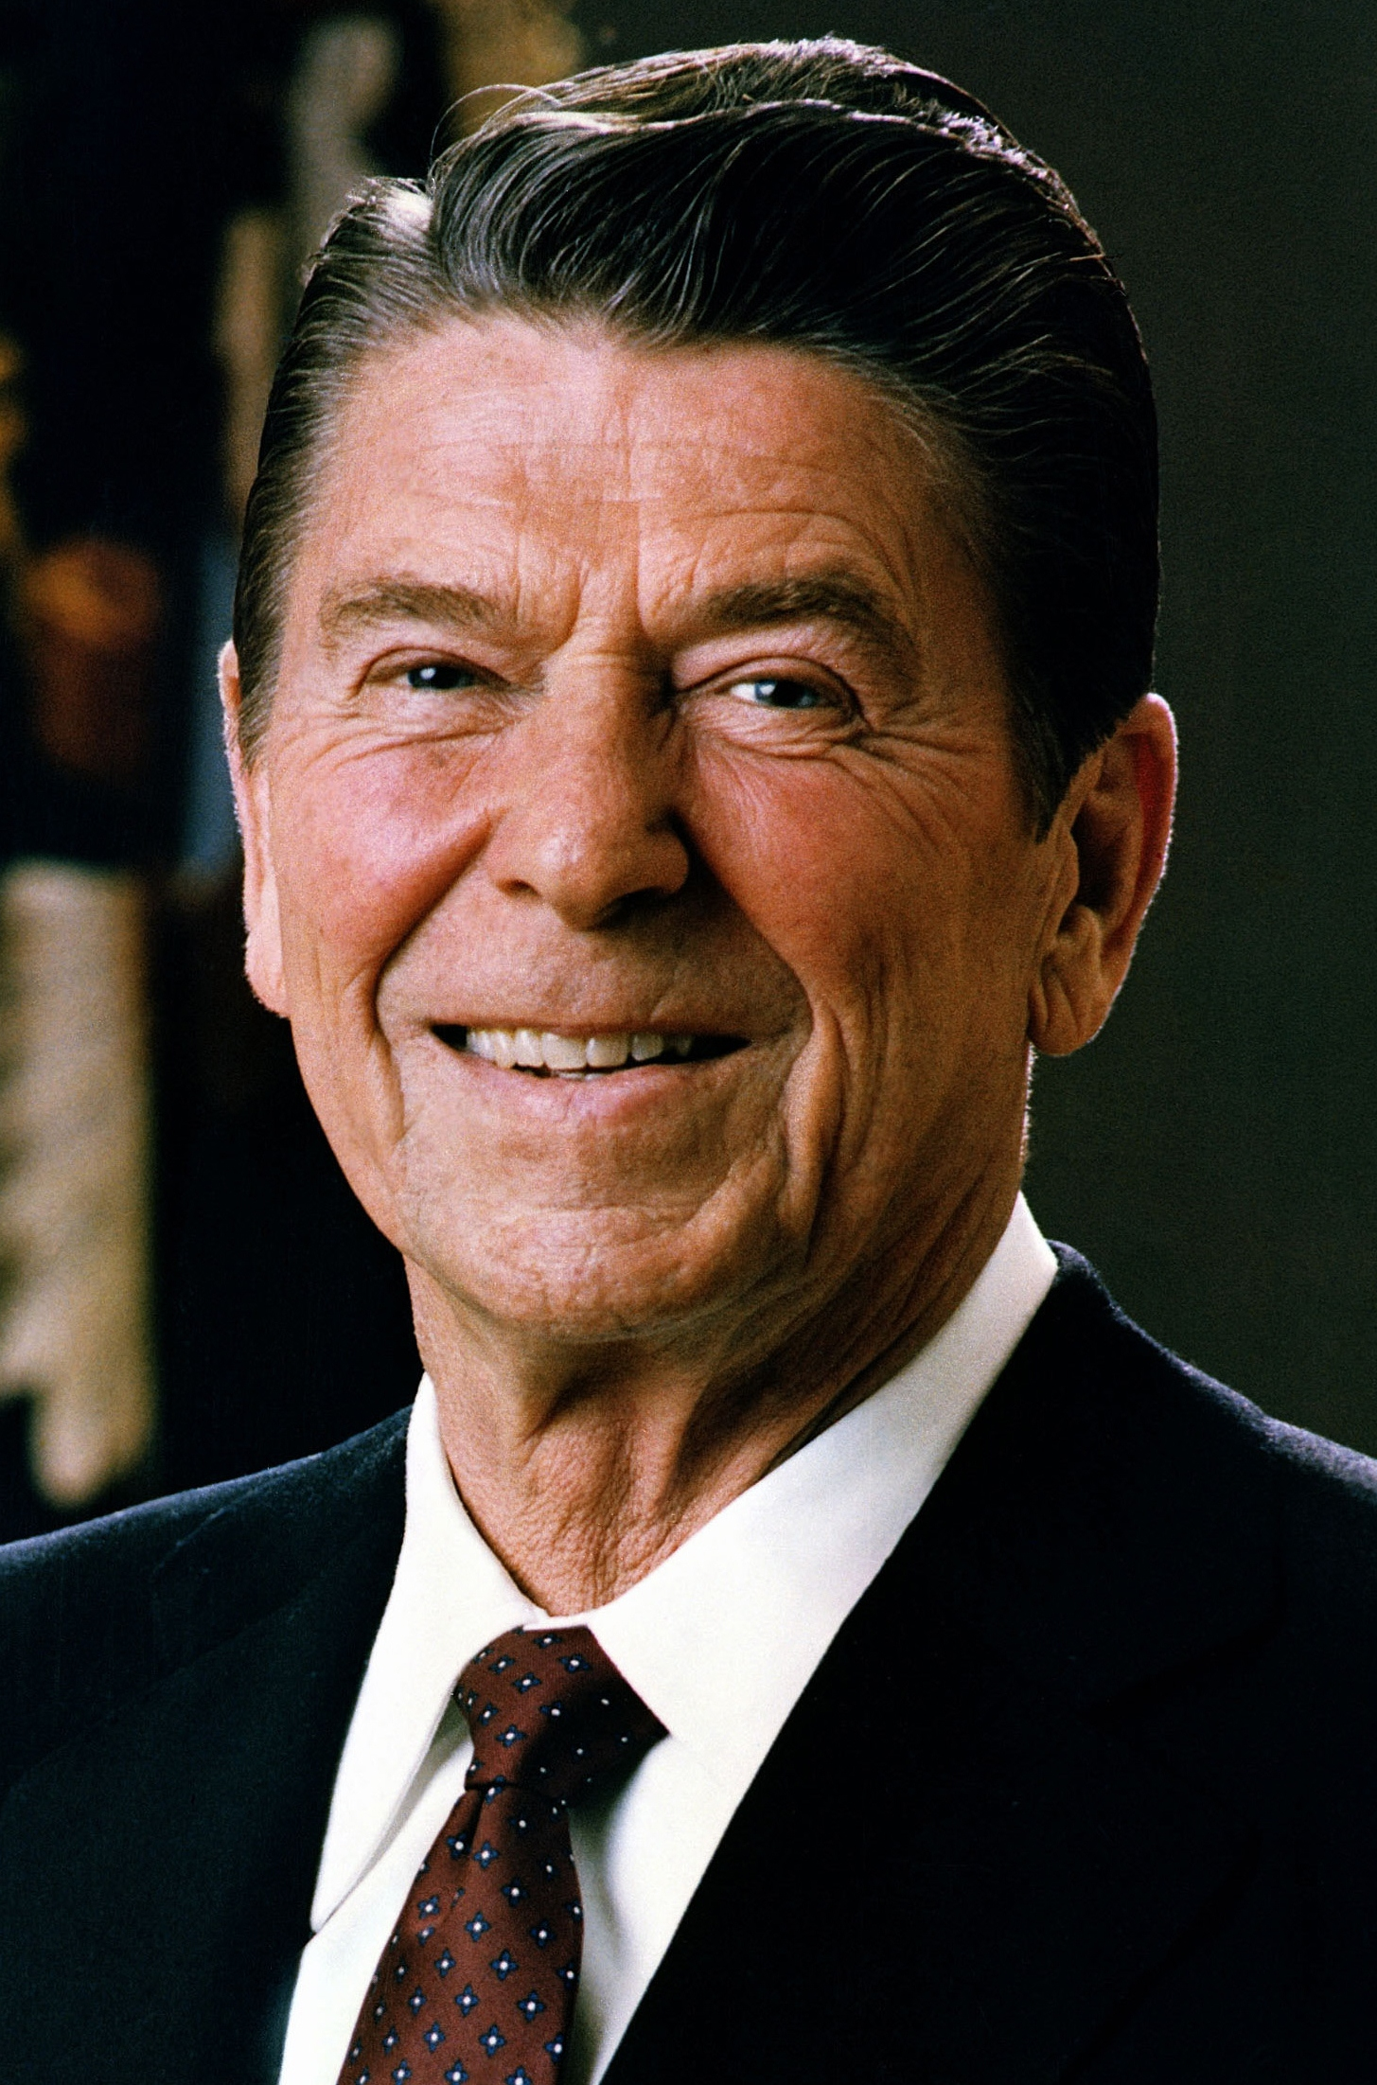
Specific Kings
Notes:
Lutheran-Roman Catholic Commission on Unity invites all Christians to study its report
open-mindedly and critically, and to walk along the path towards the full, visible unity of the Church.

Slide 51
Specific Kings
Notes:
Lutheran-Roman Catholic Commission on Unity invites all Christians to study its report
open-mindedly and critically, and to walk along the path towards the full, visible unity of the Church.

Slide 52
Hermeneutic Switch
Cannot be sustained
by any
previous interpretation
Notes:
Lutheran-Roman Catholic Commission on Unity invites all Christians to study its report
open-mindedly and critically, and to walk along the path towards the full, visible unity of the Church.

Slide 53
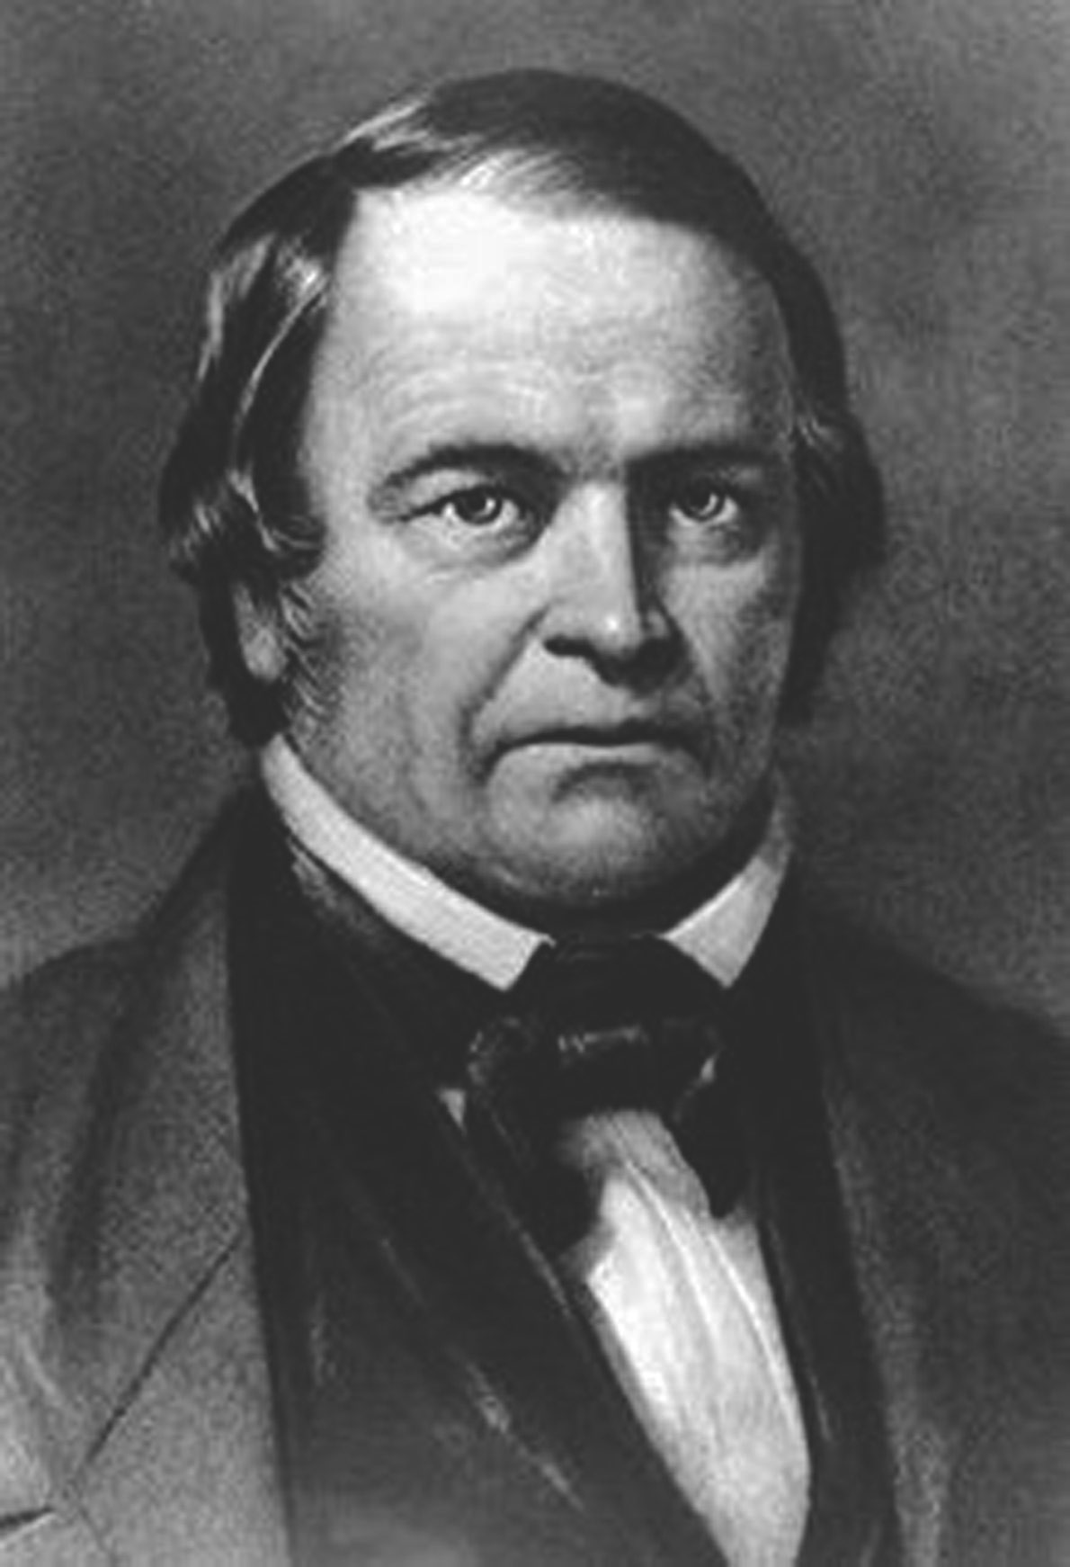
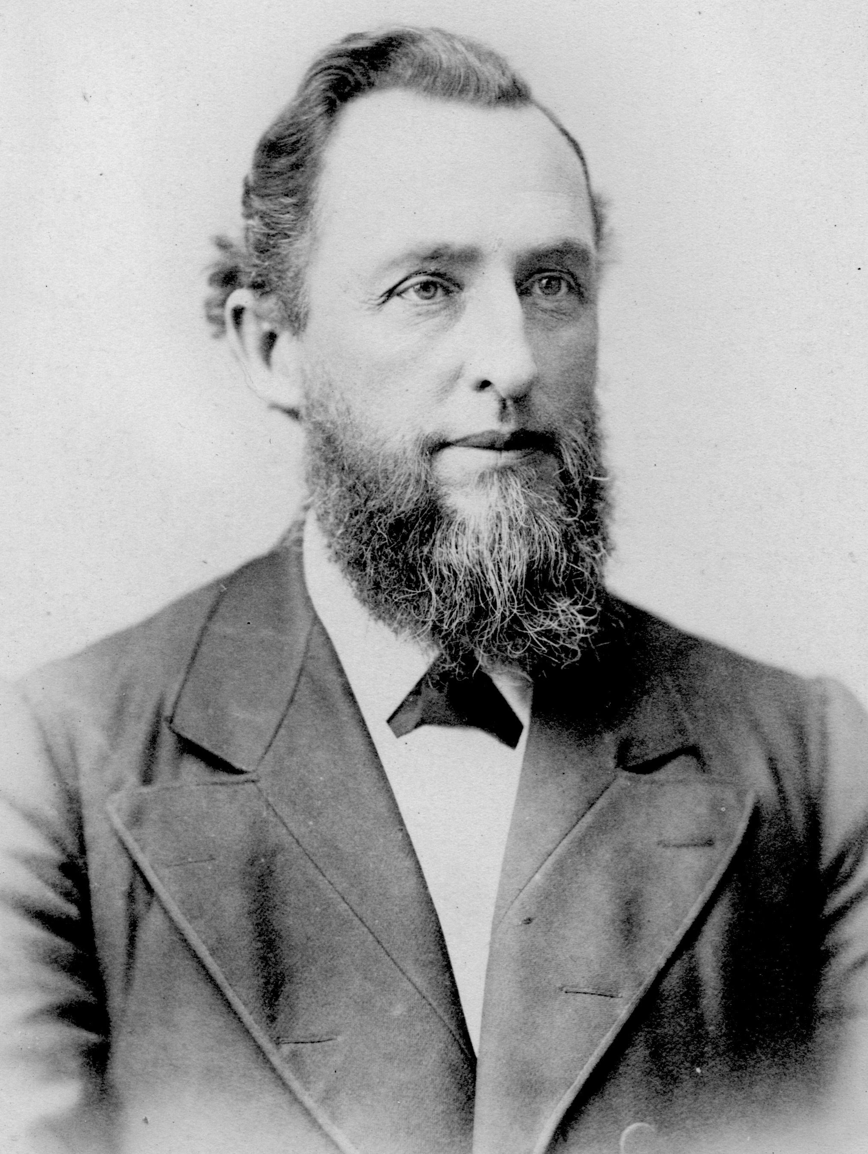
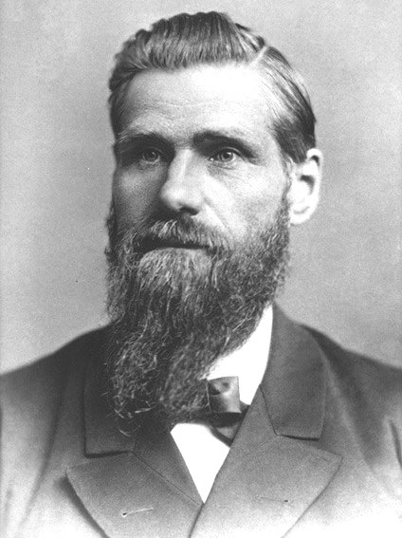
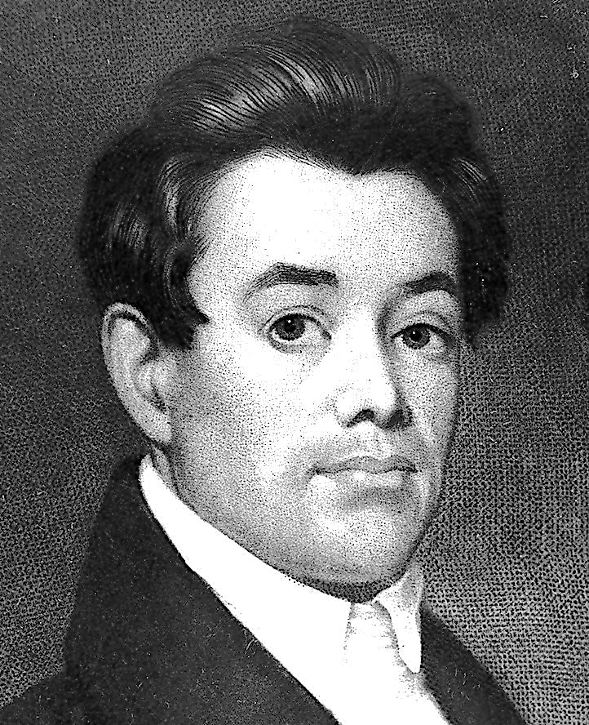
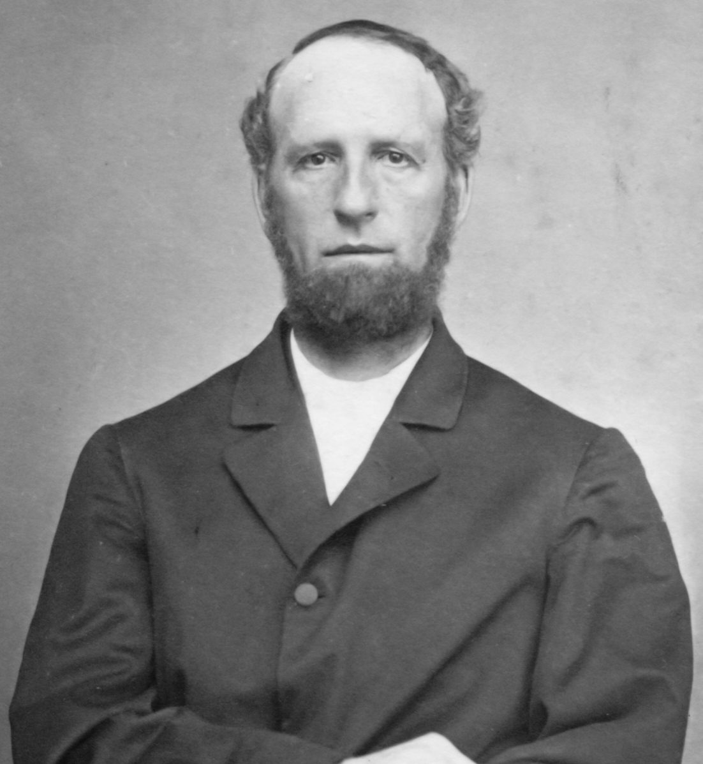
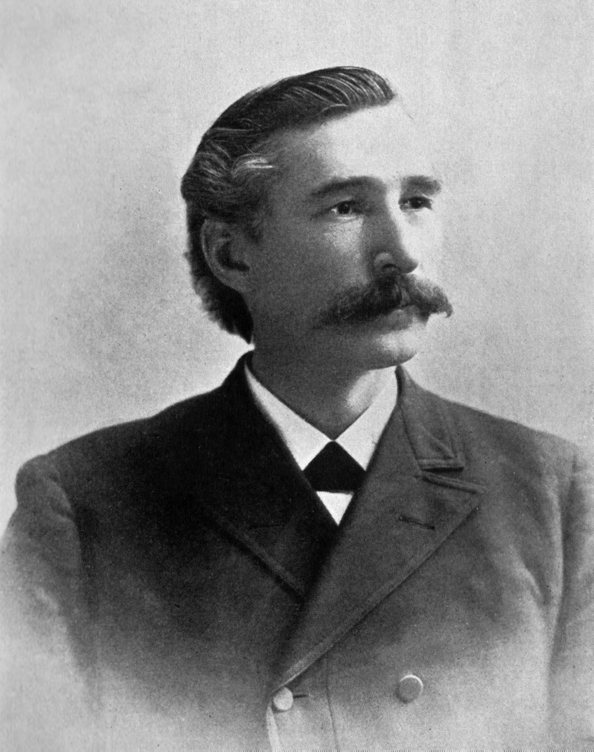
Spiritual Forefathers
Notes:
Lutheran-Roman Catholic Commission on Unity invites all Christians to study its report
open-mindedly and critically, and to walk along the path towards the full, visible unity of the Church.

Slide 54
France
King of the South
Papacy
King of the North

Slide 55
France
King of the South
Papacy
King of the North

Slide 56
France
King of the South
Papacy
King of the North

Slide 57
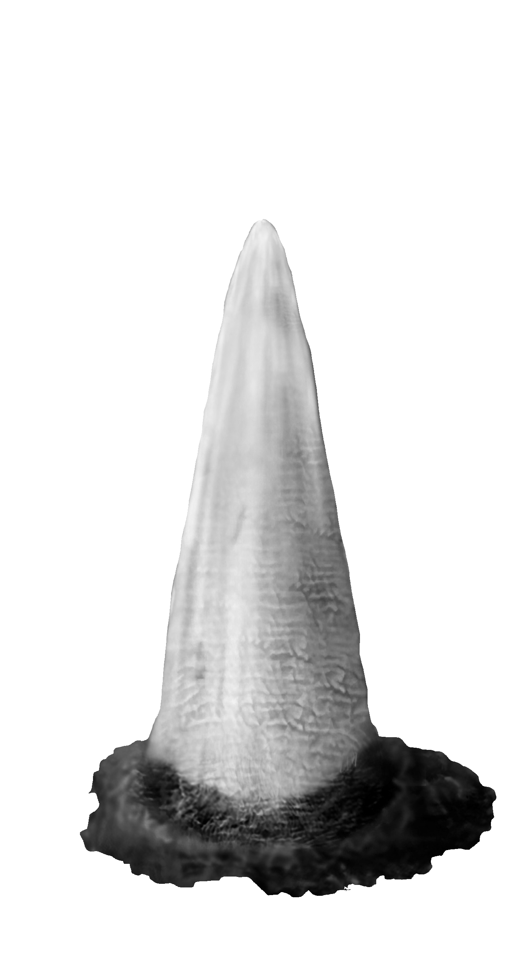
France
King of the South
Papacy
King of the North

Slide 58
U.S.S.R.
King of the South
France
King of the South
Papacy
King of the North

Slide 59
U.S.S.R.
King of the South
Papacy
King of the North
Glorious Land

Slide 60
U.S.S.R.
King of the South
Papacy
King of the North
Church,
Conscience
Were, Louis F., The Battle for the Kingship of the World, paperback, 1950, p. 25.

Slide 61
U.S.S.R.
King of the South
Papacy
King of the North
Church,
Conscience
Edom, Moab, Ammon
Were, Louis F., The Battle for the Kingship of the World, paperback, 1950, p. 25.

Slide 62
U.S.S.R.
King of the South
Papacy
King of the North
Church,
Catholics & Protestants Join the SDA Church
Conscience
Were, Louis F., The Battle for the Kingship of the World, paperback, 1950, p. 25.

Slide 63
U.S.S.R.
King of the South
Papacy
King of the North
Church,
Catholics & Protestants Join the SDA Church
Conscience
Egypt
Were, Louis F., The Battle for the Kingship of the World, paperback, 1950, p. 25.

Slide 64
U.S.S.R.
King of the South
Papacy
King of the North
Church,
Catholics & Protestants Join the SDA Church
Conscience
Atheism
Were, Louis F., The Battle for the Kingship of the World, paperback, 1950, p. 25.

Slide 65
U.S.S.R.
King of the South
Papacy
King of the North
Church,
Catholics & Protestants Join the SDA Church
Conscience
Atheism
China
Were, Louis F., The Battle for the Kingship of the World, paperback, 1950, p. 25.

Slide 66
U.S.S.R.
King of the South
China
Papacy
King of the North
Church,
Catholics & Protestants Join the SDA Church
Libya
Conscience
Atheism
Were, Louis F., The Battle for the Kingship of the World, paperback, 1950, p. 25.
Ethiopia

Slide 67
U.S.S.R.
King of the South
China
Papacy
King of the North
Church,
Catholics & Protestants Join the SDA Church
SDAs Join
Babylon
Conscience
Atheism
Were, Louis F., The Battle for the Kingship of the World, paperback, 1950, p. 25.
SDAs Join
Babylon

Slide 68
U.S.S.R.
King of the South
China
Papacy
King of the North
Church,
Catholics & Protestants Join the SDA Church
SDAs Join
Babylon
Conscience
Atheism
Were, Louis F., The Battle for the Kingship of the World, paperback, 1950, p. 25.
SDAs Join
Babylon

Slide 69
Summary
1. Symbolic vision followed by literal interpretation
2. Interpretations are literal throughout
3. Daniel 11 is an interpretation of Daniel 8
4. Daniel 11 interpretation is literal throughout
Notes:
Lutheran-Roman Catholic Commission on Unity invites all Christians to study its report
open-mindedly and critically, and to walk along the path towards the full, visible unity of the Church.

