Slide 1
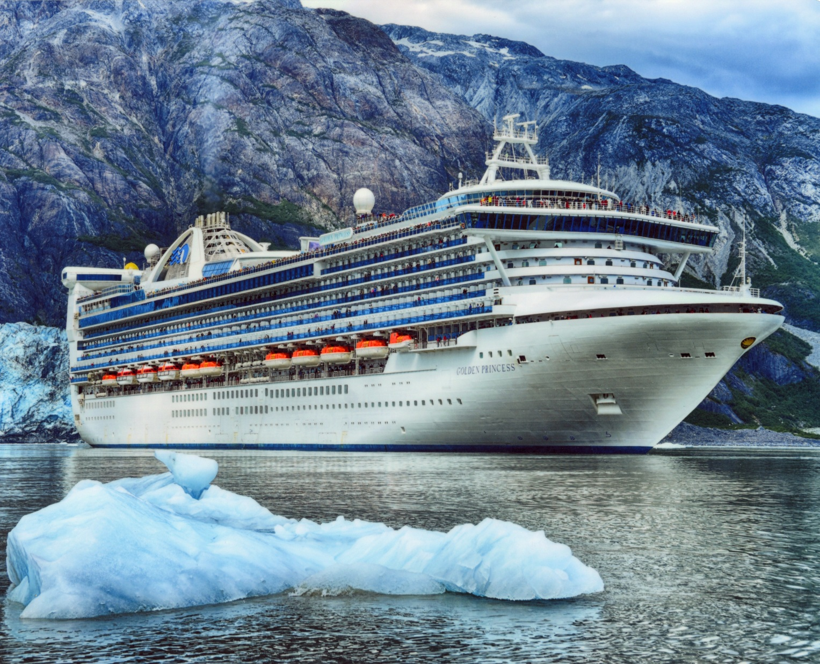
Eastern Question on the Golden Princess

Slide 2
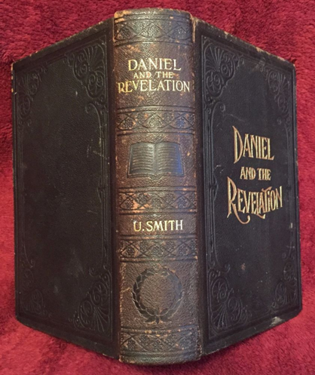
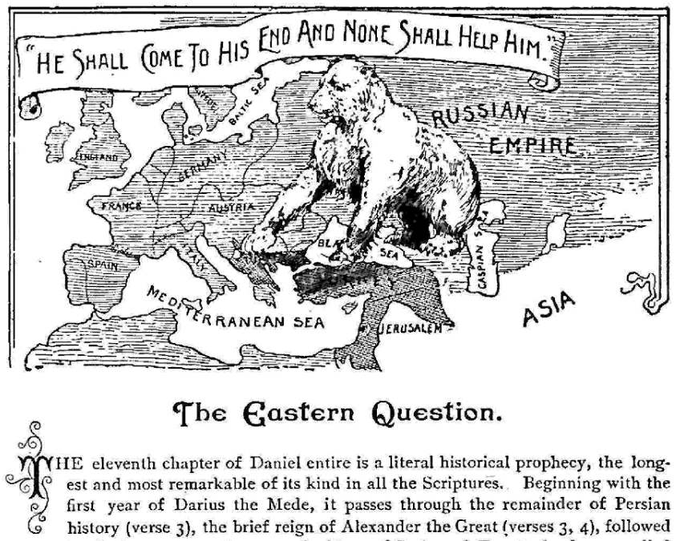

Slide 3
“The evening meeting was largely attended. Elder Smith spoke with great clearness, and many listened with open eyes, ears, and mouths. The outsiders seemed to be intensely interested in the Eastern question. He closed with a very solemn address to those who had not been preparing for these great events in the near future.” Letter 55, Aug. 24, 1884

Slide 4
Eastern Question on the Golden Princess

Slide 5
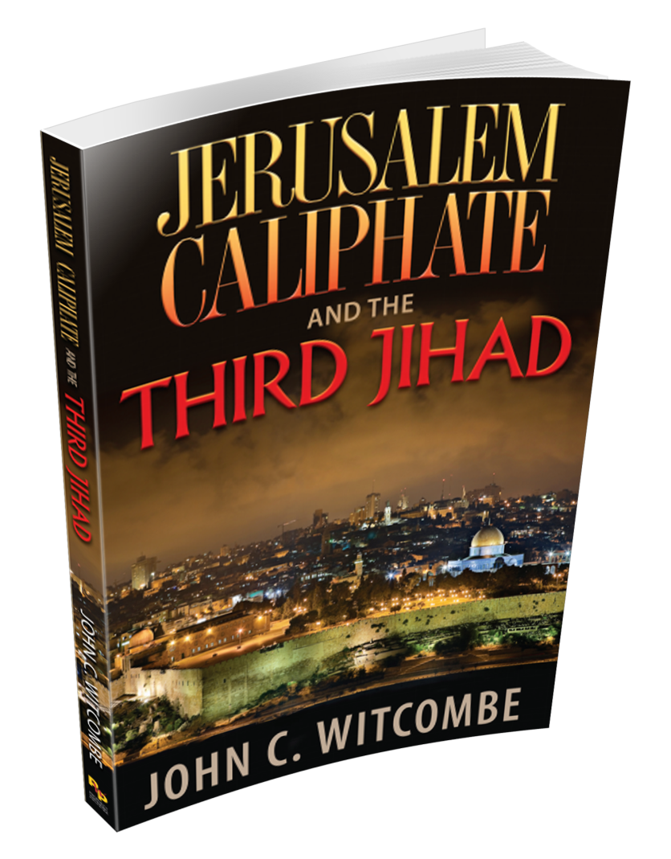

Slide 6
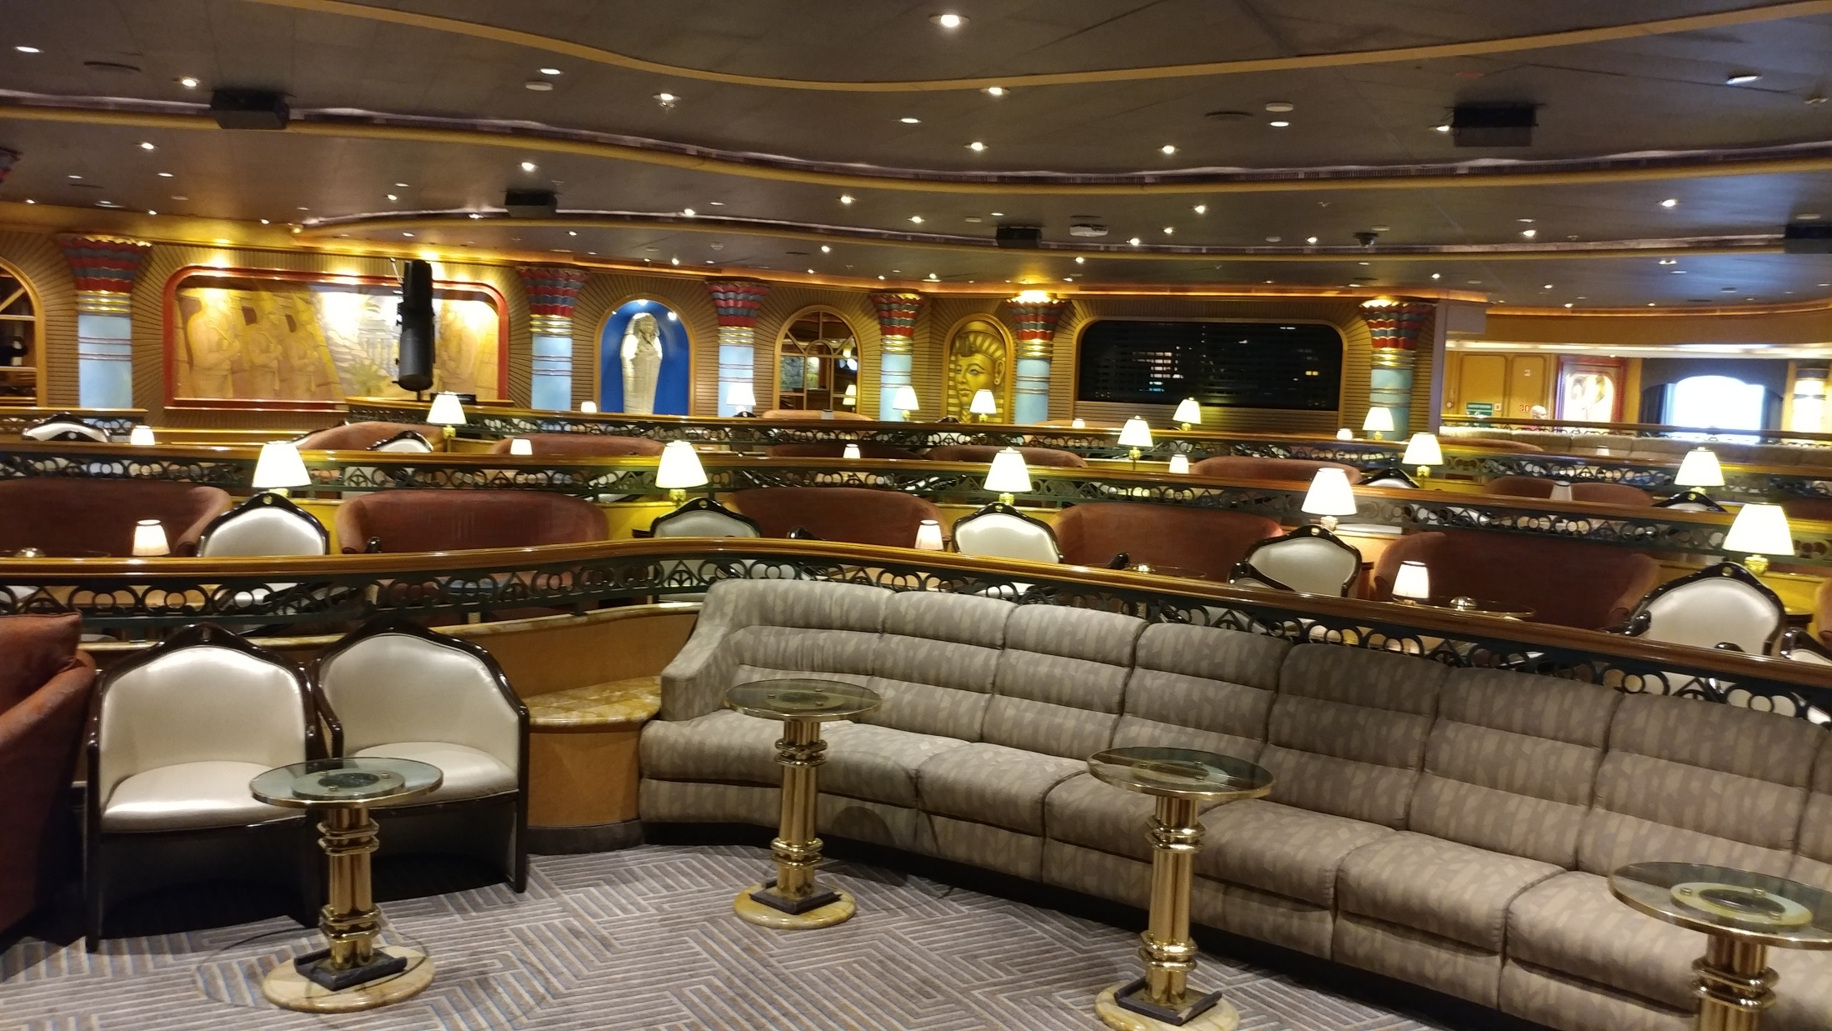

Slide 7
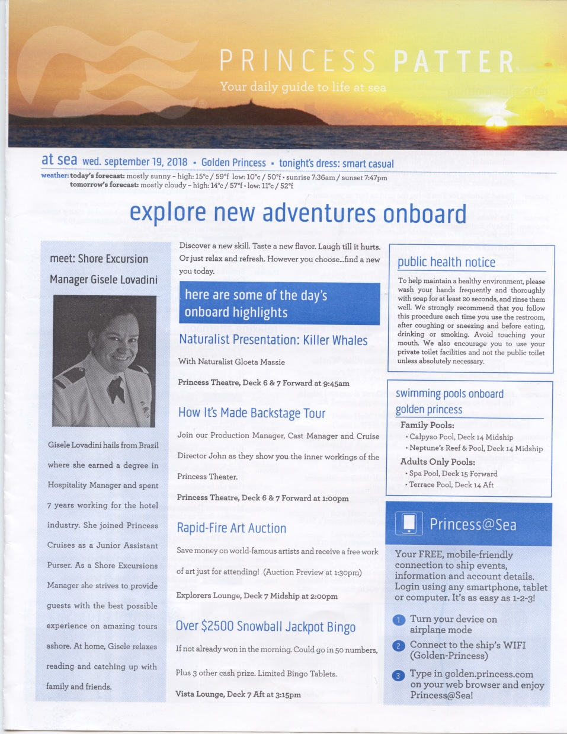

Slide 8
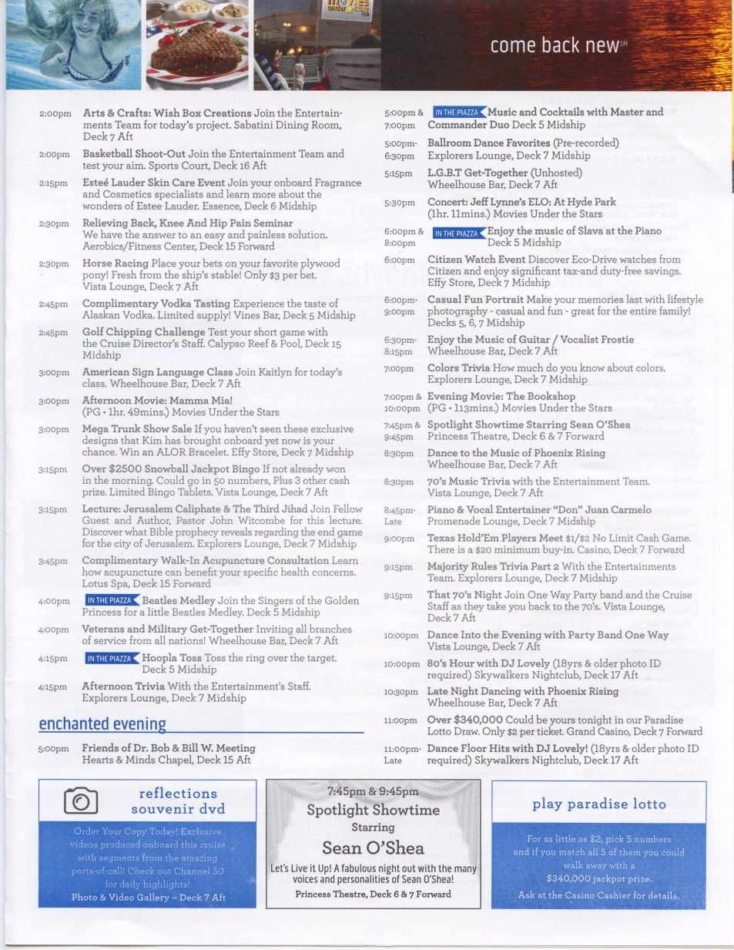

Slide 10
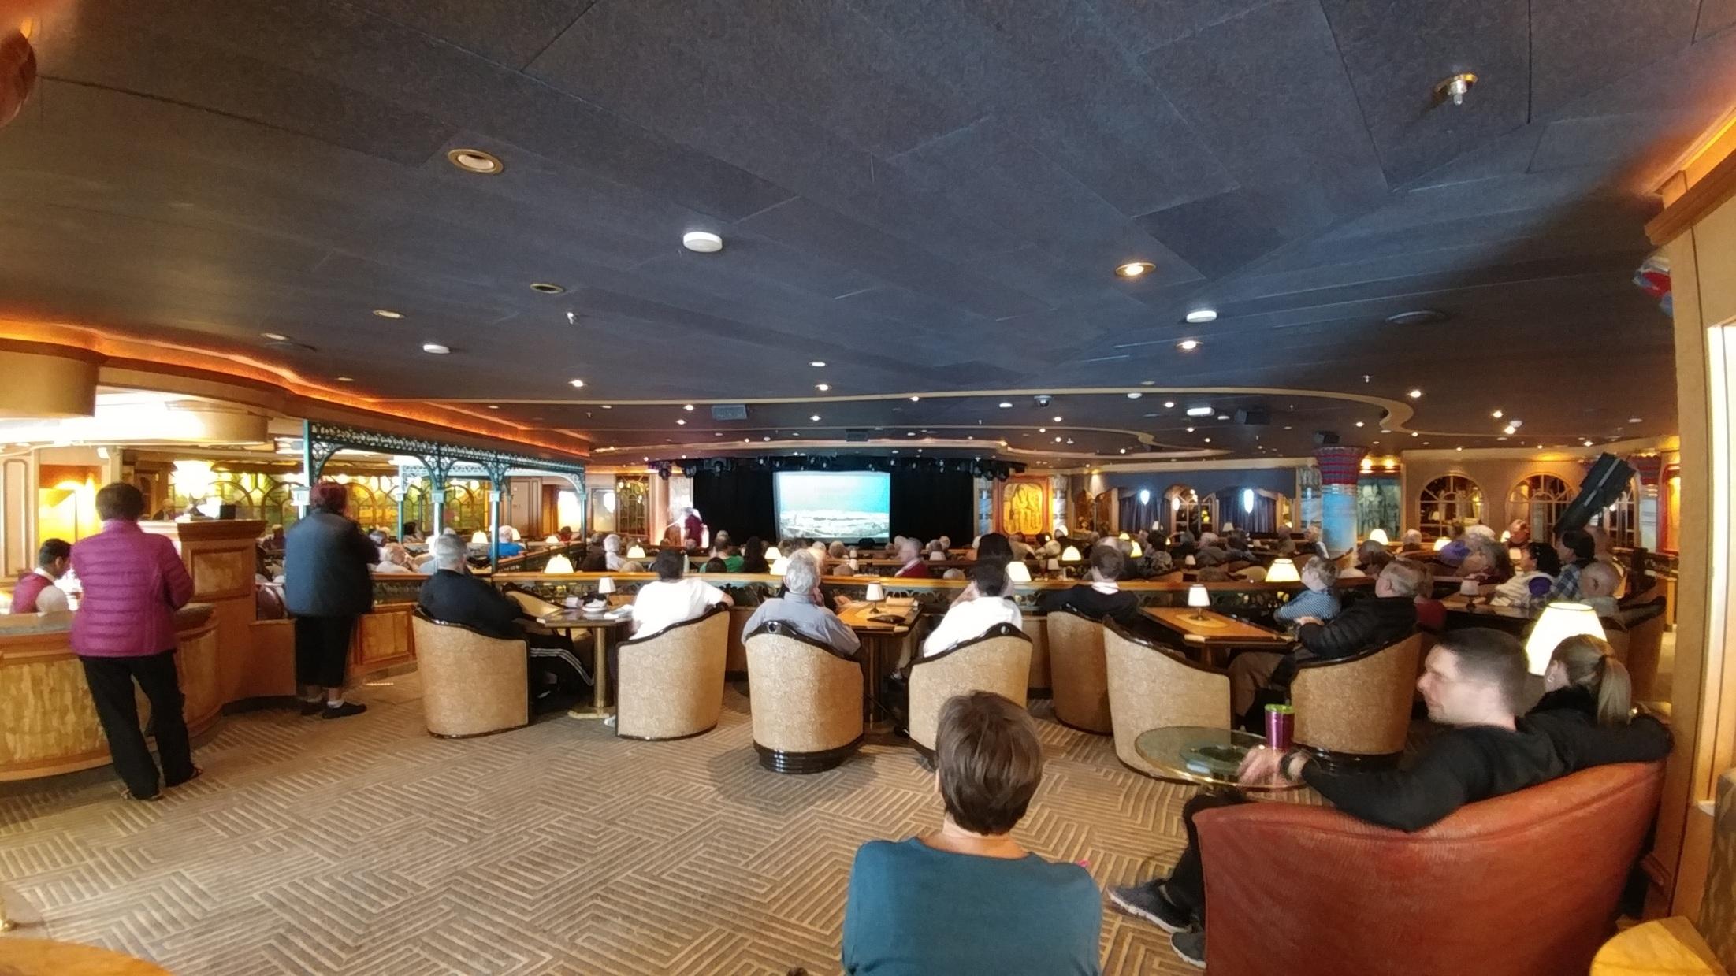

Slide 11
“The evening meeting was largely attended. Elder Smith spoke with great clearness, and many listened with open eyes, ears, and mouths. The outsiders seemed to be intensely interested in the Eastern question.” Letter 55, Aug. 24, 1884

Slide 12
“Our first general meeting in western New York, beginning August 18, was held at Volney, in Brother David Arnold's barn. About thirty-five were present,--all the friends that could be collected in that part of the State. But of this number there were hardly two agreed. Some were holding serious errors, and each strenuously urged his own views, declaring that they were according to the Scriptures.” Life Sketches, p. 110

Slide 13
“Our first general meeting in western New York, beginning August 18, was held at Volney, in Brother David Arnold's barn. About thirty-five were present,--all the friends that could be collected in that part of the State. But of this number there were hardly two agreed. Some were holding serious errors, and each strenuously urged his own views, declaring that they were according to the Scriptures.” Life Sketches, p. 110

Slide 14
“I recommend to you, dear reader, the Word of God as the rule of your faith and practice. By that Word we are to be judged. God has, in that Word, promised to give visions in the ‘last days’; not for a new rule of faith, but for the comfort of His people, and to correct those who err from Bible truth.” Early Writings, p. 78

Slide 15
“Again and again these brethren came together to study the Bible, in order that they might know its meaning, and be prepared to teach it with power. When they came to the point in their study where they said, ‘We can do nothing more,’ the Spirit of the Lord would come upon me, I would be taken off in vision, and a clear explanation of the passages we had been studying would be given me . . .” Selected Messages, vol. 1, p. 206

Slide 16
“They knew that when not in vision I could not understand these matters, and they accepted as light direct from heaven the revelations given me. The leading points of our faith as we hold them today were firmly established. Point after point was clearly defined, and all the brethren came into harmony.” This Day With God, p. 317

Slide 17
Did God give to Ellen White any indication as to whether or not the Eastern Question in Bible Prophecy was biblical truth?

Slide 18
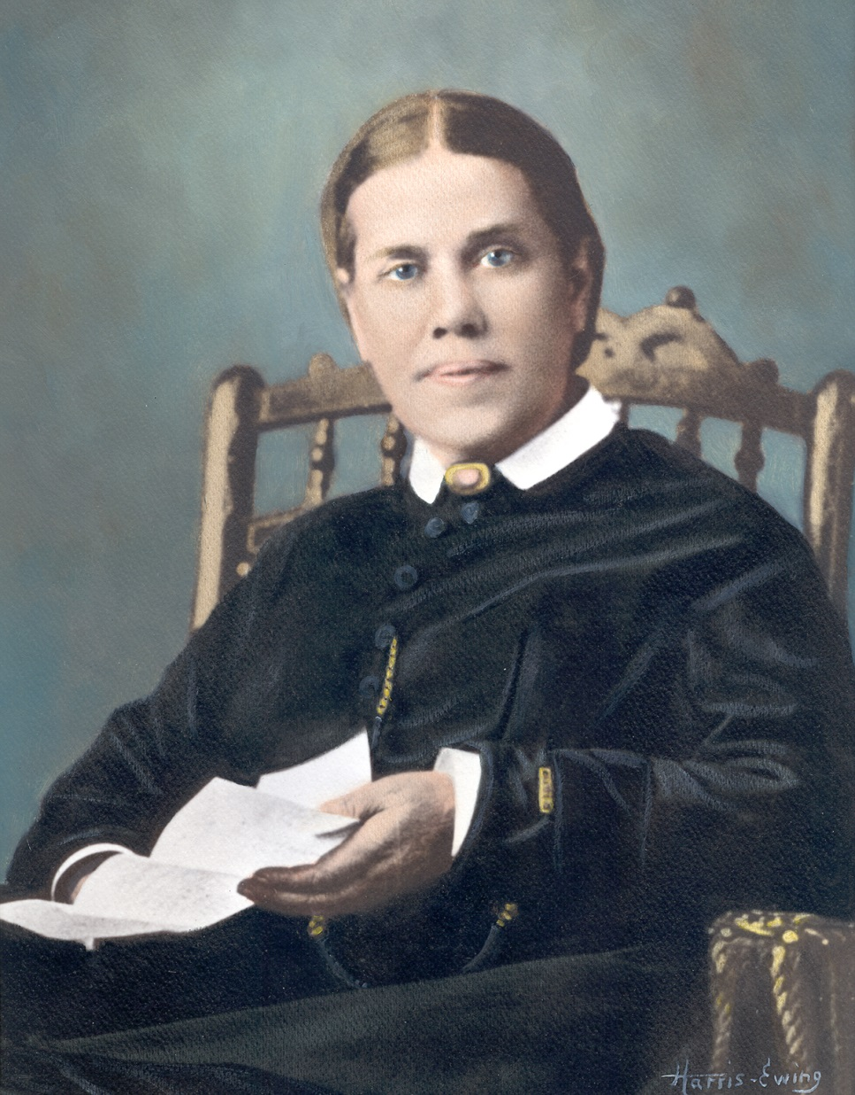
“to correct those who err from Bible truth”

Slide 19
“There must be no long discussions, no presenting of new theories in regard to prophecies that God has already made plain.” RH, November 27, 1900

Slide 20
“Elder Daniells speaks this evening upon the Eastern Question. May the Lord give His Holy Spirit to inspire the hearts to make the truth plain.” Ms189-Dec. 25, 1898

Slide 21
“Elder Daniells speaks this evening upon the Eastern Question. May the Lord give His Holy Spirit to inspire the hearts to make the truth plain.” Ms189-Dec. 25, 1898
God’s Holy Spirit could not have made the truth of the Eastern Question plain to the hearts of the listeners unless it was prophetic truth that God had already made plain to His church.

Slide 22
“While the people who are anxious for truth have been calling, ‘Watchman, what of the night?’ the answer has been given intelligently, ‘The morning cometh, and also the night.’ By a thorough investigation of the prophecies we understand where we are in this world's history; and we know for a certainty that the second coming of Christ is near. The result of these investigations must be brought before the world through the press.”
4T 592, (1881)

Slide 23
“God used the author [Uriah Smith] of this book [Daniel and the Revelation] as a channel through which to communicate light to direct minds to the truth.” 1MR 63

Slide 24
“Elder Daniells speaks this evening upon the Eastern Question. May the Lord give His Holy Spirit to inspire the hearts to make the truth plain.” Ms189-Dec. 25, 1898
“Sunday forenoon Elder Smith spoke upon the Eastern Question, . . . the great day of the meeting was over. Many had listened to the truth, and the day of final reckoning will reveal the results of that day’s meeting.” Letter 10a, 1877

Slide 25
“Those who are preparing to enter the ministry, who desire to become successful students of the prophecies, will find Daniel and the Revelation an invaluable help. They need to understand this book. It speaks of past, present, and future, laying out the path so plainly that none need err therein. . . . The great, essential questions which God would have presented to the people are found in Daniel and the Revelation. There is found solid, eternal truth for this time. Everyone needs the light and information it contains.” 1MR, 61

Slide 26
God made the interpretation of Daniel 11:40-45 plain to our church during that ten-year investigation of the prophecies, when God channeled prophetic light through Uriah Smith as he led that group of “able Bible students” in a thorough investigation of Daniel and Revelation.

Slide 27
“Elder Daniells speaks this evening upon the Eastern Question. May the Lord give His Holy Spirit to inspire the hearts to make the truth plain.” Ms189-Dec. 25, 1898

Slide 28
“Elder Daniells speaks this evening upon the Eastern Question. May the Lord give His Holy Spirit to inspire the hearts to make the truth plain.” Ms189-Dec. 25, 1898
Ellen White would not have prayed for the Holy Spirit to make the truth of the Eastern Question plain to the listeners, unless she knew it was prophetic truth that God had already made plain to His church.

Slide 29
Because God had indeed already made plain the Eastern Question in Bible Prophecy, we must not present new theories on the prophecy of Daniel 11:40-45.
“There must be no long discussions, no presenting of new theories in regard to prophecies that God has already made plain.” RH, November 27, 1900

Slide 30
“Elder Daniells speaks this evening upon the Eastern Question. May the Lord give His Holy Spirit to inspire the hearts to make the truth plain.” Ms189-Dec. 25, 1898

Slide 31
“to correct those who err from Bible truth”

Slide 32
“The very last deception of Satan will be to make of none effect the testimony of the Spirit of God. ‘Where there is no vision, the people perish’”. 10MR 311

Slide 33
“Elder Daniells speaks this evening upon the Eastern Question. May the Lord give His Holy Spirit to inspire the hearts to make the truth plain.” Ms189-Dec. 25, 1898

Slide 34
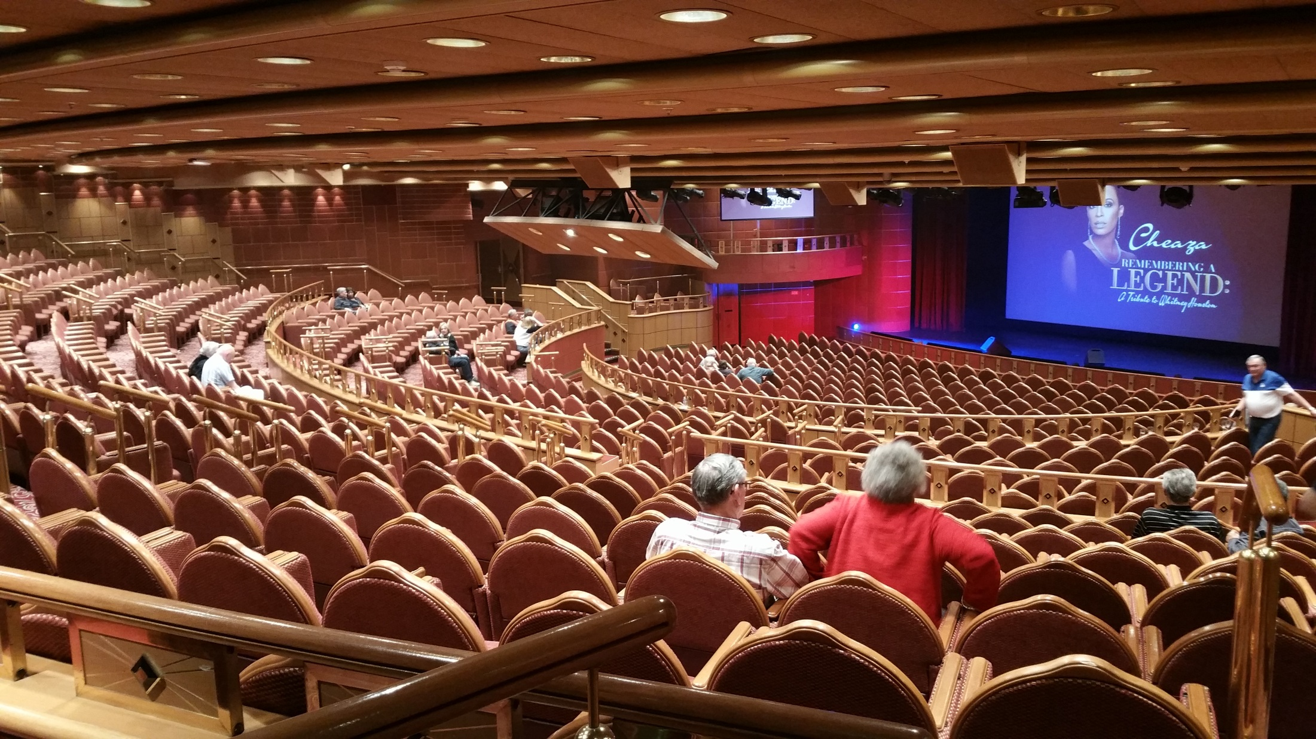

Slide 35
Eastern Question on the Golden Princess

