Slide 1
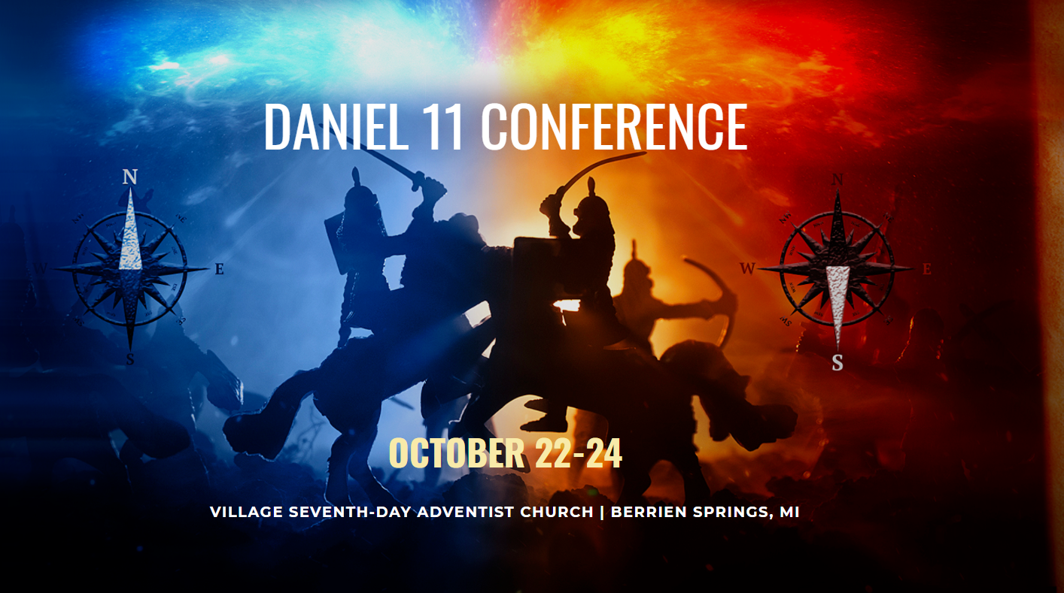
Medieval Divided Kingdoms Period in Daniel 11:23-39
Perry F. Louden, Jr. Ph.D.
Part 1: Fundamentals for this Study
Part 2: Exegesis of Verses 23-31
Part 3: Corroboration & Support
www. portaportal.com/daniel11
Notes:
School teacher and March school let out for COVID
Make a study of Daniel kingdoms by kingdom instead of our usual chapter by chapter studies
Puzzles

Slide 2
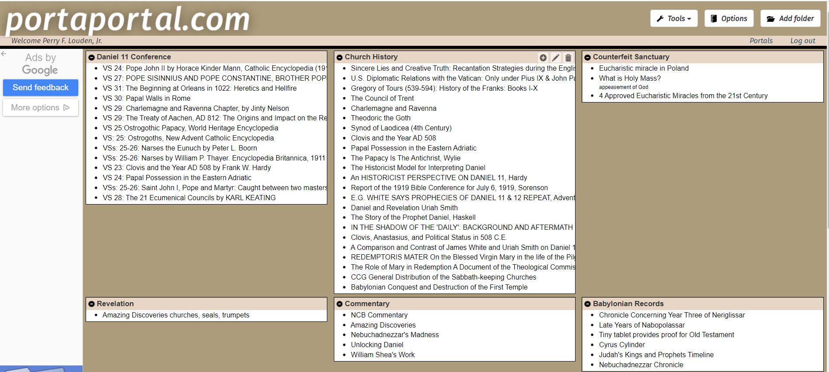
www. portaportal.com/daniel11

Slide 3
Part 1: Fundamentals for this Study
Pattern of Daniel’s Visons
6 Earthly Kingdoms of Daniel 2
Daniel’s Kingdom Periods in Chapters 2,7, 8-9
Medieval Divided Kingdoms In Daniel’s Previous Prophecies
Background of Daniel’s Prophecies
Daniel Understands the Great Conflict
Divisions of Daniel 11
Summary of Background Study

Slide 4
Pattern of Daniel’s Visons
Daniel 2: Image – Framework of Political Powers
Nebuchadnezzar's Dream Daniel gives Interpretation Dialogue
Daniel 7: Wild Beasts – Judgment of Political Powers
Daniel’s Dream Angel Gives Interpretation Dialogue
Daniel 8: Clean Beasts – Sanctuary
Daniel’s Vision Gabriel Gives Interpretation Dialogue
Daniel 9: 70 Weeks – Probation for the Jewish Nation
Refers back to Daniel 8 Gabriel Gives Interpretation Dialogue
Daniel 11: Great Conflicts
? Jesus and Gabriel give the Interpretation Dialogue

Slide 5
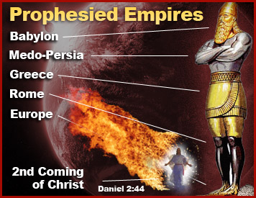
6 Earthly Kingdoms of Daniel 2
Daniel 2:42, And as the toes of the feet were partly iron and partly clay, so the kingdom shall be partly strong and partly brittle.
Head - Babylon
Chests & Arms - Medo-Persia
Belly & Thighs - Greece
Legs - Rome
Feet - Medieval Divided Kingdoms
Toes - End-Time Divided Kingdoms
Rock - Christ’s Kingdom

Slide 6
Daniel’s Kingdom Periods in Chapters 2,7, 8-9
Empire | 2 | 7 | 8-9
Babylon | 32,37-38 | 4,12,17 | n/a
Medo-Persia | 32,39 | 5,12,17 | 8:3,4,14,20,26; 9:23-25
Greece | 32,39 | 6,12,17 | 8:6-8,21-22
Imperial Rome | 33,40 | 7,12,17,19, 23 | 8:9,10a,23 9:26,27a
Divided Kingdoms | 33b,41-43 | 8,20-21,24-25 | 8:10-14,23-26; 9:27c
Papal Rome | 43,42,44 | 9-11,22, 26,27 | 25
All are Chronologically Progressive in Time

Slide 7
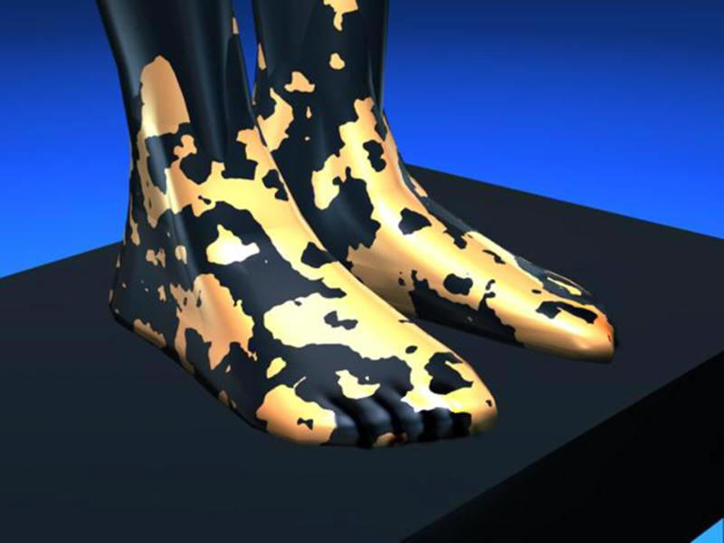
Medieval Divided Kingdoms In Daniel’s Previous Prophecies
Daniel 2 Verses 41,43
Characteristics
Church and state
Multiple kingdoms, some strong and some weak
Marriages and mixing of kingdoms
Strife and war

Slide 8
Medieval Divided Kingdoms In Daniel’s Previous Prophecies
Daniel 7 Verses 8,24,25
Characteristics
10 kingdoms and 3 are destroyed
Small kingdom which is different and can speak and see
Blaspheme God and Persecutes God’s true people
Changes 10 Commandments
Grows and reigns for 1260 Years

Slide 9
Medieval Divided Kingdoms In Daniel’s Previous Prophecies
Daniel 8 Verses 10-14, 23-25
Characteristics
Challenges God
Takes away the Individual’s Daily/ regular Sanctuary Ministry
Replaces Sanctuary with a Counterfeit
Multitudes of people follow
No respect for Scriptures
Continues to develop and grow over Time
Substitutes the Ministry of Jesus work in the Sanctuary in Heaven
Power behind him is Satan
Causes fear and kills those who disagree
Uses scheming and dishonesty to Achieve His Purposes

Slide 10
Medieval Divided Kingdoms
Fundamental Characteristics of the Medieval Divided Kingdoms
Daniel 2 – A Divided Church-state Power
Daniel 7 – Comes Up Among The 10 Horns In Europe
Daniel 7 & 8 – Persecutes God’s Covenant Keeping people
Daniel 8 – Attacks the Daily/Continual Sanctuary Practices
Islam is not found in Daniel’s Prophecies of 2,7, & 8-9

Slide 11
Daniel Understands the Great Conflict
Daniel 10:1: In the third year of Cyrus king of Persia a word was revealed to Daniel, who was named Belteshazzar. And the word was true, and it was a great conflict. And he understood the word and had understanding of the vision.
He was not given a new vision so he must have “understood” based on previous visions.
While Islam is found in revelation, it is not found in Daniel's previous visions of 2, 7, and 8-9 and should not be part of the interpretation of the vision in chapter 11.
Maybe Verse 34 “When they stumble, they shall receive a little help.” The Reformers for protected by Muslim Invasions of the contentment.
Notes:
Patten in 2, 7, 8 of Dream/Vision and interpterion
Daniel 9 has no dream or vison, but the interpretation refers back to the Mar’eh from 8
Daniel 11 likewise has no dream or vision but is a repeat and enlargement of previous prophecies in 2,7,8, and 9.
Two things I noted here. 1) Daniel understood because noting was added, Islam is not found in 2,7,8,9 and can not be part of 11. 2) Daniel prophecies are chronological. The individual prophesies are always progressive in time and never regress. Therefore, there cannot be a ‘switch back” in time such as many see between 11;22 and 23 going from 31/70AD back to 63BC.

Slide 12
Divisions of Daniel 11

Slide 13
Background Summary
Pattern of Visons include Visual Component and Interpretive dialogue.
Daniel’s visions have 6 earthly kingdom periods with Ch 2 as the Template.
Daniel does not backtrack in his prophecies, and he continues with progressive chronological timeline.
Fundamental Characteristics found in the Medieval Divided Kingdoms In Daniel’s Previous Prophecies
Islam is not found in Daniel 2,7, and 8-9.
Daniel Understands the Great Conflict.
Daniel 10-12 has 6 Divisions of Kingdoms
Medieval Divided Kingdoms period in verses 23-39 parallel the Greek Hellenistic period in verses 3-19.
Notes:
Patten in 2, 7, 8 of Dream/Vision and interpterion
Daniel 9 has no dream or vison, but the interpretation refers back to the Mar’eh from 8
Daniel 11 likewise has no dream or vision but is a repeat and enlargement of previous prophecies in 2,7,8, and 9.
Two things I noted here. 1) Daniel understood because noting was added, Islam is not found in 2,7,8,9 and can not be part of 11. 2) Daniel prophecies are chronological. The individual prophesies are always progressive in time and never regress. Therefore, there cannot be a ‘switch back” in time such as many see between 11;22 and 23 going from 31/70AD back to 63BC.

Slide 14
Part 2: Exegesis of Verses 23-31
23 And from the time that an alliance is made with him he shall act deceitfully, and he shall become strong with a small people.
24 Without warning he shall come into the richest parts of the province, and he shall do what neither his fathers nor his fathers' fathers have done, scattering among them plunder, spoil, and goods. He shall devise plans against strongholds, but only for a time.
25 And he shall stir up his power and his heart against the king of the south with a great army. And the king of the south shall wage war with an exceedingly great and mighty army, but he shall not stand, for plots shall be devised against him.
26 Even those who eat his food shall break him. His army shall be swept away, and many shall fall down slain.
27 And as for the two kings, their hearts shall be bent on doing evil. They shall speak lies at the same table, but to no avail, for the end is yet to be at the time appointed.
28 And he shall return to his land with great wealth, but his heart shall be set against the holy covenant. And he shall work his will and return to his own land.
29 “At the time appointed he shall return and come into the south, but it shall not be this time as it was before.
30 For ships of Kittim shall come against him, and he shall be afraid and withdraw, and shall turn back and be enraged and take action against the holy covenant. He shall turn back and pay attention to those who forsake the holy covenant.
31 Forces from him shall appear and profane the temple and fortress, and shall take away the regular burnt offering. And they shall set up the abomination that makes desolate.

Slide 15
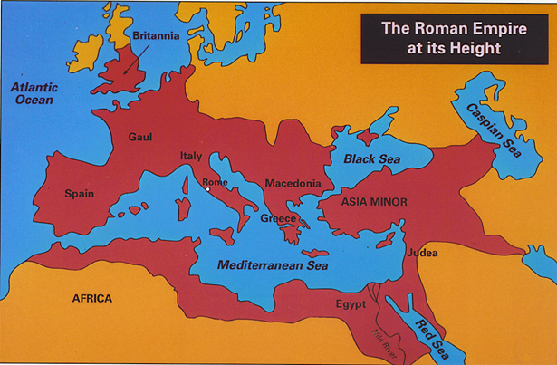
Roman Empire Ends at Verse 22
Daniel’s prophecies are all chronologically progressive in time
U. Smith: Verse 22 is at 31AD but then he uses a “switchback” in verse 23 to 161BC and covers political events of the Roman Empire to 330AD thru verse 30.
Political events in these verses had little or no impact on God’s People.
Vs 24 the word for “time” is `eth (H5703)meaning time (257x), season (16x), when (7x), always (4x), evening tide (with H6153) (2x), miscellaneous (10x).
Time prophesy is mow`ed (H3259)
Capital of the Western Roman Empire was moved to Milan/Mediolanum Italy in 292AD.
The Edict of Milan was issued by Constantine in his administrative capital of Milan.

Slide 16
Roman Empire Ends at Verse 22
Daniel 7:17 ‘These four great beasts are four kings who shall arise out of the earth. 18 But the saints of the Most High shall receive the kingdom and possess the kingdom forever, forever and ever.’
Daniel 8:9 “Out of one of them (the winds) came a little horn, which grew exceedingly great toward the south, toward the east, and toward the glorious land.”
Daniel 9:27 “And he shall make a strong covenant with many for one week, and for half of the week he shall put an end to sacrifice and offering. And on the wing of abominations shall come one who makes desolate, until the decreed end is poured out on the desolator (70AD).”

Slide 17
Roman Empire Ends at Verse 22
Pagan Rome’s downfall began the day they killed the Prince of the Covenant and subsequent destruction of His sanctuary (31/70AD).
Matthew 24:15, “So when you see the abomination of desolation spoken of by the prophet Daniel, standing in the holy place (let the reader understand)...”
1 John 4:3, “This is the spirit of the antichrist, which you heard was coming and now is in the world already.”
Now the new Power of church and state union - although small – has come on to scene and Daniel moves on in verse 23 to the next kingdom period – the Medieval Divided Kingdoms.

Slide 18
Subsections of the Medieval Divided Kingdom Period in Verses 23-39
Establishment of the Roman Church-State System Verses 23-27
Counsels and Edicts against the Covenant Verses 28-31
Protestant Reformation verses 32-35
Full Power and Force of Papal Rome Verses 36-39
Notes:
Main emphasis in these passages

Slide 19
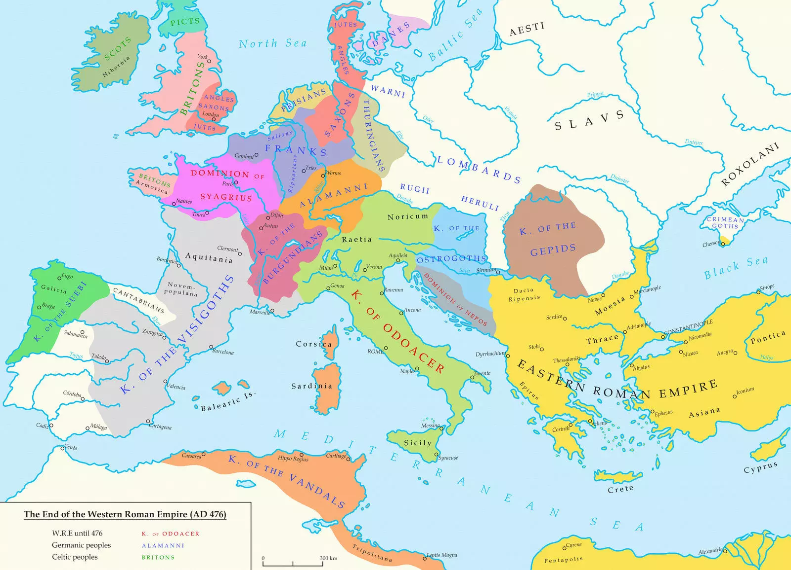
Europe 476 AD
Uprooted Kingdoms
Significant Other Kingdoms
Remaining Kingdoms
Constantinople
Istanbul, Turkey
Latitude: 41°00′49″ N
Rome, Italy
Latitude: 41°53′30″ N

Slide 20
Establishment of the Roman Church-State System Verses 23-27
²³ And from the time that an alliance is made with him he shall act deceitfully, and he shall become strong with a small people.
²⁴ Without warning he shall come into the richest parts of the province, and he shall do what neither his fathers nor his fathers' fathers have done, scattering among them plunder, spoil, and goods. He shall devise plans against strongholds, but only for a time.
²⁵ And he shall stir up his power and his heart against the king of the south with a great army. And the king of the south shall wage war with an exceedingly great and mighty army, but he shall not stand, for plots shall be devised against him.
²⁶ Even those who eat his food shall break him. His army shall be swept away, and many shall fall down slain.
²⁷ And as for the two kings, their hearts shall be bent on doing evil. They shall speak lies at the same table, but to no avail, for the end is yet to be at the time appointed.

Slide 21
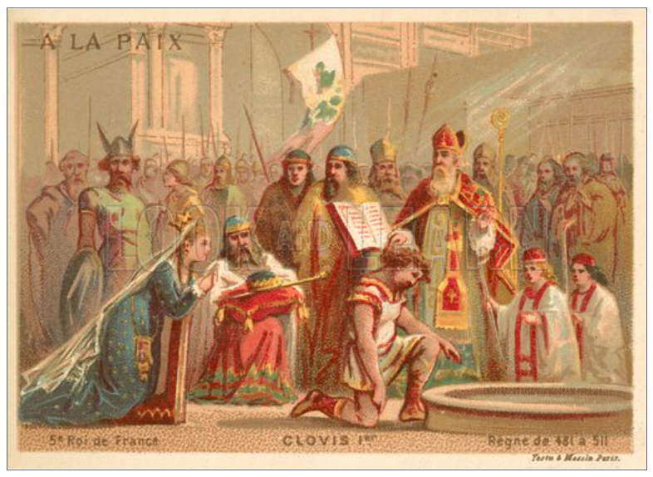
Establishment of the Roman Church-State System Verse 23
23 And from the time that an alliance (YLT = after they join themselves unto him) is made with him he shall act deceitfully, and he shall become strong with a small people.
Starting at 476, The Popes made alliances with its barbarian neighbors in order to survive.
The alliance with the Franks beginning in 508 would be the strongest and remain steadfast until the time appointed of 1798.
Catholicism was small but began to spread rapidly throughout southern, central, and western Europe after overcoming the Arian kingdoms through missionaries and with the sword of the Franks.

Slide 22
Establishment of the Roman Church-State System Verse 23
Clovis And The Year Ad 508 By Frank W. Hardy, Pg 6
According to Ian Wood, Clovis’ baptism is only one of many important events occurring in 508:
(a) Emperor Anastasias I Dicorus (491-518) gives Clovis an honorary consulship in celebration of his victory over Alaric,
(b) Clovis asserts his status as conqueror by riding through the streets of tours showering bystanders with coins,
(c) he eliminates a number of rival Frankish kings,
(d) he establishes his capital in Paris,
(e) he publishes a law code which had been in preparation earlier, and finally
(f), on Christmas day, he accepts Catholic baptism at Tours, from the aged and saintly Bishop Remigius.

Slide 23
Establishment of the Roman Church-State System Verse 24
24 Without warning he shall come into the richest parts of the province, and he shall do what neither his fathers nor his fathers' fathers have done, scattering among them plunder, spoil, and goods. He shall devise plans against strongholds, but only for a time (`eth = season, not 360 yrs).
In 533, the Papacy began the process of receiving a temporal dominion with the Byzantine Emperor giving the pope the city of Rome.
Papal Possessions in the Eastern Adriatic
Simony, the practice of buying and selling ecclesiastical privileges, church offices, or promotion, began as early as 498.
Pope John II by Horace Kinder Mann
The pope of Rome had to “devise plans” to be a temporal ruler, using monastic establishments to spread spiritual rule throughout Europe and leverage against the Byzantine Emperor who had the Bishop of Constantinople at his side.
“But only for a time” the Papacy would engage in scattering plunder, spoil, and goods among those who honor them until the time of the end in 1798.

Slide 24
Establishment of the Roman Church-State System Verse 25
25 And he shall stir up his power and his heart against the king of the south with a great army. And the king of the south shall wage war with an exceedingly great and mighty army, but he shall not stand, for plots shall be devised against him.
535-554 The Gothic Wars with Byzantine General Narses (KOS) and an overwhelming force defeated the Ostrogoths again liberating Rome at the Battle of Taginae of 552 and vanquishing the remaining Ostrogothic army for good.
As to “plots shall be devised against him”, this can clearly be seen in the fact that Papacy initially supported the Arian Ostrogoths and in the subsequent interplay between the popes, Ostrogoths, and the emperor.
Ostrogothic Papacy, World Heritage Encyclopedia
New Advent Catholic Encyclopedia Ostrogoths
Saint John I, Pope and Martyr: Caught between two masters, the pope is crushed in a secular vice

Slide 25
Establishment of the Roman Church-State System Verse 26
26 Even those who eat his food shall break him. His army shall be swept away, and many shall fall down slain.
None of the alliances with the Barbarian nation could give the Papacy the temporal power against Constantinople during this period.
General Narses annihilated the remaining Ostrogoths and Heruli, decisively defeated Alamanni and Franks, and held back the Lombards from invasion .
Thomas Hodgkin, “Narses” 1911 Encyclopedia Britannica
Narses the Eunuch by Peter L. Boorn
The Exarchate of Ravenna under the authority of the Byzantine emperor dominated the region.
The populace of the peninsula had been devastated by war, famine, and disease. Also, the Papacy had lost control over papal elections. The Papacy would not gain the upper hand on Constantinople until 800 with the crowning of the French king, Charlemagne as Holy Roman Emperor.

Slide 26
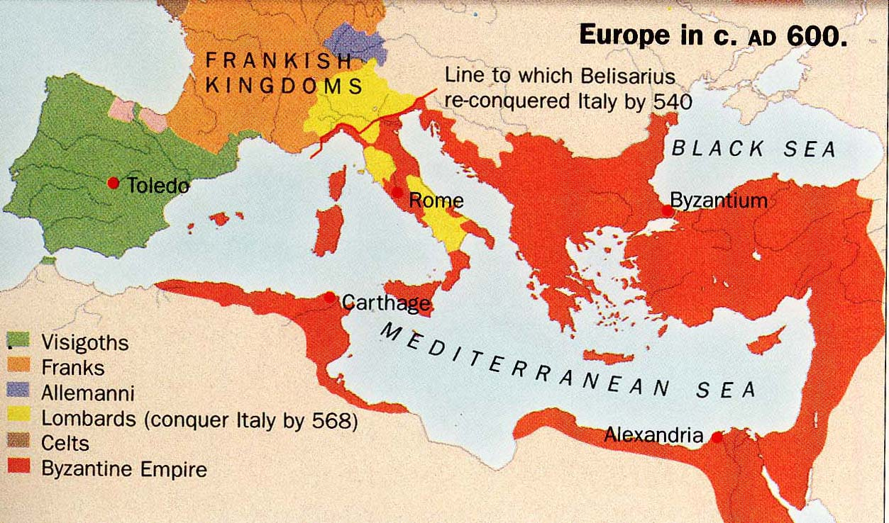
Europe C.A. 600 AD

Slide 27
Establishment of the Roman Church-State System Verse 27
27 And as for the two kings, their hearts shall be bent on doing evil. They shall speak lies at the same table, but to no avail, for the end is yet to be at the time appointed (mow`ed 1798).
711 Pope Constantine traveled to Constantinople to end a dispute over the Quinisext Ecumenical Council with Emperor Justinian II. However, the pope’s real motive was the split over sacramental marriages. A compromise was reached where Pope Constantine gave ground on “Economia” or the handling, management, and disposition, of the council, but he held firm on most papal concerns. It was truly a compromise borne in diplomatic speak between the two rival “kings” where many words were spoken but accomplished little towards ending the rift between the two parties.
POPE SISINNIUS AND POPE CONSTANTINE, BROTHER POPES BY DEBRA BOOTON MCCOY

Slide 28
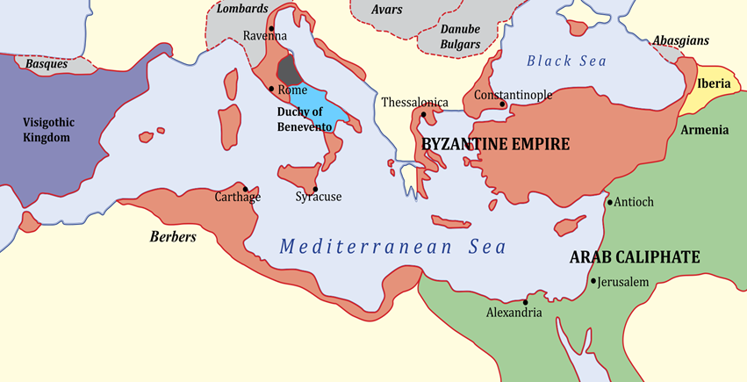
Europe c.a. 700 AD

Slide 29
Counsels and Edicts against the Covenant Verses 28-31
28 And he shall return to his land with great wealth, but his heart shall be set against the holy covenant. And he shall work his will and return to his own land.
29 At the time appointed he shall return and come into the south, but it shall not be this time as it was before.
30 For ships of Kittim shall come against him, and he shall be afraid and withdraw, and shall turn back and be enraged and take action against the holy covenant. He shall turn back and pay attention to those who forsake the holy covenant.
31 Forces from him shall appear and profane the temple and fortress, and shall take away the regular (Daily/Continual) burnt offering. And they shall set up the abomination that makes desolate.

Slide 30
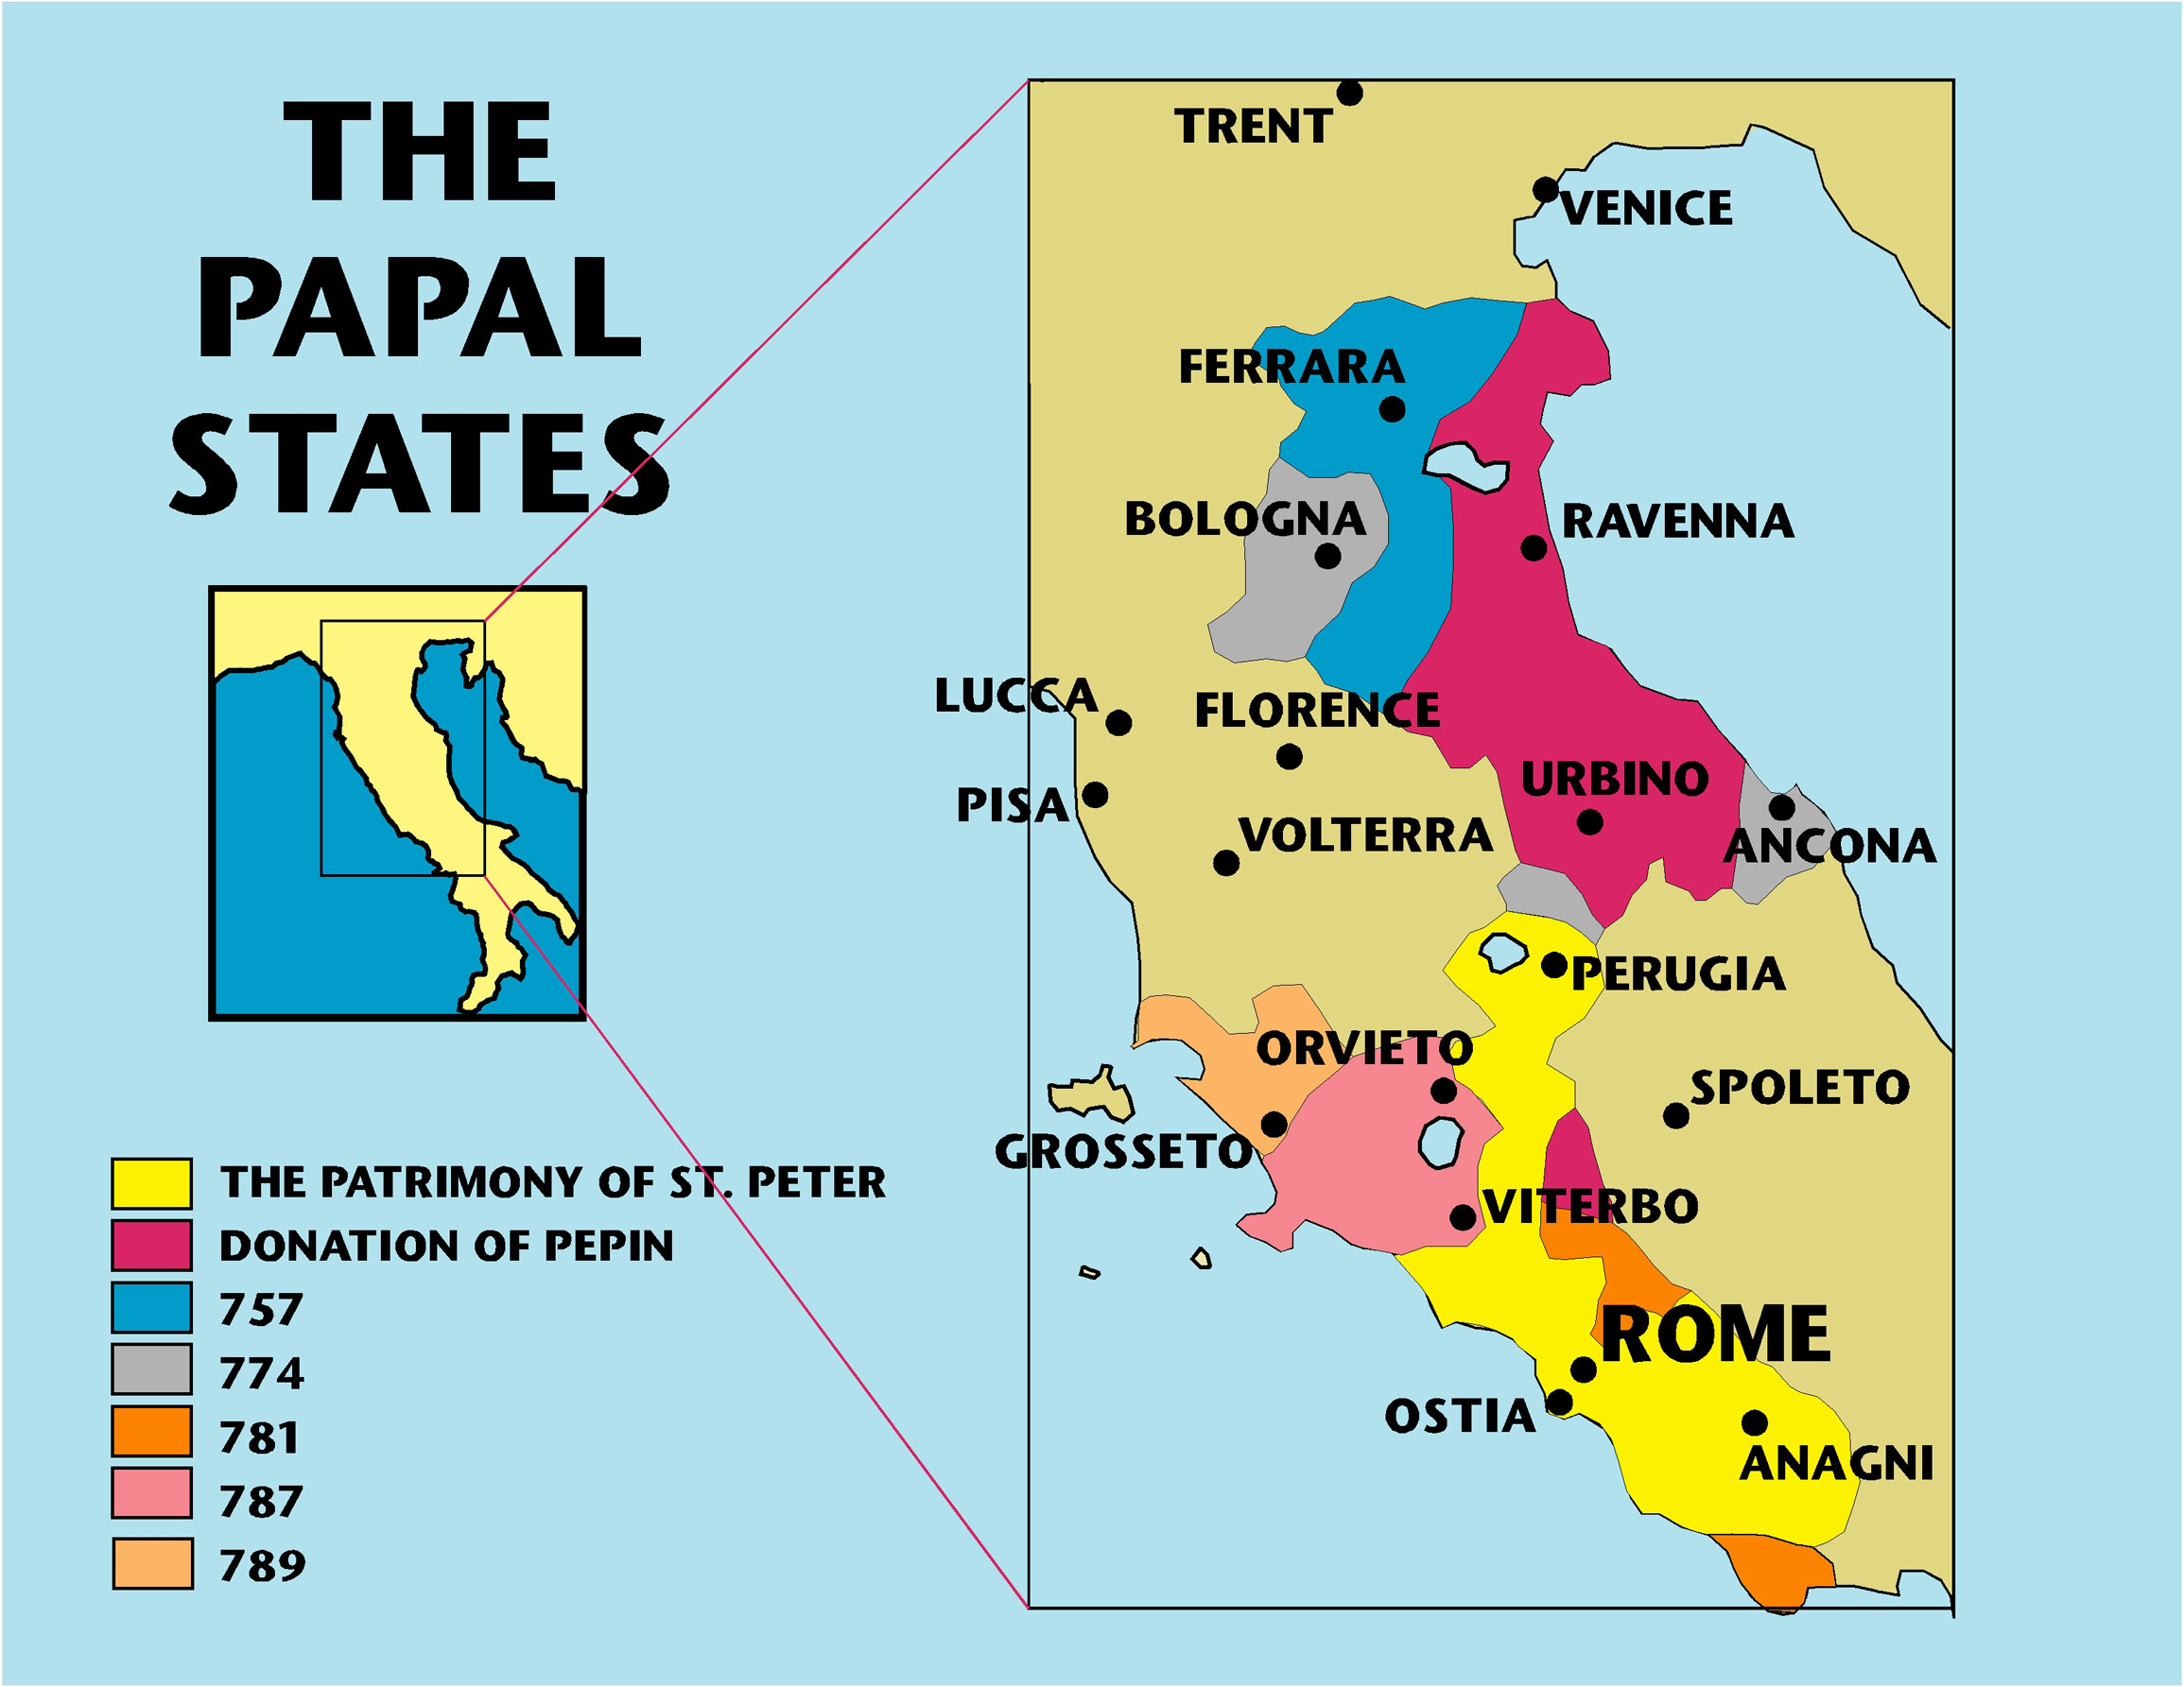
Counsels and Edicts against the Covenant Verse 28
28 And he shall return to his land with great wealth, but his heart shall be set against the holy covenant. And he shall work his will and return to his own land.
After 756 and the establishment of the Papal States territories in the majority of the Italian Peninsula gave direct temporal sovereign rule to the Pope.
Nicea II, 7th Ecumenical Council 787 AD. Sanctioned the veneration of images
The 21 Ecumenical Councils by KARL KEATING

Slide 31
Counsels and Edicts against the Covenant Verse 29
29 “At the time appointed he shall return and come into the south, but it shall not be this time as it was before.
The pope as KON with his Frankish armies went on the offensive against Constantinople, the KOS again. Charlemagne with sizable force attacked the Byzantine peripheral states of Venice and the Dalmatian coast. The Byzantines were not in a position to send a force to their aid. Additionally, the pope refused to acknowledge Irene as Byzantine Emperor in 797.
In 812, a peace treaty was finally signed between Charlemagne and Byzantine emperor Michael I where the Byzantine Empire would accept Charlemagne as “King of the Franks,” and Charlemagne would give back the Dalmatian coast region.
The Treaty of Aachen, AD 812: The Origins and Impact on the Region between the Adriatic, Central, and Southeastern Europe
Charlemagne and Ravenna Chapter, by Jinty Nelson

Slide 32
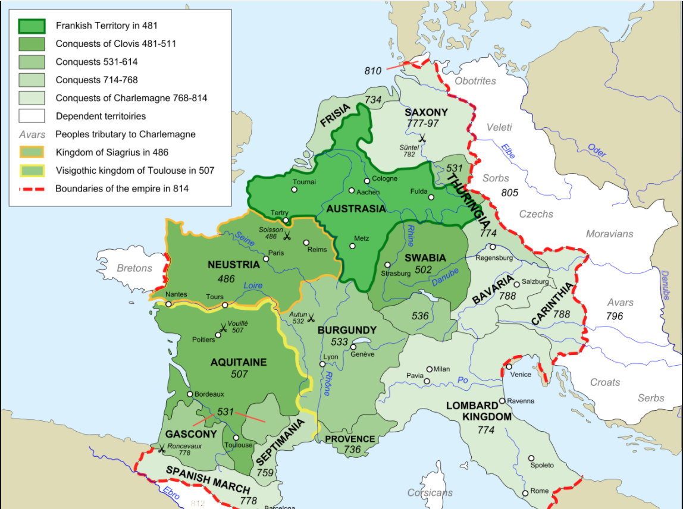
Europe 814 AD

Slide 33
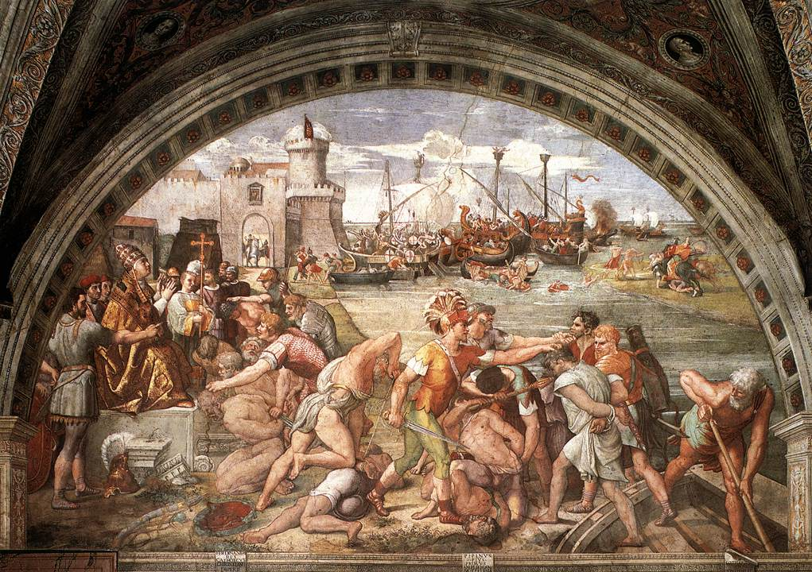
Counsels and Edicts against the Covenant Verse 30
30 For ships of Kittim shall come against him, and he shall be afraid and withdraw, and shall turn back and be enraged and take action against the holy covenant. He shall turn back and pay attention to those who forsake the holy covenant.
Out of their Mediterranean Sea bases, Arab pirate raiders sacked Rome in 843, which caused the Papacy to withdraw and form the Italian League of Papal, Neapolitan, Amalfitan, and Gaetan ships to fend off the Arab pirates and winning the famous naval Battle of Ostia in 849.
Papal Walls in Rome

Slide 34
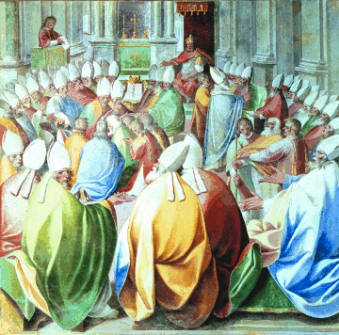
Counsels and Edicts against the Covenant Verse 30
30 For ships of Kittim shall come against him, and he shall be afraid and withdraw, and shall turn back and be enraged and take action against the holy covenant. He shall turn back and pay attention to those who forsake the holy covenant.
In 870, at the Fourth Council of Constantinople, the Covenant was again attacked with the sanctioning idolatry and veneration of Mary. Reaffirmed the image of Christ to have veneration equal with that of the Bible.
The 21 Ecumenical Councils by KARL KEATING

Slide 35
Counsels and Edicts against the Covenant Verse 31
31 Forces from him shall appear and profane the temple and fortress, and shall take away the regular burnt offering. And they shall set up the abomination that makes desolate.
At this point in time, the Papacy held all ecclesiastical authority in the Western Church. The pope’s “forces” included the temporal powers in Europe, with the increased focus of the inquisition beginning in the 1250s, and later with the Jesuit Order beginning in 1540.
The Beginning at Orleans in 1022: Heretics and Hellfire
At the Fourth Council of Lateran in 1215, it was ordered that parishioners must keep the annual reception of penance and the Eucharist. They also used the term “transubstantiation” to explain the Real Presence of Christ in the Eucharist. Through the Eucharist and the Sacraments, the Catholic church has removed the Daily/Continual sanctuary ministries of lay members. Congregants no longer study the Bible for themselves, pray directly to God, or witness to their neighbors.

Slide 36
Counsels and Edicts against the Covenant Verse 31
31 Forces from him shall appear and profane the temple and fortress, and shall take away the regular burnt offering. And they shall set up the abomination that makes desolate.
High Priest (Mediator): Represents Jesus (Hebrews 8:1)
• Transgressed through confession to church priests
Alter of Sacrifice: Represents Jesus substitutionary death on the cross (John 1:29)
• Transgressed through the Mass where the wine and bread become the literal body and blood of Jesus who is sacrificed every Sunday.
Laver: Represents Baptism by emersion symbolizing the death, burial and resurrection of Jesus (Romans 6:3)
• Transgressed through sprinkling and infant baptism.

Slide 37
Counsels and Edicts against the Covenant Verse 31
31 Forces from him shall appear and profane the temple and fortress, and shall take away the regular burnt offering. And they shall set up the abomination that makes desolate.
Lampstand: Represents Holy Spirit who interprets the Bible and convicts of sin (Rev. 4:5)
• Transgressed through tradition and ecclesiastical counsels interpret scripture
Table of Showbread: Represents the Father and the Son seated on the thrown and who are the bread of life (John 6:35; Matt 4:4)
• Transgressed through the Pope claiming to be God on earth and Mary as the mother of God
Alter of Incense: Represents Prayers of the saints mingled with Jesus prayers (Rev 8:4)
• Transgressed through prayers to Mary and the Saints

Slide 38
Counsels and Edicts against the Covenant Verse 31
31 Forces from him shall appear and profane the temple and fortress, and shall take away the regular burnt offering. And they shall set up the abomination that makes desolate.
Ark of the Covenant with the Ten Commandments: Represents God’s Character (James 1:23, 25)
• Transgressed through:
changing the 4th from Sabbath to Sunday,
removing the 2nd prohibiting the worship of idols,
splitting the 10th into two in order to preserve the “10” number of commandments

Slide 39
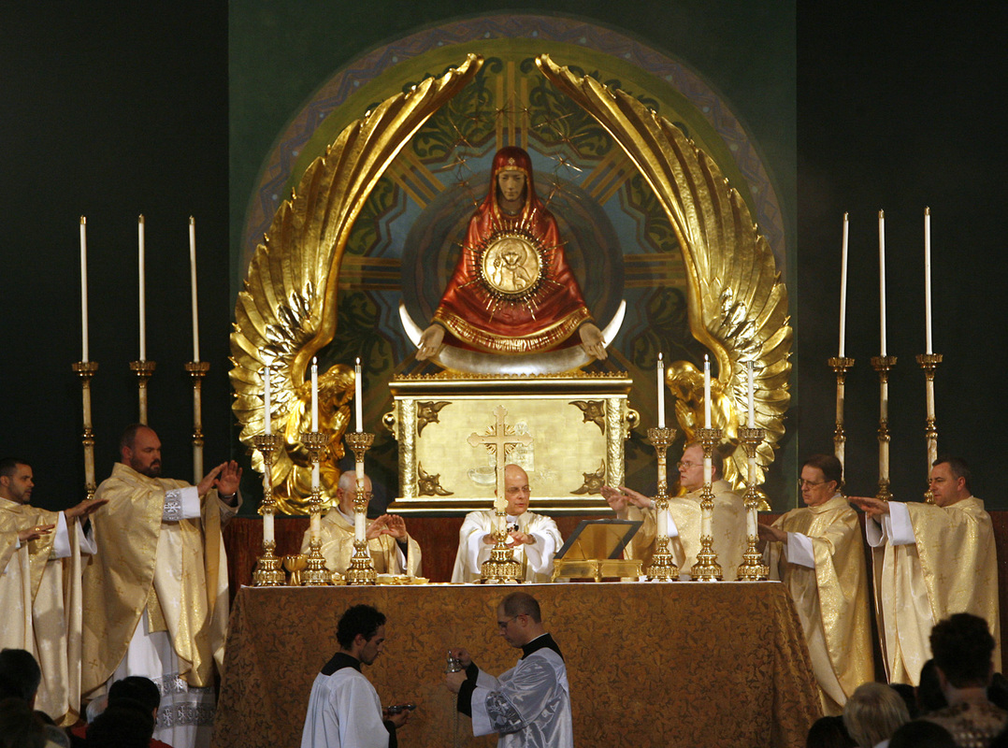
Counsels and Edicts against the Covenant Verse 31
31 Forces from him shall appear and profane the temple and fortress, and shall take away the regular burnt offering. And they shall set up the abomination that makes desolate.
In 70 AD, the Imperial Roman flags or standards were set up in the temple.
In1215 AD with the sanctions of its counsels, the Papacy was in direct contradiction to the teachings of the Apostles and of Scripture especially in the areas of the sanctuary which set up the Papal Roman abomination of desolation.

Slide 40
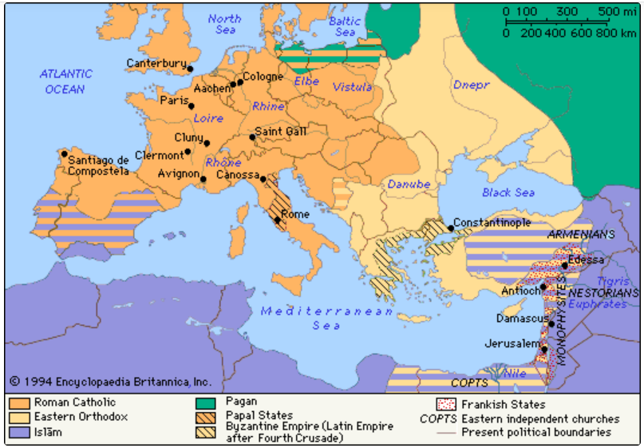
Counsels and Edicts against the Covenant Catholicism in Medieval Europe

Slide 41
Protestant Reformation Verses 32-35
32 He shall seduce with flattery those who violate the covenant, but the people who know their God shall stand firm and take action.
33 And the wise among the people shall make many understand, though for some days they shall stumble by sword and flame, by captivity and plunder.
34 When they stumble, they shall receive a little help(Muslim Invasion into Europe?). And many shall join themselves to them with flattery,
35 and some of the wise shall stumble, so that they may be refined, purified, and made white, until the time of the end, for it still awaits the appointed time.

Slide 42
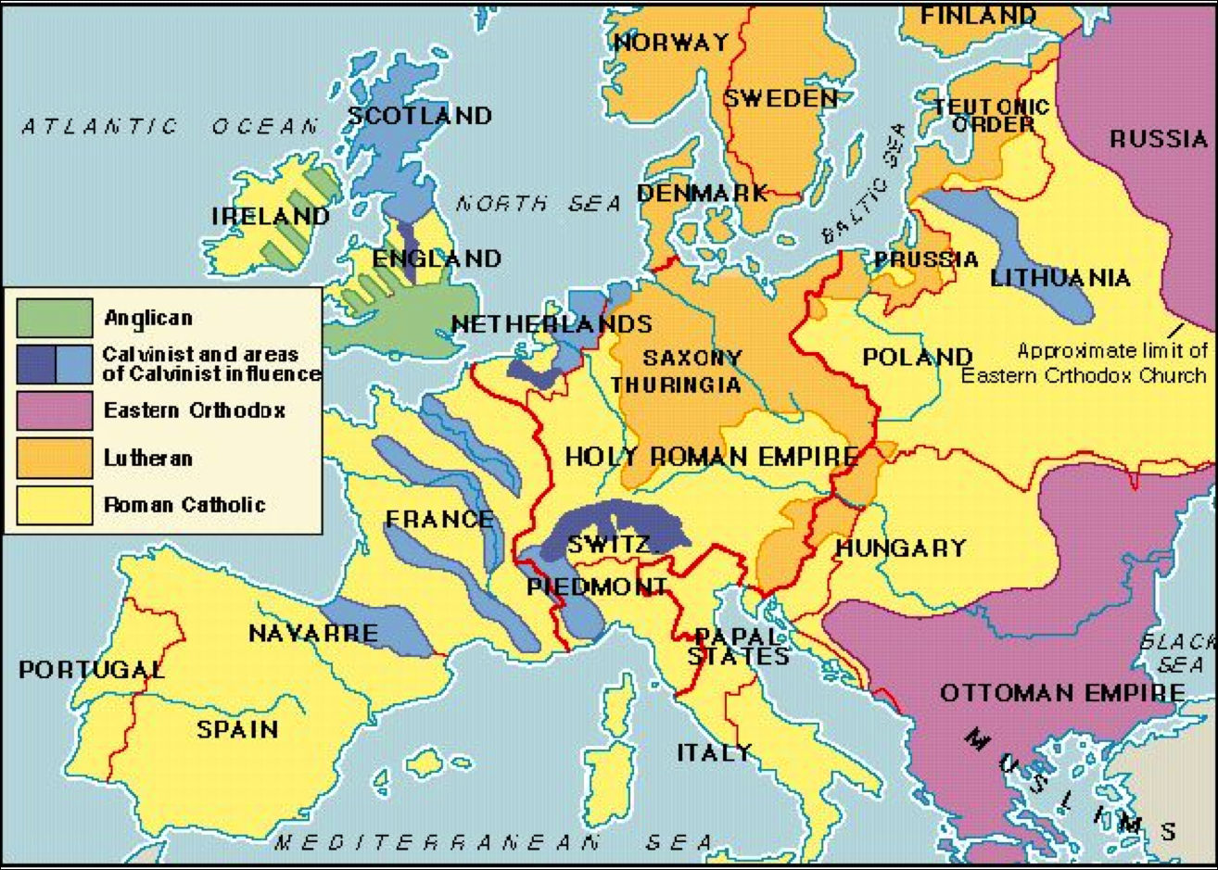
Protestant Reformation Christianity in Europe c.a. 1600

Slide 43
Full Power and Force of Papal Rome Verses 36-39
36 “And the king shall do as he wills. He shall exalt himself and magnify himself above every god, and shall speak astonishing things against the God of gods. He shall prosper till the indignation is accomplished; for what is decreed shall be done (until 1798?).
37 He shall pay no attention to the gods of his fathers, or to the one beloved by women. He shall not pay attention to any other god, for he shall magnify himself above all.
38 He shall honor the god of fortresses instead of these. A god whom his fathers did not know he shall honor with gold and silver, with precious stones and costly gifts.
39 He shall deal with the strongest fortresses with the help of a foreign god. Those who acknowledge him he shall load with honor. He shall make them rulers over many and shall divide the land for a price.

Slide 44
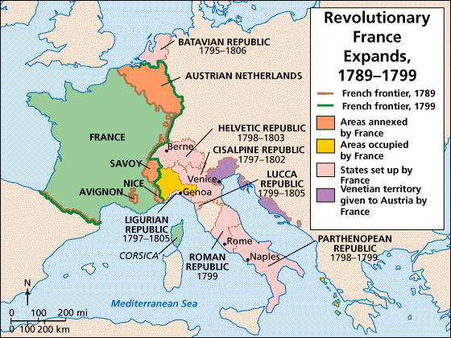
Beginning of the End-Time Divided Kingdoms Italy 1789-1875

Slide 45
Summary Of Medieval Divided Kingdom Period Verses 23-39
Details The Final Destruction Of Arian Ostrogoths and Heruli Kingdoms had to be Uprooted Before The Papacy Could Gain Power
Points out the Church Schisms between the East and West
Explains How The Daily Sanctuary Ministry Was Taken Away

Slide 46
Part 3: Corroborations and Implications
Greek Hellenistic Period and Medieval Divided Kingdom Period
Time Prophecies in Daniel
Daniel 11 and Spirit of Prophecy
Pagan Rome and the Medieval Divided Kingdom Period and Revelation
Michael verses Satan in Daniel and Revelation 12

Slide 47
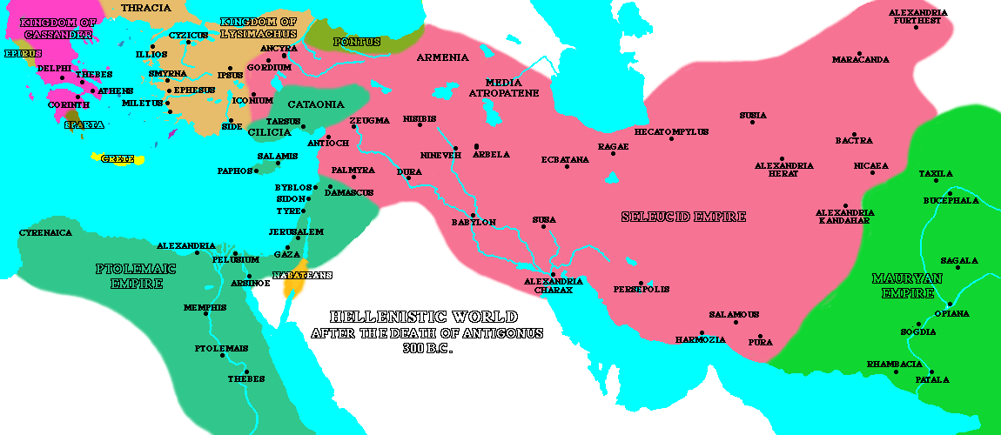
Greek Hellenistic Period and Medieval Divided Kingdom Period
Alexander the Great
Aeacides of Epirus ended 313 BC
Cassander ended 294 BC
Lysimachus ended 281 BC
KOS Ptolemy ended 188 BC
KON Seleucus ended 168 BC

Slide 48
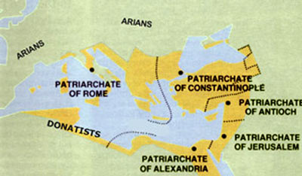
Greek Hellenistic Period and Medieval Divided Kingdom Period
Constantine the Great
Jerusalem ended 637
Antioch ended 637
Alexandria ended 641
KOS Constantinople ended 1453
KON Rome ended 1798

Slide 49
Time Prophecies in Daniel “Time, times, and ½ a times” - Daniel 7 &12
Literal Historical Event
This began in 538 when the Papacy had all three elements to rule Christendom:
1) a temporal power arm (508 Frankish kingdom),
2)authority (533 the letter from the Emperor), and 3)domination to operate from (538 the defeat of the Ostrogoths from Rome).
It ended in 1798 when the French Directory ordered General Berthier to capture and exile the pope removing his temporal authority.
Event Prophecy text
Daniel 7:24 “As for the ten horns, out of this kingdom ten kings shall arise, and another shall arise after them”
Daniel 7:26 “But the court shall sit in judgment, and his dominion shall be taken away, to be consumed and destroyed to the end.”

Slide 50
Time Prophecies in Daniel “70 Weeks” - Daniel 9
Literal Historical Event
Our starting point is the decree Artaxerxes decree in 457 BC.
Jesus started His earthly ministry in week 70, which was AD 27 at His baptism. In the middle of the week, AD 31, He was crucified and ended the sacrificial service. Then in AD 34, at the end of the week, after Stephan’s defense before the Jewish Sanhedrin, he was stoned and the 70-week probationary period for the Jews closed.
Event Prophecy Text
Daniel 9:25 “Know therefore and understand that from the going out of the word to restore and build Jerusalem to the coming of an anointed one, a prince, there shall be seven weeks. Then for sixty-two weeks it shall be built again with squares and moat, but in a troubled time.”

Slide 51
Time Prophecies in Daniel “2300 Days” - Daniel 8
Event Prophecy Text
Daniel 8:14 “And he said to me, ‘For 2,300 evenings and mornings. Then the sanctuary shall be restored to its rightful state.’”
Daniel 9:25 “Know therefore and understand that from the going out of the word to restore and build Jerusalem to the coming of an anointed one, a prince, there shall be seven weeks. Then for sixty-two weeks it shall be built again with squares and moat, but in a troubled time.”
Literal Historical Event
This is the heavenly Day of Atonement which began 2,300 years from the Decree of Artaxerxes in 457 BC. In 1844, Jesus, our High Priest, entered the Most Holy Place in Heaven.

Slide 52
Time Prophecies in Daniel 1290 Days & 1335 Days - Daniel 12
Literal Historical Event
From 508 to 1798 (1290 years) the French had an alliance with the papacy and never wavered in the use of the Sword against non-Catholics.
---------------
From 508 to 1843 (1335years) The Papacy trampled Down and Obscured the true Sanctuary Ministry
Event Prophecy Text
?

Slide 53
Time Prophecies in Daniel 1290 Days & 1335 Days - Daniel 12
Literal Historical Event
From 508 to 1798 (1290 years) the French had an alliance with the papacy and never wavered in the use of the Sword against non-Catholics.
---------------
From 508 to 1843 (1335years) The Papacy trampled Down and Obscured the true Sanctuary Ministry
Event Prophecy Text
Daniel 11:23 “And from the time that an alliance is made with him he shall act deceitfully, and he shall become strong with a small people.”

Slide 54
Daniel 11 and Spirit of Prophecy
Manuscript Releases Vol. 13: We have no time to lose. Troublous times are before us. The world is stirred with the spirit of war. Soon the scenes of trouble spoken of in the prophecies will take place. The prophecy in the eleventh of Daniel has nearly reached its complete fulfillment. Much of the history that has taken place in fulfillment of this prophecy will be repeated. In the thirtieth verse a power is spoken of that “shall be grieved, and return, and have indignation against the holy covenant: so shall he do; he shall even return, and have intelligence with them that forsake the holy covenant.” [Verses 31-36, quoted.] (13MR394).
While the French were converted and the alliance was formed in 508AD, this text could not be fulfilled until France was strong enough to use the sword for the Papacy after 800AD and continuing during the Protestan Reformation.

Slide 55
Daniel 11 and Spirit of Prophecy
Fri, Jun 19, 2020 at 2:26 AM <Plouden@dtccom.net> wrote:
Hello,
Could you tell me if Mrs. White ever referenced the Battle of Actium or the Cleopatra, Mark Anthony, Octavian affair? I have search online but haven’t found anything.
Thank you,
Perry Louden
From : White Estate Mail <mail@whiteestate.org>
Subject : Re: EGW References on Actium
To : Perry Louden <Plouden@dtccom.net>
Fri, Jun 19, 2020 04:57 PM
Dear Brother Louden,
Thank you for contacting the Ellen G. White Estate. I did the same searches that you did, and I got the same results that you did. I am not aware of Ellen White's having written specifically about the people or events you mentioned. Sorry! Thank you for getting in touch, and God bless!
William Fagal
Associate Director (Retired)
Ellen G. White Estate

Slide 56
Daniel 11 and Spirit of Prophecy
Chapter 1 —The Destruction of Jerusalem
Verse 22 (Destruction of the Temple)
Chapter 2—Persecution in the First Centuries
Chapter 3—An Era of Spiritual Darkness
Verses 36-39 (Full Power and Authority of the Papacy)
Verses 23-31 (Establishment of the Roman Church-State System)
Chapter 4-14 Chapter 4—The Waldenses, John Wycliffe, Huss and Jerome, Luther's Separation From Rome, Luther Before the Diet, The Swiss Reformer, Progress of Reform in Germany, Protest of the Princes, The French Reformation, The Netherlands and Scandinavia, Later English Reformers
Verses 32-35 (Protestant Reformation)
Chapter 15—The Bible and the French Revolution
Verse 40
Chapter 35 —Liberty of Conscience Threatened
Verse 41
Chapter 36—The Impending Conflict
Verse 42
Chapter 37—The Scriptures a Safeguard
Verse 43
Chapter 38—The Final Warning
Verse 44
Chapter 39—The Time of Trouble
Verse 45
Chapter 40—God's People Delivered
Verse 12:1

Slide 57
Daniel 11 and Spirit of Prophecy
In sum, Mrs. White does not reference or endorse the predominant interpretation of her time, or any of the interpretational views extending Imperial Rome from verse 23 to verse 29. Even so, she also did not openly endorse the proposed interpretation of verses 23-29, nevertheless what she does encourage is more and deeper study into Daniel 11. Nothing in this new proposal contradicts the Spirit of Prophecy, and the interpretation of this proposal matches the sections in the Great Controversy regarding the rise of the Papacy, the full power and control of Rome, and the Protestant Reformation.

Slide 58
Daniel 11 and Spirit of Prophecy
Thu, Jul 2, 2020 at 6:47 PM <plouden@dtccom.net> wrote:
Yes! I got it and will make those changes and besides those, I didn't see any indication from you that my proposal was heretical. I do have a publishing agreement with TEACH Services who should proofread it well (I can't see my own mistakes). Thanks again for you your help and if you send me your mailing address, I will send you a copy.
Blessings!
Perry
From : White Estate Mail <mail@whiteestate.org>
Subject : Re: Mrs. White and Daniel 11
To : Perry Louden <plouden@dtccom.net>
Fri, Jul 03, 2020 06:41 PM
Glad you found what I had sent earlier. I didn't find your proposal heretical. I would be interested in receiving a copy of the book when it is published. As you know, I have retired in Berrien Springs. My mailing address is 3106 Willo Dr., Berrien Springs, MI 49103. Thank you for your kindness!
WF

Slide 59
Pagan Rome and the Medieval Divided Kingdom Period and Revelation
Daniel 11:20-22 (4BC-476AD)
Woman gives Birth in Rev 12
Throne Room Scene in Rev 4
Churches of Ephesus, Smyrna, Pergamum
Seals #s 1,2,3
Trumpets 1,2,3,4 (U. Smith)
Daniel 11:23-39 (508- 1798)
Church of Thyatira and Sardis
Seals #s 4,5
Trumpets #s 5,6
Two Witnesses

Slide 60
End-Time Divided Kingdom Period and Revelation
Daniel 11:40-45 (1798-Probation)
Churches of Philadelphia and Laodicea
6th Trumpet with four Horns of the Altar
5th Seal with Saints Blood under the Altar
Sea and Land Beasts in Rev 13
Dragon makes War in Rev 12:17
3 Angels Massage
Angel of Rev 18 (two-minute Warning)
Daniel 12:1-2 (Probation to 2nd Coming)
6th and 7th Seal
7th Trumpet
144,000 Sealed
Harvest of the Earth in Rev 14
Seven Last Plagues
Fall of Babylon
Rider on the White Horse of Rev 19
Marriage Supper of the Lamb

Slide 61
Michael verses Satan in Daniel and Revelation 12
Daniel 10
1b And the word was true, and it was a great conflict.
13 The prince of the kingdom of Persia withstood me twenty-one days, but Michael, one of the chief princes, came to help me, for I was left there with the kings of Persia, 14 and came to make you understand what is to happen to your people in the latter days. For the vision is for days yet to come.”
20b But now I will return to fight against the prince of Persia; and when I go out, behold, the prince of Greece will come. 21 But I will tell you what is inscribed in the book of truth: there is none who contends by my side against these except Michael, your prince.

Slide 62
Michael verses Satan in Daniel and Revelation 12
Revelation 12
War in Heaven
3 And another sign appeared in heaven: behold, a great red dragon, with seven heads and ten horns (Dan 7:7,20,24) and on his heads seven diadems.
7 Now war arose in heaven, Michael (Dan 10:13,21; 12:1) and his angels fighting against the dragon. And the dragon and his angels fought back,
8 but he was defeated, and there was no longer any place for them in heaven.
4a His tail swept down a third of the stars of heaven and cast them to the earth (Dan 8:10).
10 And I heard a loud voice in heaven, saying, “Now the salvation and the power and the kingdom of our God and the authority of his Christ have come, for the accuser of our brothers has been thrown down, who accuses them day and night before our God.

Slide 63
Michael verses Satan in Daniel and Revelation 12
Pegan Roman Period
1 And a great sign appeared in heaven: a woman clothed with the sun, with the moon under her feet, and on her head a crown of twelve stars (Dan 12:3).
2 She was pregnant and was crying out in birth pains and the agony of giving birth.
4b And the dragon stood before the woman who was about to give birth, so that when she bore her child he might devour it.
5a,c She gave birth to a male child, but her child was caught up to God and to his throne,

Slide 64
Michael verses Satan in Daniel and Revelation 12
Medieval Divided Kingdoms Period
13 And when the dragon saw that he had been thrown down to the earth, he pursued the woman who had given birth to the male child.
14 But the woman was given the two wings of the great eagle so that she might fly from the serpent into the wilderness, to the place where she is to be nourished for a time, and times, and half a time (Dan 7:25; 12:7).
6 and the woman fled into the wilderness, where she has a place prepared by God, in which she is to be nourished for 1,260 days.
15 The serpent poured water like a river out of his mouth after the woman, to sweep her away with a flood.
16 But the earth came to the help of the woman, and the earth opened its mouth and swallowed the river that the dragon had poured from his mouth.
11 And they have conquered him by the blood of the Lamb and by the word of their testimony, for they loved not their lives even unto death.

Slide 65
Michael verses Satan in Daniel and Revelation 12
End-Time Divided Kingdoms
12 Therefore, rejoice, O heavens and you who dwell in them! But woe to you, O earth and sea, for the devil has come down to you in great wrath, because he knows that his time is short!”
17 Then the dragon became furious (Dan 11:44) with the woman and went off to make war on the rest of her offspring, on those who keep the commandments of God and hold to the testimony of Jesus.
5b one who is to rule all the nations with a rod of iron (Dan 2:44).

Slide 66
Summary of Corroboration & Support
Gives A Reference Event Prophecy Text For The 1290 And 1335
Explains How The Daily Sanctuary Ministry Was Taken Away
Fits With The Spirit Of Prophecy Outlined In The Great Controversy
Provides a Clear Framework for Prophetic Elements from Revelation

Slide 67
Medieval Divided Kingdoms Period in Daniel 11:23-39
Questions?

