Slide 1
The King of the North Planted in Jerusalem
Daniel 11:40-45
Presented by
Karla K. Wagner
at the
2018 Daniel 11 Conference
Village Seventh-day Adventist Church
Berrien Springs, MI
Notes:
Good morning. Today I'll be going over with you an interpretation of Daniel 11, verses 40-45.
Before we get into the actual verses of this passage, I’ll go over the thought process that we use to identity the King of the North and the King of the South. There are 4 steps in the process.
*****

Slide 2
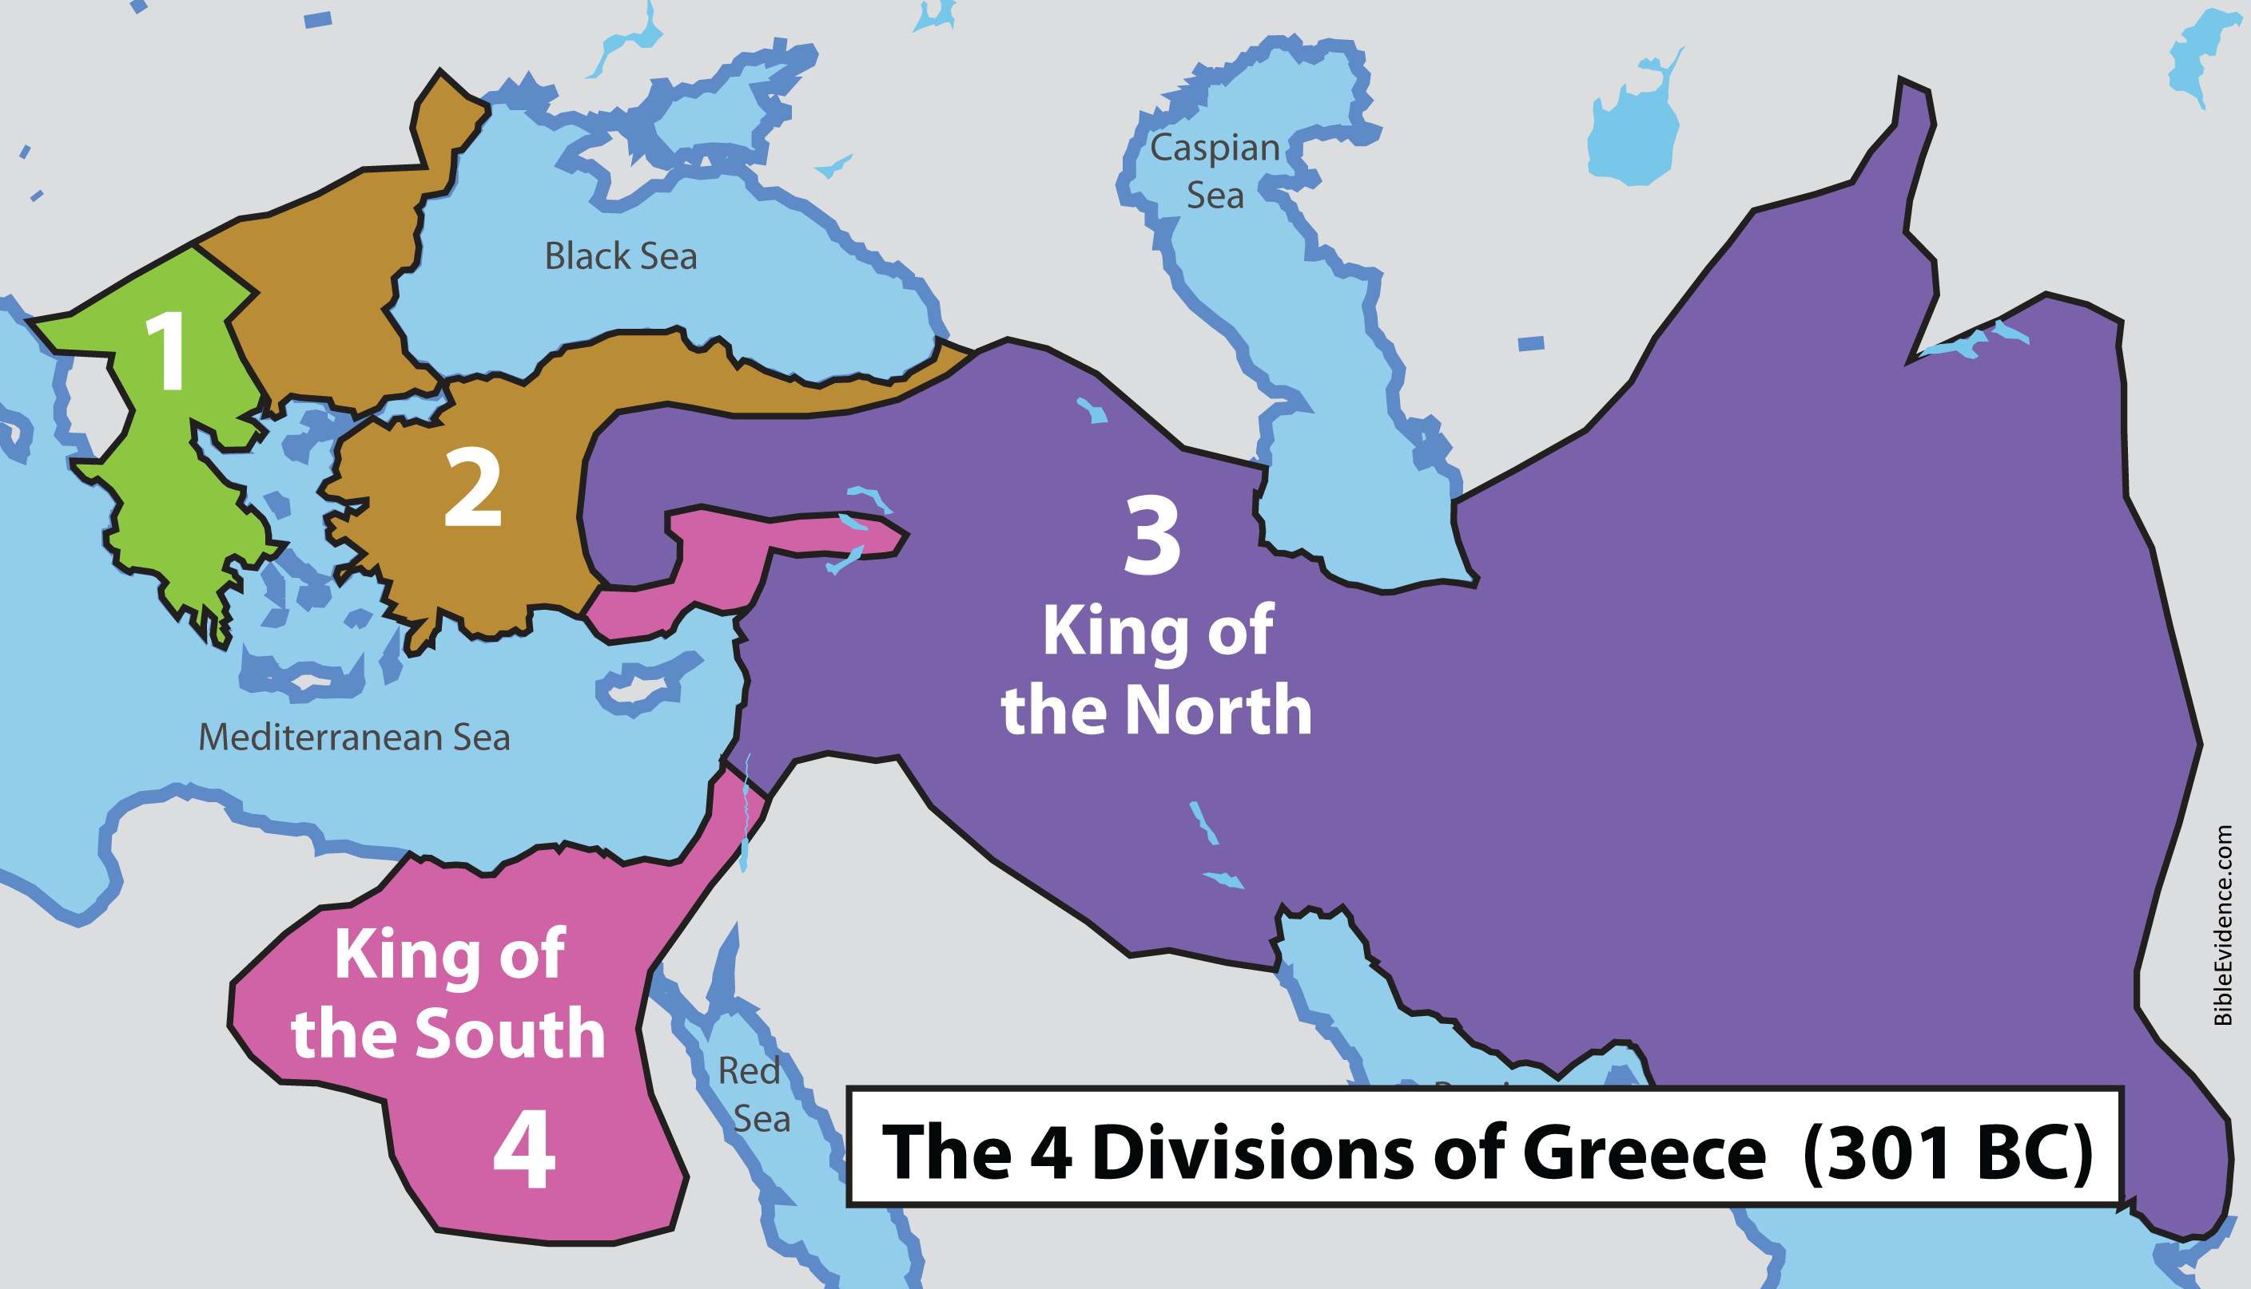
STEP #1: Determine the realm in power
Both the KON and KOS are part of the same realm.
Notes:
The first step is to determine the realm in power. In Daniel 11:3-16, it describes Greece dividing into four divisions of political power. Two of the divisions engage in a series of wars with each other and are named the KON and KOS. Though there are four separate powers or divisions, Daniel's prophecies still treat them as all belonging to the single realm of Greece. Remember that the leopard, in Daniel 7, had four heads to symbolize this division of Greece, but the heads were on one beast, symbolizing one realm. It was the same way with the goat in Daniel 8 that grew four horns.
[CLICK] This establishes a precedent to be used throughout the chapter: The KON and the KOS both belong to the same realm. They are the two main opposing political powers that war against each other within the same realm, generally positioned north and south of each other. Since both kings are from the SAME realm, it is critical that we know what realm is in power, during the time of the end in verses 40-45, and we have to know its territory and what it looks like politically, in order to properly identify the kings.
Of course, we know from Daniel’s previous prophecies, that during the time of the end, the realm in power is Rome. So as we move forward, we can expect both the KON and KOS to arise from within the Roman realm.
*****

Slide 3
STEP #2: Determine what the realm looks like
Rome (the 4th Realm)
168 BC
West
East
285 AD
486 AD
English
Italians
French
Swiss
Spanish
Vandals
Portuguese
Ostrogoths
1798 AD
Germans
Heruli
Notes:
Step #2 is to determine what the realm looks like.
In 285 AD Rome divided into two halves, east and west. Over the next several hundred years, the eastern half became an entirely separate entity, becoming the Byzantine Empire. Prophecy treats the Roman realm as continuing in the western half.
[CLICK] In 486 AD, the last place of imperial Roman rule in the west collapsed, leaving 10 tribes or kingdoms and Rome became a divided realm. Though divided, the tribes have characteristics that tie them together, and the Bible treats them as one prophetic unit or realm.
[CLICK] Three of the 10 Tribes disappeared due to the influence of a little horn, which would operate for 1260 years. After that, if we look at the Roman realm in 1798, the time of the end, what we see are 7 remaining tribes, and they continue until the 2nd coming.
*****

Slide 4
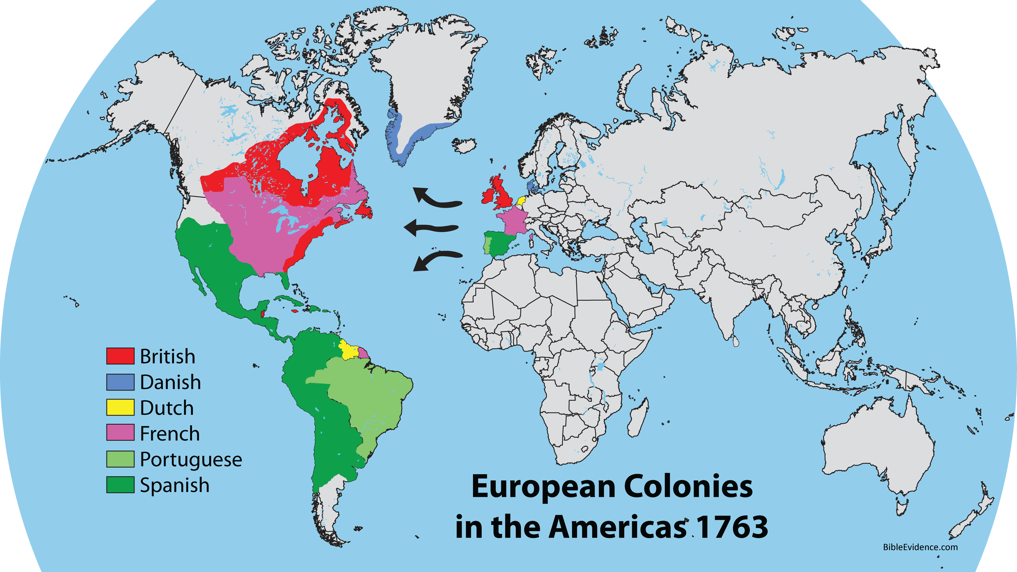
Notes:
If we look at the territory of the Roman realm, of course the 7 tribes were in western Europe. But, during the 1700s, they dramatically expanded their territory into the new world. They considered the American colonies an extension of their homeland.
If we look at the United States specifically, though people of various nations immigrated to the USA, it was the English (tribe) that provided by far the largest number of immigrants. Also, after the British gained the claims of the French and Swiss, the British ruled the land. The USA took on the English language, customs and laws, and continued as a predominantly English country after gaining its independence from Britain.
*****

Slide 5
STEP #3: Determine the 2 main opposing forces
GREECE
ROME
4 Horns
10 Horns
KON
Seleucus (Asia)
Lysimachus (Thrace)
English
Portuguese
Seleucus (Asia)
French
Heruli
Spanish
Vandals
Cassander (Macedonia)
Ptolemy (Egypt)
Italians
Ostrogoths
KOS
Swiss
Germans
Ptolemy (Egypt)
Notes:
So, with an understanding of what the Roman realm looks like, we can now move on to step #3, which is to determine the two main opposing forces within the realm.
[CLICK] The 4 divisions of Greece are symbolized by horns in Daniel 8. You can see the divisions up on the screen
[CLICK] The 10 divisions of ROME are symbolized by HORNS in Daniel 7. And you can see those 10 divisions on the screen.
[CLICK] During the time of Greece, the KON and the KOS arise out of the divisions Greece.
In like manner, during the time of the end, the KON and KOS arise out of the divisions of Rome.
[CLICK] This precedent set by Greece, means that the two main opposing forces in verses 40-45 will be two of the 7 remaining tribes of divided Rome.
*****

Slide 6
STEP #3: Determine the 2 main opposing forces
GREECE
ROME
4 Horns
10 Horns
KON
KON
English
Seleucus (Asia)
Lysimachus (Thrace)
English
Portuguese
French
Heruli
Spanish
Vandals
Cassander (Macedonia)
Italians
Ostrogoths
KOS
Swiss
Germans
KOS
Ptolemy (Egypt)
Germans
Notes:
So, according to these verses, we can expect two major western European powers, which would be 2 of the 7 remaining tribes of Rome, to engage in a history-making war against each other and that it will involve significant battles in the Middle East.
[CLICK] We can look in history to see when or if this happened. And we see it precisely fulfilled in World War I and II, in which the two main opposing powers were the English tribe (the British Empire) along with its allies, fighting against the German tribe ( the German Empire), and its allies.
Throughout Daniel 11, the most significant wars of the era are described, so this is not surprising here, that the most significant wars of OUR era are also going to be described.
*****

Slide 7
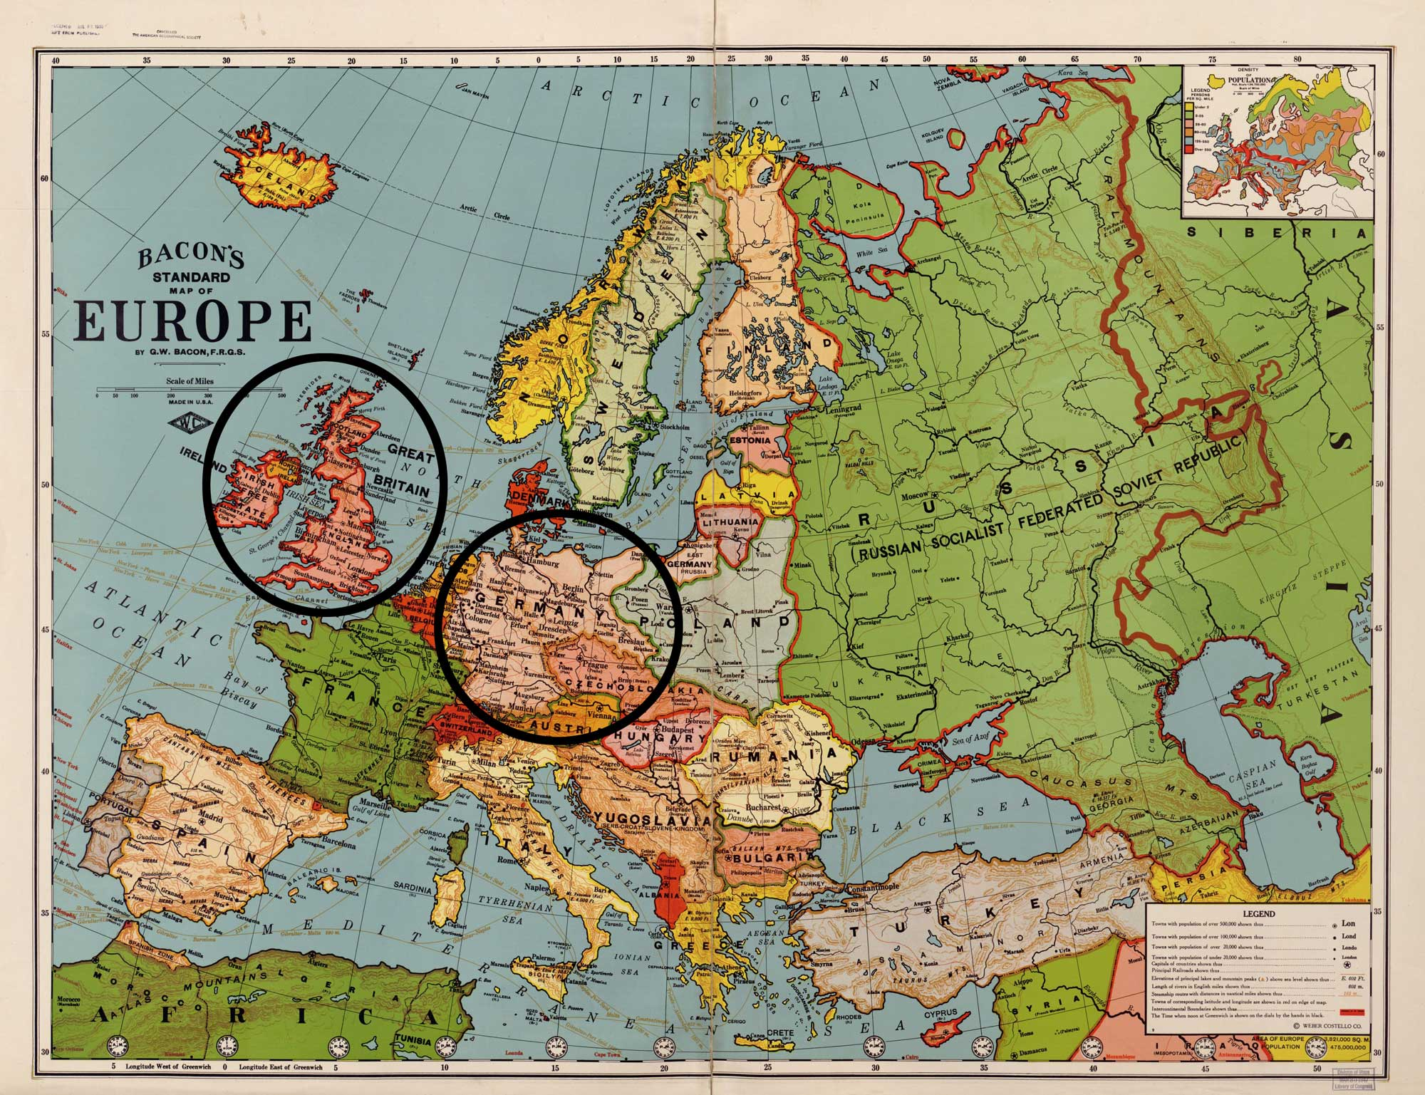
STEP #4: Determine who is north and south
King of the North: English Tribe
King of the South: German Tribe
Notes:
All that remains is step #4, determine who is north and who is south.
When the angel is describing the events in Daniel 11 and refers to the south, north, east or west, he is looking at them from a certain location or reference point. This interpretation sees that reference point, not from the perspective and location of Israel, but from the perspective of the realm, the location of the kings themselves.
[CLICK] As seen during the time of Greece, the king generally located further north of the other is the KON, and the king further south of the other is the KOS.
When looking at a map during the time of Rome, Britain is more north of Germany, and Germany is more south of Britain.
So now we have the identity of the two kings, and we will proceed to look at the actual Bible verses and their fulfillment. I’ll just do a brief summary, but you can look at the online document for more details on each verse.
*****

Slide 8
Daniel 11:40
“And at the time of the end | Between 1798 and the 2nd Coming
shall the king of the south | Germany / German tribe/horn
push | Invasions by Germany and its allies in World War I
at him: | Britain / English tribe/horn
Notes:
If you’d like to follow along in your Bible, we’ll start in Daniel 11, verse 40: “And at the time of the end shall the king of the south push at him:”
In other words, between 1798 and the 2nd coming, the German Tribe or horn (and its allies), invades and wars against, the English Tribe or horn (and its allies).
In 1914, World War I broke out. It began with Austria-Hungary declaring war on Serbia and Germany declaring war on Russia. Then Germany invaded Luxembourg, France and Belgium, which pulled Britain into the war.
At the same time, the Ottomans, who ruled much of the Middle East and North Africa, entered into an agreement with Germany, and the caliphate later declared Jihad against the Allied Powers.
*****

Slide 9
Daniel 11:40
and the king of the north shall come against him like a whirlwind, | The English-led allies respond like a fearful storm
with chariots, | Horse-drawn carts
and with horsemen, | Cavalry forces
and with many ships; | Britain’s navy
and he shall enter into the countries, and shall overflow and pass over.” | Allied armies swept through Central Powers’ countries like a flood
Notes:
Continuing in verse 40: “…and the king of the north shall come against him like a whirlwind, with chariots, and with horsemen, and with many ships; and he shall enter into the countries, and shall overflow and pass over.”
The Allies responded like a fearful storm. They engaged militarily in various countries, completely covering the areas and sweeping through like a flood.
Horses were used extensively, even as technology advanced, and the dominance of the British navy, with its many ships, was key to victory.
Within 4 years the allies were decisively victorious. Radical changes were made to the European and Middle Eastern maps. The German, Austro-Hungarian and Ottoman Empires all ceased to exist. New nations were created, dynasties fell, and countries were badly damaged.
*****

Slide 10
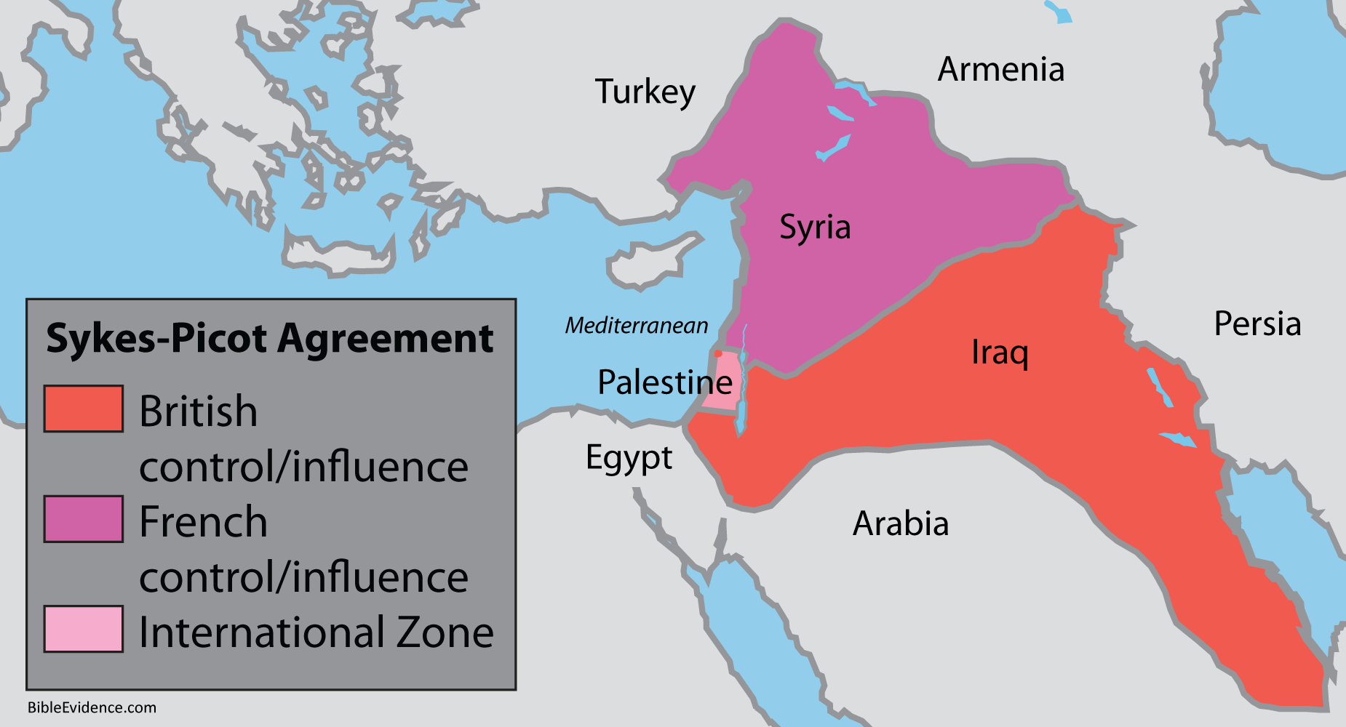
Dan. 11:41 “He shall enter also into the glorious land, And many countries shall be overthrown:”
Notes:
Verse 41: “He shall enter also into the glorious land, And many countries shall be overthrown.”
In addition to the many other countries already entered, the English tribe would also enter the “glorious land”, which is the land promised to Abraham’s descendents in the Middle East.
The map onscreen shows the secret agreement made between the British and French during the war, and shows the areas they entered into and took control of… IN the Middle East.
*****

Slide 11
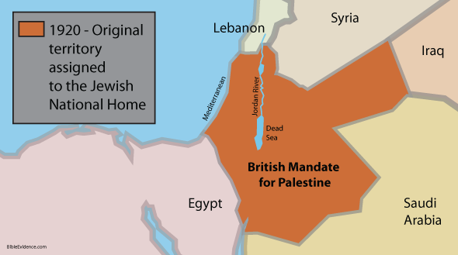
Dan. 11:41 “…But these shall escape out of his hand, even Edom, and Moab, and the chief of the children of Ammon.”
Notes:
Continuing with verse 41: “But these shall escape out of his hand, even Edom, and Moab, and the chief of the children of Ammon.”
During the 1800s, a movement called Zionism emerged. The movement was formalized in 1897 and expanded rapidly. In 1917, the British officially stated its support for the Zionist movement to establish a national homeland for the Jewish people in Palestine.
The British captured Palestine and Jerusalem later that year during the war. The British Mandate of Palestine, established by the League of Nations, is shown on the map in orange. The Mandate included the territory to the west of the Jordan River and the territory to the east of the Jordan River. That entire area was at first allotted to the creation of a Jewish national homeland.
*****

Slide 12
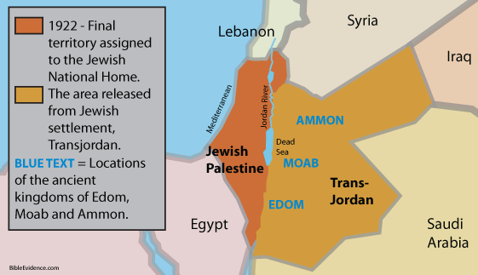
Dan. 11:41 “…But these shall escape out of his hand, even Edom, and Moab, and the chief of the children of Ammon.”
Notes:
However, in 1922, the British released the area east of the Jordan River from involvement in the Jewish settlement. The east area is where the people of Edom, Moab and Ammon were located in Bible times. These areas escaped from being part of the Jewish homeland.
On the map, the orange area is the revised area allotted to the Jewish Homeland. The gold area is the area that was officially released from the Mandate provisions relating to the Jewish Homeland. It became Trans-Jordan.
*****

Slide 13
Dan. 11:42-43 “He shall stretch forth his hand also upon the countries: and the land of Egypt shall not escape. But he shall have power over the treasures of gold and of silver, and over all the precious things of Egypt: and the Libyans and the Ethiopians shall be at his steps.”
Notes:
Verses 42-43: “He shall stretch forth his hand also upon the countries: and the land of Egypt shall not escape. But he shall have power over the treasures of gold and of silver, and over all the precious things of Egypt: and the Libyans and the Ethiopians shall be at his steps.”
Egypt, along with Sudan, which is where the Ethiopians were located during Bible times, both became part of the British Empire in 1914 during the war. Also, Libya was defeated and agreed to the terms of the British.
*****

Slide 14
Daniel 11:44
“But tidings out of the east and out of the north shall trouble him: therefore he shall go forth with great fury to destroy, and utterly to make away many.”
Notes:
Verse 44: ”But tidings out of the east and out of the north shall trouble him: therefore he shall go forth with great fury to destroy, and utterly to make away many.”
Even though the Allied Powers decisively won World War I, there were many unresolved issues and resentments that brewed and fueled World War II (1939 - 1945). This developed into a volatile situation that created the troubling tidings for the KON.
[CLICK] The Empire of Japan had imperialistic aims of dominating Asia and the Pacific, and in 1937, went to war with China. These were disturbing “tidings out of the east”.
[CLICK] Also during the late 1930s, Nazi Germany began demanding and taking more territory in Europe, and in 1939, made an agreement with the Soviet Union to overrun the countries that lay between them. These were the alarming “tidings... out of the north”.
*****

Slide 15
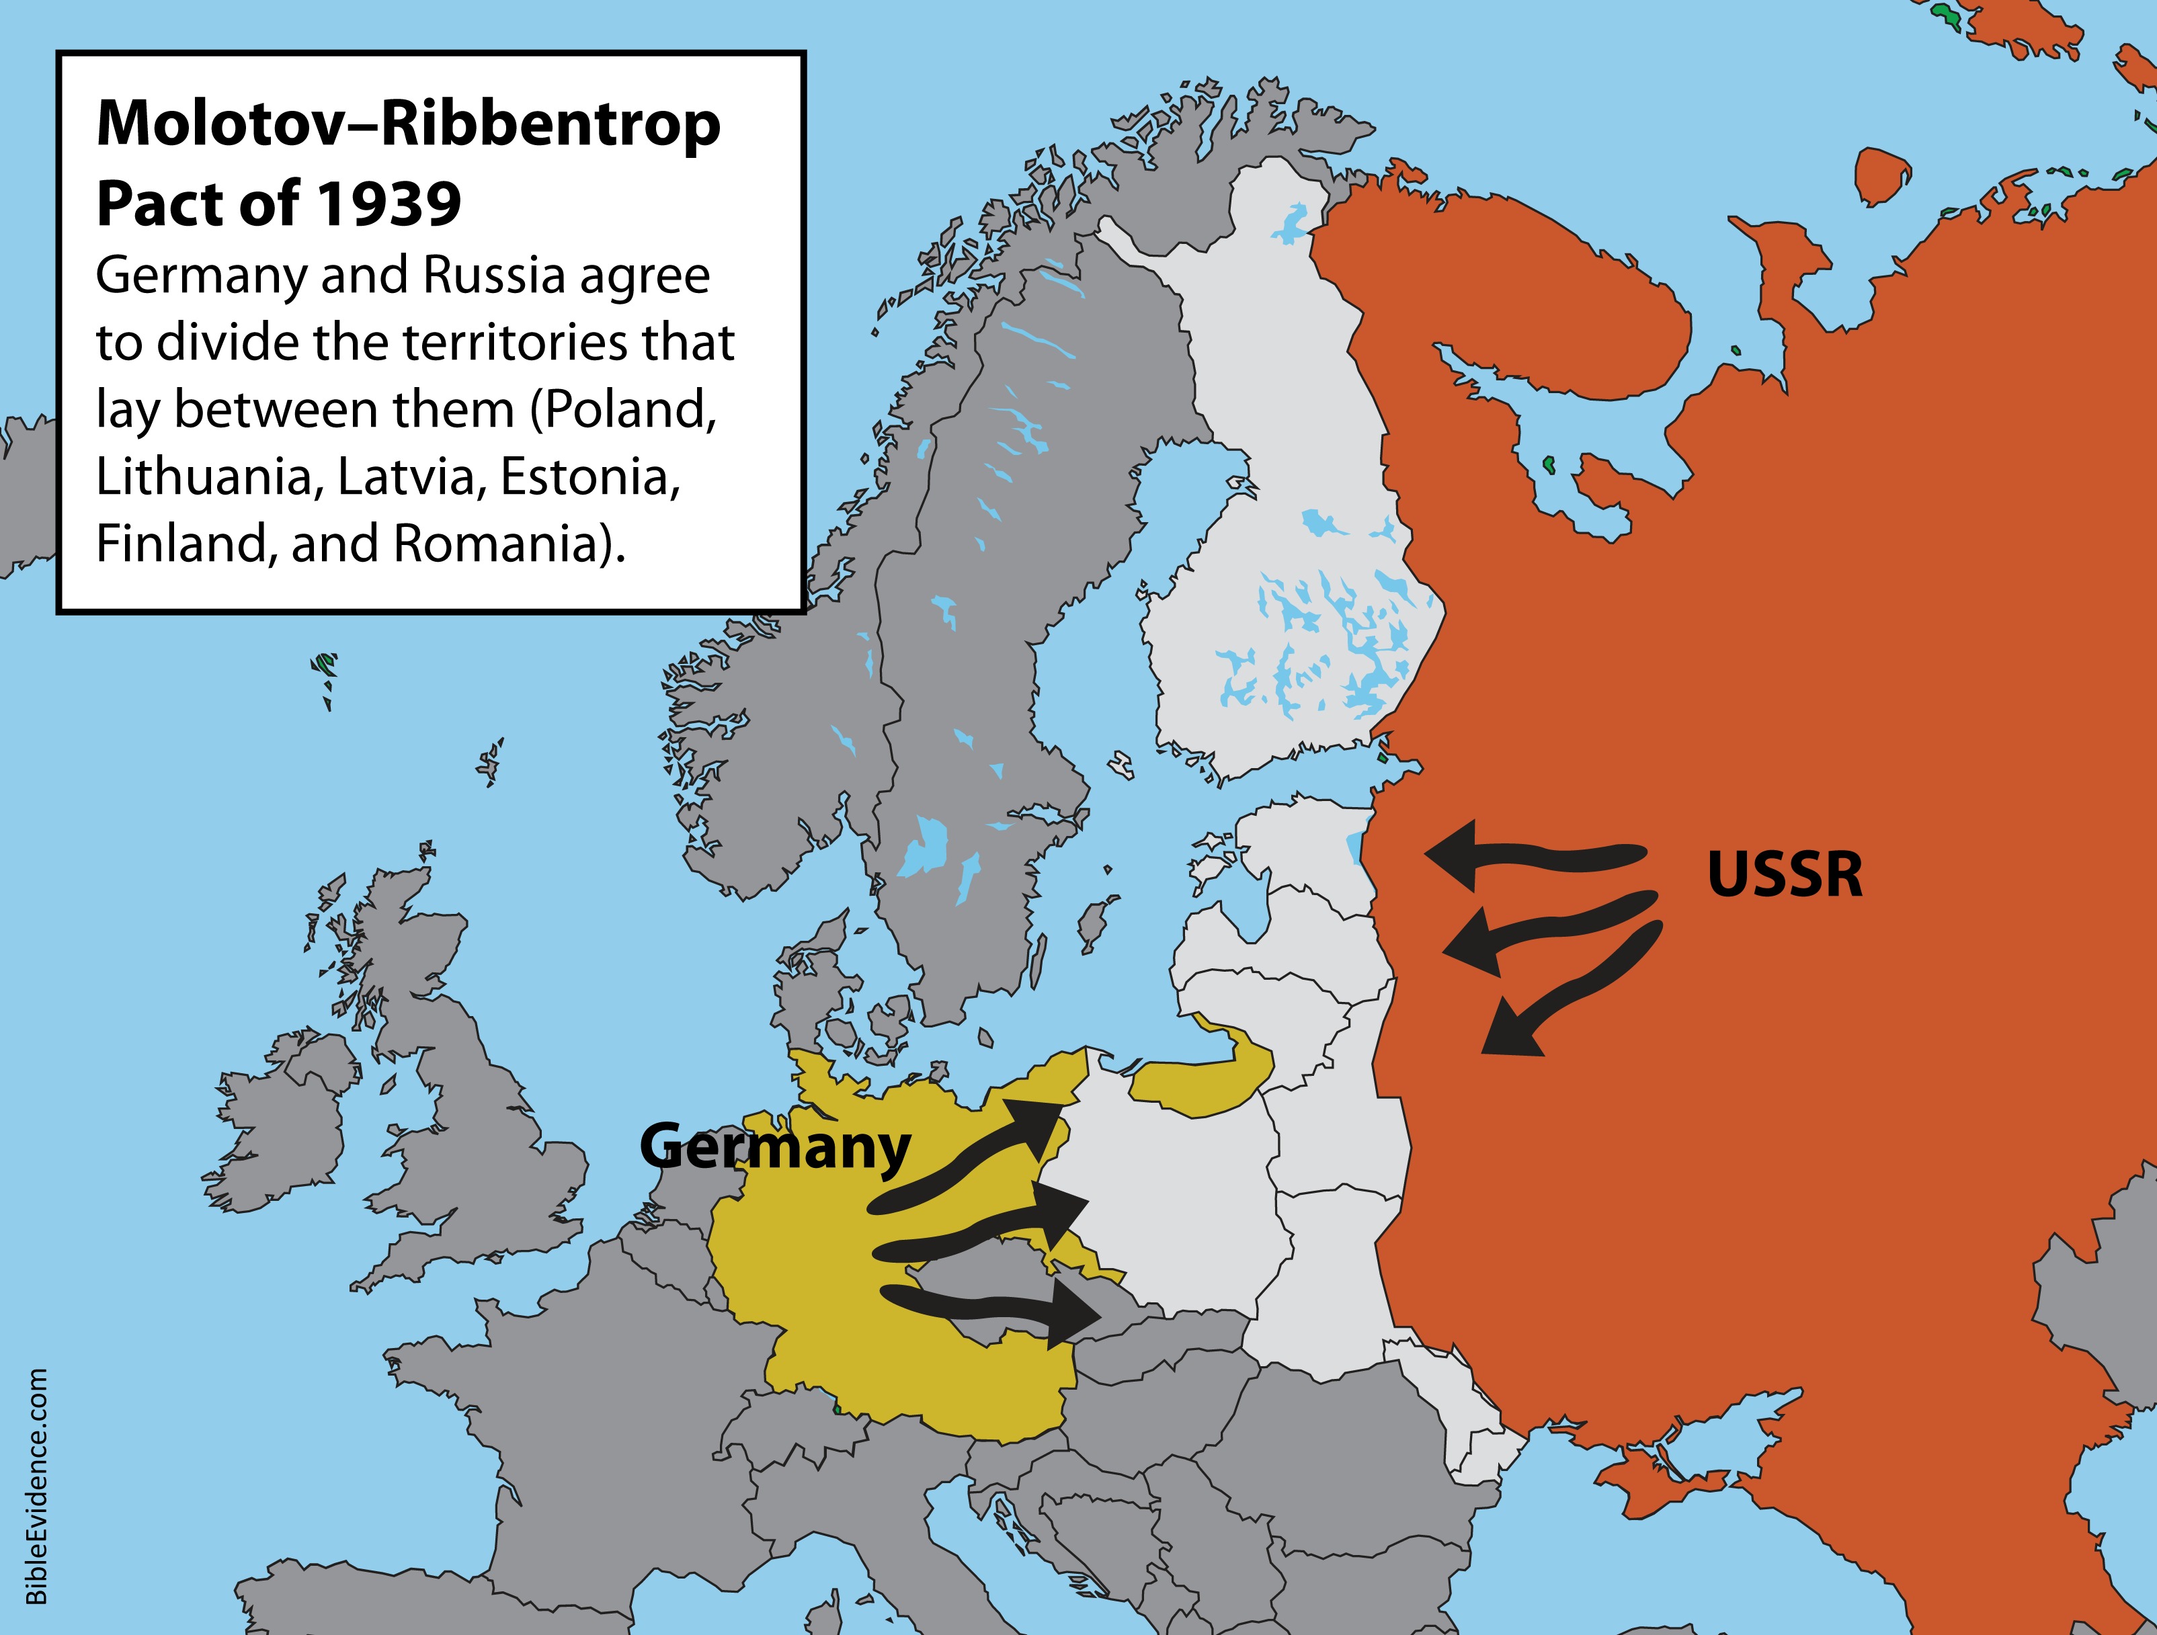
Notes:
The agreement between Germany and the Soviets was the Molotov-Ribbentrop Pact, a 10-year agreement. The pact enabled Hitler to proceed with his plans to attack Poland and elsewhere without opposition from Soviet armies.
When the pact was announced, there was shock and alarm across the world. Also, some of the secret protocols of the pact were leaked, which produced rumors and great fear. Hitler’s aims of world domination were known and his actions were now clearly showing that he would only be stopped by force.
*****

Slide 16
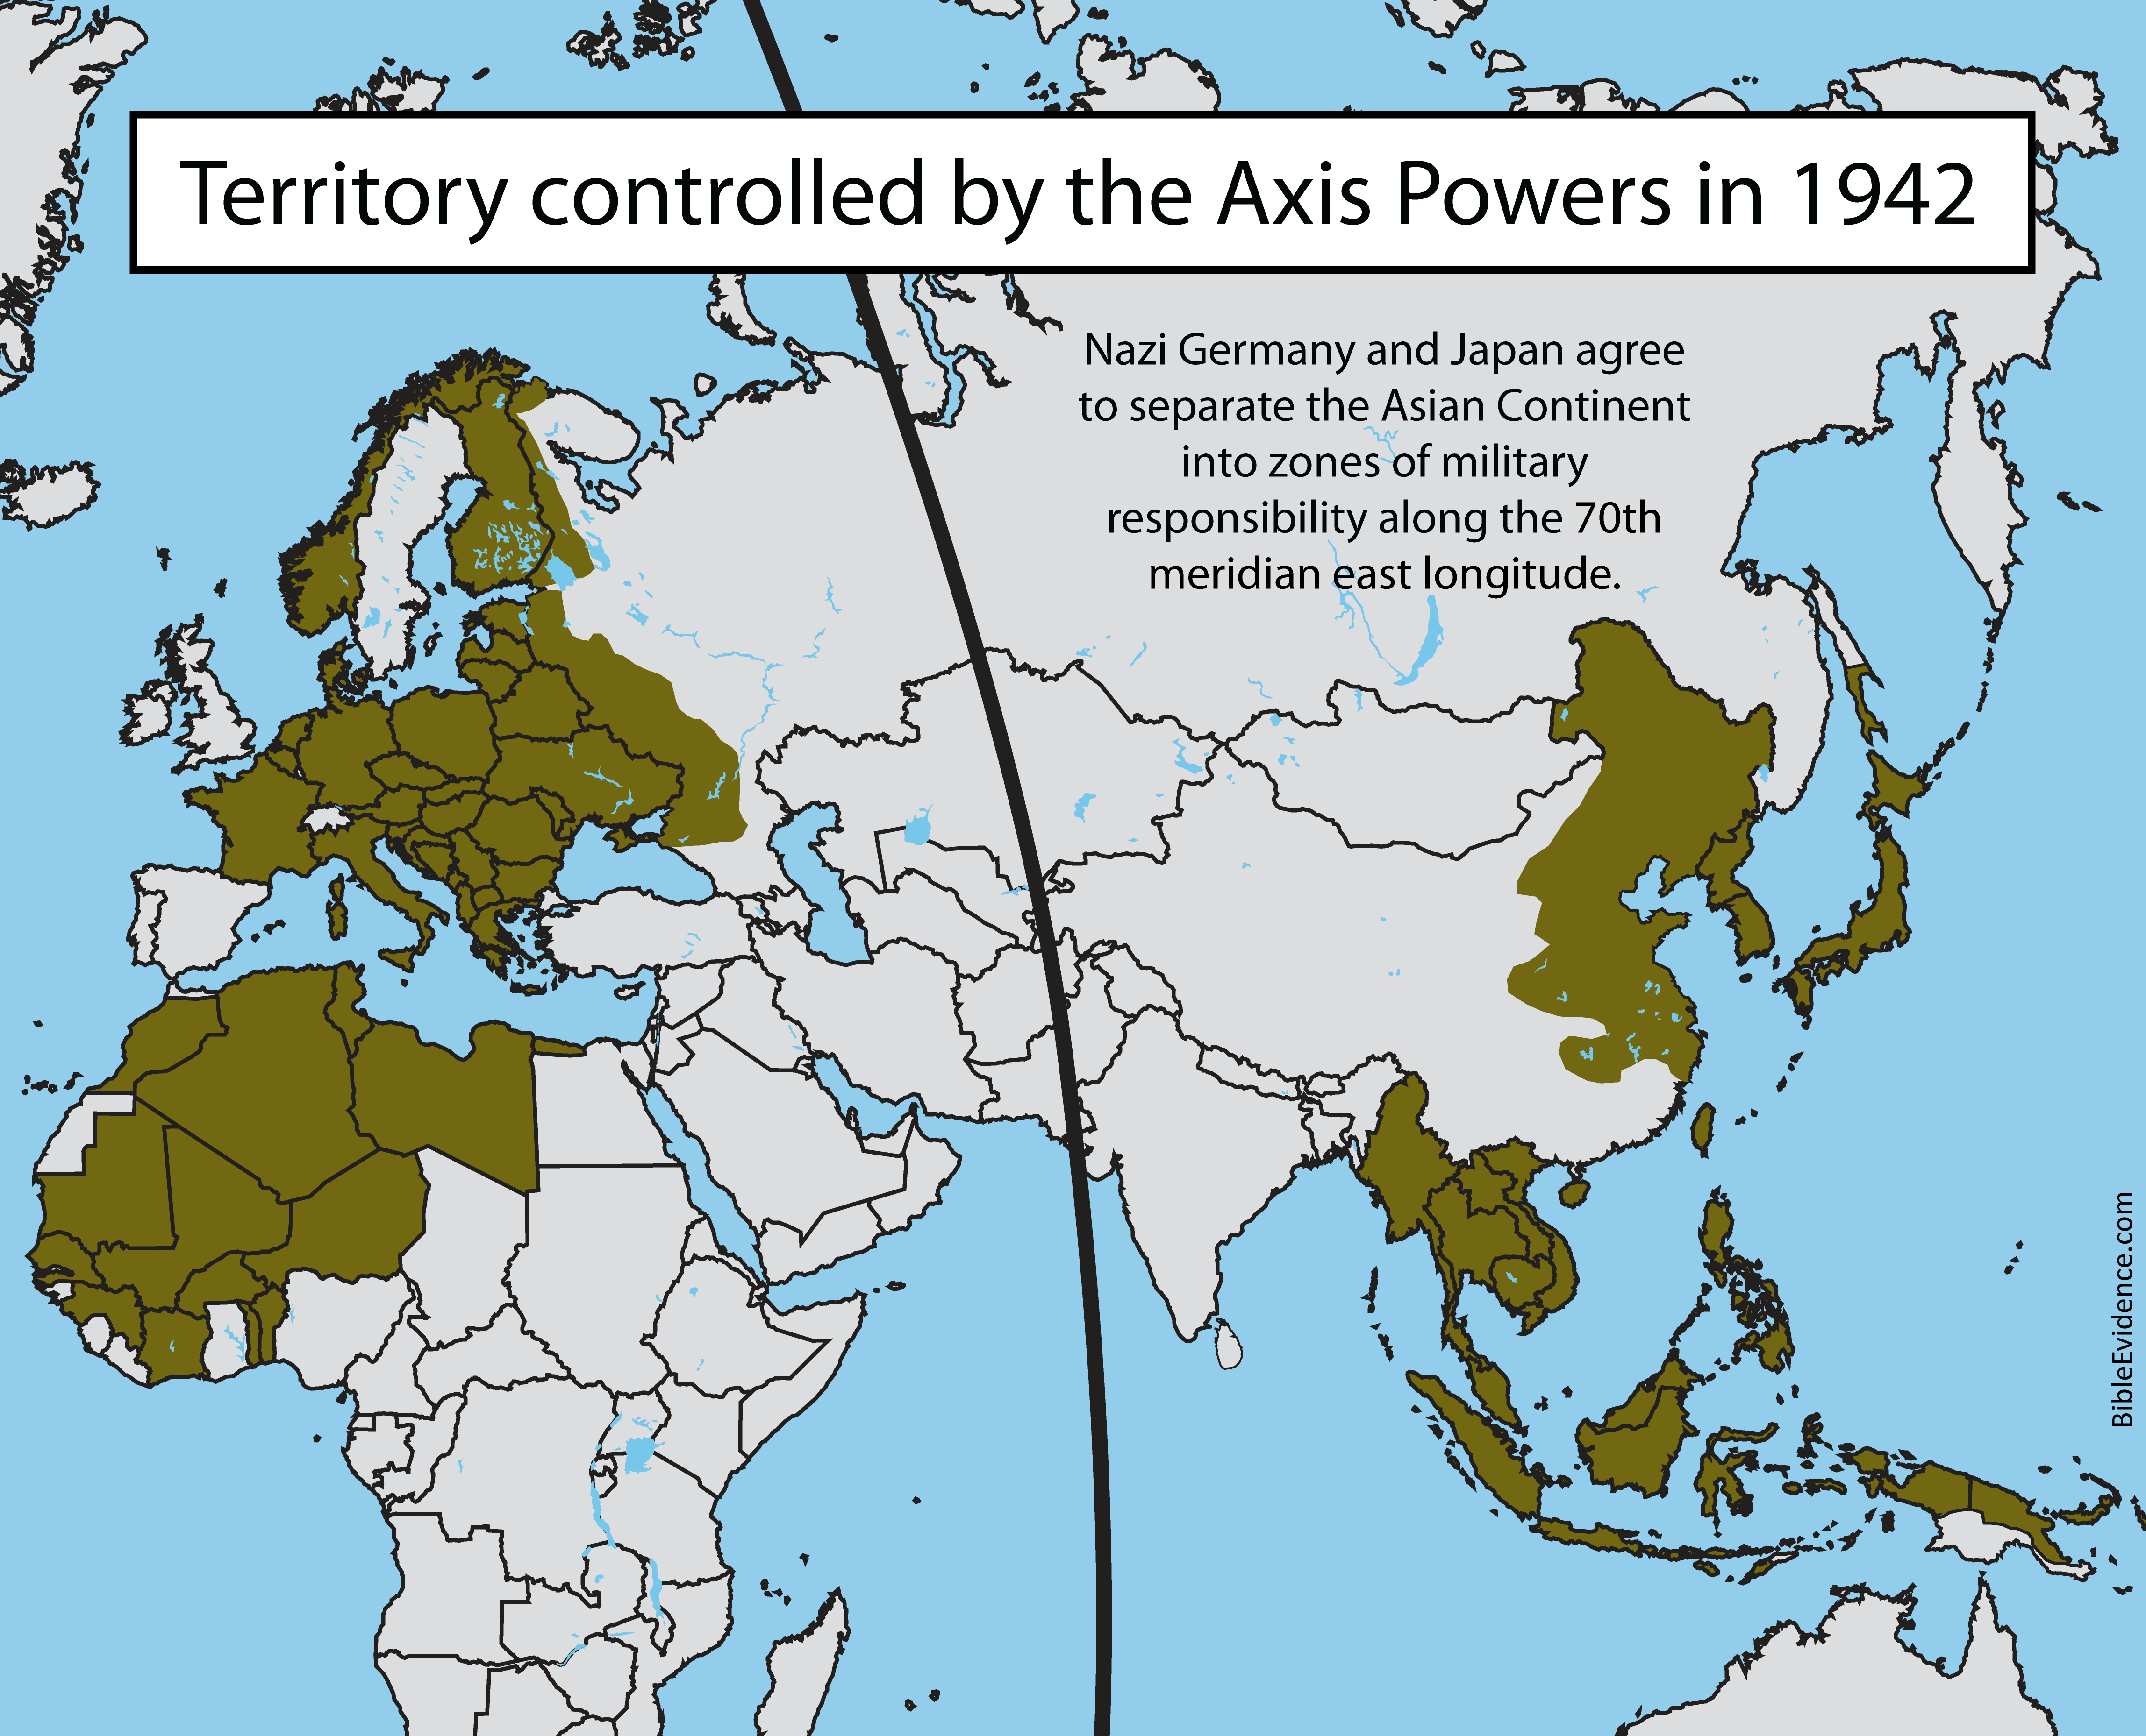
Notes:
Of course, the activities of Japan, Nazi Germany and Russia “troubled” the KON; they disturbed and alarmed the English Tribe (which was Britain and the increasingly involved USA) along with the rest of the Allied Powers, and caused them to rise up in ANGER against the Axis powers.
The fighting was intense. After 1942, the Allied powers began to steadily take back the territories lost, as hundreds of thousands died along the way. In 1945, the Germans finally surrendered. The atomic bombs were dropped, and Japan also surrendered. The total casualties of the war are estimated at 50 - 85 million people. It was the deadliest war in history.
*****

Slide 17
Daniel 11:45
“And he shall plant the tabernacles of his palace between the seas in the glorious holy mountain; yet he shall come to his end, and none shall help him.”
Notes:
Verse 45: “And he shall plant the tabernacles of his palace between the seas in the glorious holy mountain; yet he shall come to his end, and none shall help him.”
*****

Slide 18
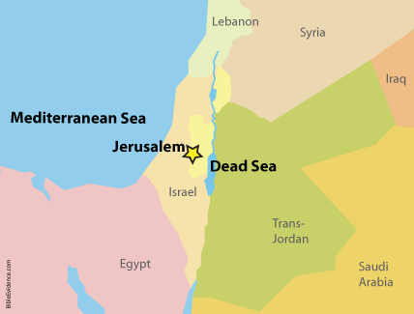
“And he shall plant the tabernacles of his palace between the seas in the glorious holy mountain…”
Notes:
The “holy mountain” refers to Jerusalem as Daniel stated in chapter 9.
Jerusalem is located “between the seas”, the Mediterranean Sea and the Dead Sea.
The “tabernacles of his palace” refers to a royal dwelling place, the location where a ruler lives, which is the capital of a nation.
This verse describes the KON planting or establishing a capital in Jerusalem. This is precisely what occurred as a result of World War I and II. In 1947, the United Nations established a partition plan for the British Mandate in Palestine. It was rejected by the Arabs. In 1948, the British ended the Mandate and on the same day, the World Zionist Organization declared the establishment of the State of Israel. Israel was immediately attacked by the surrounding Arab nations, but Israel defeated them and took control of West Jerusalem and almost 60% of the area that had been assigned to the Arabs in the partition plan. In 1967, Israel also took control of East Jerusalem. They have declared Jerusalem to be Israel’s “eternal capital.”
*****

Slide 19
“…Yet he shall come to his end, and none shall help him.”
Notes:
During World War II, the power behind the English tribe shifted from Britain to the United States. The balance of power for the whole Roman realm shifted from Europe to the USA as a global superpower. The US has provided massive support to Israel, financially, militarily and politically. Many say that Israel would cease to exist without the support of the United States.
It is not unexpected that we would see the English Tribe as powered by the United States as the final KON. We know, according to Revelation 13 and 17, that the US plays the leading role in prophecy in the end times.
In conclusion, I’d like to put forth to you today, that the KON is ALREADY planted in Jerusalem. And there he will REMAIN, according to chapter 12 verse 1, until the end, when MICHAEL, Jesus Christ, stands up. I believe we are very, very close to that end.
Thank you for your time, and may God bless as we continue to study God’s Word together.
*****

