Slide 1
Understanding Daniel 11:40-45
An Inductive Approach

Slide 2
Introduction

Slide 3
Introduction: Symbols in Dan 2
This progression involves chemical composition. Another has to do with relative value (more to less), and another with hardness (less to more).

Slide 4
Introduction: Symbols in Dan 7
Here we have simply a succession of numbers (less to more).

Slide 5
Introduction: Animacy Hierarchy
Across chapters the symbols form an animacy hierarchy, from entirely inanimate to beings capable of worship. The scale is one of spiritual relevance (less to more).

Slide 6
Introduction: Animacy Hierarchy (Summary)
In this context Dan 10-12 should be the most spiritual of the prophecies.

Slide 7
Introduction: Progressions by Narrative
This is what we get when Dan 8 and 9 are combined.

Slide 8
Introduction: Progressions by Narrative
And this is what we get when they are not. Dan 8 and 9 belong together.

Slide 9
Introduction: Progressions by Empire
The early prophecies can be studied as a group.

Slide 10
Introduction: Progressions by Empire
The last prophecy is comparable to the earlier ones.

Slide 11
Introduction: Progressions by Empire

Slide 12
Introduction: Progressions (Summary)
Dan 8-9 must be joined as one.
Dan 10-12 must be joined as one.
Dan 8-9 and 10-12 are parallel prophecies.

Slide 13
Daniel 10-12

Slide 14
Dan 10-12: Overview

Slide 15
Daniel 10

Slide 17
Daniel 11

Slide 18
Dan 11: Prince of the Covenant

Slide 19
Prince of the Covenant
11:16-22/23-28

Slide 20
Dan 11: Prince of the Covenant

Slide 21
Dan 11: Prince of the Covenant
These terms are part of a shared context. The connection is not limited to shared words.

Slide 22
Dan 11: Prince of the Covenant
“The one who comes” in Dan 11:16 is the same as “the prince who comes in 9:26, and this in turn is the same as the “little horn,” introduced in 8:9.

Slide 24
Dan 11: Prince of the Covenant

Slide 25
Dan 11: Prince of the Covenant

Slide 26
Dan 11: Prince of the Covenant

Slide 27
Dan 11: Prince of the Covenant

Slide 28
Dan 11: Prince of the Covenant

Slide 29
Dan 11: Prince of the Covenant

Slide 30
Wars
Dan 11

Slide 31
Dan 11: Wars
These verses at the end of the center section have their own internal chiastic structure.

Slide 32
Dan 11: Wars
These verses at the end of the center section have their own internal chiastic structure.

Slide 33
Dan 11: Wars
These verses at the end of the center section have their own internal chiastic structure.

Slide 34
Dan 11: Wars
These verses at the end of the center section have their own internal chiastic structure.

Slide 35
Dan 11: Wars
These verses at the end of the center section have their own internal chiastic structure.

Slide 36
Dan 11: Wars
It is significant that the stopping statements in the above table come at the end of a section (23-28, with special emphasis on 25-28), and that the starting statements come at the beginning of a section (29-35).

Slide 37
Dan 11: Wars
There is no wrath in vs. 36, or elsewhere in vss. 36-39. The rage, or indignation, mentioned here described earlier in vss. 30b-35. The two sections overlap. This is recapitulation.

Slide 38
First Set of Parallels
Dan 11:35-36/12:6-7

Slide 39
Dan 12: First Set of Parallels
למוד is the first word of vs. 29 and the last word of vs. 35. If the section begins at an “appointed time” and ends at an “appointed time,” that’s not two appointed times, but one appointed period. This period is described in 11:29-35, in 11:36-39, and 12:7.

Slide 40
Dan 12: First Set of Parallels

Slide 42
Dan 12: First Set of Parallels
Four separate lines of evidence come together in support of the idea that Dan 11:35-36 and 12:6-7 are coreferential:
The verbal and thematic parallels listed above are too numerous for the passages to be accidentally related. They represent shared contexts.
The reference to “help” in 11:34 (“When they stumble, they shall receive a little help”) corresponds to similar references in Rev 12:6 and 14.
The reference to “indignation” in 11:36 (“He shall prosper till the indignation [זעם] is accomplished”) cannot refer to anything in 11:36-39. It must refer instead to 11:30b-35, with all its wrath and hardship.
The definite article on “the king [המלך]” shows that 11:36-39 goes back over what was already described in 11:30b-35.

Slide 43
Dan 12: First Set of Parallels (Summary)
Dan 11:30b-35 and 36-39 describe two aspects of what was happening during the “time, times, and half a time” of 12:7.
Wrath against God’s people
Blasphemy against God
If Dan 11:30b-35 describes the 1260 days (538 onward), 11:29-30a do not describe the Battle of Lepanto (1571). Lepanto is too late for this passage by 1000 years.

Slide 44
Second Set of Parallels
Dan 11:31-35/12:10-11

Slide 45
Dan 12: Second Set of Parallels
These terms are also comparable, but for the most part not identical. There is a question how much latitude we can allow when calling something a verbal parallel.

Slide 46
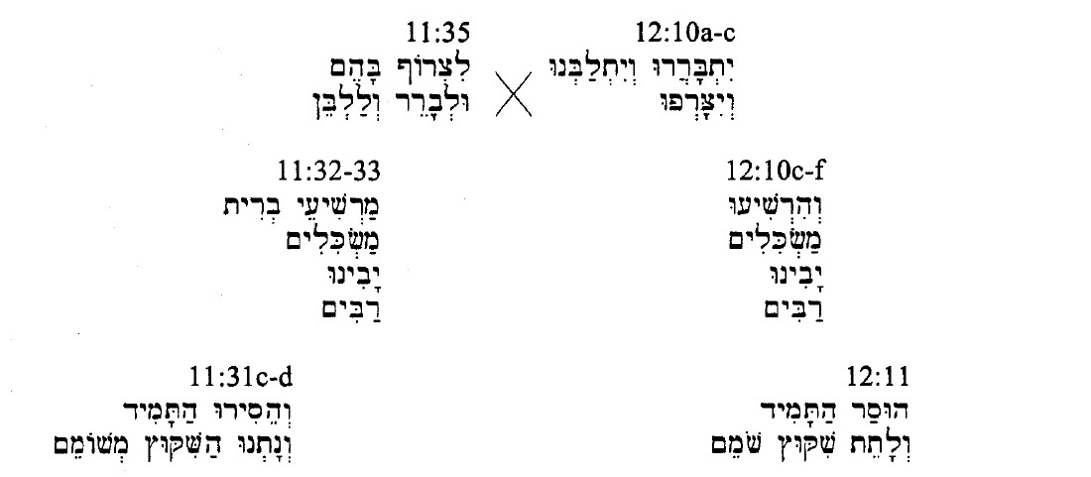

Slide 47
Dan 12: Second Set of Parallels
In Dan 12:6-7 the events of 11:30b-35 are associated with the “time, times, and half a time” (12:7).
In Dan 12:10-11 the same events of 11:30b-35 are associated with the “1,290 days” (12:11).
It is not necessary to suggest that the events are repeated. That is not the most economical hypothesis. It’s not just that the events are the same; the verses that describe them are the same.
Revelation shows that there will be maskilim in the future; Heb 11 shows that there were maskilim in the past.

Slide 48
Discussion

Slide 49
Discussion
The One speaking in 12:6-7 and presumably 12:10-11 is “the man clothed in linen.”
We see Him in Dan 10:5-6, in Dan 11:22, and in Dan 12:6-7.

Slide 50
Discussion
Another name for this holy Being is “Michael”; another is “the prince of the covenant” (11:22).
These are descriptions of Christ. He occupies the center verse, of the center section, of the center chapter, of the book’s culminating prophecy – and other passages.
And He appears prominently in Dan 10 and Dan 12.

Slide 51
Discussion
In Dan 11:40-45 we have the king of the North and the king of the South.
In Revelation the corresponding figures are spiritual “Babylon” (Rev 14:8; 16:19; 17:5; 18:2, 10, 21) and spiritual “Egypt” (Rev 11:8).
“[A] little before the year 1798 some power of satanic origin and character would rise to make war upon the Bible. And in the land where the testimony of God’s two witnesses should thus be silenced, there would be manifest the atheism of the Pharaoh and the licentiousness of Sodom.” GC 269
This is Revolutionary France, which in 1798 “made the pope a prisoner” in 1798 (GC 266).

Slide 52
Discussion
If we can affirm the first three bullet points below, we should be able to affirm the fourth:
King of the North/king of the South Comparable
King of the North/spiritual “Babylon” Parallel
Spiritual “Babylon”/spiritual “Egypt” Comparable
King of the South/spiritual “Egypt” Consistent with all of the above
It should not be necessary to separate Daniel from Revelation in order to do good exegesis. We must study these books together.

Slide 53
Conclusion

Slide 54
Conclusion
When South attacks North in Dan 11:40a, the attack is entirely one sided. Pius VI has no defense whatever against a French army. And similarly, when North attacks South in vss. 40b-c/42-43, South has no defense against the papacy’s spiritual warfare. The text gives no indication of any Southern response, or any Southern awareness that an invasion is taking place. This phase of the conflict also is entirely one sided.

Slide 55
Conclusion
The point to notice here is not that North and South fight, but that they merge. Fighting is a process, merging is the ensuing outcome or result. The king of the North overwhelms “Egypt” and the result is that “Egypt” and its satellites become his territory, just as the North was always his territory. At this point, by virtue of controlling both North and South, he is no longer a king of the North, nor is he a king of the South. In becoming both, he becomes neither. He is a king of this world.

Slide 56
Conclusion
Now the stage is set for the real conflict. The battle is not in vss. 40a-c/41-43, with 40d/44-45 as a sidebar. On the contrary, the earlier verses merely set the stage for what follows. Verses 40a-c/41-43, are an explanation of how the real war could ever take place, since one of the sides (North/South) is so consistently fragmented. Even in the time of the end North and South are still squabbling. Saying they would one day unite under one command requires explanation, and that is the function of vss. 40a-c/41-43.

Slide 57
Conclusion
The two sides must eventually unite or Rev 13:3 would be untrue (“but its mortal wound was healed [41-43], and the whole earth marveled as they followed the beast [44-45]”), and Rev 19:19 (“And I saw the beast and the kings of the earth with their armies gathered [συνηγμένα] to make war against him who was sitting on the horse and against his army”). This takes us back to Rev 16:16 (“And they assembled [συνήγαγεν] them at the place that in Hebrew is called Armageddon”), and 16:14 (“For they are demonic spirits, performing signs, who go abroad to the kings of the whole world, to assemble [συναγαγεῖν] them for battle on the great day of God the Almighty”).

Slide 58
Conclusion
So long as North and South are still squabbling the real war cannot begin, because the first army has not yet coalesced as one. And even when they form one army the war cannot take place, because the second army has not yet arrived. When it does arrive (“And the armies of heaven, arrayed in fine linen, white and pure, were following him on white horses” [Rev 19:14]), the conflict is over almost before it begins (“and he shall come to his end with none to help him” [Dan 11:45b]). “And then the lawless one will be revealed, whom the Lord Jesus will kill with the breath of his mouth and bring to nothing by the appearance of his coming” (2 Thess 2:8 ESV). In this case also, the conflict is entirely one sided.

Slide 59
Conclusion
It is imperative that we combine the narrative of Daniel with the narrative of Revelation. Until we do this, we will never understand it. The angel says, “And none of the wicked shall understand, but those who are wise shall understand” (Dan 12:1). This language is very blunt, but I did not write it. My question is, why is this so? What hermeneutic leads the wicked not to understand? And in fact there are many ways to misunderstand, with many hermeneutics that could lead to such a result.

Slide 60
Conclusion
But if, through rigorous exegesis, we follow what the Holy Spirit tells us in Daniel, and add to this what the Holy Spirit tells us in Revelation, and add to this what the Holy Spirit tells us in the Spirit of Prophecy, we will not misunderstand. The meaning will be clear. And it will be Christ centered.

