Slide 1
Daniel 11:40-45
Toward a Spiritual Application

Slide 2
Introduction

Slide 3
Introduction
In this paper my goal is to read the text inductively.
In aid of doing this I will avoid interpretations as much as possible and focus instead on textual markers.
The broader context for 11:40-45 is 11:2-12:4, and the broader context for that is Dan 10-12 along with Dan 2, 7, 8-9.

Slide 4
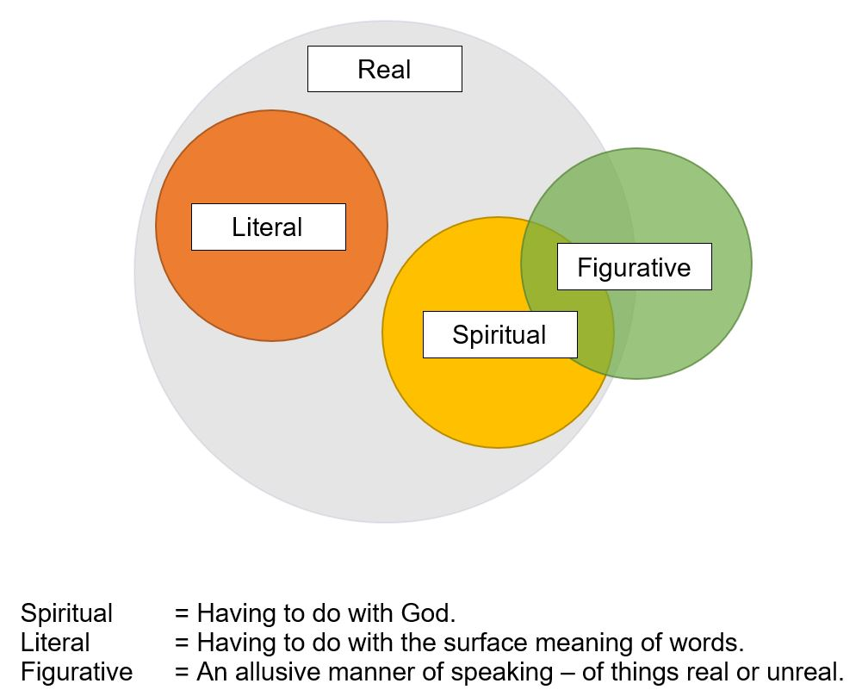

Slide 5
Progressions

Slide 6
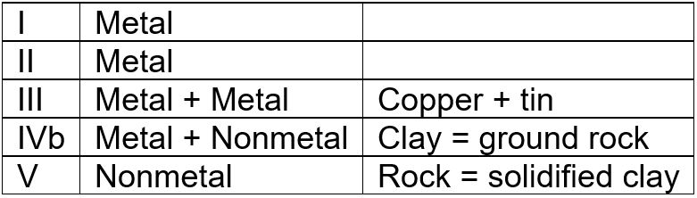
Progressions: Symbols in Dan 2
This progression involves chemical composition. Another has to do with relative value (more to less), and another with hardness (less to more).

Slide 7
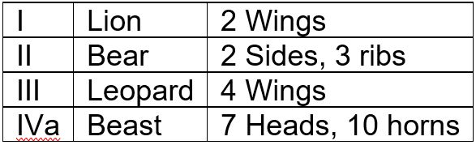
Progressions: Symbols in Dan 7
Here we have simply a succession of numbers (less to more).

Slide 8
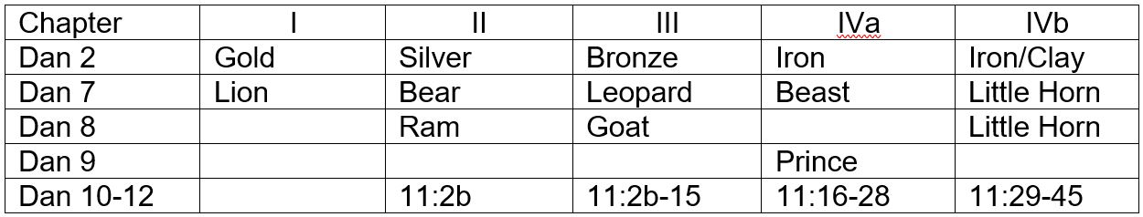
Progressions: Dan 8-9 Separate
Here Dan 8 and 9 are treated separately because of their use or nonuse of symbolism.

Slide 9
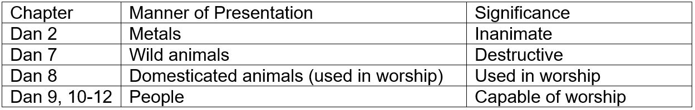
Progressions: Animacy Hierarchy
Across chapters the symbols form an animacy hierarchy, from entirely inanimate to beings capable of worship. The scale is one of spiritual relevance (less to more).

Slide 10
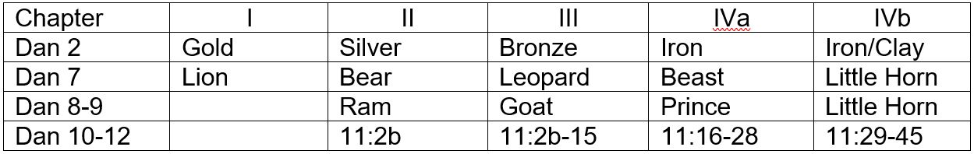
Progressions: Dan 8-9 Combined
We now collapse Dan 8 and 9 as one row because of their shared subject matter.

Slide 11
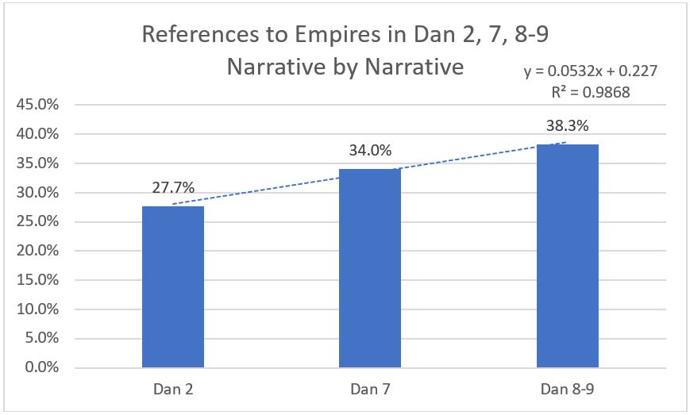
Progressions: By Narrative
This is what we get when Dan 8 and 9 are combined.

Slide 12
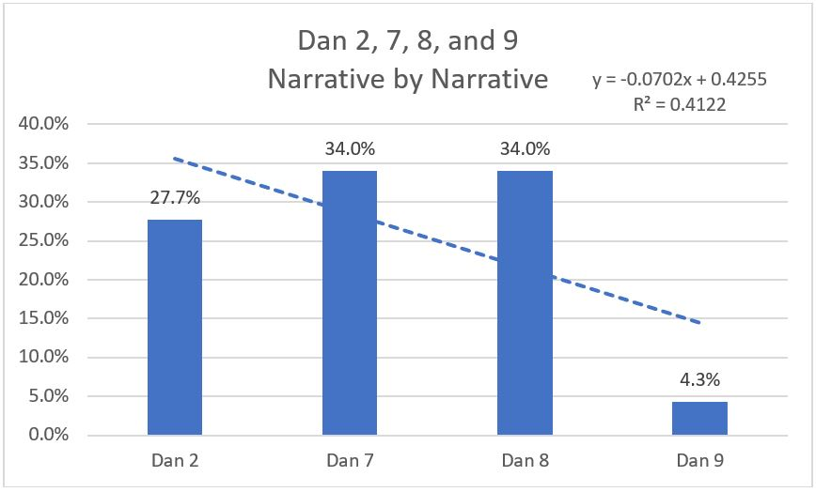
Progressions: By Narrative
And this is what we get when they are not. Dan 8 and 9 belong together.

Slide 13
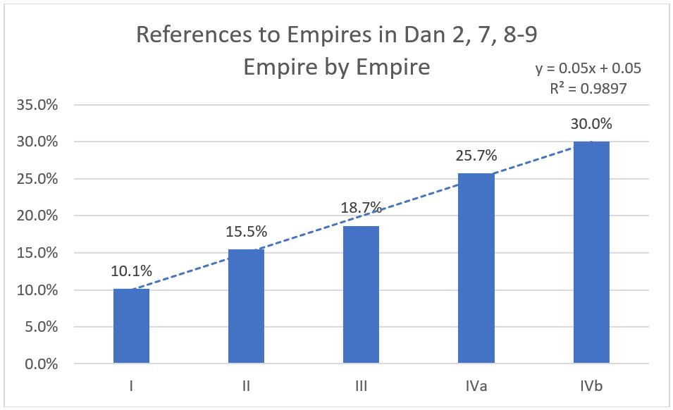
Progressions: By Empire
The early prophecies can be studied as a group.

Slide 14
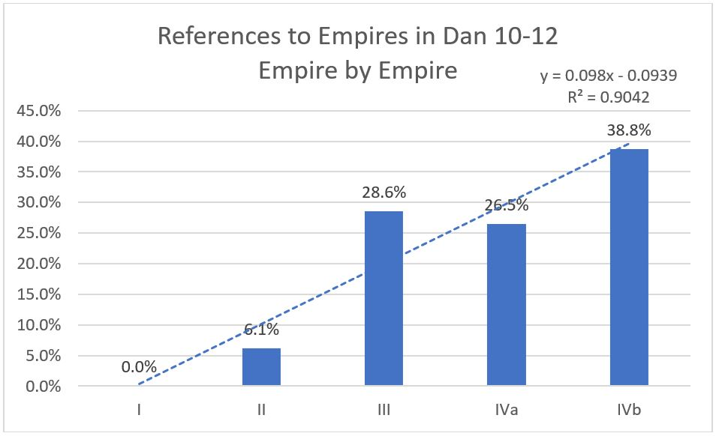
Progressions: By Empire
The last prophecy is comparable to the earlier ones.

Slide 15
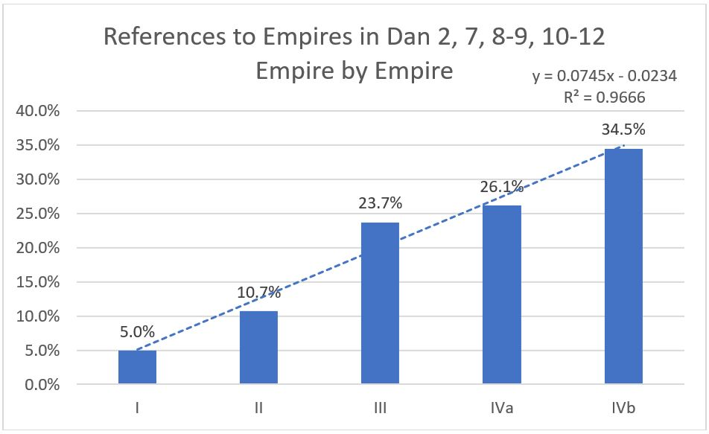
Progressions: By Empire

Slide 16
Progressions: Summary
Dan 2
  Chemical composition (metal, metal+metal, metal+nonmetal, nonmetal).
  Value (more to less).
  Hardness (less to more).
Dan 7
  A sequence of numbers (2 wings; 2 sides, 3 ribs; 4 wings; 7 heads, 10 horns).
Dan 2, 7, 8, 9, 10-12
  Animacy hierarchy involving spiritual relevance (less to more).
Dan 2, 7, 8-9, 10-12
  Increasing levels of interest in world empires from narrative to narrative.
  Increasing levels of interest in world empires from empire to empire.

Slide 17
Daniel 10-12

Slide 18
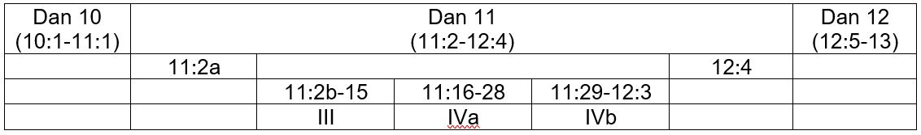
Dan 10-12: Overview

Slide 19
Dan 10-12: Issues
One way to think of explanation is that it is that process by which all representational content is filtered out, leaving only what is literal.
But . . .

Slide 20
Dan 10-12: Issues
Dan 8 explains Dan 7.
  In Dan 7 the little horn is only empire IVb. It rises among 10 horns, half a millennium after Christ.
  In Dan 8 the little horn is empires IVa and IVb. It rises among 4 horns, a century and a half before Christ. In 8:9 its interests are horizontal (IVa), in 8:10-12 its interests are vertical (IVb).
  This concept adds value to what we can learn about the little horn from Dan 7 and therefore explains the little horn further.

Slide 21
Dan 10-12: Issues
Dan 9 explains Dan 8.
  The beginning of the 2300 evening-mornings is given only in Dan 9.

Slide 22
Dan 10-12: Issues
Dan 12 explains Dan 11.
  Dan 12:6-7 is parallel with, goes back to, and explains Dan 11:35-36.
  Dan 12:10-11 is parallel with, goes back to, and explains Dan 11:31-35.
  In both cases we are dealing with shared contexts and the later passage gives added value, i.e., it constitutes an explanation.

Slide 23
Dan 10-12: Issues
If Dan 11 gives an explanation, it cannot itself be an explanation under the definition offered above.
Thus, it follows that an argument for literality in Dan 11 based on the idea that Dan 11 explains Dan 8 does not bear scrutiny. Dan 11 is not necessarily literal because of its relationship to Dan 8.

Slide 24
Daniel 10

Slide 25
Dan 10
The hand that “touched me and set me trembling on my hands and knees” did not belong to “the man clothed in linen,” but to Gabriel.
“The man clothed in linen” is the same as “Michael” (Dan 10:13, 21; 12:1; Jude 9; Rev 12:7).
The following passages (Dan 10, Rev 1) describe the same holy Being. This fact is an important part of the context for Dan 10-12.

Slide 26
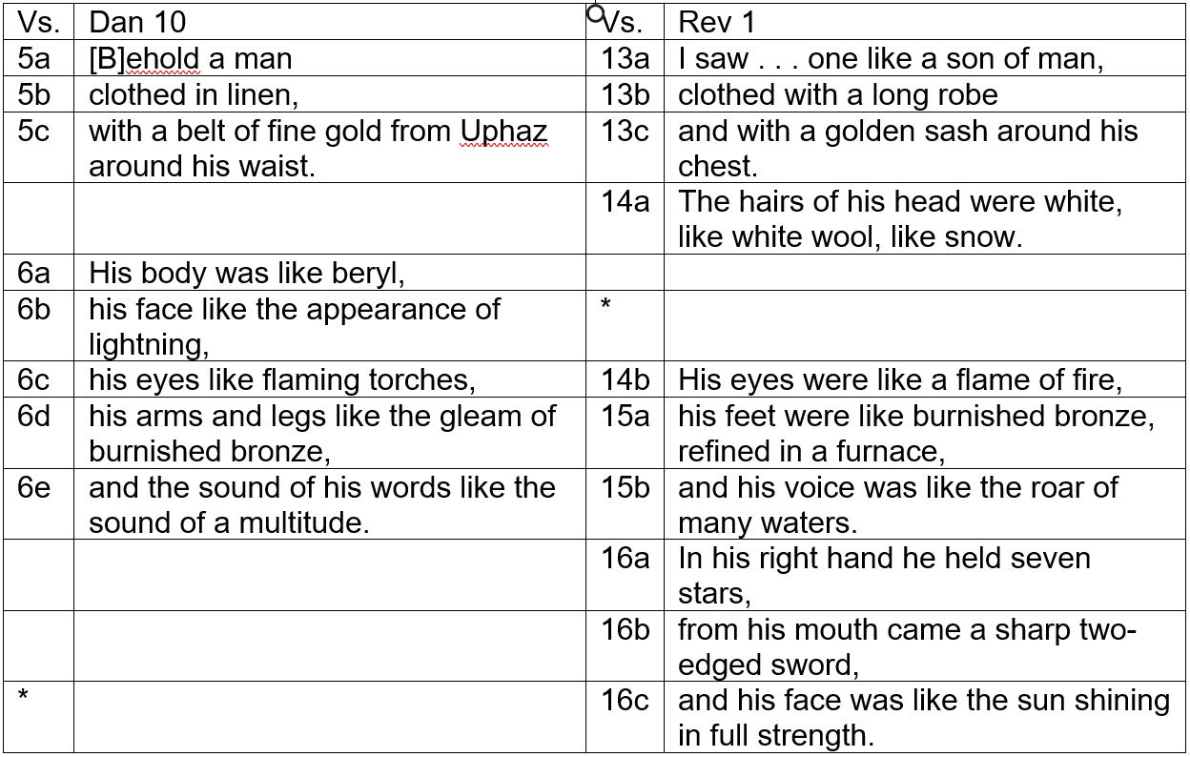

Slide 27
Daniel 11

Slide 28
Dan 11: Overview
Dan 11 has three sections and these have an increasing number of subsections:
  1
    11:2b-15
  2
    11:16-22
    11:23-28
  3
    11:29-35/36-39
    11:40-43
    11:44-45/12:1-3

Slide 29
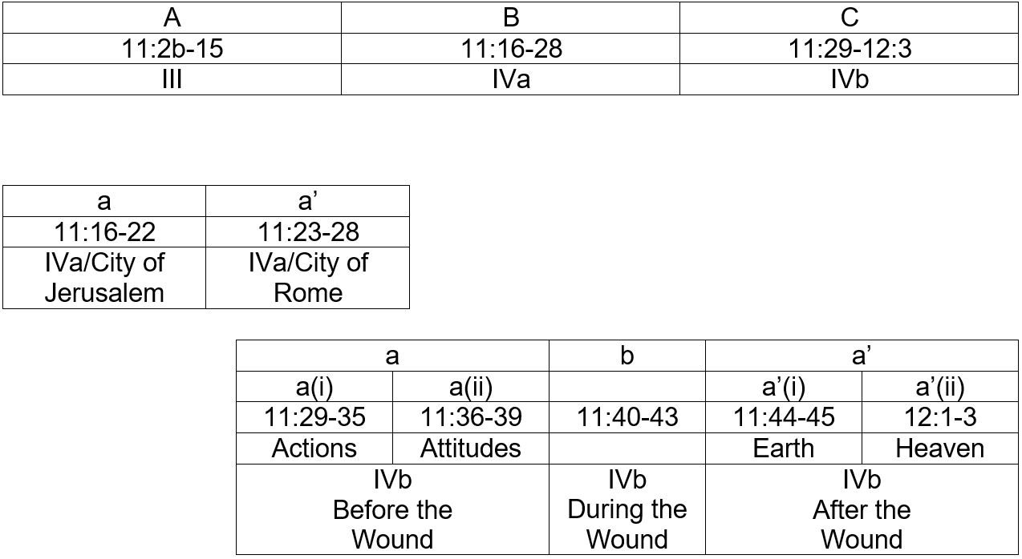
Dan 11: Overview

Slide 30
Daniel 11
Sections

Slide 31
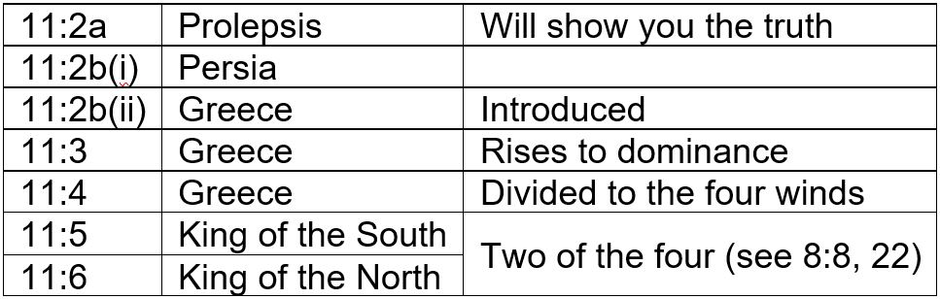
Dan 11: Section A (Beginning)
Everything after the words, “And now I will show you the truth,” is part of the prophetic narrative. The section begins at 11:2b.

Slide 32
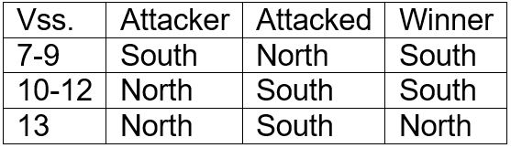
Dan 11: Section A
By gradual stages North becomes stronger than South.

Slide 33
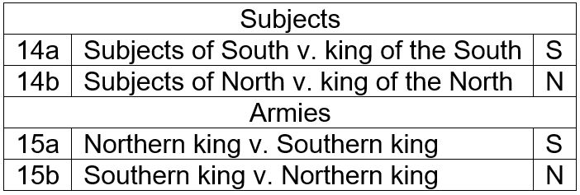
Dan 11: Section A (End)
The word החזון (11:14) is a short, but direct, quotation from Dan 8:13.

Slide 34
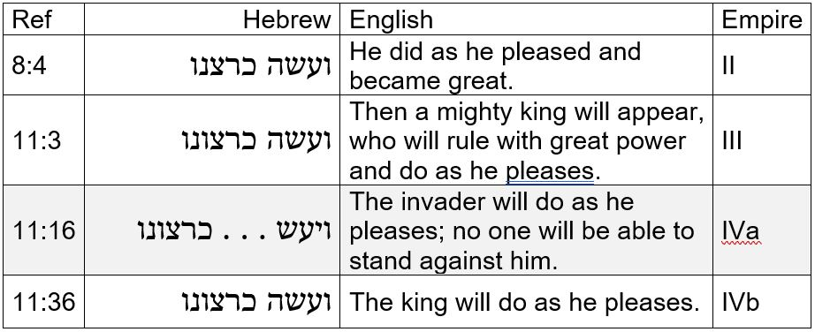
Dan 11: Section B (Beginning)

Slide 35
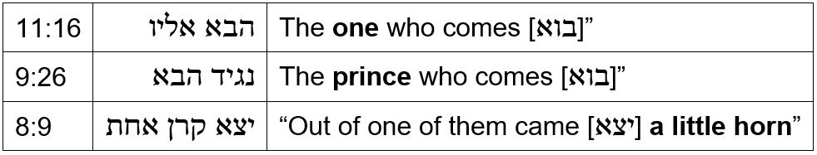
Dan 11: Section B (Beginning)
“The one who comes” in Dan 11:16 is the same as “the prince who comes in 9:26, and this in turn is the same as the “little horn,” introduced in 8:9.

Slide 36
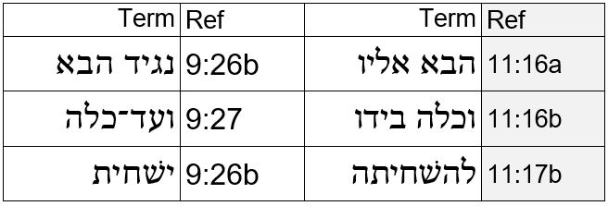
Dan 11: Section B (Beginning)
These terms are part of a shared context. The connection is not limited to shared words.

Slide 37
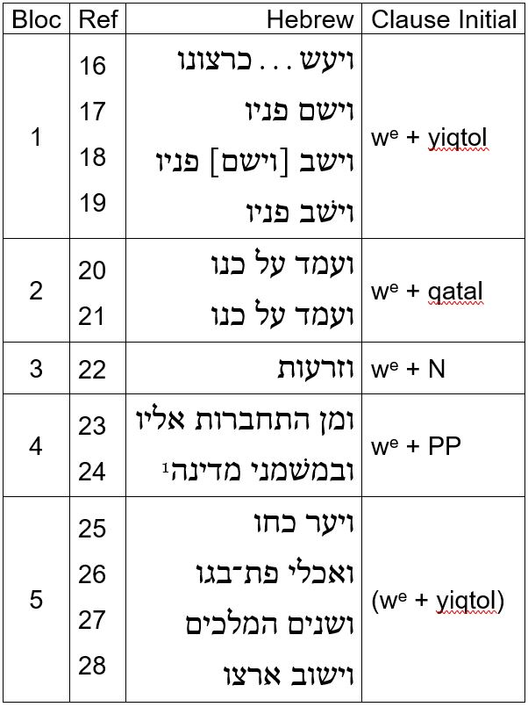

Slide 38
Dan 11: Section B

Slide 39
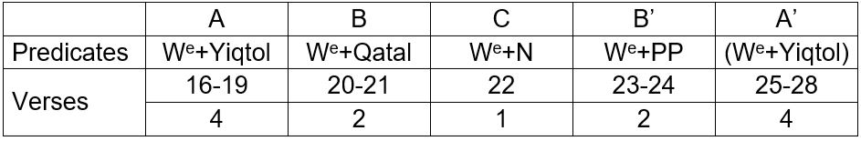
Dan 11: Section B

Slide 40
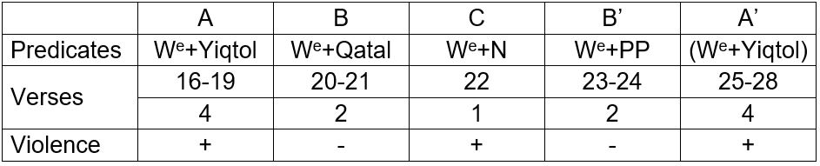
Dan 11: Section B

Slide 41
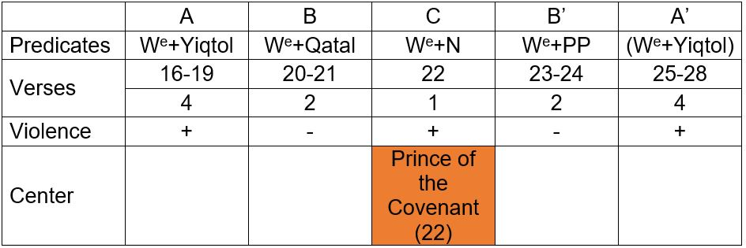
Dan 11: Section B

Slide 42
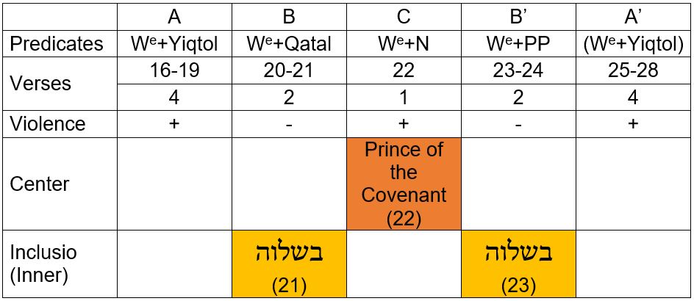
Dan 11: Section B

Slide 43
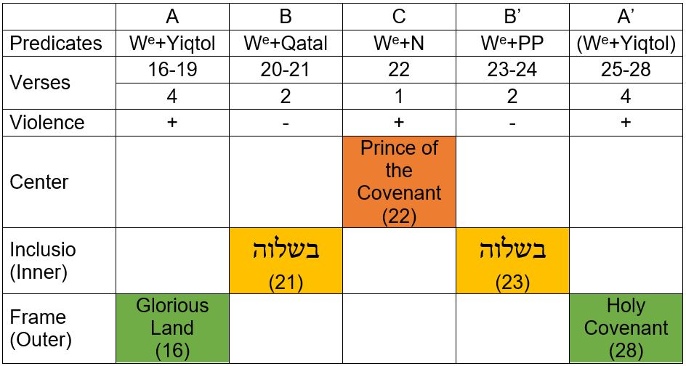
Dan 11: Section B

Slide 44
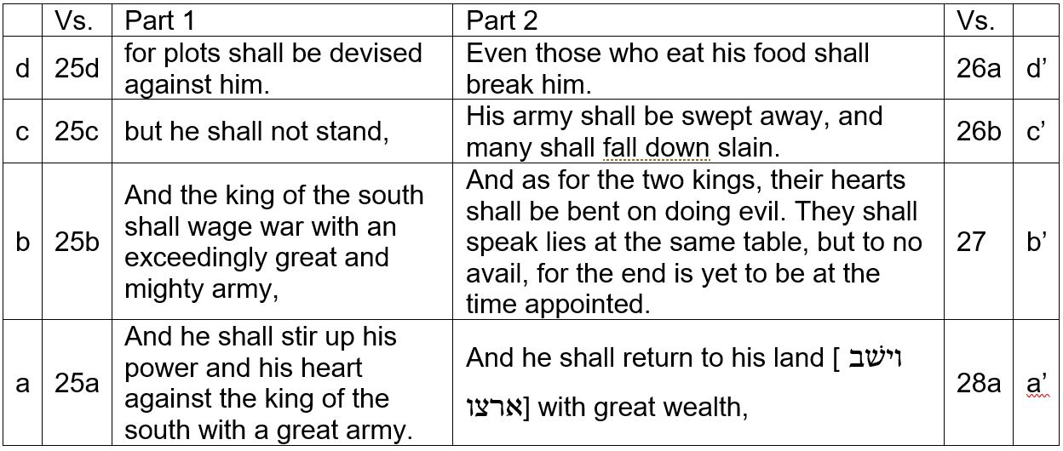
Dan 11: Section B (End)

Slide 45
Daniel 11
Wars

Slide 46
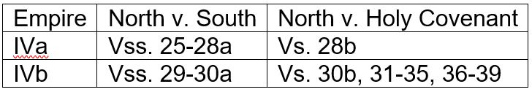
Dan 11: Wars
At the end of 11:23-28 empire IV (IVa) is strong, whereas at the beginning of 11:29-35 empire IV (IVb) is weak.

Slide 47
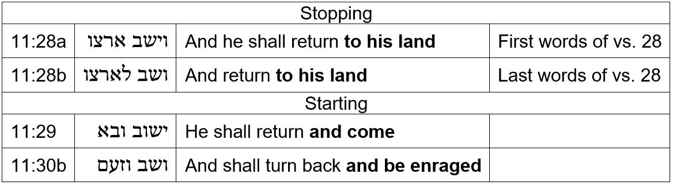
Dan 11: Wars
It is significant that the stopping statements in the above table come at the end of a section (23-28, with special emphasis on 25-28), and that the starting statements come at the beginning of a section (29-35).

Slide 48
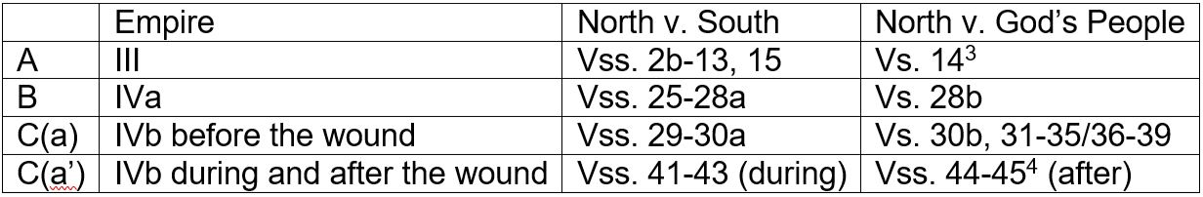
Dan 11: Wars
In each major section there is a war involving North v. South, and in each section there is a war involving North v. the holy covenant. The term “holy covenant” occurs only in 11:28b, 30b(x2). In 11:45 the term is “glorious holy mountain.”

Slide 49
Daniel 11
Framing Statements

Slide 50
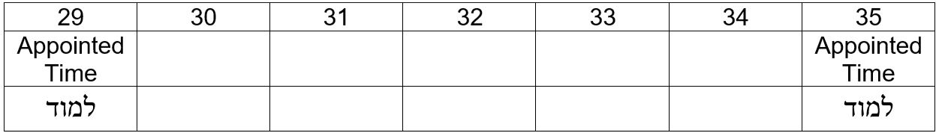
Dan 11: Section C (Framing Statements)
These frames include all of 11:29-35. What happens there occurs within an appointed period (with an appointed beginning and ending point), which I identify as the “time, times, and half a time” mentioned in 7:25; 12:7.

Slide 51
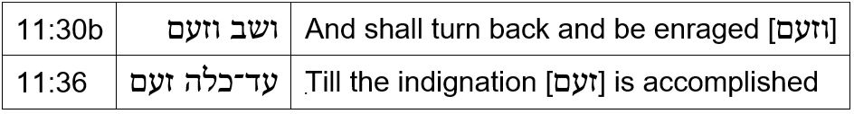
Dan 11: Section C (Framing Statements)
These frames omit the initial war against the South, but unite the subsections dealing with the king’s actions (30b-35) and attitudes (36-39).

Slide 52
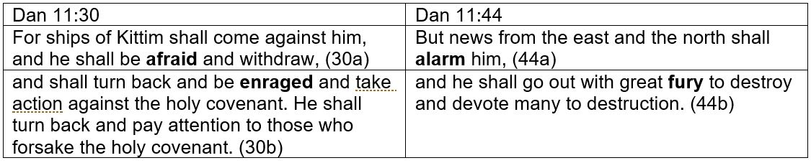
Dan 11: Section C (Framing Statements)
The sequence of “alarm” followed by “fury” (11:44) reflects an earlier parallel sequence involving fear and rage (11:30).

Slide 53
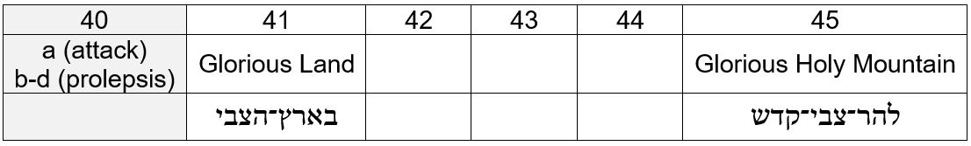
Dan 11: Section C (Framing Statements)
What’s being framed here are events of the section, omitting vs. 40, which apart from 40a is proleptic and looks forward to the events of the section. Taking 40b as an example, if there is no prolepsis, there are two Northern responses (40b, 42-43), because in 41 he has not yet reached “Egypt.”

Slide 54
Dan 11: Section C (Framing Statements)
The beginning terms are identical.

Slide 55
Dan 11: Section C (Framing Statements)
The ending terms are comparable.

Slide 56
Daniel 12

Slide 57
Dan 12: Overview
We here examine two sets of parallels:
  Dan 11:35-36/12:6-7
  Dan 11:31-35/12:10-11
Both sets of parallels constitute shared contexts. In both cases the later passage gives further information about the earlier one.

Slide 58
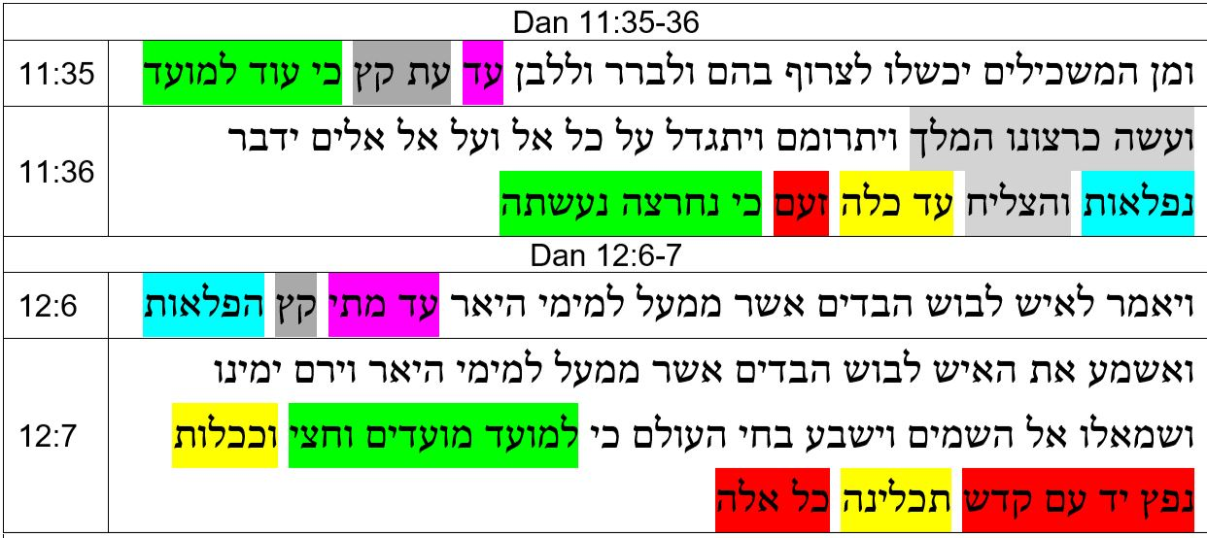
Dan 12: Parallels 1 (11:35-36/12:6-7)

Slide 59
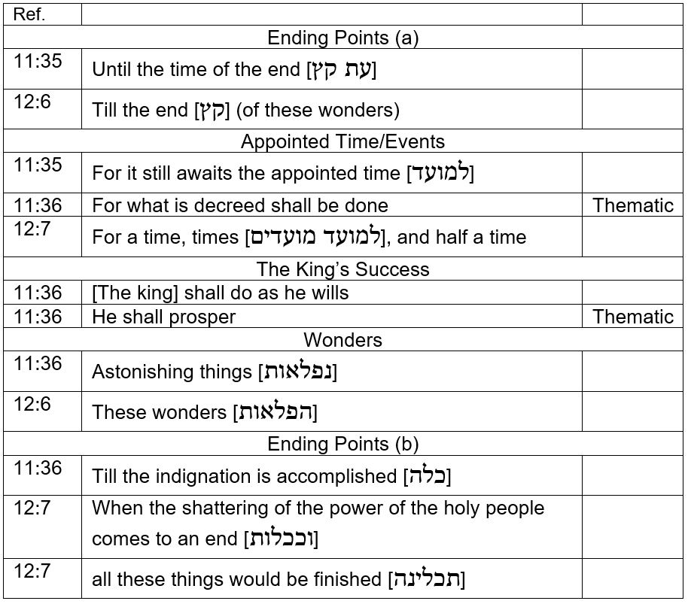

Slide 60
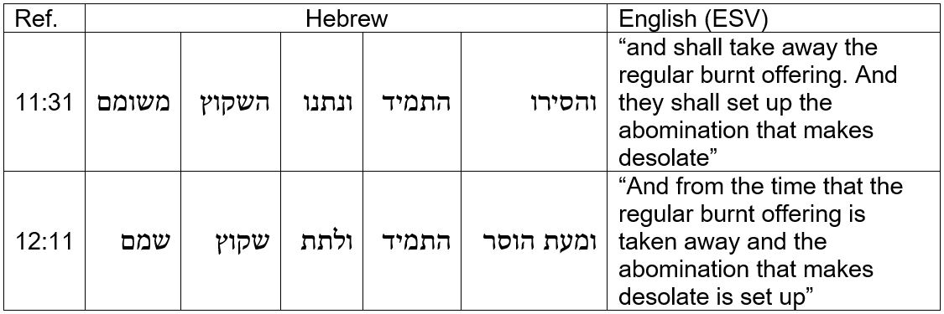
Dan 12: Parallels 2 (11:31-35/12:10-11)
These terms are also comparable, but for the most part not identical. The question is how much latitude can we allow in determining what is a parallel and what is not.

Slide 61
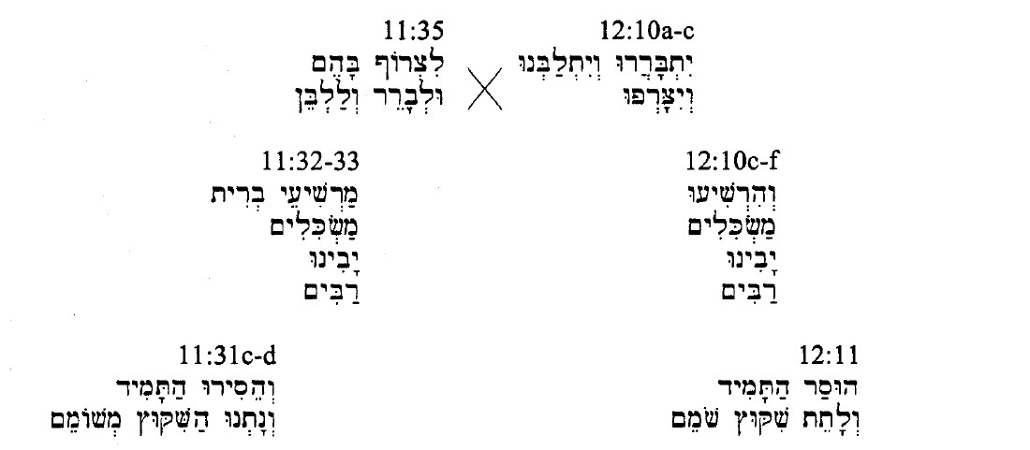

Slide 62
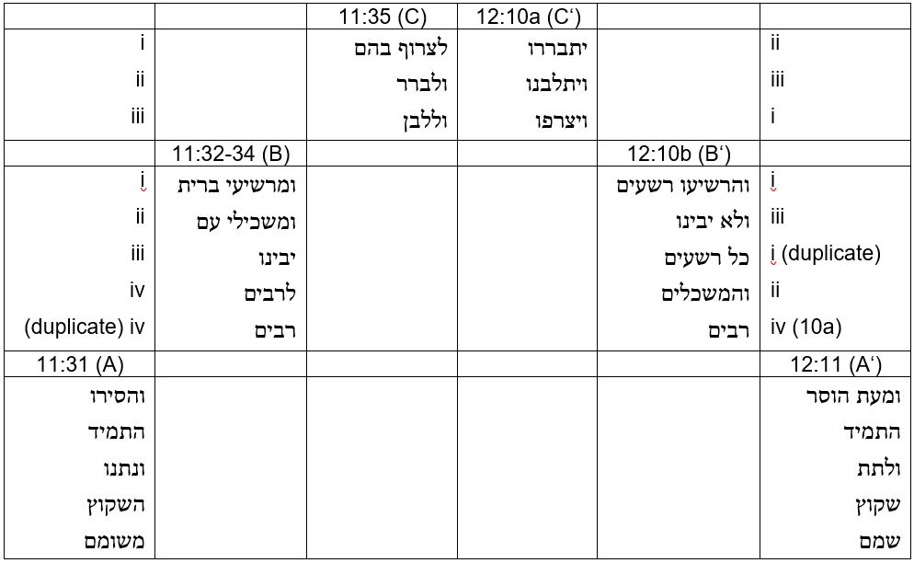

Slide 63
Dan 12: Parallels
I include this discussion because “the man clothed in linen” is the One speaking in Dan 12:6-7 and presumably 12:10-11.
We have seen this holy Being in Dan 10:5-6, in 11:22 and 37 (“the one desired by women”). And we see Him again in 12:6.
We hear Him in 10:9; 12:7, 9, 10-12, and 13.

Slide 64
Outline

Slide 65
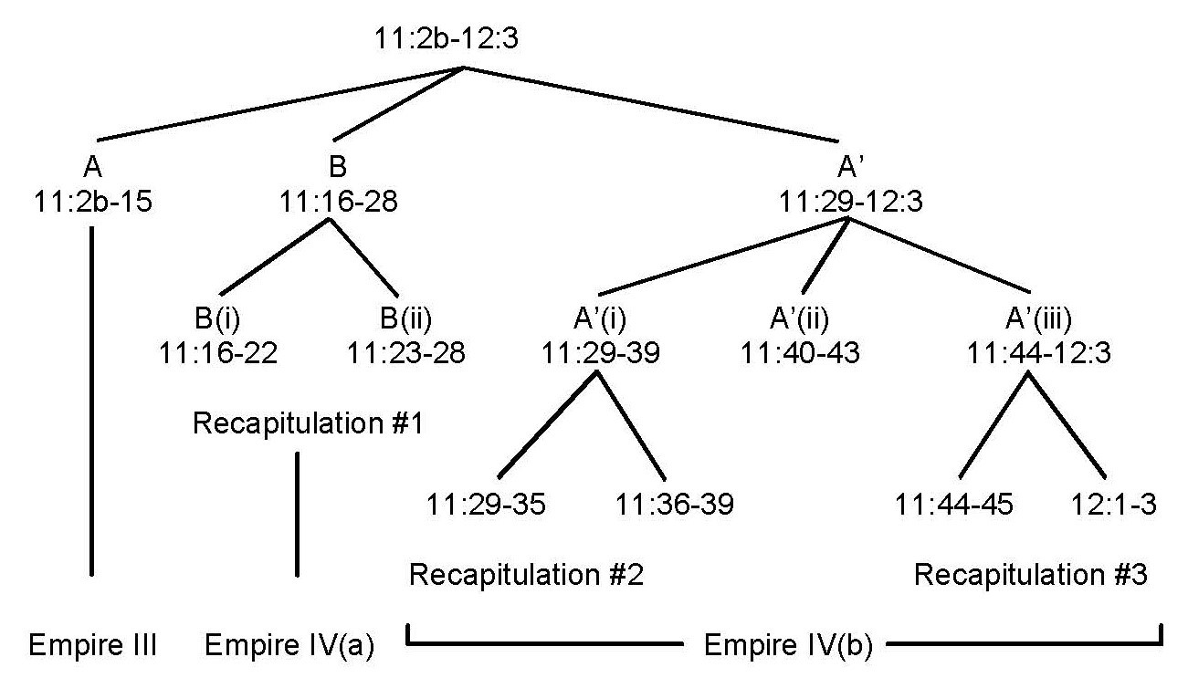
Outline

Slide 66
Discussion

Slide 67
Discussion
The presence of “the man clothed in linen” permeates the prophecy and the structures of 11:16-22/23-28 focus on His presence in vs. 22 and the center of the section.
On either side of section B (11:16-22/23-28) are sections A (11:2b-15) and C (11:29-35/36-39, 40-43, 44-45/12:1-3).
On either side of these outer sections is an inner inclusio around the entire narrative consisting of 11:2a and 12:4.
On either side of this inner inclusio is an outer inclusio consisting of Dan 10 and 12.

Slide 68
Discussion
Another name for “the man clothed in linen” (12:6) is “the prince of the covenant” (11:22).
He occupies the center verse, of the center section, of the center chapter, of the book’s final prophecy – and other passages.

Slide 69
Discussion
This prophecy occupies one quarter (1/4) of the book of Daniel by chapter count and represents the summing up of everything Gabriel was trying to say to Daniel throughout the series of four apocalyptic prophecies.
The prophecy of Dan 11 does not end with a minor war in the Middle East – or a major war, in the Middle East or elsewhere. It ends with the whole earth coming under one command in opposition to God.

Slide 70
Discussion
It takes two armies to fight.
The first army is led by what we have been calling the king of the North (after vss. 41-43 the king of this world, North and South together).
The second army is led by Christ and consists of all the holy angels (Rev 19:11-16), the King of heaven. When this second army arrives, that is the second coming.

Slide 71
Discussion
The powers we call the king of the North and the king of the South at the end of Dan 11 are called spiritual “Babylon” (Rev 14:8; 16:19; 17:5; 18:2, 10, 21) and spiritual “Egypt” (Rev 11:8) in the book of Revelation.
  “According to the words of the prophet, then, a little before the year 1798 some power of satanic origin and character would rise to make war upon the Bible. And in the land where the testimony of God’s two witnesses should thus be silenced, there would be manifest the atheism of the Pharaoh and the licentiousness of Sodom.” GC 269

Slide 72
Discussion
This is the power that attacked Pius VI at Rome in 1798. Berthier (or Napoleon, or Revolutionary France) is the king of the South in Dan 11:40a, and France is spiritual “Egypt” in GC 269 (Rev 11:8).
It takes nothing out of context to connect the two sets of terms. We should not have to separate Daniel from Revelation in order to do good exegesis of either book.

Slide 73
Conclusion

Slide 74
Conclusion
When South attacks North in Dan 11:40a, the attack is entirely one sided. Pius VI has no defense whatever against a French army. And similarly, when North attacks South in vss. 40b-c/42-43, South has no defense against the papacy’s spiritual warfare. The text gives no indication of any Southern response, or any Southern awareness that an invasion is taking place. This phase of the conflict also is entirely one sided.

Slide 75
Conclusion
The point to notice here is not that North and South fight, but that they merge. Fighting is a process, merging is the ensuing outcome or result. The king of the North overwhelms “Egypt” and the result is that “Egypt” and its satellites become his territory, just as the North was always his territory. At this point, by virtue of controlling both North and South, he is no longer a king of the North, nor is he a king of the South. In becoming both, he becomes neither. He is a king of this world.

Slide 76
Conclusion
Now the stage is set for the real conflict. The battle is not in vss. 40a-c/41-43, with 44-45 as a sidebar. On the contrary, the earlier verses merely set the stage for what follows. Verses 40a-c/41-43, are an explanation of how the real war could ever take place, since one of the sides (North/South) is so consistently fragmented. Even in the time of the end North and South are still squabbling. Saying they would one day unite under one command requires explanation, and that is the function of vss. 40a-c/41-43.

Slide 77
Conclusion
The two sides must eventually unite or Rev 13:3 would be untrue (“but its mortal wound was healed [41-43], and the whole earth marveled as they followed the beast [44-45]”), and Rev 19:19 (“And I saw the beast and the kings of the earth with their armies gathered [συνηγμένα] to make war against him who was sitting on the horse and against his army”). This takes us back to Rev 16:16 (“And they assembled [συνήγαγεν] them at the place that in Hebrew is called Armageddon”), and 16:14 (“For they are demonic spirits, performing signs, who go abroad to the kings of the whole world, to assemble [συναγαγεῖν] them for battle on the great day of God the Almighty”).

Slide 78
Conclusion
So long as North and South are still squabbling the real war cannot begin, because the first army has not yet coalesced as one. And even when they form one army the war cannot take place, because the second army has not yet arrived. When it does arrive (“And the armies of heaven, arrayed in fine linen, white and pure, were following him on white horses” [Rev 19:14]), the conflict is over almost before it begins (“and he shall come to his end with none to help him” [Dan 11:45b]). “And then the lawless one will be revealed, whom the Lord Jesus will kill with the breath of his mouth and bring to nothing by the appearance of his coming” (2 Thess 2:8 ESV). In this case also, the conflict is entirely one sided.

Slide 79
Conclusion
It is imperative that we combine the narrative of Daniel with the narrative of Revelation. Until we do this, we will never understand it. The angel says, “And none of the wicked shall understand, but those who are wise shall understand” (Dan 12:1). This language is very blunt, but I did not write it. My question is, why is this so? What hermeneutic leads the wicked not to understand? And in fact there are many ways to misunderstand, with many hermeneutics that could lead to such a result.

Slide 80
Conclusion
But if, through rigorous exegesis, we follow what the Holy Spirit tells us in Daniel, and add to this what the Holy Spirit tells us in Revelation, and add to this what the Holy Spirit tells us in the Spirit of Prophecy, we will not misunderstand. The meaning will be clear. And it will be Christ centered.

