Slide 1
Errors in Translation and Genre that Derail Interpretations of Daniel 11
Michael F. Younker, PhD
ASTR with General Conference of SDA

Slide 2
The actual words matter, and so does sound scholarship
A lesson from Dan 8:12:
EGW: “Then I saw in relation to the "daily" (Daniel 8:12) that the word "sacrifice" was supplied by man's wisdom, and does not belong to the text.”
While Adventists emphasize the correct translation, scholars are in harmony with us on the translation—it is the interpretation where we differ.
We should seek to understand the correct translations before we interpret! And scholarly opinion does matter here.

Slide 3
Verse 14
ûbä`iTTîm hähëm (~heêh' ~yTiä[ib'W )
= “and in those times” (plural).
This exact form occurs only one other time in 2 Chr 15:5. Has a waw disjunctive (interruption in narrative-scene continuity).
Indicates a larger window of time.
Several commentators have considered the phrase ûbä`iTTîm hähëm in 2 Ch 15:5, spoken by Azariah to king Asa, as referring to the numerous previous kings and judges, a span of many decades.
This is supported by Warren W. Wiersbe, The Wiersbe Bible Commentary: Old Testament (Colorado Springs, CO: 2007), 652; and James E. Smith, 2 Chronicles: A Commentary (Lulu Press, 2016), 118. Others see it as “intentionally ambiguous,” but depicting a broad period, even “all of Israelite history,” Andrew E. Hill, The NIV Application Commentary: 1 & 2 Chronicles (Grand Rapids, MI: Zondervan, 2003), 471.
In the least, it seems the term can imply a significant stretch of time, and in the prophetic context of Dan 11:14, its usage may be similar.
No need to rigidly restrict the rebellions spoken of in Dan 11:14 to a very tight window of time under Antiochus III as many interpreters have done; just compare with 2 Chr 15:5 where more time is clearly present.

Slide 4
Verse 14
ûbünê Pärîcê `ammükä
Three consecutive nouns in construct form, with a 2nd person masculine possessive suffix.
A construct chain indicates a possessive series—that is, “and sons of violent-ones of your people.”
Heinrich Ewald, Syntax of the Hebrew Language of the Old Testament (Edinburgh: T & T Clark, 1891), 102-110. As Ewald explains, “when the series of construct words extends to three or more nouns, the same laws obtain [as with two]. . . . If the second noun describes merely the property of the first, or is in any other way intimately connected with it, the third noun refers equally to the two preceding.” Furthermore, “to the foregoing construction of three or several nouns, corresponds that of several nouns, which are intimately connected in idea, with the pronominal suffix as the final member of the series.”
That is to say, one could legitimately rearrange the words in the present phrase to say “and your people’s violent sons.” This is a common understanding by Bible translators; the phrase refers to Daniel’s own people rising up (Dan 10:14).

Slide 5
Verse 14
Lastly, most modern translations correctly render Pärîcê as “violent ones” among Daniel’s people, the Jews. The translation of “robbers” in the KJV is not a good choice for Pärîc, as its root meaning is ‘violence / breaker / breacher,’ not robber or thief, which might in English appear to indicate an outside entity as seen with the ‘robbers of your people’ in the KJV.
Indeed, the interpretation of ‘robbers’ is not possible, as confirmed by the usage of Pärîc in other passages, such as Isa 35:9, which reads, “no lion shall be there, nor any pürîc/violent beast.” Similarly, in Eze 18:10, it reads, “If he has a son, a pürîc/violent one, a shedder of blood.” In the other passages it appears violence is also assumed, such as Eze 7:22-23, and Jer 7:9-11. No where does it imply simply “robber,” even if robbers can also be violent.
The Romans do not appear here. No reason to include the word “sons” if they appeared here for the first time, and likewise no reason to mention the collapse of the Romans or papacy which was several hundreds or thousands of years away, beyond what’s reasonably allowed by “those times.” The uprising occurs during the period of the Greek kingdoms.

Slide 6
Verse 14: Correct translations!
^{NAS} Daniel 11:14 "Now in those times many will rise up against the king of the South; the violent ones among your people will also lift themselves up in order to fulfill the vision, but they will fall down.
^{NKJ} Daniel 11:14 "Now in those times many shall rise up against the king of the South. Also, violent men of your people shall exalt themselves in fulfillment of the vision, but they shall fall.

Slide 7
Verse 15: Correct translations
^{KJV} Daniel 11:15 So the king of the north shall come, and cast up a mount, and take the most fenced cities: and the arms of the south shall not withstand, neither his chosen people, neither shall there be any strength to withstand.
^{NKJ} Daniel 11:15 "So the king of the North shall come and build a siege mound, and take a fortified city; and the forces of the South shall not withstand him. Even his choice troops shall have no strength to resist.
Note the two nouns; the KoN and KoS are both present in verse 15 in the singular. mibHäräyw has a 3rd person masculine singular suffix = “his choicest”

Slide 8
Verse 16, Correct translations
^{NKJ} Daniel 11:16 "But he who comes against him shall do according to his own will, and no one shall stand against him. He shall stand in the Glorious Land . . . .
^{YLT} Daniel 11:16 And he who is coming unto him doth according to his will, and there is none standing before him; and he standeth in the desirable land, and it is wholly in his hand.
^{GWN} Daniel 11:16 . . . . beautiful land and it will be completely under his control.

Slide 9
Verse 16
No new narrative power is introduced here through the waw consecutive which indicates that the flow of the text requires that the story of the rise, victory, and demise of the king of the north introduced in verse 5, narratively, and verse 10, specifically, needs to be concluded.
Neither the Hebrew “he who comes”/haBBä´ (Dan 9:26 prefaces this word by naming the power in mind as the “people of the prince”) nor “as he pleases /Kircônô ever introduces a ‘new’ king or power in Daniel’s prophecies by itself.
haBBä´ looks for a previous noun; 2 Sam 12:4, Mal 3:19, 2 Chron 28:9, Ezra 8:15, etc.
E.g., ^{NAS} 1 Samuel 4:16 And the man said to Eli, "I am the one who came from the battle line. Indeed, I escaped from the battle line today." And he said, "How did things go, my son?"
^{NAS} Numbers 4:47 from thirty years and upward even to fifty years old, everyone who could enter to do the work of service and the work of carrying in the tent of meeting.

Slide 10
In Dan 8:4, the phrase “as he pleases” is accompanied by a context that makes clear a distinct power is intended—the power of the ram in 8:3, who is so strong none can ‘stand’ before him. The phrase “as he pleases,” however, does not introduce the power of the ram in itself, but rather indicates the apex of the ram’s power—this is a power who will truly rule “as he pleases” for a limited time. “As he pleases” serves the same function in 11:16 to conclude with the apex of the KoN’s power at this point in the narrative before his demise (11:17-19).
The use of two pronouns, whether with a particle, participle or as a suffix, in verse 16 indicates one must look to the previous verse 15 to identify what nouns are referred to in verse 16. Scholars agree this is the correct syntax and grammar!

Slide 11
Verse 16
Many assume wükälâ büyädô means “destruction in his hand.” Unfortunately several popular Bible versions do render it this way. But this is not fully accurate, as noted by other scholars.
Affirming that the power attained by Antiochus III was “finished/complete control” (kälâ) rather than actual “destruction” as some translate it, see Johns, The Visions of Daniel the Hebrew Prophet, 271-272; and Greidanus, Preaching Christ from Daniel: Foundations for Expository Sermons, 379. The reason for this is logical—Antiochus III wanted to control Israel as his own possession, not destroy it; his quest to defeat his foe controlling it took some time, however. The usage of kälâ in Hebrew confirms the probability of this interpretation, as seen in Num 4:15, 1 Sam 3:12, Isa 10:25, Isa 21:16, Jer 4:27, Jer 5:10, Eze 42:15, etc. In brief, kälâ as a verb or noun means “end, finish, full end, cease, accomplish, completeness, consume,” etc. Destruction is only one possible interpretation, and not one that fits the context nor possible historical applications.

Slide 12
Verse 16
Neither Antiochus III nor the Romans destroyed the temple upon entering Israel, nor burned the countryside; only much later in 63 B.C. did the Romans first destroy Jerusalem’s walls, but even then did not destroy the temple. Israel’s invaders wanted to profit from Israel as a prize, not destroy it.
Furthermore, it does not make sense to put the Romans here, as this would skip Antiochus III’s decade of control (same length as Alexander in 8:4!), and also ignore the fact that the Romans first gained control of Israel as a proxy ruler over the Seleucids, then lost control of it for a century to the Jewish Hasmonean kingdom, before being invited to Jerusalem by the Hasmonean rulers.

Slide 13
Verse 16
(my translation)11:16 For he [KoN] who comes toward him [KoS] will do as he pleases, and nothing will stand against his face. And he [KoN] will stand in the beautiful land, and have complete control in his hand.

Slide 14
Verse 20
^{KJV} Daniel 11:20 Then shall stand up in his estate a raiser of taxes in the glory of the kingdom: but within few days he shall be destroyed, neither in anger, nor in battle.
^{NAS} Daniel 11:20 "Then in his place one will arise who will send an oppressor through the Jewel of his kingdom; yet within a few days he will be shattered, though neither in anger nor in battle.

Slide 15
Verse 20
Observe that nôgëS / overseer is used in Job 39:7, Zec 10:4, and also Ex 3:7, 5:6.
Taskmaster/slavemaster, not simply “taxer.”
First Roman to do this is general Pompey, who was authorized by the Republic to go to the east, and ultimately invited to resolve a dispute for the crown of Jerusalem. The Hasmonean throne’s competitors, the brothers Hyrcanus and Aristobulus, appealed to him for Rome’s help in resolving their dispute.
The Roman historian Tacitus wrote, “Pompeius was the first of our countrymen to subjugate the Jews. And invoking the right of conquest, he entered the Temple . . . . The walls of Jerusalem were destroyed, but the Temple was left standing,” Tacitus, History V, 8, 9.

Slide 16
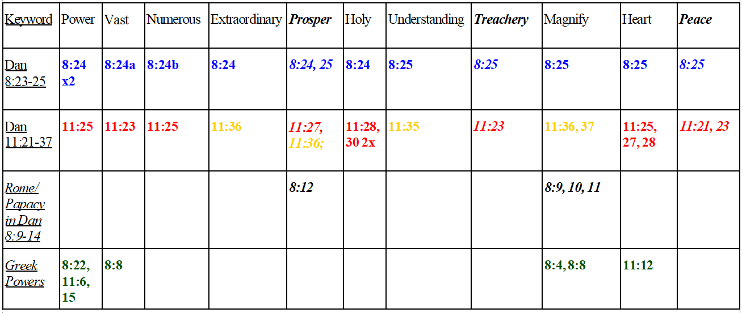
Verses 21-39: Lexical data in relation to Dan 8:23-25
Blue = Keywords in 8:23-25 that are repeated in Dan 11:
Red = 11:21-30; Yellow = 11:36-37; Black = Rome in Dan 8:9-14;
Green = Greek powers in Dan 8

Slide 17
Verses 21-30
Question: why do so many words attributed to Rome, and very likely the papacy, in Dan 8 appear in Dan 11 before verse 31? (And also in verses 36-37?).
Answer is clear, lexically: The papacy appears before verse 31, and is highlighted again in verses 36-37.

Slide 18
1) In 8:25 he corrupts through "peace/shalvah" and shalvah only appears twice more in 11:21 and 11:23/24.
2) The word “vast/atsam” only appears in reference to united Greece in 8:8, and then twice more in 8:24a (as the papacy and 11:23 (probably as the papacy again?) Vast means ‘vast.’ Only united Greece and Rome (but not divided Greece!) controlled such vast geographical territory. The context of becoming vast from a few people in verse 23 indicates that this is the papacy, as Rome was already introduced and was already vast.
3) The word “numerous/atsum” only appears twice, once in 8:24b as the papacy’s enemies and again in 11:25 as the papacy’s(?) arch-rival. Numerous means ‘numerous.’ Only papal Rome and the southern empire of the 7th century attained ‘numerous’ armies within the relevant time windows. Imperial Rome did not have a ‘numerous’ enemy or enemies worthy of note before Constantine. And no single united enemy would attack Imperial Rome before 538 as the text depicts in 11:25.

Slide 19
4) Dan 8:25 refers to "treachery/mirmah," a word appearing only twice in Daniel, with the other in 11:23. Dan 8:25 is widely seen as the papacy.
5) "Extraordinary/pala" only occurs three times in Daniel, in 8:24, 11:36, and 12:6. The latter refers to the former two, and identifies the ‘end of these wonders’ as the end of papal dominance and the cleansing of the temple in 1844 (12:7, 11-12).
6) "Heart/lebab" appears in Dan 11:12, but only again in 8:25, and then in the despised king in 11:25, 27, 28.

Slide 20
7) In 8:25, he will “magnify/gadol himself,” which only appears in Dan 8:4, 8, 9, 10, 11, and again in Dan 11:36-37. It is likely those in 8:25 and 11:36-37 are all pointing toward Rome.
8) The word understanding/sakal is always used in a positive sense in Scripture (e.g. Dan 11:35); the king of Dan 8:25 corrupts God’s people through an understanding of their own religion; he professes to be one of them to corrupt them. This cannot be applied to Antiochus IV, who did not deceive any Jews.
9) “Prosper/salah” only appears in Dan 8:12, 24-25, 11:27 and 11:36. In each instance it likely refers to the papacy; it would be remarkable if only those occurrences in Dan 8 were the papacy.

Slide 21
10) Also, in Dan 9:26, the Jews under pagan Imperial Rome corrupt/shachat themselves, Jerusalem, and the sanctuary during and after Christ’s life and sacrifice, and the end comes with a flood; Cf., 11:22 and its flood; and 8:24-25 and its corruption of Christianity by Rome’s Christian papacy. That is, both corruptions originate from professing believers.
11) “Desolation/shamem” appears in Dan 8:13, 9:26-27, 11:31, and 12:11. They likely all refer to the same general events of desolation caused by the Roman empire and papacy; note however that it appears in the plural in 9:26, indicating more than one is indicated (cf. Matt 24:15) so 8:13 and 11:31 are likely later than the initial fulfilment of 9:26-27 (abominations in 9:27 is also plural).

Slide 22
12) Deut 28:50 and Dan 8:23 contain lexical parallels (“fierce face”), as do Dan 9:24 and 8:23 (“transgressions” are “finished”). If these are valid, then it is likely Imperial Rome in each case, which likely indicates Dan 8:9 is Imperial Rome.

Slide 23
Verse 30 and Kittim
In sum, at the time Daniel wrote the prophecy in the 6th century B.C., Kittim meant Cyprus, and only Cyprus, even if later on the eschatologically-minded Jews who wrote 1 Maccabees or those near Qumran who wrote the apocalyptic War Scrolls or even others that wrote Jubilees or the Pesharim on Habbakuk had expanded its original literal geo-political meaning to fit their own expectations, very likely based on their speculations about the meaning of Kittim in Numbers, Isaiah, and Daniel!
^{NKJ} Daniel 11:30 "For ships from Cyprus shall come against him; therefore he shall be grieved, and return in rage against the holy covenant, and do damage. So he shall return and show regard for those who forsake the holy covenant.

Slide 24
Verse 40, 12:1-2
ûbä`ët = at or during the time?
“et” = season of time, implies duration
In every Hebrew occurrence of ûbä`ët it can be translated with “during the time,” based off the b preposition + et.
E.g., Joel 3:1 "For behold, in those days and during that time, When I restore the fortunes of Judah and Jerusalem.”
ûbä`ët precedes events that take place during a season or process of time.

Slide 25
Where is the KoN?
Dan 8:9 and 11:40 are the introduction and conclusion of the same narrative power. As such, there should be no insurmountable objections either historically or textually to having the Roman despised king also function as the KoN during the end times. Jer 25:26 refers to “all the kings of the north, far and near, one with another, and all the kingdoms of the world that are on the face of the earth”

Slide 26
Edom, Moab, and Ammon
Dan 11:40-45 does not mention God’s people in connection with the glorious holy mountain nor Ammon, Edom, and Moab, etc. Rather, the glorious holy mountain is the target of God’s adversaries, and it still is, literally, today. Furthermore, in each biblical passage in which Edom, Moab, and Ammon are mentioned (Dan 11:41), even in prophetic passages depicting the far distant future, fulfilled during the Christian era, they are used literally. For example, Isa 11:14, as well as Jer 9:26, and 25:21.

Slide 27
Ellen G. White, Prophets and Kings, 367-378.
In this chapter, White emphasizes that as Isaiah was “looking on still farther through the ages, the prophet beheld the literal fulfillment of these glorious promises. He saw the bearers of the glad tidings of salvation going to the ends of the earth, to every kindred and people,” ibid., 374. She continues, “these prophecies of a great spiritual awakening in a time of gross darkness are today meeting fulfillment in the advancing lines of mission stations that are reaching out into the benighted regions of earth. The groups of missionaries in heathen lands have been likened by the prophet to ensigns set up for the guidance of those who are looking for the light of truth.”

Slide 28
“‘In that day,’ says Isaiah, ‘there shall be a root of Jesse, which shall stand for an ensign of the people; to it shall the Gentiles seek: and his rest shall be glorious. And it shall come to pass in that day, that the Lord shall set His hand again the second time to recover the remnant of His people. . . . And He shall set up an ensign for the nations, and shall assemble the outcasts of Israel, and gather together the dispersed of Judah from the four corners of the earth.’ Isaiah 11:10-12,” ibid., 375-376.

Slide 29
Although White does not specifically quote Isa 11:14, in point of fact, during the first part of the Christian dispensation before Islam arose, it was literally fulfilled, alongside the numerous other nations referred to in Isa 11:11-14 (Assyria, Egypt, Pathros, Cush, Elam, Shinar, Hamath, the islands of the sea, and the Philistines—after Isaiah’s time, all these nations later saw Christianity before Islam arose, and it would be very difficult to determine a symbolic meaning for each of them). Isaiah sees a real, literal future, and writes the names of those places he is familiar with, regardless of changes in their names or peoples in the future.

Slide 30
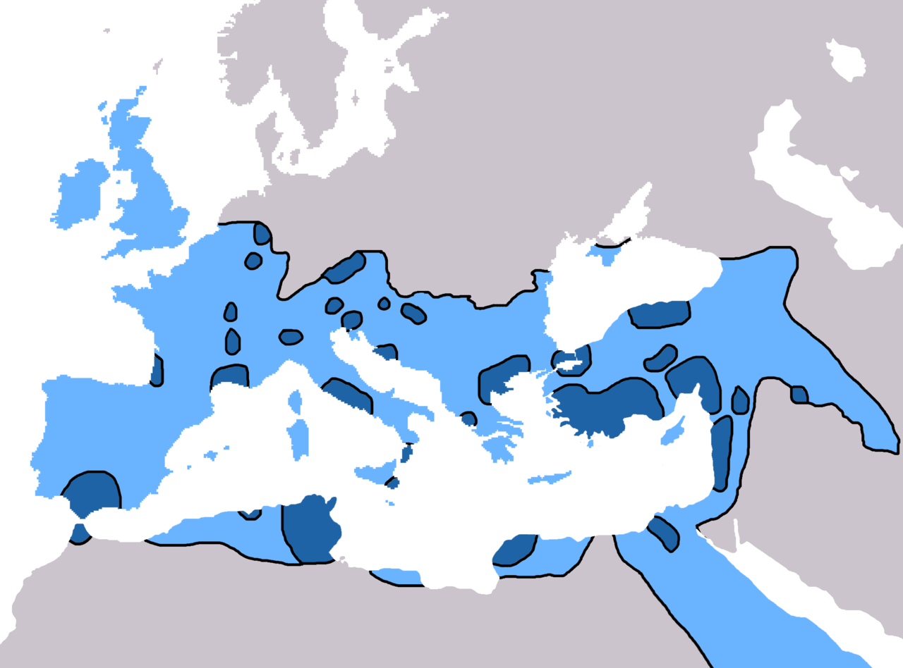
Christianity in 3rd and 5th Century AD
Assyria
Shinar/Babylon
Hamath
Elam
Islands of the sea
Jerusalem
Philistia
Egypt
Pathros
Cush

Slide 31
In sum, Isa 11 contains prophecies that are focusing on the Christian (including its later ‘heavenly’) era, and were or will be literally fulfilled, including the calf and the young lion being together, with a young boy to lead them (Isa 11:6; cf. White, Early Writings (1882), 18). There is no “symbolism” in Isa 11; rather, more distant lands are literally referred to through the classic metaphor of the “four corners of the earth.” Cf. Jer 25, which also refers to Edom, Moab, and Ammon (25:21), alongside “all the kingdoms of the world” (25:26). The juxtaposition of these specific places alongside “the world” indicates the places are literal in meaning, as the rest of the world is literally included as well.
It is our task today to again literally fulfill, per White, this prophecy.

Slide 32
White, The Great Controversy (1911), 662-663
Christ descends upon the Mount of Olives, whence, after His resurrection, He ascended, and where angels repeated the promise of His return. Says the prophet: “The Lord my God shall come, and all the saints with Thee.” “And His feet shall stand in that day upon the Mount of Olives, which is before Jerusalem on the east, and the Mount of Olives shall cleave in the midst thereof, . . . and there shall be a very great valley.” “And the Lord shall be king over all the earth: in that day shall there be one Lord, and His name one.” Zechariah 14:5, 4, 9. As the New Jerusalem, in its dazzling splendor, comes down out of heaven, it rests upon the place purified and made ready to receive it, and Christ, with His people and the angels, enters the Holy City.

Slide 33
“When the sin-cursed earth is purified from every stain of sin, when the Mount of Olives is rent asunder and becomes an immense plain, when the holy city of God descends upon it, the land that is now called the Holy Land will indeed become holy,” Lt26-1895.

Slide 34
Ellen White, A Word to the Little Flock (1847), 11-12
“I saw that Satan was “loosed out of his prison,” at the end of the 1000 years, just at the time the wicked dead were raised; and that Satan deceived them by making them believe that they could take the holy city from the saints. The wicked all marched up around the “camp of the saints,” with Satan at their head; and when they were ready to make an effort to take the city, the Almighty breathed from his high throne, on the city, a breath of devouring fire, which came down on them, and burnt them up, “root and branch.”
And I saw, that as Christ is the vine, and his children the branches: so Satan is the “root”, and his children are the “branches;” and at the final destruction of “Gog and Magog,” the whole wicked host will be burnt up, “root and branch,” and cease to exist. Then will appear the new heaven and the new earth [see Rev 20:7-9].”

Slide 35
It is probable that Daniel, like Isaiah, describes the future from his perspective, his vocabulary, his point-of-view, even as it reveals a divine purpose and picture.

