Slide 2
The Case
For 3 Powers In Daniel 11:40

Slide 3

“It is also hoped that de Regt or other scholars will find more patterns in addition to his very insightful rules that would allow for the identification of anaphoric references that span longer stretches of text. ”
Who did What to Whom? Anaphoric Subjects and Objects in Daniel 11:2b-12:3, p. 16

Slide 4
King of the North/South
Verses 6-15
Verses 16-39
80%
8%

Slide 5
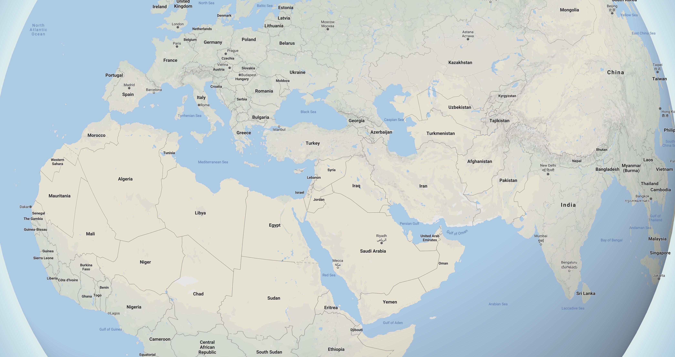



Slide 6

Daniel 11:13
For the king of the north shall return, and shall set forth a multitude greater than the former, and shall certainly come after certain years with a great army and with much riches.

Slide 7
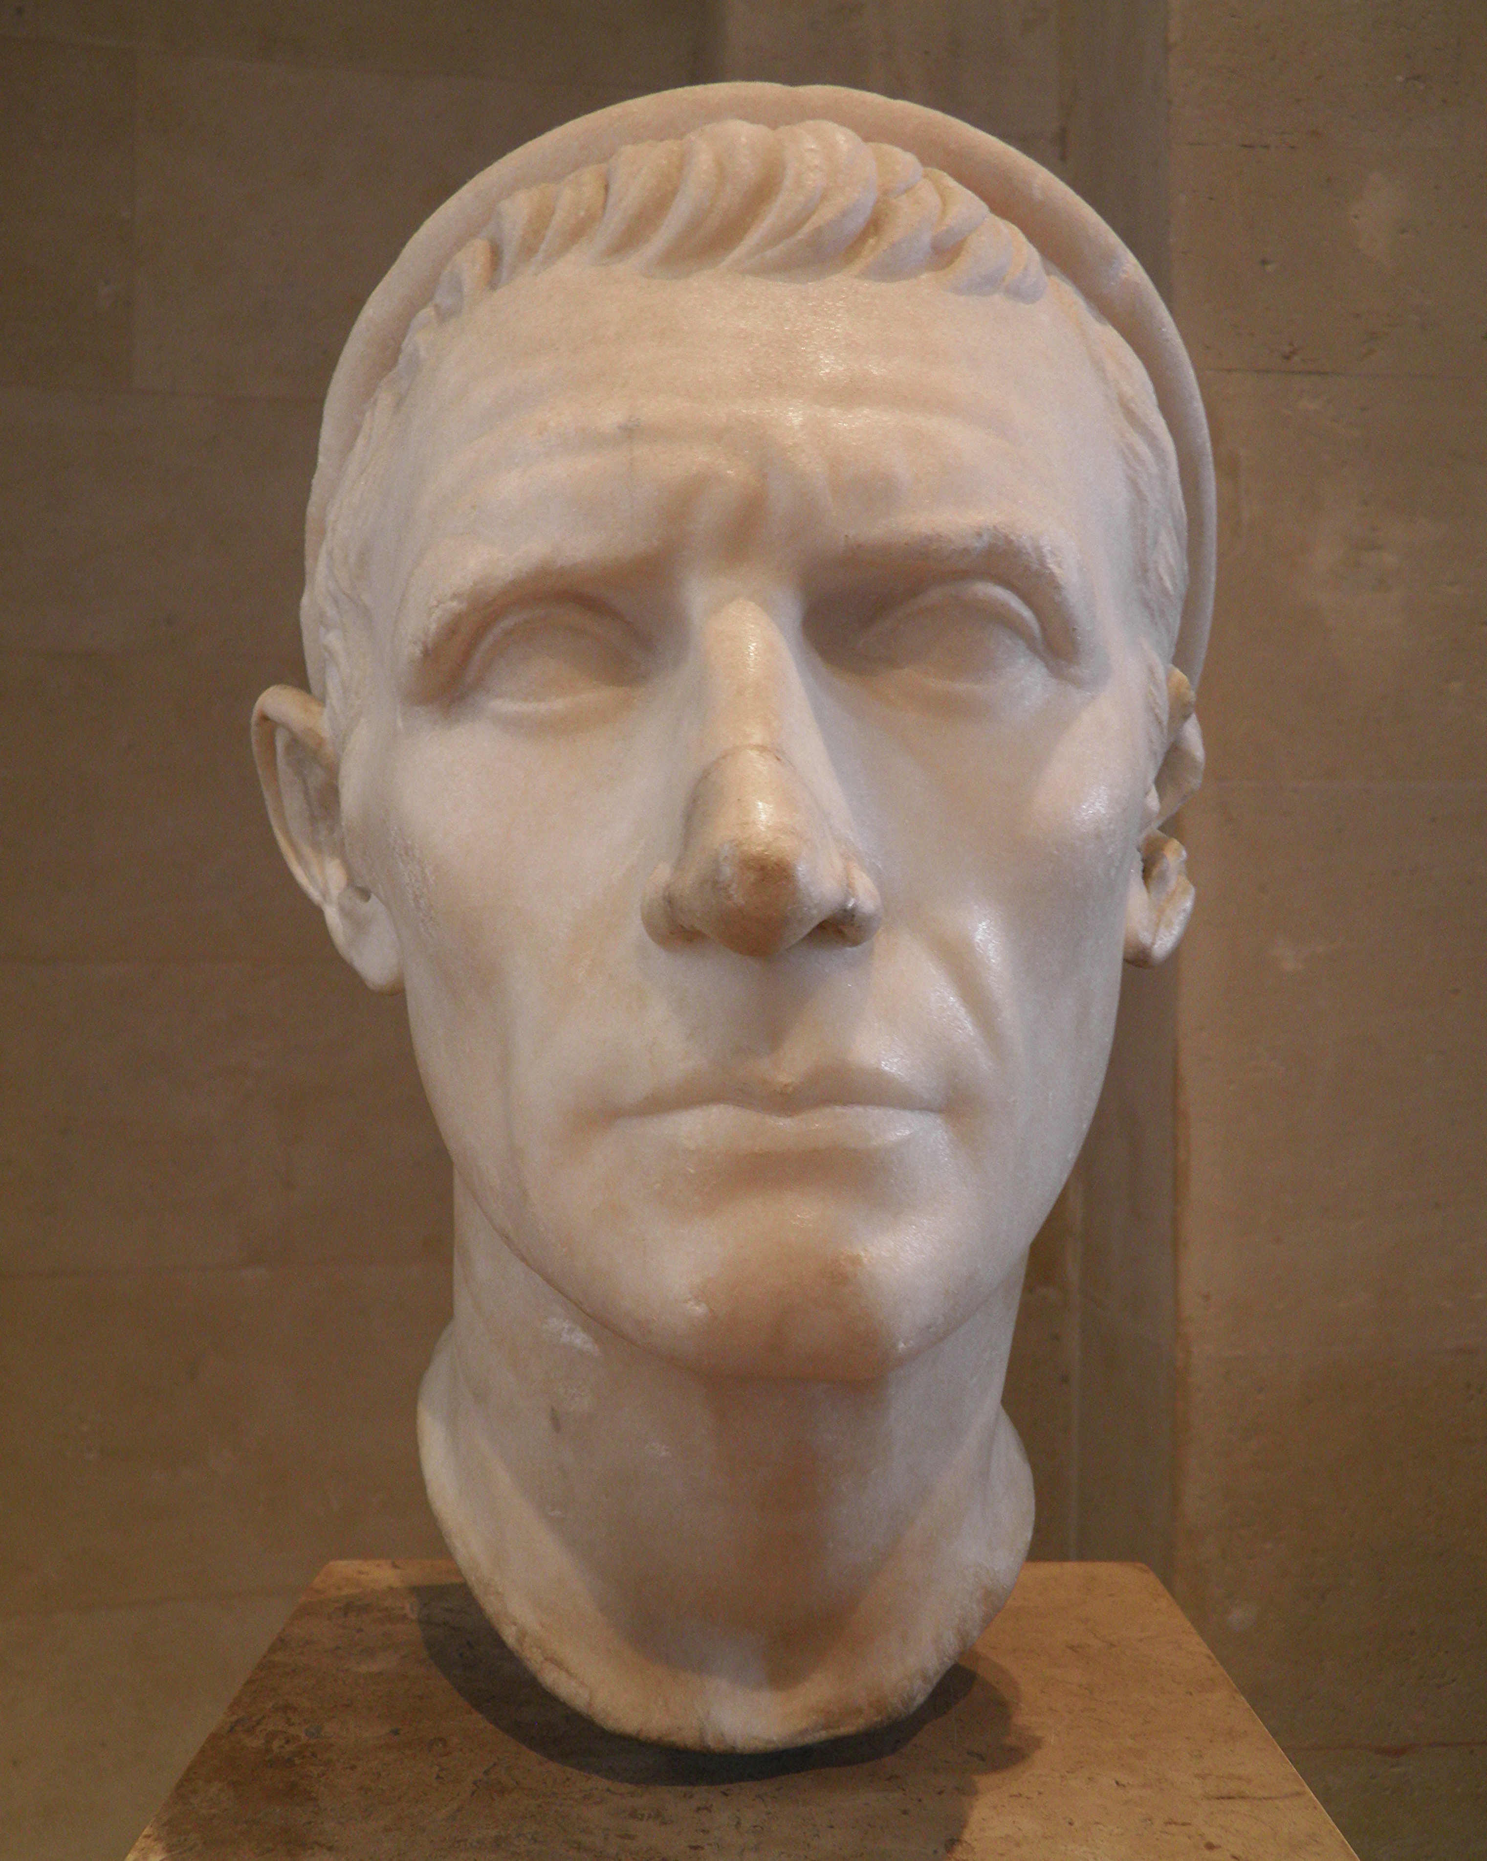
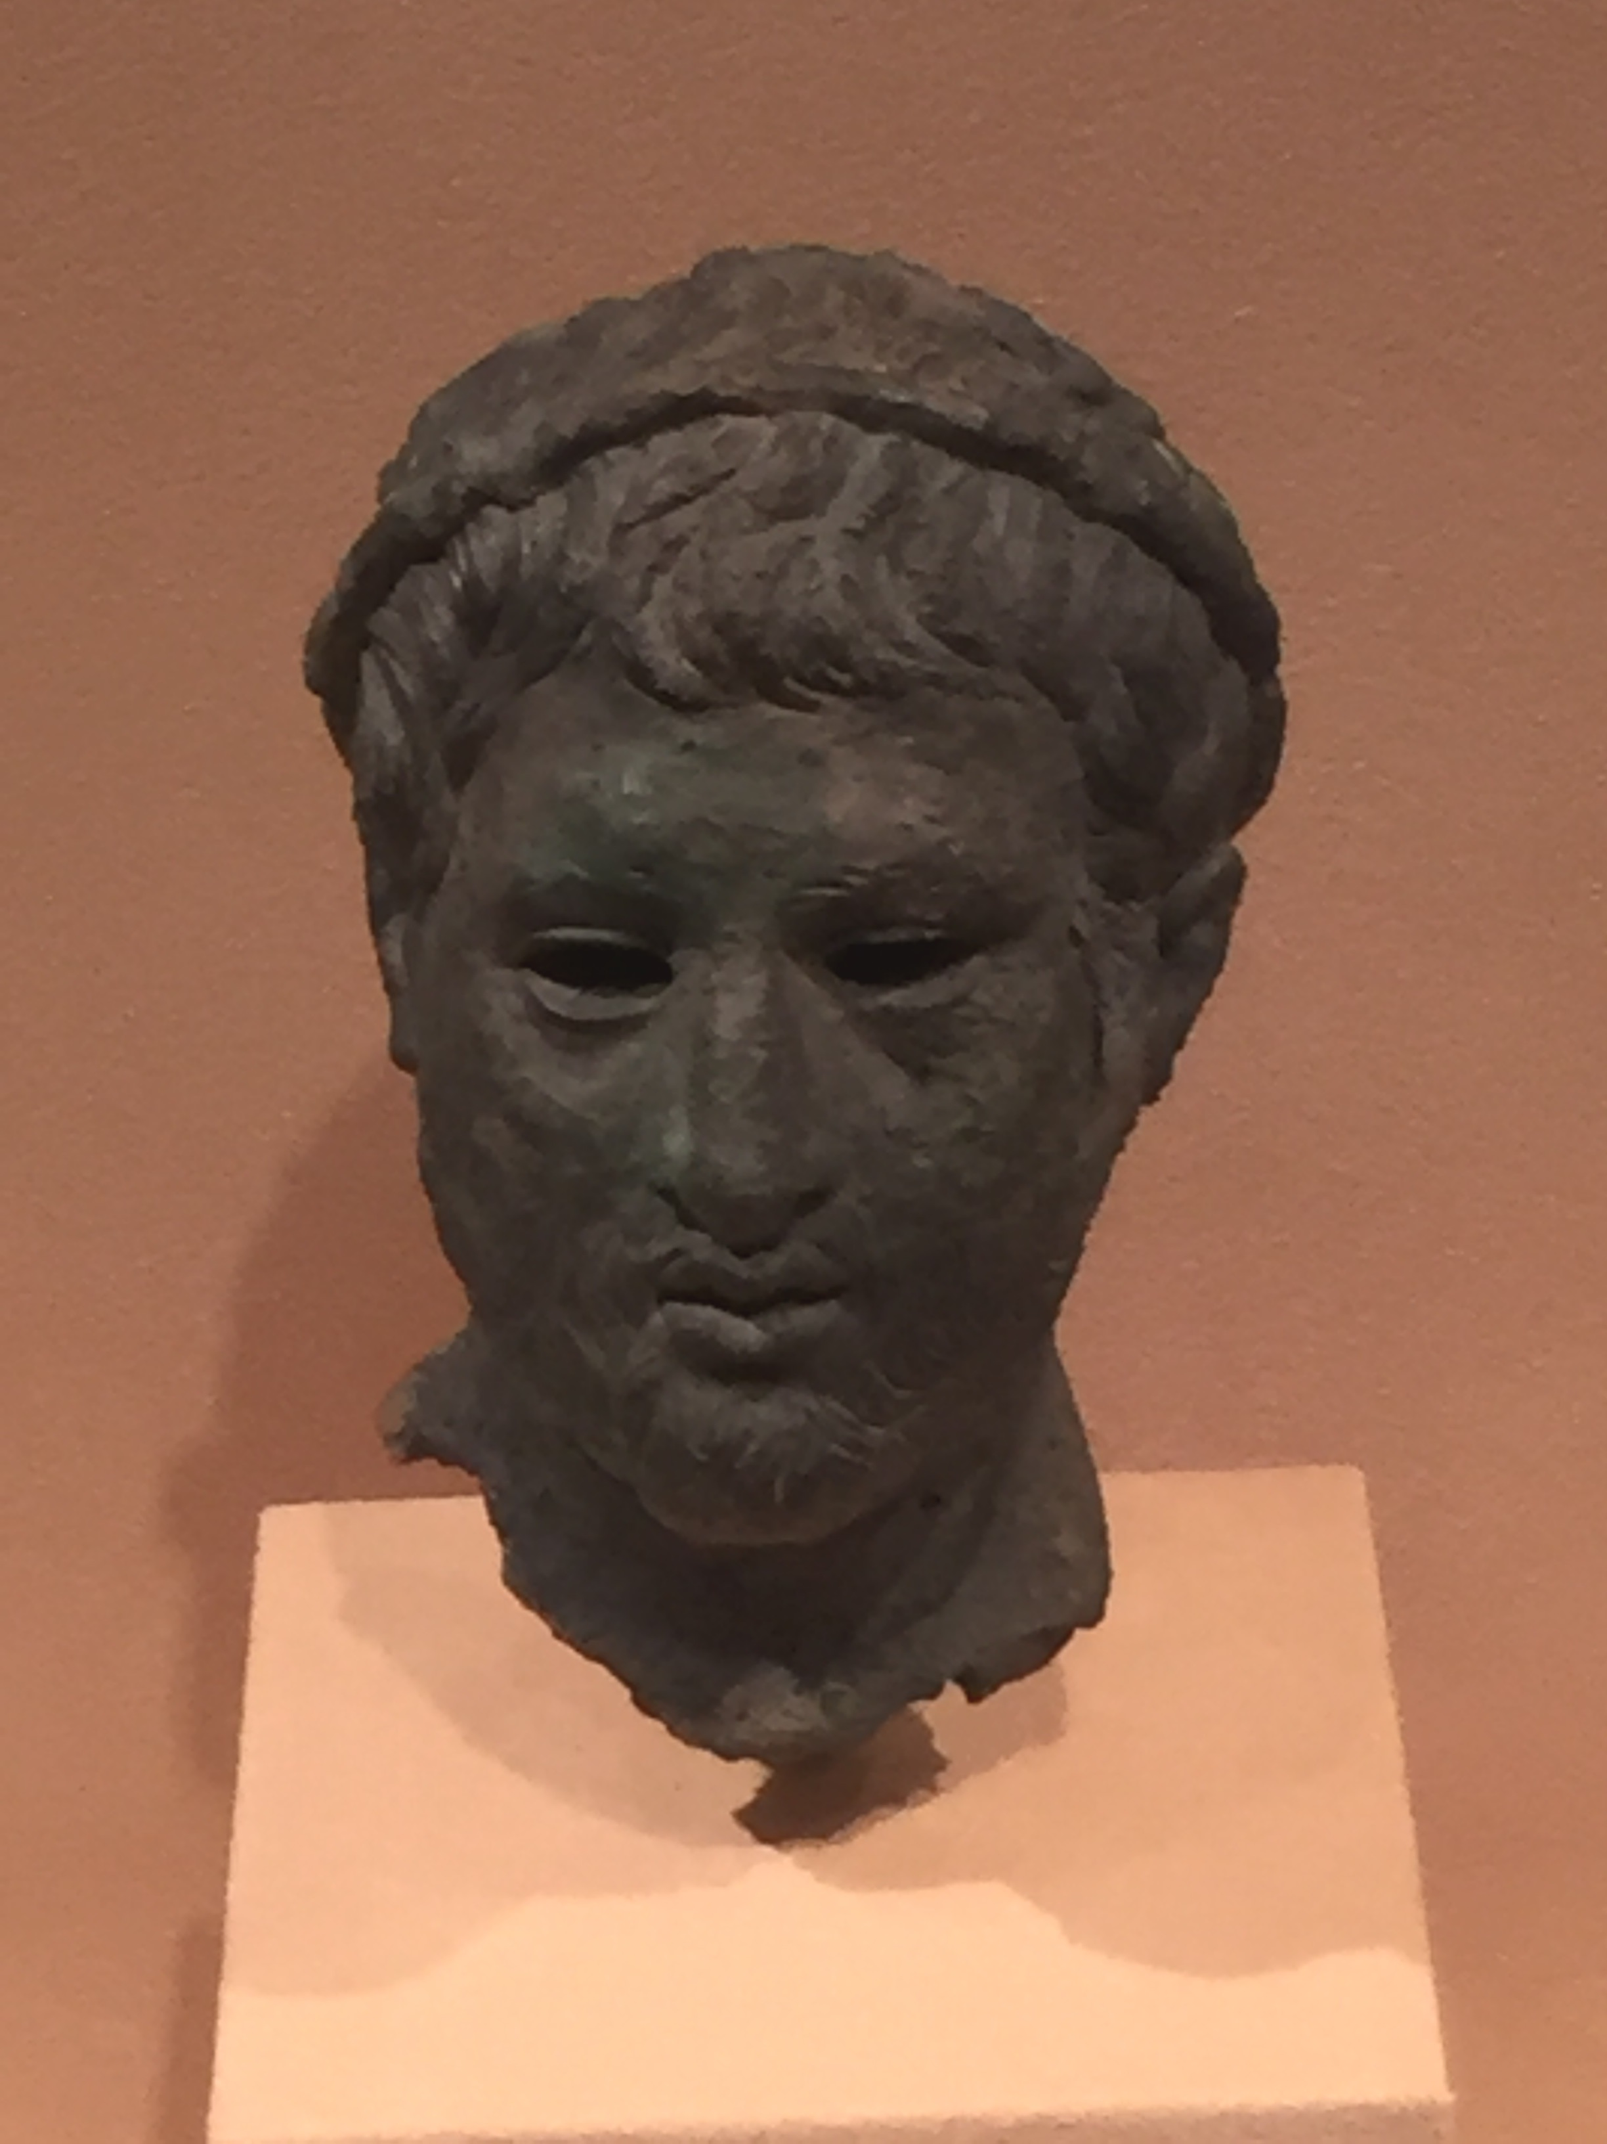
King of the North
Antiochus III
Phillip V of Macedon

Slide 8
Daniel 11:14
And in those times there shall many stand up against the king of the south: also the robbers of thy people shall exalt themselves to establish the vision; but they shall fall.

Slide 9
Daniel 11:14
And in those times there shall many stand up against the king of the south: also the robbers of thy people shall exalt themselves to establish the vision; but they shall fall.

Slide 10
Daniel 11:14
And in those times there shall many stand up against the king of the south: also the robbers of thy people shall exalt themselves to establish the vision; but they shall fall.

Slide 11
Daniel 11:14
And in those times there shall many stand up against the king of the south: also the robbers of thy people shall exalt themselves to establish the vision; but they shall fall.

Slide 12
Daniel 11:14
NASB, NIV, ESV
And in those times there shall many stand up against the king of the south: also violent ones among your people shall exalt themselves to establish the vision; but they shall fall.

Slide 13
Daniel 11:14
And in those times there shall many stand up against the king of the south: also the robbers of thy people shall exalt themselves to establish the vision; but they shall fall.

Slide 14
King of the North
?
the robbers
of thy people
violent ones
among your people

Slide 15
Daniel 11:14
And in those times there shall many stand up against the king of the south: also the robbers of thy people shall exalt themselves to establish the vision; but they shall fall.

Slide 16
King of the North
What vision?

Slide 17
Daniel 11:14
And in those times there shall many stand up against the king of the south: also the robbers of thy people shall exalt themselves to establish the vision (châzôn ); but they shall fall.

Slide 18
Daniel 10:14
Now I am come to make thee understand what shall befall thy people in the latter days: for yet the vision (châzôn ) is for many days.

Slide 19
Daniel 10:14
Now I am come to make thee understand what shall befall thy people in the latter days: for yet the vision (châzôn ) is for many days.

Slide 20
Daniel 10:14
Now I am come to make thee understand what shall befall thy people in the latter days: for yet the vision (châzôn ) is for many days.

Slide 21
Daniel 10:14
Now I am come to make thee understand what shall befall thy people in the latter days: for yet the vision (châzôn ) is for many days.
Daniel 8:26
And the vision of the evening and the morning which was told is true: wherefore shut thou up the vision (châzôn ); for it shall be for many days.

Slide 22
Daniel 9:21
Yea, whiles I was speaking in prayer, even the man Gabriel, whom I had seen in the vision (châzôn ) at the beginning, being caused to fly swiftly, touched me about the time of the evening oblation.

Slide 23
Daniel 9:22
And he informed me, and talked with me, and said, O Daniel, I am now come forth to give thee skill and understanding.

Slide 24

“Upon the occasion just described, [Gabriel’s visit in Daniel 9 where Ellen White quotes Daniel 9:4-6,15-19] the angel Gabriel imparted to Daniel all the instruction which he was then able to receive. ”
The Sanctified Life, p. 49

Slide 25
“A few years afterward, however, the prophet desired to learn more of subjects not yet fully explained, and again set himself to seek light and wisdom from God. [Daniel 10:2-6 quoted] … Our Lord comes with another heavenly messenger to teach Daniel what would take place in the latter days…And in response to his supplications, light from the heavenly courts was communicated for those who should live in the latter days.”
The Sanctified Life, p. 49,50

Slide 26
King of the North
Daniel 11:14
…establish the vision (châzôn );
Daniel 10:14
…the vision (châzôn ) is for many days.
Daniel 8:26
…the vision (châzôn ); for it shall be for many days.

Slide 27
King of the North
Violence against
Violence prophesied against Daniel’s people
Daniel 7:7,21,25; 8:10,24; 9:26
Violence committed against Daniel or his people
Daniel 1:1,2; 2:13; 3:19,20; 6:16,17

Slide 28
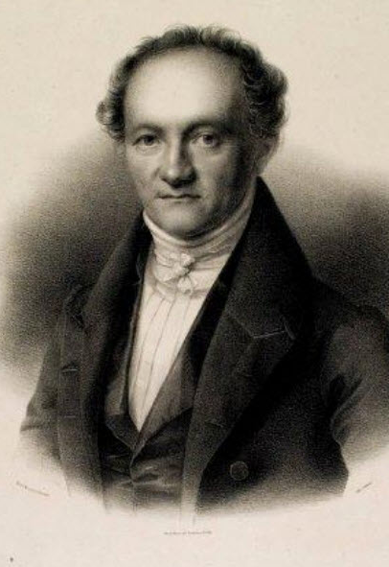
Robber
“prop. breaking, rending abroad; used of wild beasts, Isa. 35:9; hence a violent (man), Ps. 17:4; Eze. 7:22; 18:10; Jer. 7:11; Dan.11:14.”
Wilhelm Gesenius
A Hebrew And Chaldee Lexicon Of The Old Testament, p. 690
1890 edition

Slide 29
Daniel 8:10
And it waxed great, even to the host of heaven; and it cast down some of the host and of the stars to the ground, and stamped upon them.
Daniel 8:24
And his power shall be mighty, but not by his own power: and he shall destroy wonderfully, and shall prosper, and practise, and shall destroy the mighty and the holy people.

Slide 30
Ezekiel 7:22
My face will I turn also from them, and they shall pollute my secret place: for the robbers shall enter into it, and defile it.

Slide 31
Daniel 1:1
In the third year of the reign of Jehoiakim king of Judah came Nebuchadnezzar king of Babylon unto Jerusalem, and besieged it.

Slide 32
Daniel 1:2
And the Lord gave Jehoiakim king of Judah into his hand, with part of the vessels of the house of God: which he carried into the land of Shinar to the house of his god; and he brought the vessels into the treasure house of his god.

Slide 33
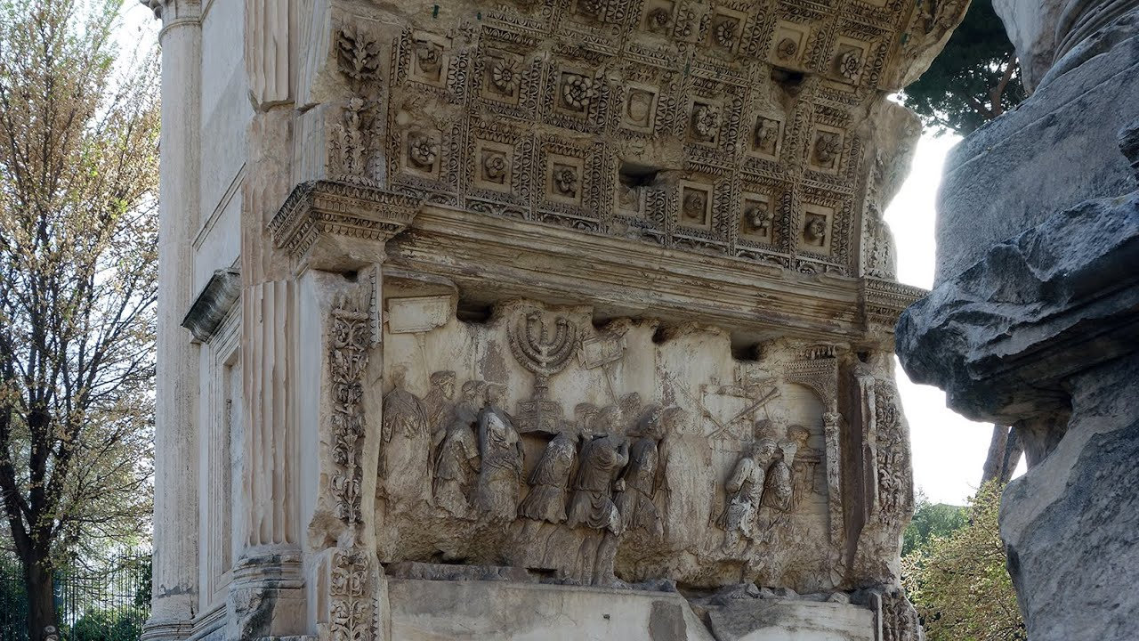

Slide 34
Daniel 8:9
And out of one of them came forth a little horn, which waxed exceeding great, toward the south, and toward the east, and toward the pleasant land.

Slide 35
Daniel 8:23
And in the latter time of their kingdom, when the transgressors are come to the full, a king of fierce countenance, and understanding dark sentences, shall stand up.

Slide 37

King of
Fierce Countenance

Slide 38
Daniel 11:14
And in those times there shall many stand up against the king of the south: also the robbers of thy people shall exalt themselves to establish the vision (châzôn ); but they shall fall.

Slide 39
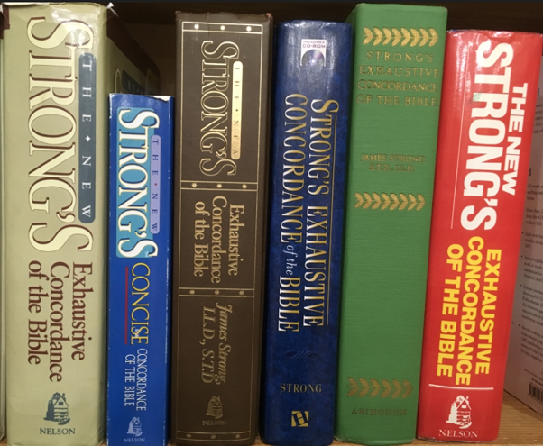
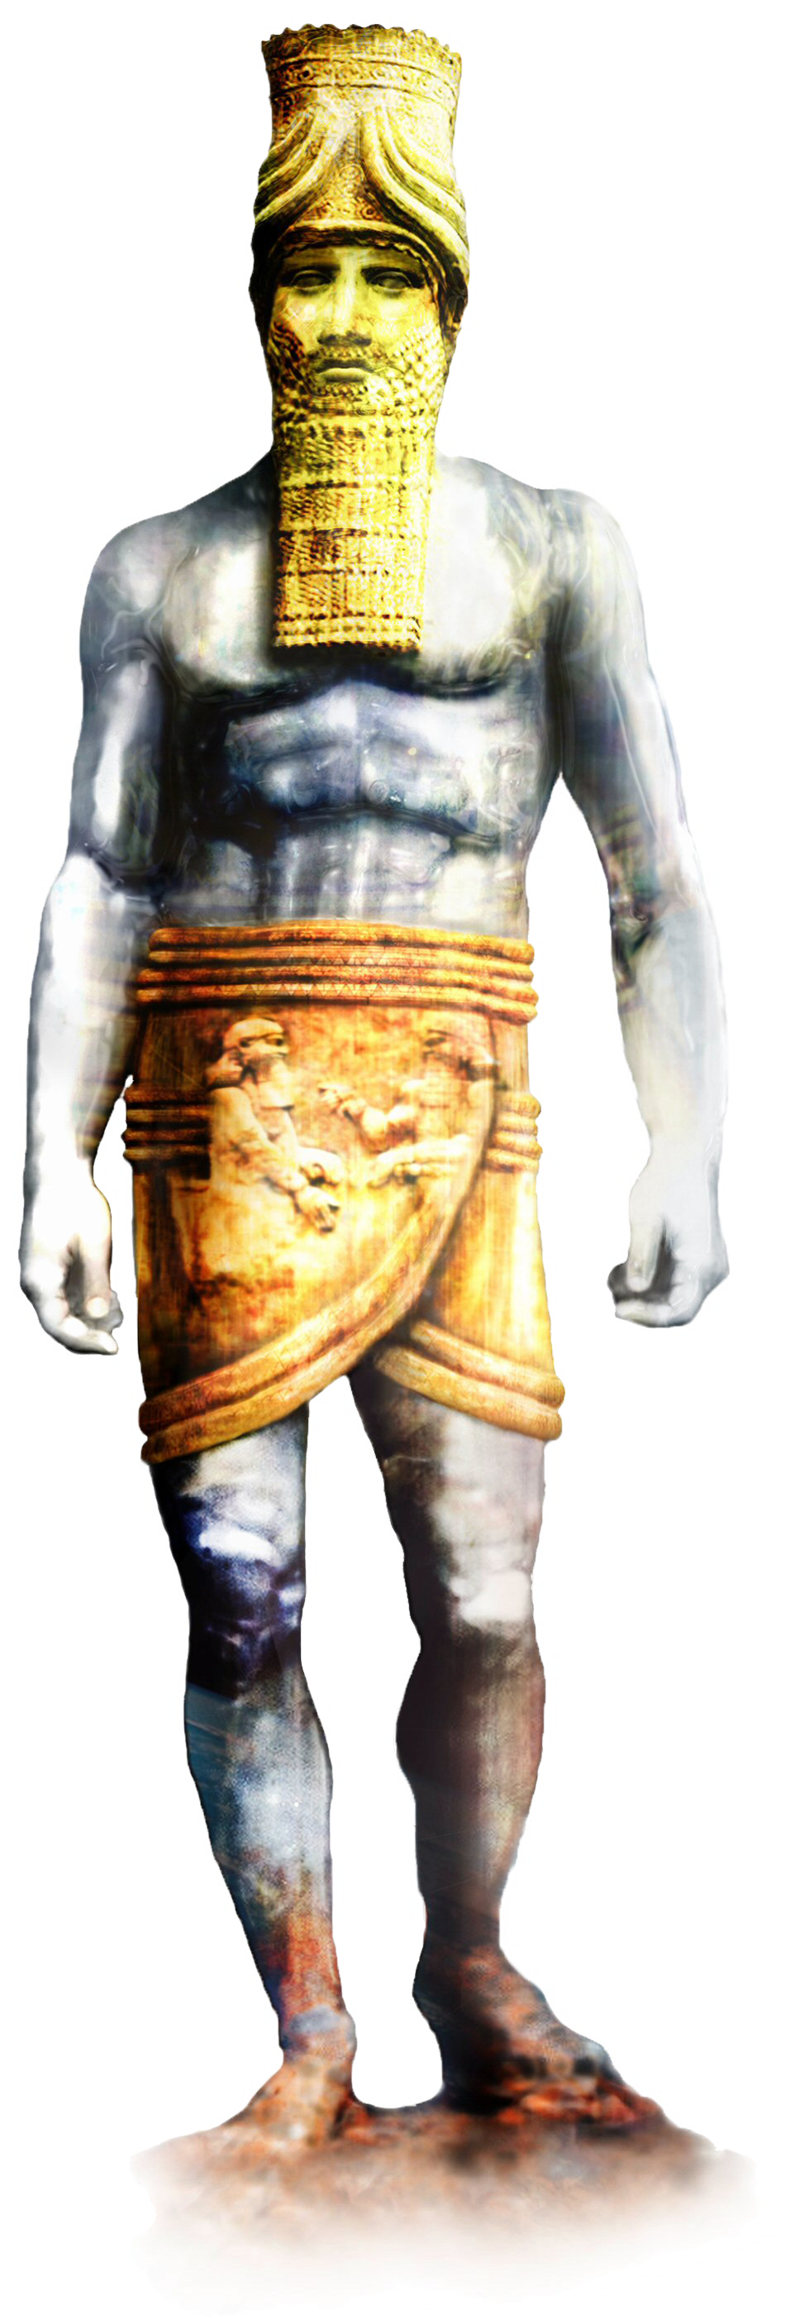
Establish
עָמַד
‛âmad
aw-mad’
A primitive root; to stand, in various relations (literally and figuratively, intransitively and transitively): - abide (behind), appoint, arise, cease, confirm, continue, dwell, be employed, endure, establish, leave, make, ordain, be [over], place, (be) present (self), raise up, remain, repair, + serve, set (forth, over, -tle, up), (make to, make to be at a, with-) stand (by, fast, firm, still, up), (be at a) stay (up), tarry.

Slide 40
Stand Up
Daniel 8:3,4,6,7,22,23,25 - stand up - begin to reign
Daniel 11:2 - Medo-Persian kings stand up
Daniel 11:3,4 - Alexander
Daniel 11:6 - not stand - losing power
Daniel 11:7 - standing up - beginning rule
Daniel 11:14 - standing up against King of South
Daniel 11:20,21 - new kings standing up to rule
Daniel 11:25 - not able to stand or retain power
Daniel 11:31 - military power standing on behalf
Daniel 12:1 - Michael stands up beginning reign

Slide 41
Daniel 8:23
And in the latter time of their kingdom, when the transgressors are come to the full, a king of fierce countenance [Rome], and understanding dark sentences, shall stand up.

Slide 42
Daniel 8:25
And through his policy also he shall cause craft to prosper in his hand; and he shall magnify himself in his heart, and by peace shall destroy many: he shall also stand up against the Prince of princes; but he [Rome] shall be broken without hand.

Slide 43
Daniel 11:14
And in those times there shall many stand up against the king of the south: also the robbers of thy people [Rome] shall exalt themselves to establish the vision (châzôn ); but they shall fall.

Slide 44
Violent Ones Among thy People
Not mentioned anywhere in vision of Chapter 8
Did not stand up to begin any kind of rule
Did not exalted themselves

Slide 47
Daniel 11:15
So the king of the north shall come, and cast up a mount, and take the most fenced cities: and the arms of the south shall not withstand, neither his chosen people, neither shall there be any strength to withstand.

Slide 48
Daniel 11:15
So the king of the north shall come, and cast up a mount, and take the most fenced cities: and the arms of the south shall not withstand, neither his chosen people, neither shall there be any strength to withstand.

Slide 49
Daniel 11:15
So the king of the north shall come, and cast up a mount, and take the most fenced cities: and the arms of the south shall not withstand, neither his chosen people, neither shall there be any strength to withstand.

Slide 50
Daniel 11:15
So the king of the north shall come, and cast up a mount, and take the most fenced cities: and the arms of the south shall not withstand, neither his chosen people, neither shall there be any strength to withstand.

Slide 51
Daniel 11:15
So the king of the north shall come, and cast up a mount, and take the most fenced cities: and the arms of the south shall not withstand, neither his chosen people, neither shall there be any strength to withstand.

Slide 52
Daniel 11:16
But he that cometh against him shall do according to his own will, and none shall stand before him: and he shall stand in the glorious land, which by his hand shall be consumed.

Slide 53
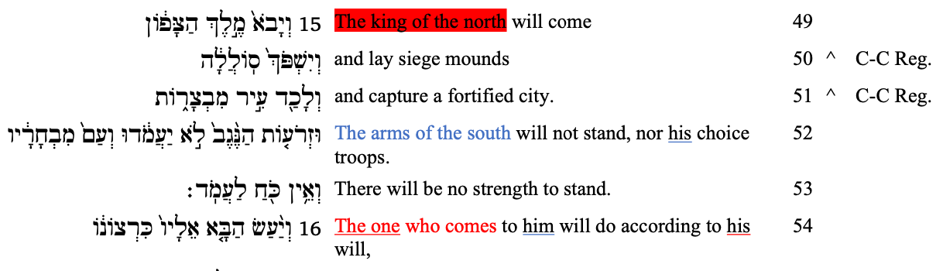

Slide 54
Daniel 11:16
ASV, ESV, NASB, RSV
But he that cometh against him shall do according to his own will, and none shall stand before him: and he shall stand in the glorious land, which by his hand shall be consumed.

Slide 55
Daniel 11:16
But he that cometh against him shall do according to his own will, and none shall stand before him: and he shall stand in the glorious land, which by his hand shall be consumed.

Slide 56
He that comes against him
“KoN” defeats “KoS”
BUT
“KoN” defeats “KoS”

Slide 57
He that comes against him
“KoN” defeats “KoS”
BUT
“he” defeats “KoN”

Slide 58
Daniel 11:16
But he that cometh against him shall do according to his own will, and none shall stand before him: and he shall stand in the glorious land, which by his hand shall be consumed.

Slide 59
Three Powers
King of the South
King of the North
he

Slide 61
“…this deity, having raised up the Romans against them, inflicted upon them, with the most exact measure of justice, those very evils which they had unjustly meditated against others.”
Polybius, The General History of Polybius, Vol. IV, p. 168,169

Slide 62
Daniel 11:16
But he that cometh against him shall do according to his own will, and none shall stand before him: and he shall stand in the glorious land, which by his hand shall be consumed.

Slide 63
According to his will
Daniel 8:4 - Medo-Persia
Daniel 11:3 - Alexander

Slide 64
Daniel 8:22
Now that being broken, whereas four stood up for it, four kingdoms shall stand up out of the nation, but not in his power.

Slide 65
“He also was obliged to pay an indemnity of 15,000 talents over a period of 12 years, surrender his elephants and his fleet, and furnish hostages, including his son Antiochus IV. His kingdom was now reduced to Syria, Mesopotamia, and western Iran. In 187 Antiochus was murdered in a Baal temple near Susa, where he was exacting tribute in order to obtain much needed revenue.”
Encyclopedia Britannica,
Article Antiochus III the Great

Slide 66
Daniel 11:16
But he that cometh against him shall do according to his own will, and none shall stand before him: and he shall stand in the glorious land, which by his hand shall be consumed.

Slide 67
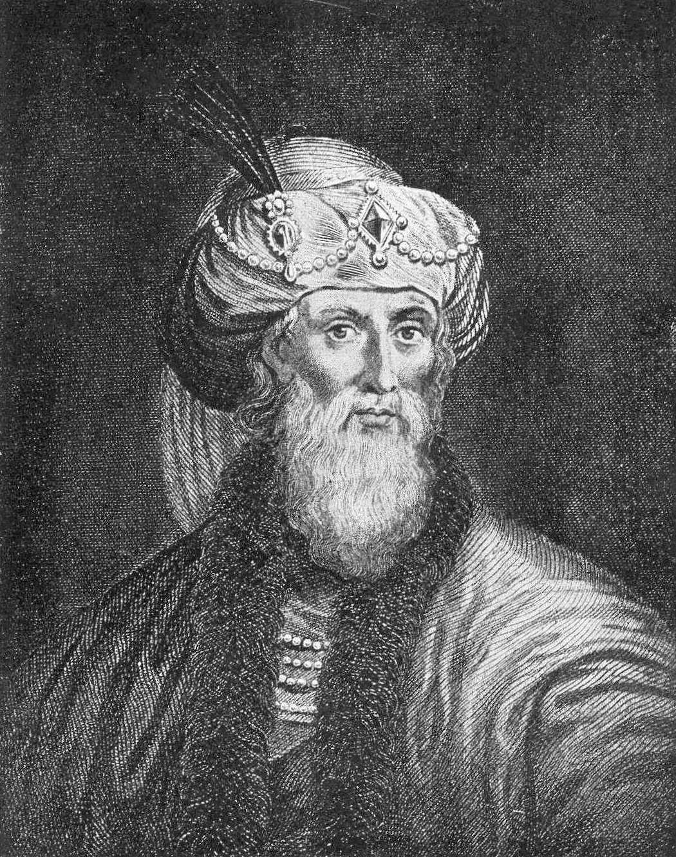
“Now these testimonials which I have produced, are sufficient to declare the friendship that Antiochus the Great bare to the Jews.”
Flavius Josephus
Complete Works of Josephus, Vol. 2,
Antiquities of the Jews, Book XII, Chapter IV, p. 231

Slide 68
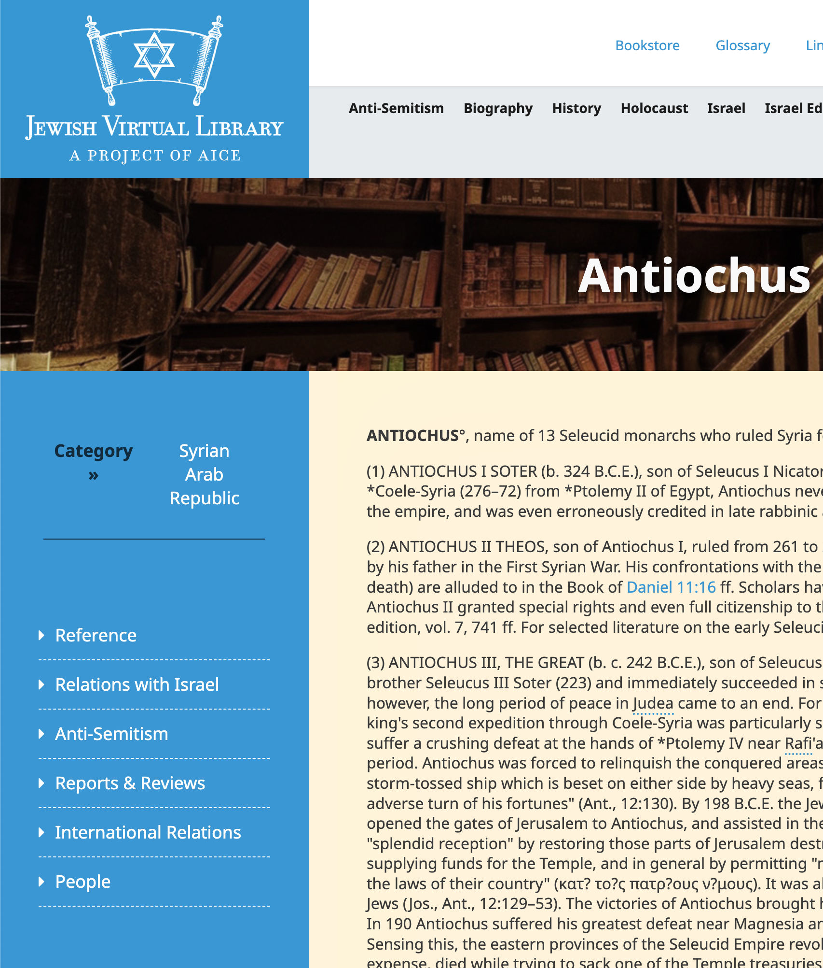
“By 198 B.C.E. the Jews of Palestine had become disenchanted with Ptolemaic rule, and they opened the gates of Jerusalem to Antiochus, and assisted in the expulsion of its Egyptian garrison. Antiochus rewarded the Jews for their ‘splendid reception’ by restoring those parts of Jerusalem destroyed by the war, freeing its citizens from taxes for three years
Jewish Virtual Library,
Article Antiochus

Slide 69
and supplying funds for the Temple, and in general by permitting ‘members of the nation to have a form of government in accordance with the laws of their country.’ ”
Jewish Virtual Library,
Article Antiochus

Slide 70
According to his will
Daniel 8:4 - Medo-Persia
Daniel 11:3 - Alexander
Daniel 11:16 - Pagan Rome

Slide 71
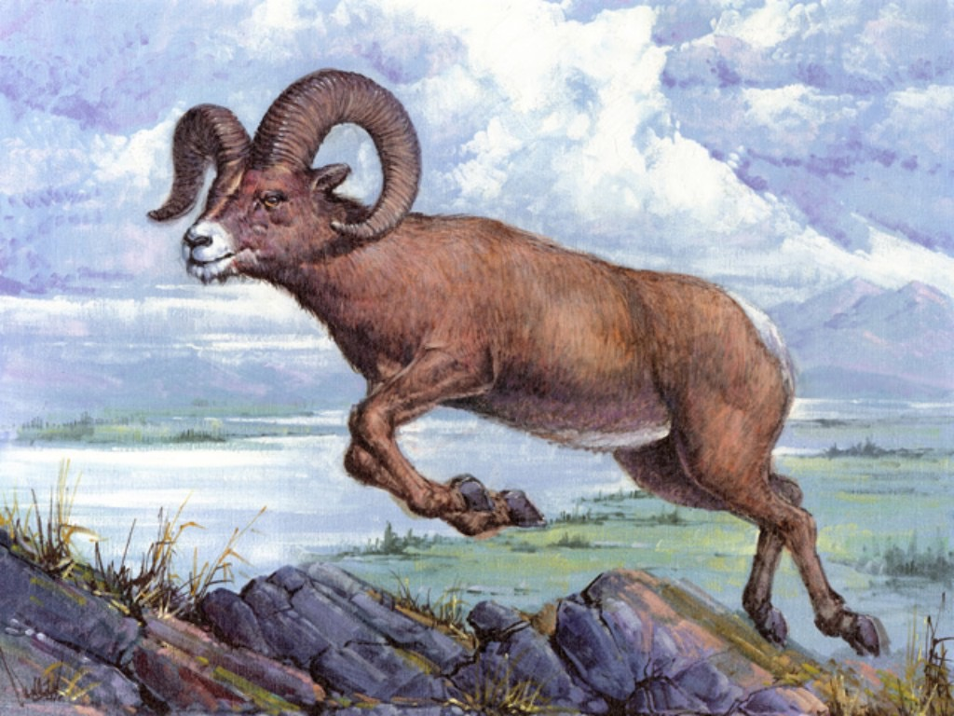
Ram | Medo-Persia | Great

Slide 72
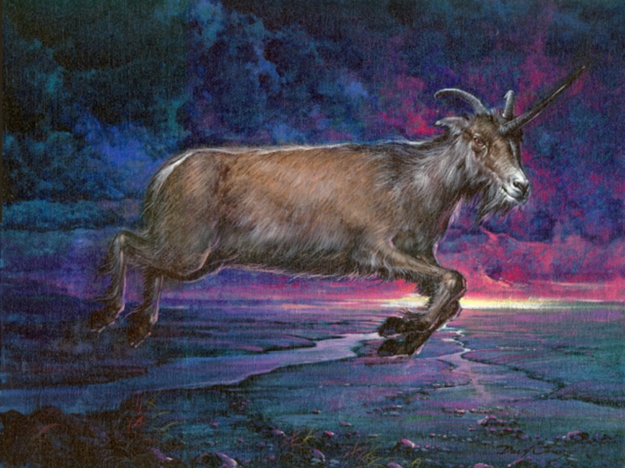
Ram | Medo-Persia | Great
Goat | Greece | Very Great

Slide 73

Ram | Medo-Persia | Great
Goat | Greece | Very Great
 | Rome | Exceeding Great

Slide 74
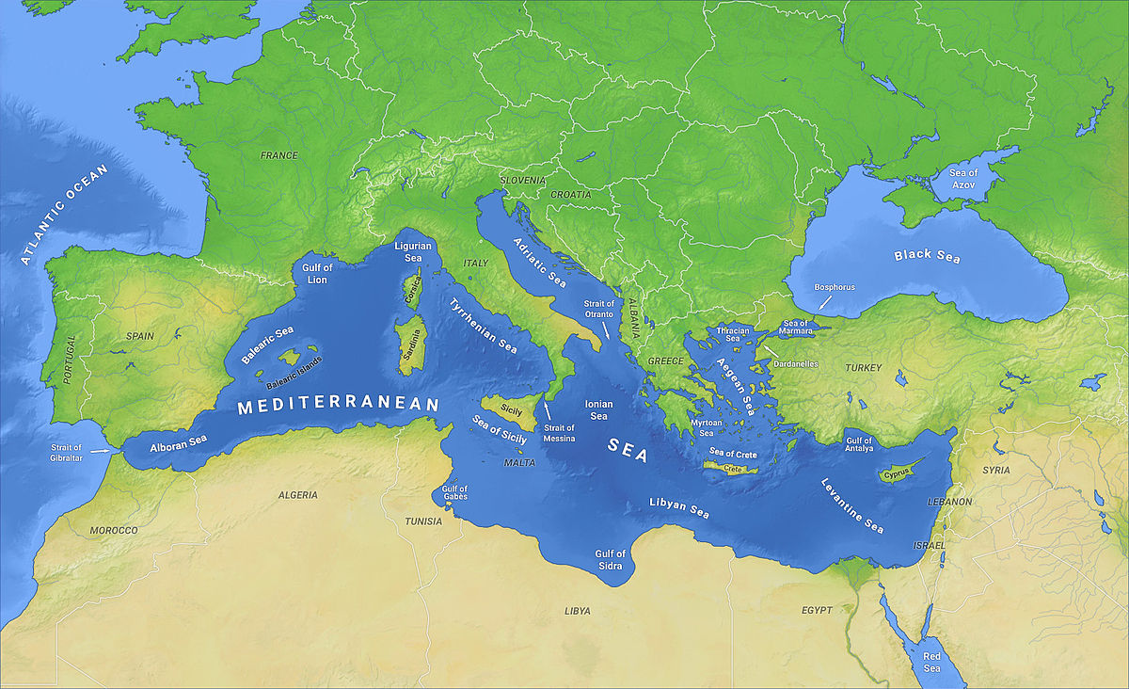
Daniel 8:9
And out of one of them came forth a little horn, which waxed exceeding great, toward the south, and toward the east, and toward the pleasant land.
Pagan
Rome
King of
the South

Slide 75
Daniel 8:9
And out of one of them came forth a little horn, which waxed exceeding great, toward the south, and toward the east, and toward the pleasant land.
Pagan
Rome
King of
the North
King of
the South

Slide 76
Daniel 8:9
And out of one of them came forth a little horn, which waxed exceeding great, toward the south, and toward the east, and toward the pleasant land.
Pagan
Rome
King of
the North
Glorious
Land
King of
the South

Slide 77
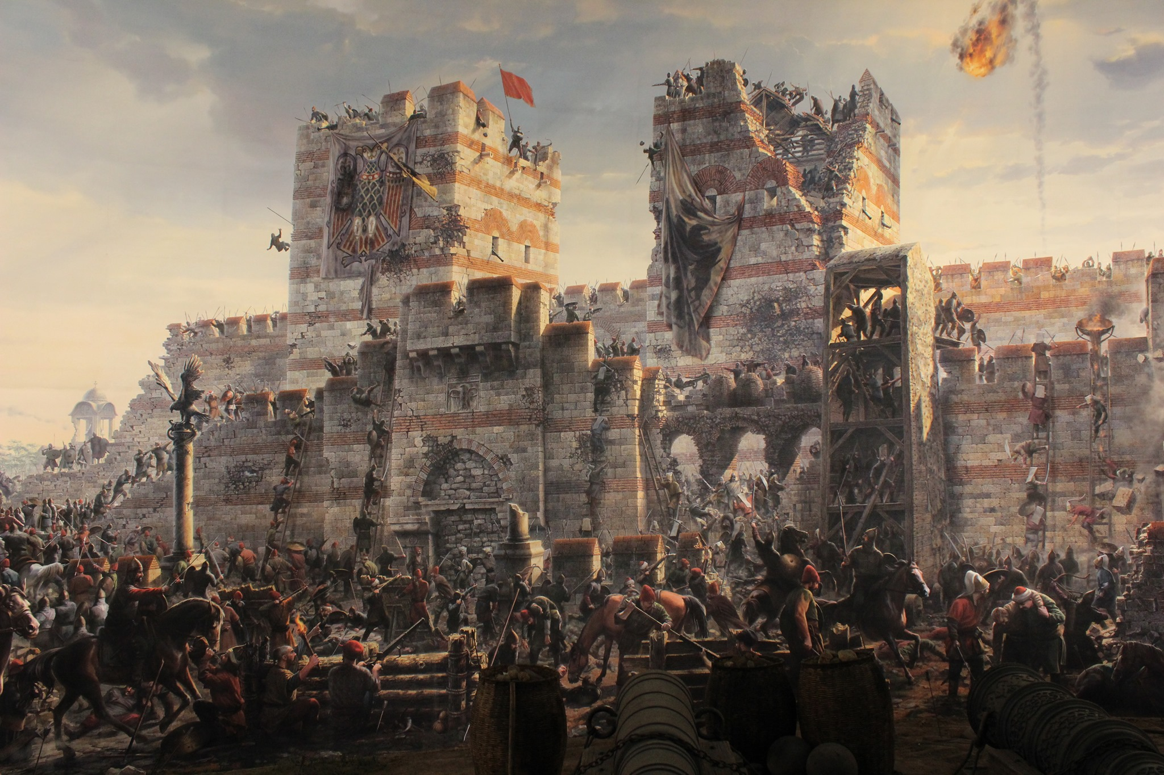

Slide 78
Truth of the symbols
Daniel 11:2 - I shew thee the truth
Daniel 7:16 - asked him the truth…made me know the interpretation

Slide 79
Daniel 11:16
But he that cometh against him shall do according to his own will, and none shall stand before him: and he shall stand in the glorious land, which by his hand shall be consumed.

Slide 80
Daniel 11:17
He shall also set his face to enter with the strength of his whole kingdom, and upright ones with him; thus shall he do: and he shall give him the daughter of women, corrupting her: but she shall not stand on his side, neither be for him.

Slide 81
Daniel 11:17
He shall also set his face to enter with the strength of his whole kingdom, and upright ones with him; thus shall he do: and he shall give him the daughter of women, corrupting her: but she shall not stand on his side, neither be for him.

Slide 82
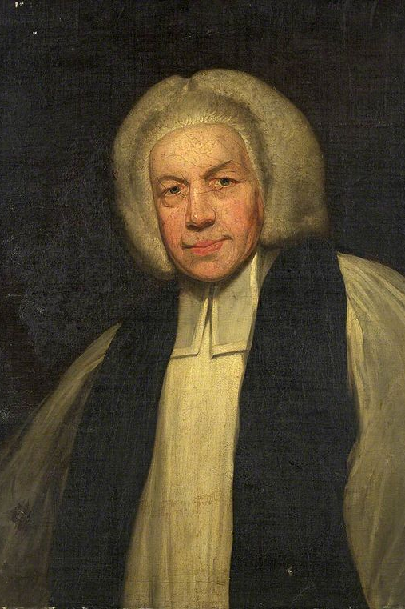
“He shall also set his face to enter with the strength of his whole kingdom, or rather, He shall also set his face to enter by force the whole kingdom:”
Dissertations on the Prophecies, p. 322
1758 edition

Slide 83
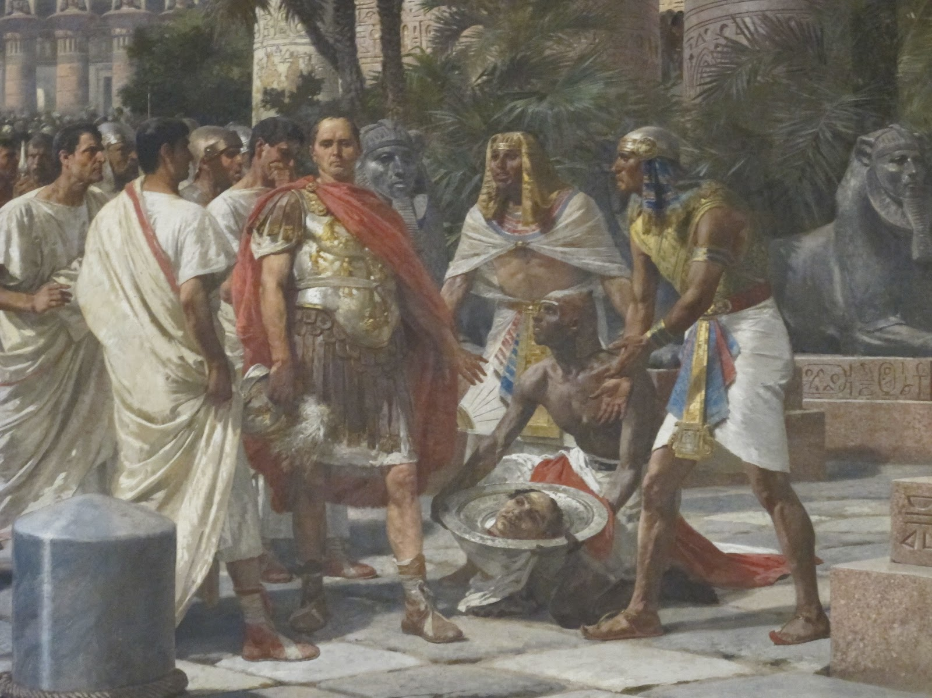

Slide 84
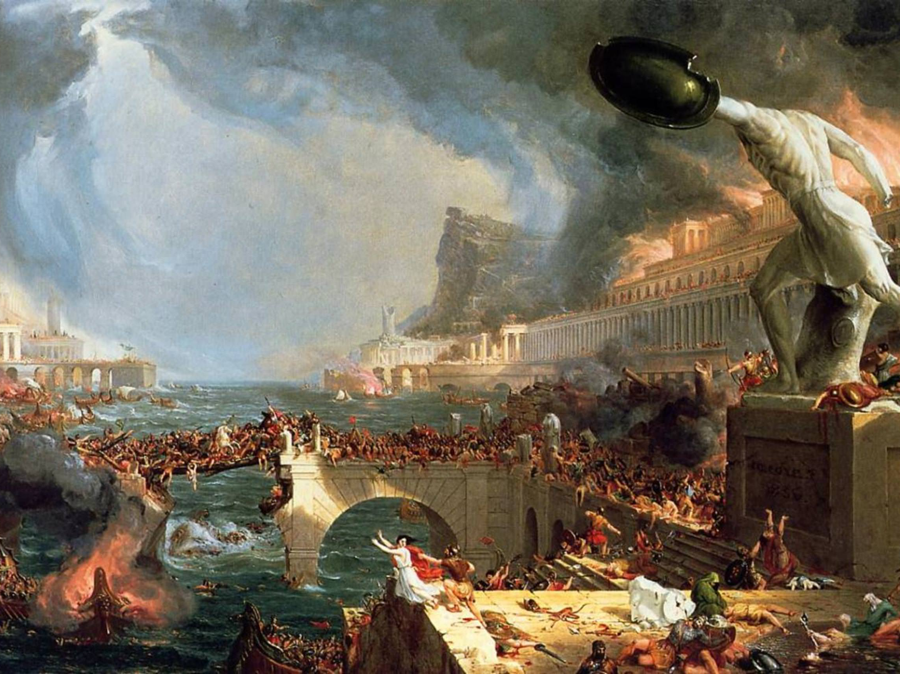

Slide 85
Give
Daniel 1:2; 8:12,13; 11:11 - give - placed in one’s control
Daniel 11:6 - give - given up
Daniel 11:31; 12:11 - give - set up or placed

Slide 86
Daniel 11:17
He shall also set his face to enter with the strength of his whole kingdom, and upright ones with him; thus shall he do: and he shall give him the daughter of women, corrupting her: but she shall not stand on his side, neither be for him.

Slide 87
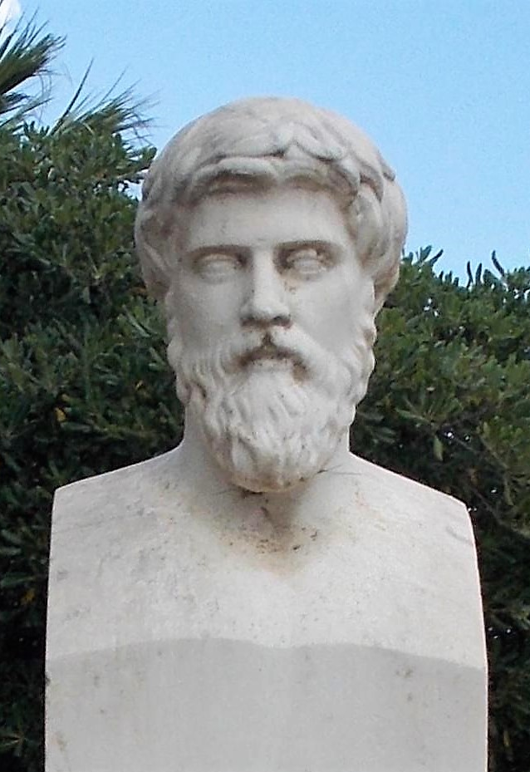
“But for the king [Ptolemy XIII], no man could ever tell what became of him after. Thereupon Caesar made Cleopatra his sister, Queen of Egypt. ”
Thomas North, Plutarch’s Life of Julius Caesar, p. 52

Slide 88

“Caesar returned to Alexandria, master of the situation (January 47 B.C.). Although Cleopatra was now hated by her subjects — at any rate, by the Greeks and Macedonians of Egypt — because she had given herself to the Roman, they had to see her established as queen by the invincible Caesar.”
Edwyn Bevan,
A History Of Egypt Under The Ptolemaic Dynasty, p. 366

Slide 89
Daniel 11:17
He shall also set his face to enter with the strength of his whole kingdom, and upright ones with him; thus shall he do: and he shall give him the daughter of women, corrupting her: but she shall not stand on his side, neither be for him.

Slide 90
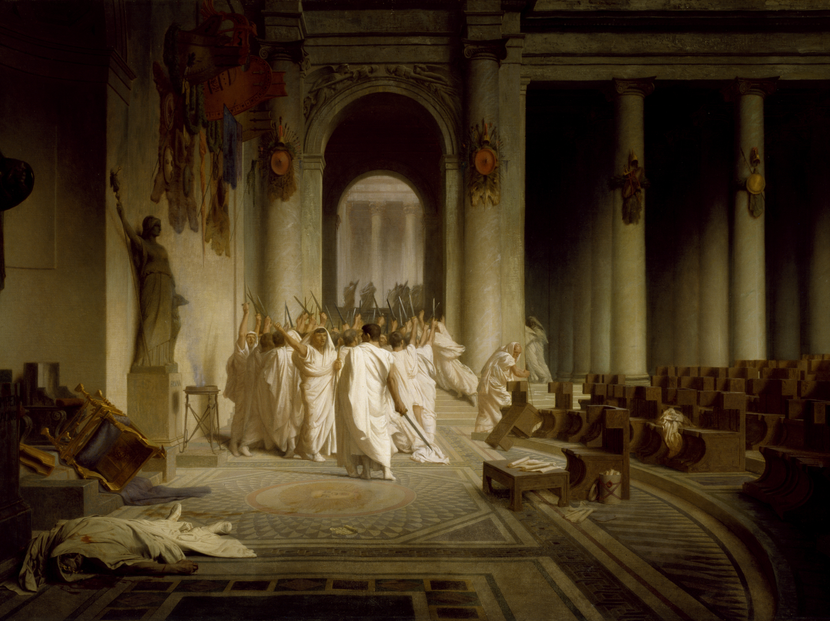

Slide 91
Daniel 11:20
Then shall stand up in his estate a raiser of taxes in the glory of the kingdom: but within few days he shall be destroyed, neither in anger, nor in battle.

Slide 92
Daniel 11:20
Then shall stand up in his estate a raiser of taxes in the glory of the kingdom: but within few days he shall be destroyed, neither in anger, nor in battle.

Slide 93
Daniel 11:20
Then shall stand up in his estate a raiser of taxes in the glory of the kingdom: but within few days he shall be destroyed, neither in anger, nor in battle.

Slide 94
Daniel 11:20
Then shall stand up in his estate a raiser of taxes in the glory of the kingdom: but within few days he shall be destroyed, neither in anger, nor in battle.

Slide 95
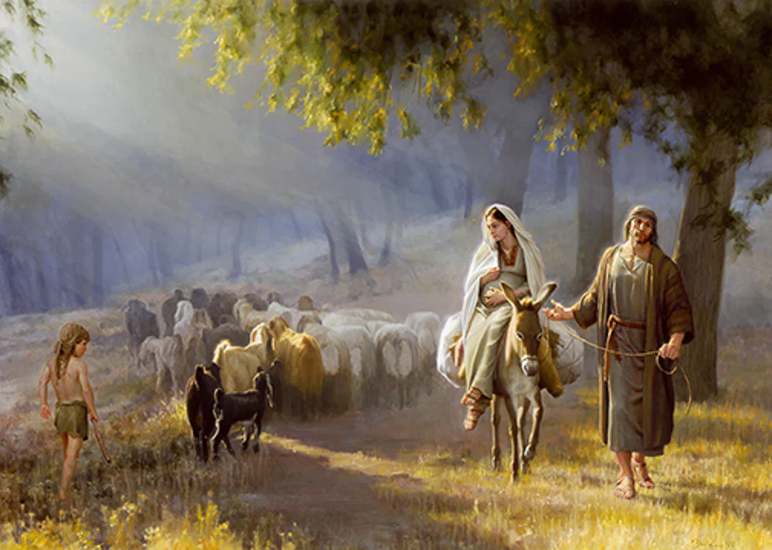

Slide 96
Luke 2:1
And it came to pass in those days, that there went out a decree from Caesar Augustus, that all the world should be taxed.

Slide 97
Luke 2:2
(And this taxing was first made when Cyrenius was governor of Syria.)

Slide 98
Daniel 11:20
Then shall stand up in his estate a raiser of taxes in the glory of the kingdom: but within few days he shall be destroyed, neither in anger, nor in battle.

Slide 99
Daniel 11:20
Then shall stand up in his estate a raiser of taxes in the glory of the kingdom: but within few days he shall be destroyed, neither in anger, nor in battle.

Slide 100
Daniel 8:9
And out of one of them came forth a little horn, which waxed exceeding great, toward the south, and toward the east, and toward the pleasant land.
Daniel 8:23
And in the latter time of their kingdom, when the transgressors are come to the full, a king of fierce countenance, and understanding dark sentences, shall stand up.

Slide 101
Three Powers
King of the North
King of the South
Rome

Slide 102
Daniel 11:21
And in his estate shall stand up a vile person, to whom they shall not give the honour of the kingdom: but he shall come in peaceably, and obtain the kingdom by flatteries.

Slide 103
Daniel 11:21
And in his estate shall stand up a vile person, to whom they shall not give the honour of the kingdom: but he shall come in peaceably, and obtain the kingdom by flatteries.

Slide 104
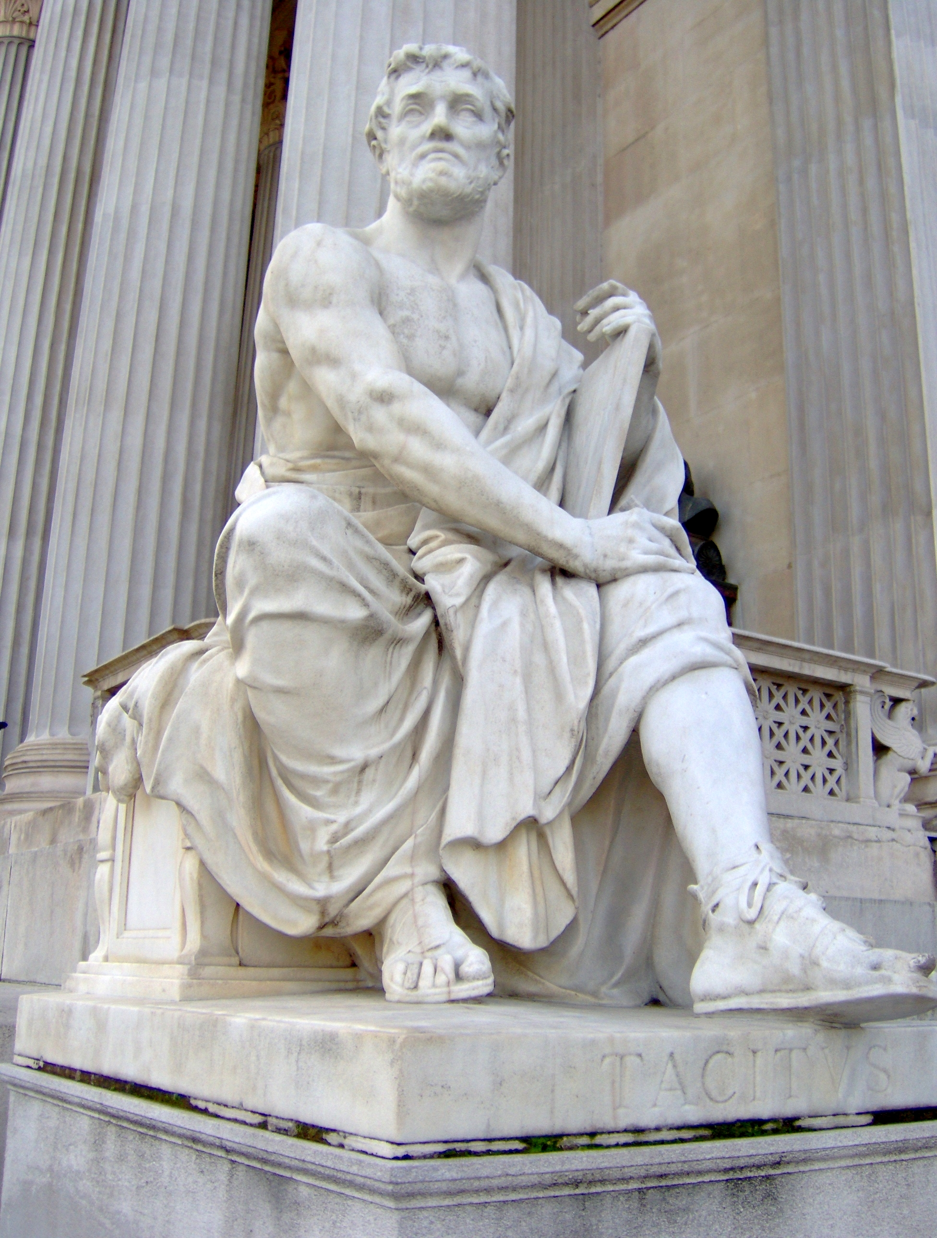
“…the senators, whose sole fear was to seem to understand him, burst into tears, plaints, and vows: with extended arms they supplicated the gods, invoked the image of Augustus, and embraced the knees of Tiberius… the senate stooping to the most humiliating importunity… ”
Annals of Tacitus, Book 1, p. 24

Slide 105
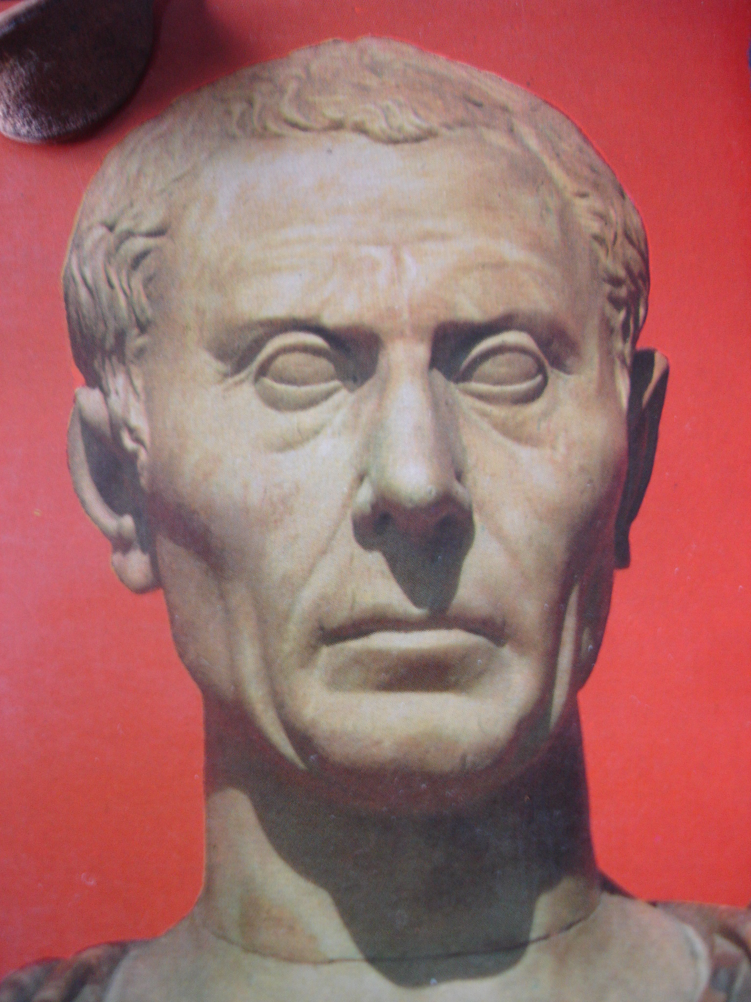
“The first news of his death caused such joy at Rome that people ran about yelling: ‘To the Tiber with Tiberius!’ and other offered prayers to Mother Earth and the Infernal Gods to give him no home below except among the damned. There ware [sic] also loud threats to drag his body off with a hook and fling it on the Stairs of Mourning
Gauis Seutonius Tranquillus
The Lives of the Twelve Caesars, p. 130

Slide 106
[Gemonian Stairs]; for popular resentment against his savage behaviour was now increased by a fresh outrage… Thus the hatred of Tiberius grew hotter than ever - his cruelty, it was said, continued even after his death - and when the funeral procession left Misenum, the cry went up: ‘Take him to the amphitheatre at Atella! Give him
Gauis Seutonius Tranquillus
The Lives of the Twelve Caesars, p. 130

Slide 107
only a half-burning.’ (For Atella was the home of popular farces, and half-burning in an amphitheatre would have been a farcical ignominy.)”
Gauis Seutonius Tranquillus
The Lives of the Twelve Caesars, p. 130

Slide 108
Daniel 11:36
And the king shall do according to his will; and he shall exalt himself, and magnify himself above every god, and shall speak marvellous things against the God of gods, and shall prosper till the indignation be accomplished: for that that is determined shall be done.

Slide 109
Daniel 11:36
And the king shall do according to his will; and he shall exalt himself, and magnify himself above every god, and shall speak marvellous things against the God of gods, and shall prosper till the indignation be accomplished: for that that is determined shall be done.

Slide 110
Daniel 11:36
And the king shall do according to his will; and he shall exalt himself, and magnify himself above every god, and shall speak marvellous things against the God of gods, and shall prosper till the indignation be accomplished: for that that is determined shall be done.

Slide 111
According to his will
Daniel 8:4 - Medo-Persia
Daniel 11:3 - Alexander
Daniel 11:16 - Pagan Rome
Daniel 11:36 - Papal Rome

Slide 112
Daniel 11:36
And the king shall do according to his will; and he shall exalt himself, and magnify himself above every god, and shall speak marvellous things against the God of gods, and shall prosper till the indignation be accomplished: for that that is determined shall be done.

Slide 113
Daniel 11:40
And at the time of the end shall the king of the south push at him: and the king of the north shall come against him like a whirlwind, with chariots, and with horsemen, and with many ships; and he shall enter into the countries, and shall overflow and pass over.

Slide 114
Daniel 11:40
And at the time of the end shall the king of the south push at him: and the king of the north shall come against him like a whirlwind, with chariots, and with horsemen, and with many ships; and he shall enter into the countries, and shall overflow and pass over.

Slide 116
Daniel 11:40
And at the time of the end shall the king of the south push at him: and the king of the north shall come against him like a whirlwind, with chariots, and with horsemen, and with many ships; and he shall enter into the countries, and shall overflow and pass over.

Slide 117
Three Powers
King of the North
King of the South
Rome

Slide 118
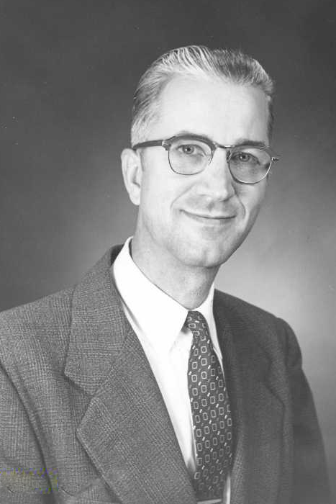
Dr. Richard Litke, PhD
Professor Emeritus,
Walla Walla University

Slide 119
“In Daniel 11:40, there exist two significant but parallel clauses, which are rendered in the NKJV as, (1) ‘the king of the South shall attack him,’ and (2) ‘the king of the North shall come against him.’ The construction, in the Hebrew Bible here portrays two distinctly separate powers (represented in typical Hebrew syntactical style in a parallel construction) as struggling in hostile action with the same singular object of their fury. In each clause, an action verb is followed by an
Richard L. Litke, The Other Side of Daniel, excerpt of chapter 15,
Abbreviated Notes for Daniel 11:1-45.
Unpublished manuscript, 2013.

Slide 120
antagonistic preposition to which a pronominal suffix is attached (literally, ’immo ‘with him’ and ’alayw ‘against him’). In this syntactical arrangement, a person who is familiar with Hebrew syntax would immediately perceive here the existence of such an obviously parallel idea and construction that it would tend to eliminate any idea of a reciprocal action as being pictured in these two verbs, against supposed plural prepositional objects (hence here, there is only one single object, in
Richard L. Litke, The Other Side of Daniel, excerpt of chapter 15,
Abbreviated Notes for Daniel 11:1-45.
Unpublished manuscript, 2013.

Slide 121
spite of the two verbs!) The prepositional object of all this verbal activity is clearly to be found in the topical subject introduced much earlier (in 11:36, ‘the King’)—the one who is the focus of all the activity in 11:36-39. One just cannot here obtain the idea in 11:40 that the King of the South and the King of the North are somehow attacking each other; they are here represented instead as both attacking a common enemy who is simply represented as ‘him’ in each of the two clauses! Thus,
Richard L. Litke, The Other Side of Daniel, excerpt of chapter 15,
Abbreviated Notes for Daniel 11:1-45.
Unpublished manuscript, 2013.

Slide 122
the first clause itself pictures an attack against some previously mentioned antecedent (‘with him’); and it is thus anaphoric in its general sense rather than reciprocal or cataphoric in force; and the clause should therefore not be construed (either syntactically or exegetically!) as representing a reciprocal attack against each other or against someone who is to be mentioned in the following part of the verse…
In brief, then, the pronominal suffix at the
Richard L. Litke, The Other Side of Daniel, excerpt of chapter 15,
Abbreviated Notes for Daniel 11:1-45.
Unpublished manuscript, 2013.

Slide 123
end of each of the two prepositional phrases in 11:40 must refer to one single entity that is utterly separate from both the King of the North and the King of the South. In other words, a third power is clearly involved here—and that reference is certainly to the king who was introduced at the beginning of 11:36!”
Richard L. Litke, The Other Side of Daniel, excerpt of chapter 15,
Abbreviated Notes for Daniel 11:1-45.
Unpublished manuscript, 2013.

